Slide 1
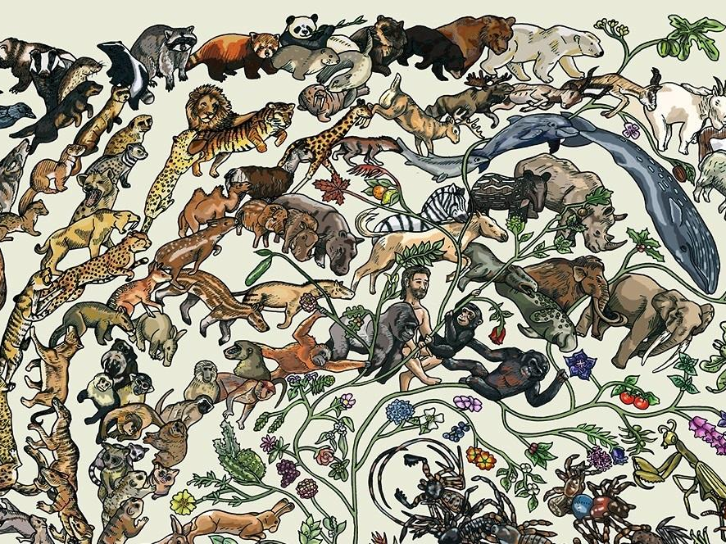
Evidence for Evolution

Slide 2
Scientific Theory
A Scientific Theory is a widely accepted statement based on scientific evidence that helps explain and predict natural phenomena.
  Theory of Relativity
  Cell Theory
  Theory of Evolution
  Germ Theory
  Atomic Theory
  Big Bang Theory
  Theory of Plate Tectonics

Slide 3
Theory of Evolution
theory states that species change over time
living things evolve in response to changes in their environment
evolution is a slow process and DOES NOT change individual organisms
  ex: manny from ice age

Slide 4
Observations Provide Support for The Theory of Evolution
Fossil Evidence
II. Biological Evidence
III. Genetic Evidence

Slide 5
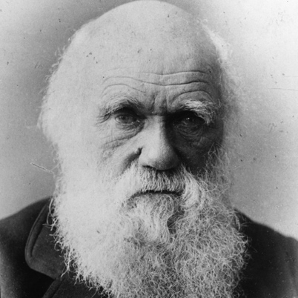
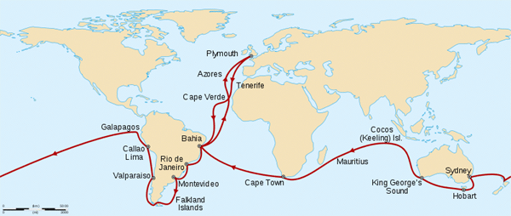
I. Fossil Evidence
Charles Darwin collected many living species, and many fossils of extinct animals.
Charles Darwin noticed similarities in the fossilized creatures and modern organisms.
This led the Darwin to believe that species with a similar trait can develop differently in different locations.

Slide 6
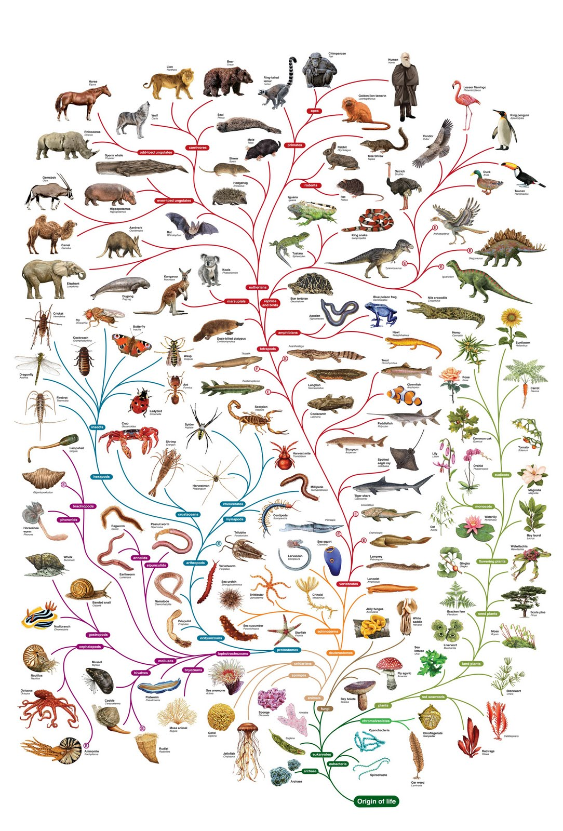
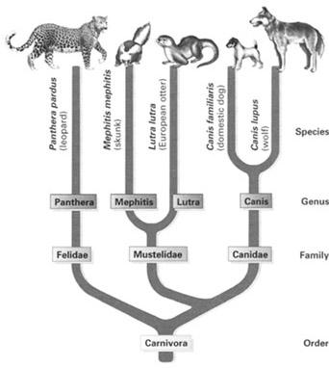
I. Fossil Evidence
He noticed similarities in these creatures and modern organisms.
This information led the scientist to believe that species with a common ancestor can develop differently in different locations.

Slide 8
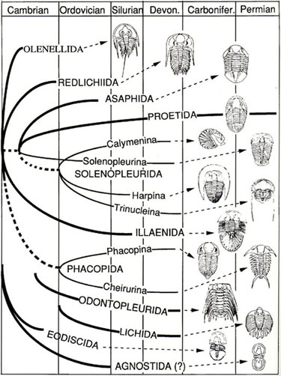
I. Fossil Evidence
An Ancestor is an early form of an organism in which later forms descended(came from).
A common ancestor – an early form of an organism that is the same for two different organisms

Slide 9
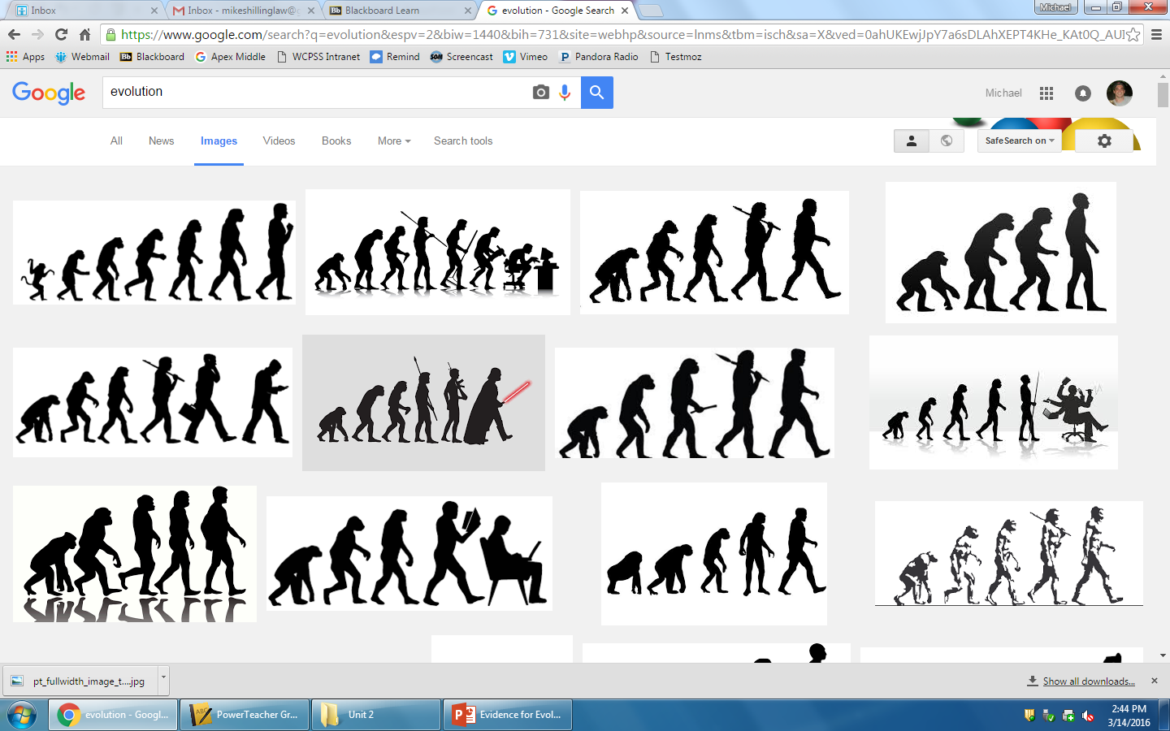

Slide 10
II. Biological Evidence
We will look at four forms of biological evidence:
  a. Vestigial Organs
  b. Homologous Structures
  c. Analogous Structures
  d. Embryology

Slide 11
II. Biological Evidence – Vestigial Organs
Vestigial organs are physical structures that were fully developed and functioning in an earlier group of organisms, but are missing or not used in modern organisms.
  Examples: hip bones in dolphins, leg bones in snakes, wings on penguins, and the appendix in humans.

Slide 12
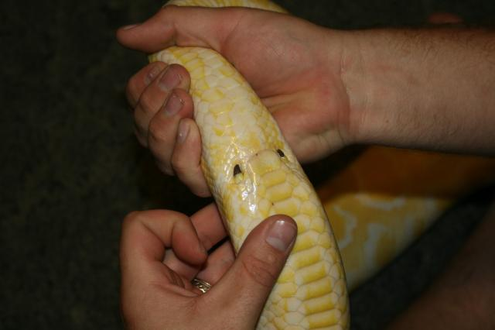
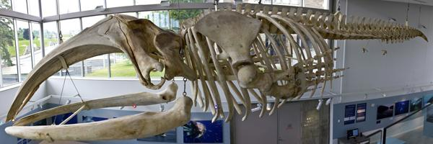
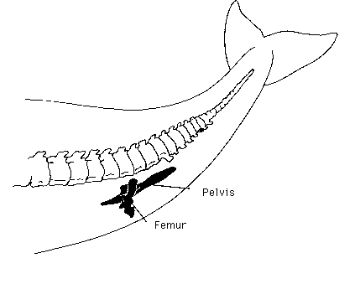
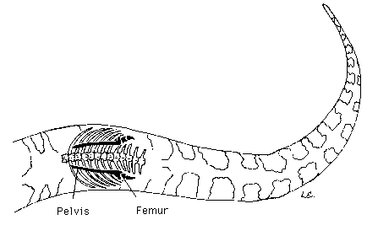
II. Biological Evidence – Vestigial Organs
Vestigial organs are physical structures that were fully developed and functioning in an earlier group of organisms, but are reduced or unused in modern organisms
  Ex: Hip bones in whales, leg bones in snakes, and wings on a penguin

Slide 13
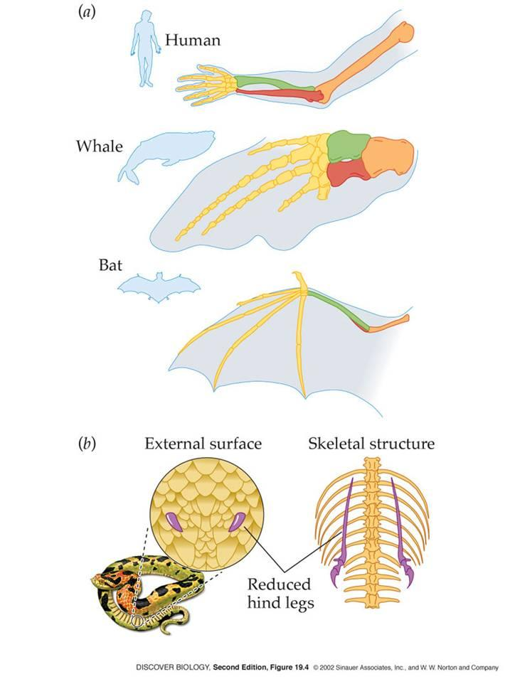
II. Biological Evidence – Homologous Structures
Many species have features that are very similar, these features are called homologous structures
  They are “similar structures with different functions”
  forelimbs in salamander, humans, turles, whales, and bats.

Slide 14
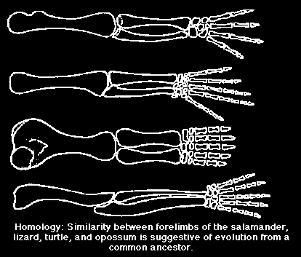

Slide 15
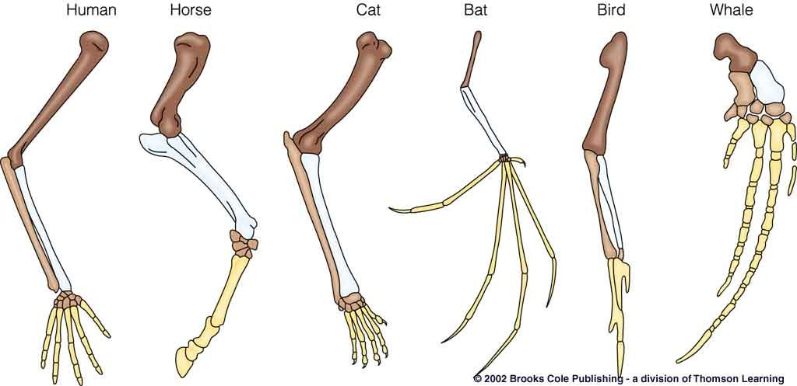

Slide 16
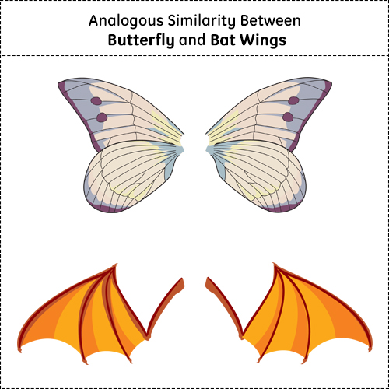
Analogous structures are those that have similar functions, but look different in terms of structure.
**write this bullet point on the bottom of the the front side**

Slide 17
II. Biological Evidence – Embryology
Adult animals do not always look alike. For example, an adult chicken does not look like an adult human. Yet, their embryos look very much alike. The study of the similarities of embryos is called Embryology.
An embryo is the earliest stages of development of an organism.

Slide 18
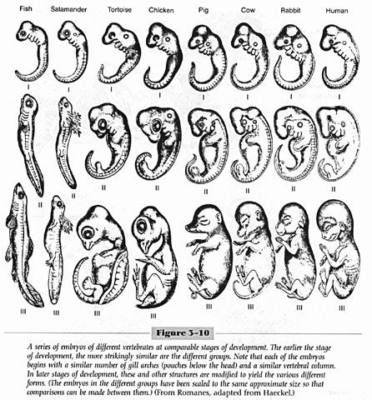
In the diagram, notice the development of three different species: a fish, a chicken and a pig. In the earlier stages of development, the embryos look similar. As they continue to develop, they begin to take on distinct characteristics.

Slide 20
III. Genetic Evidence
Similar organisms have similar genes
A gene is a segment of DNA, the genetic material found in a cell.
Less closely related organisms have genes that are easy to tell apart
Organisms with similar patterns of DNA also share common ancestors.

Slide 21
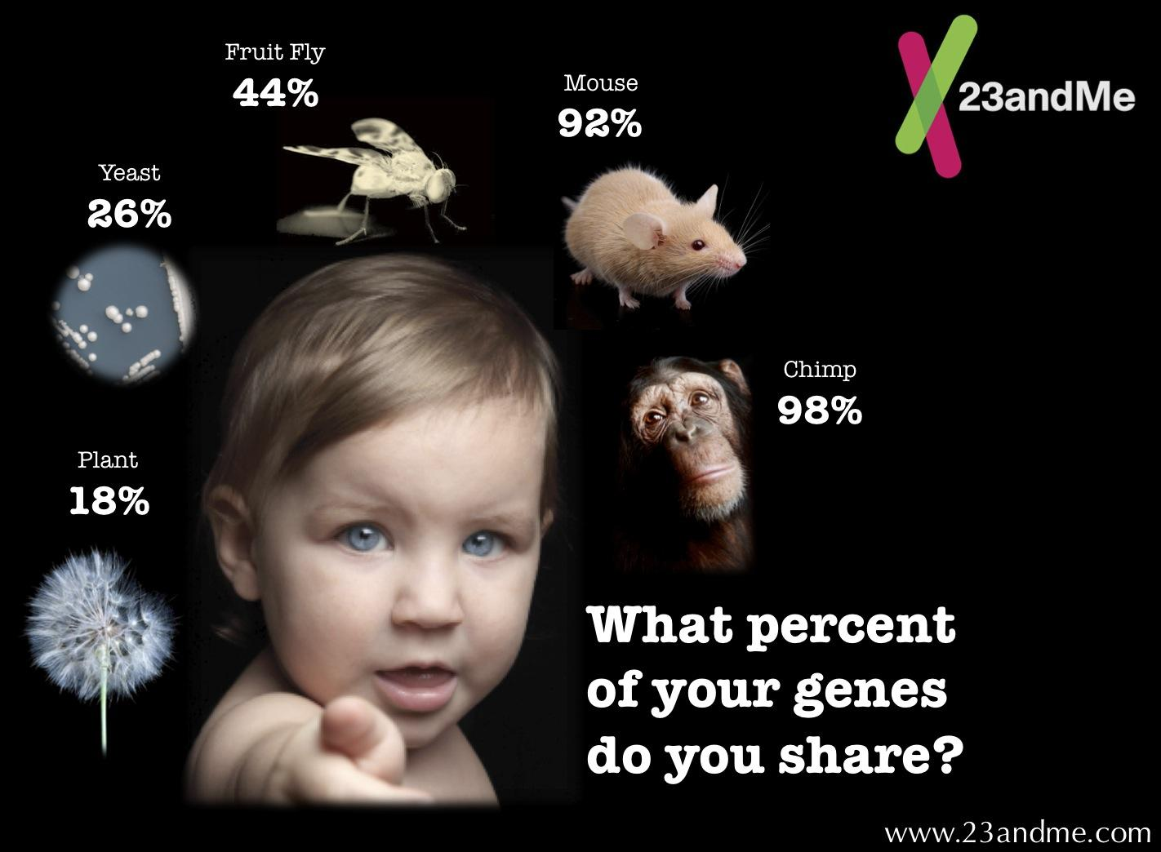

Slide 22
Biological Classification
Biological Classification is a system that is used to organize all life on Earth.
Biological Classification is also called Taxonomy.
  Creating a system of classification allows scientists to examine the relationships between different organisms.
  Comparing the embryological development of different species also shows similarities between those species that may not be present in adult form

Slide 23
Levels of Taxonomy
The classification of all living organisms is organized into different levels. The levels go from least to more specific.
  Kingdom(least specific), Phylum, Class, Order, Family, Genus, and Species (most specific)

Slide 24
