Slide 1
What “abiotic factors” make up an estuary?
Structure (characteristics) of an Estuary

Slide 2
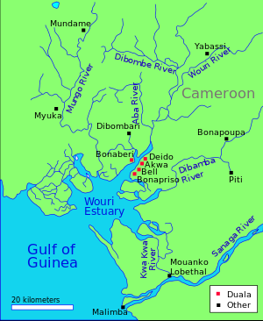
What is an
Estuary?
The place where a river flows into the ocean.
Places where freshwater in rivers meets and mixes with the salty ocean.

Slide 3

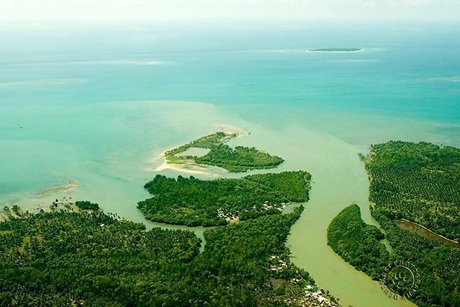
Brackish Water
  Mixture of fresh and salt water
Barrier Island
  An island that acts as a barrier (blocks/protest) against ocean tides or waves

Slide 4
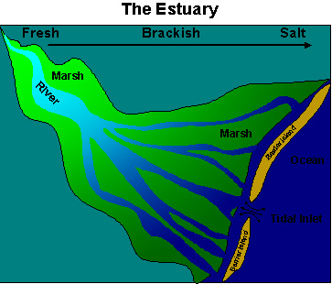
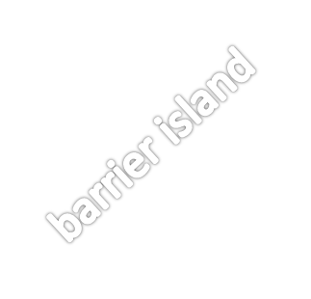
barrier island
ocean
Estuaries have a special type of water in them. It is what we call “Brackish” water.
tidal inlet

Slide 5
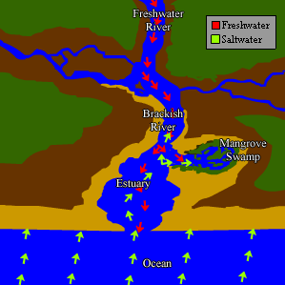
Brackish Water
Brackish water is a mixture of freshwater and saltwater. It is too salty to be freshwater, but not salty enough to be classified as ocean water. Therefore, it has its own classification as “Brackish”.
Measuring the amount of “salts” in a water environment is called salinity. The units are ppt (parts per thousand).
The salinity levels of water types:
Freshwater = 0-5 ppt
Brackish water = 5-25 ppt
Ocean water = 25-35 ppt

Slide 6
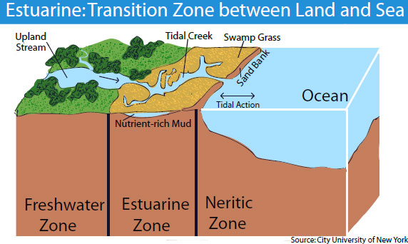
Physical Features of an Estuary
Estuaries have a few other unique physical features:
-shallow water
-light penetrates all the way to the bottom
-warmer water
-Excessive amounts of nutrients

Slide 7
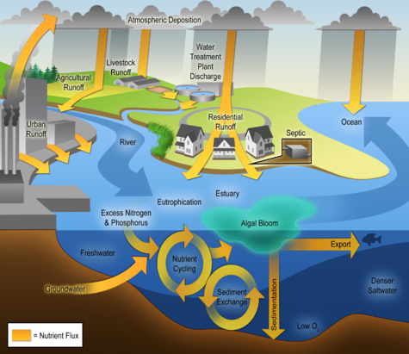
Nutrients and an estuary
Estuaries cycle nutrients which makes them one of the most productive ecosystems on the planet.
Nutrients are cycled by the following things:
-flow of river
-ocean surface currents
-upwelling currents
-deep ocean currents
-tides and waves
-Water column cycling
-Animal food webs

Slide 8
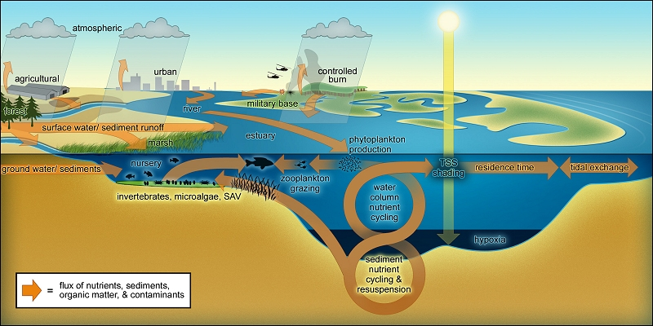
Nutrient Cycling within an Estuary

Slide 9
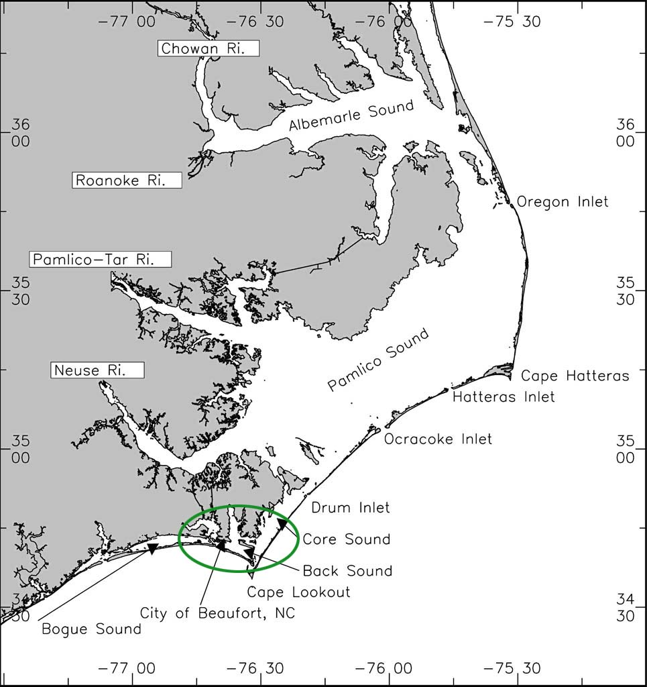
What Is An Estuary?
Estuaries may be called:
  bays
  lagoons
  sounds
  sloughs (slews).

Slide 10
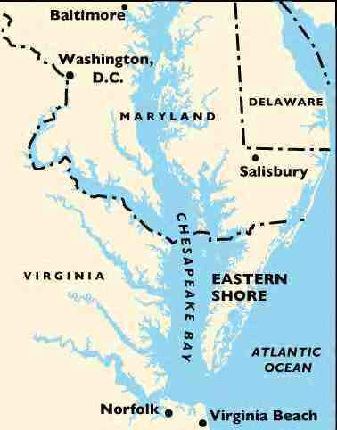
The Chesapeake
Bay is a well know
estuary. It goes
through many
states.

Slide 11
What is unique about an estuary that makes it different from everything else?
Why are Estuaries Important?

Slide 12
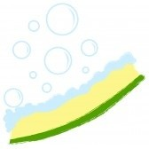
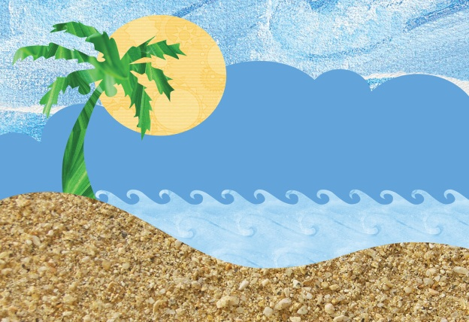
1. Why Are Estuaries Important?
Estuaries buffer upland areas from:
  Crashing waves
  Storms and preventing soil erosion.
  Estuaries protect upland areas from:
  Estuarine plants help prevent erosion.
  Barrier islands are built by waves and currents.

Slide 13
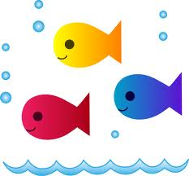
2. Why Are Estuaries Important?
Estuaries provide a protective nursery for young fish, shellfish, migrating birds, and coastal shore animals.
  Estuaries are rich in nutrients.
  Estuaries provide places for animals to breed and raise their young.
  Estuaries support many kinds of plant and animal life.
  Estuaries help provide the seafood we eat.

Slide 14

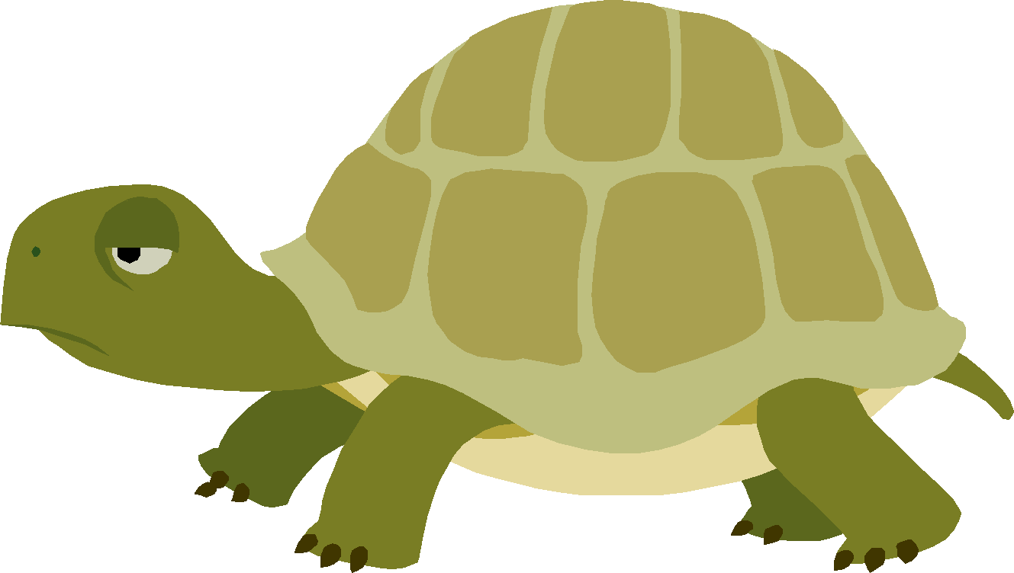
3. Why Are Estuaries Important?
Estuaries act like huge sponges.
  They soak up excess water from floods and tidal surges driven into shore from strong winds.
  Wetlands around estuaries help add water to underground aquifers that are important sources of freshwater for humans.
  Estuaries slow water runoff.

Slide 15
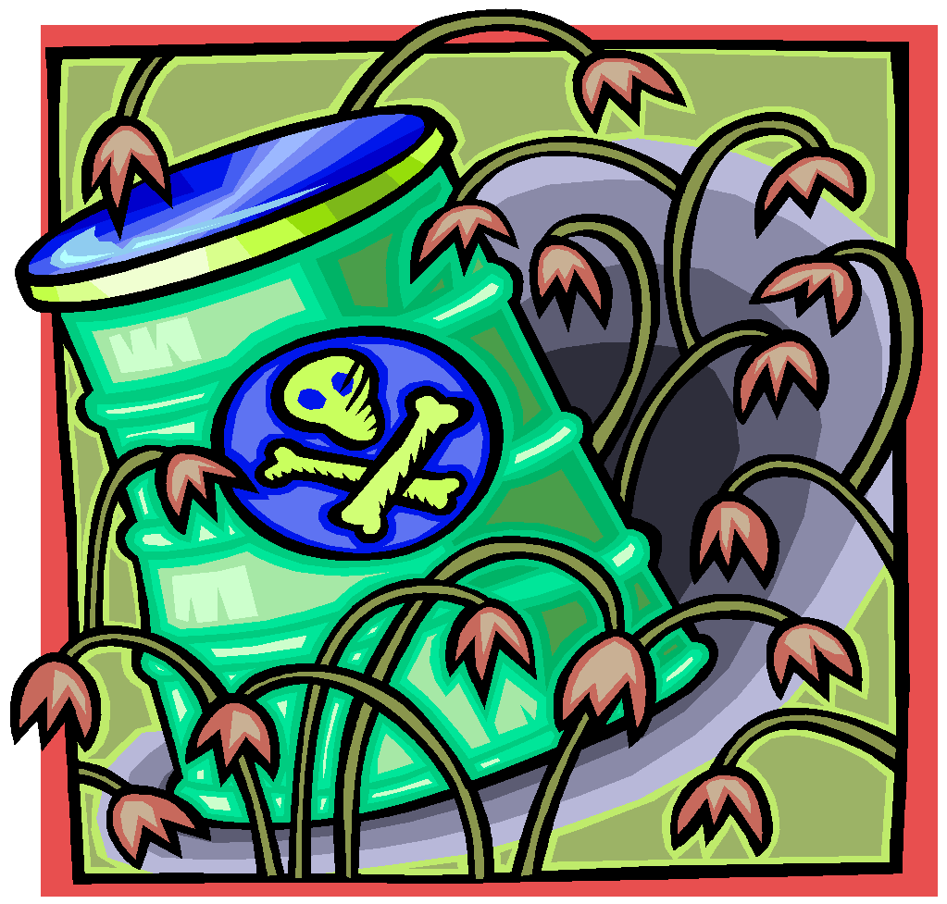
3. Why Are Estuaries Important?
  Vegetation in estuaries helps trap and filter silt, chemicals, fertilizer, water pollutants and sewage from river runoff that would flood out to sea.
Wetlands surrounding
estuaries act as a natural
sewer system that absorb
and clean wastewater.

Slide 16
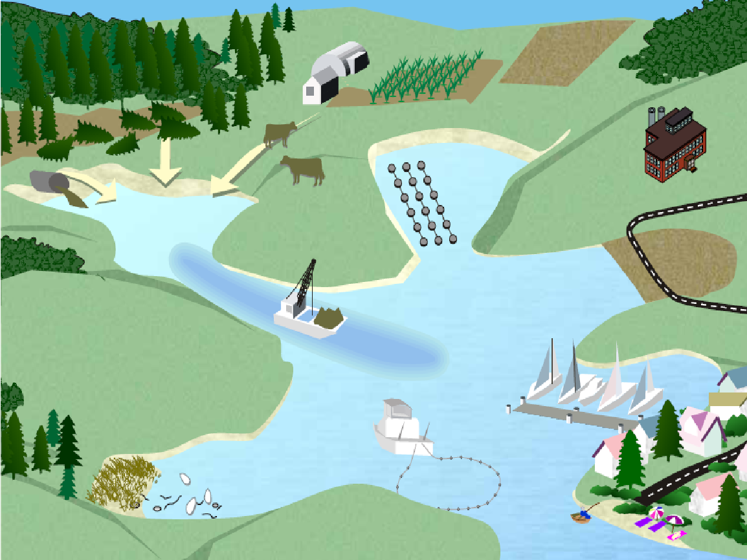
What happens upstream that could affect downstream?

Slide 17
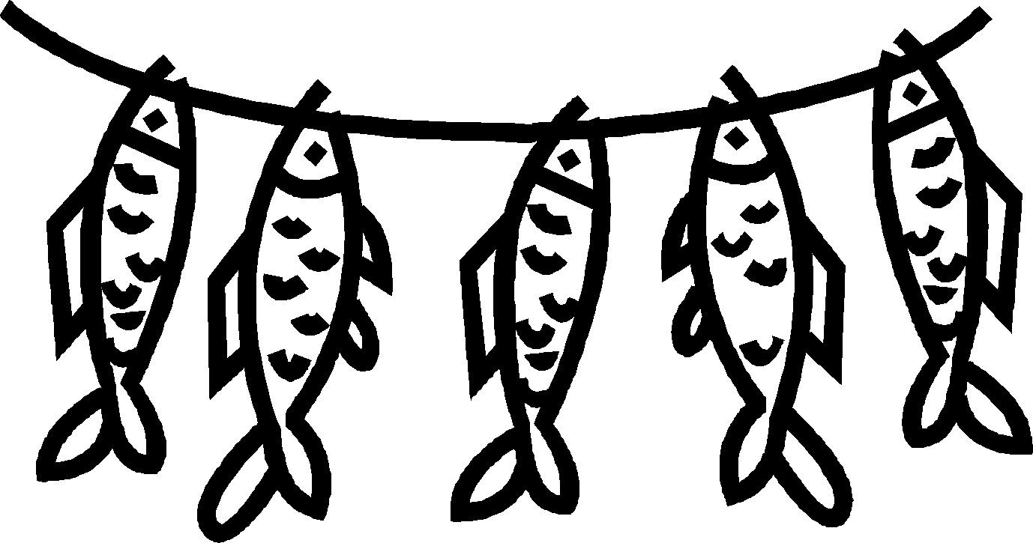

4. Why Are Estuaries Important?
Recreation
  People enjoy living near estuaries and the surrounding coastline. They sail, fish, hike, swim, and enjoy bird watching.
  Over 50% of the U.S. population lives near the coast.
  Coastal communities support recreation with vacation homes, hotels, restaurants and stores.

Slide 18

4. Why Are Estuaries Important?
Estuaries are important to humans for commercial fishing and transportation.
  Estuaries support local economies through shrimp, shellfish, crab and lobster fishing in the wild.
  Estuaries also support fish and shellfish farming, called aquaculture.
  Estuaries provide habitat for
  over 75%of the U.S. commercial
  seafood caught.

Slide 19
What different habitats exist within an estuary?
Estuary Habitats

Slide 20
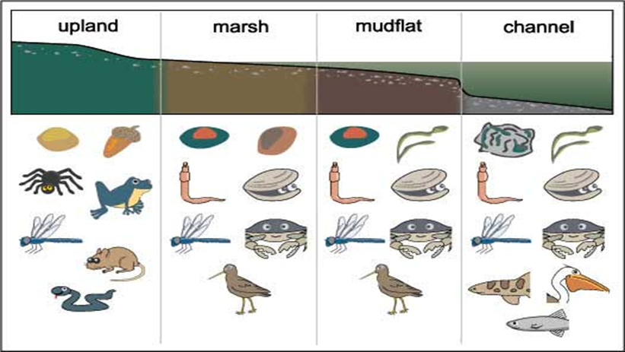
Because estuaries offer such diverse landscapes with different amounts/ types of water present, many different types of habitats exist with different types of organisms that survive in each one.

Slide 21
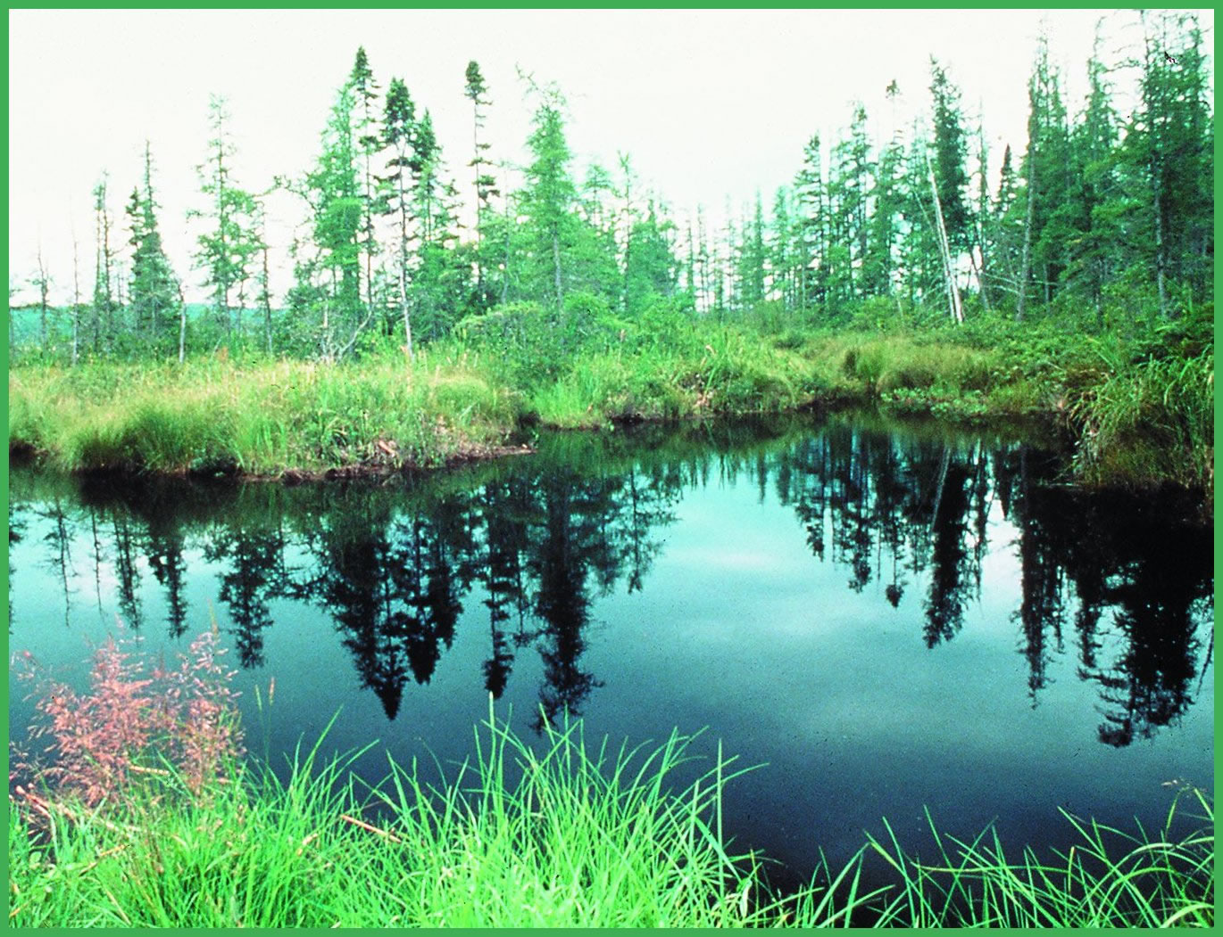

Wetlands
A lowland area, such as a marsh or swamp, that is saturated with water
Wetlands exist where the water table meets the surface of land.
We find wetlands along the perimeter of estuaries.

Slide 22
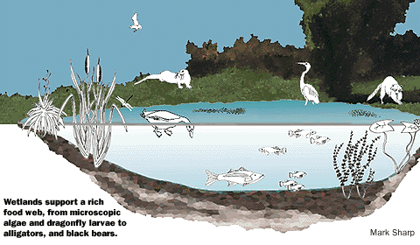
Wetlands

Slide 23
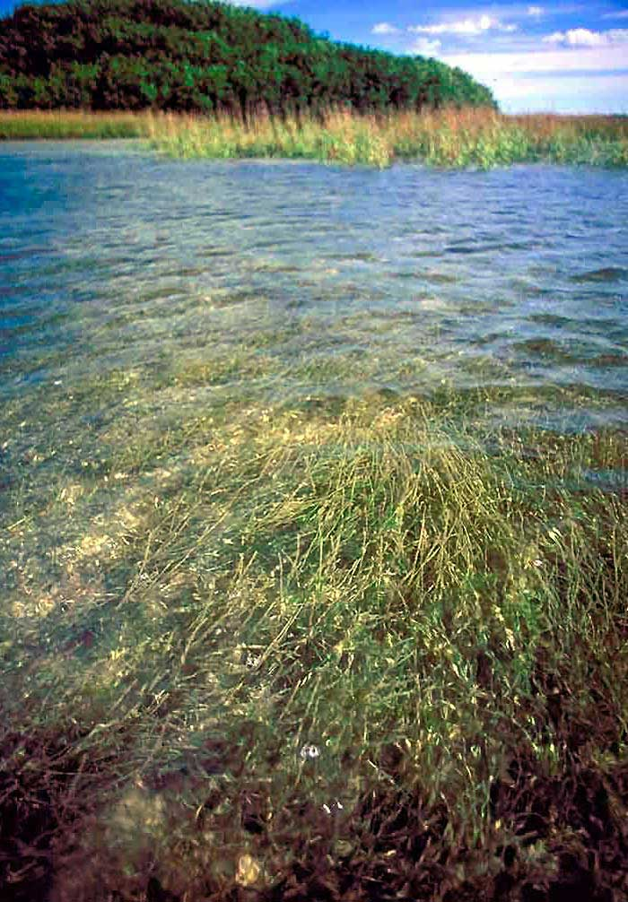
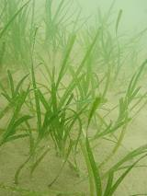
Submerged Aquatic Vegetation Zone (or SAV)

Slide 24
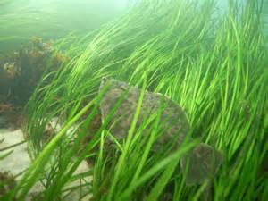
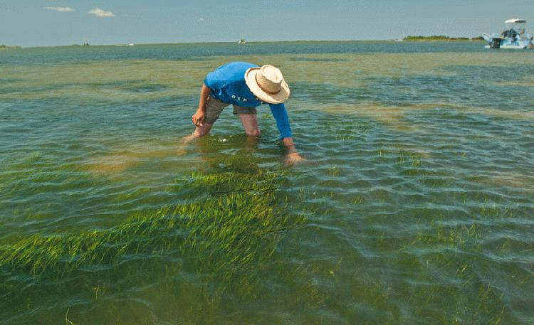
Submerged Aquatic Vegetation Physical Features
If you continue further into the water from the estuary you will find the submerged aquatic vegetation zone.
Shallow waters where sea grass and other underwater plants grow.
Full sunlight penetration
Many young fish and macroinvertebrates live here because the water is very clear and healthy.

Slide 25
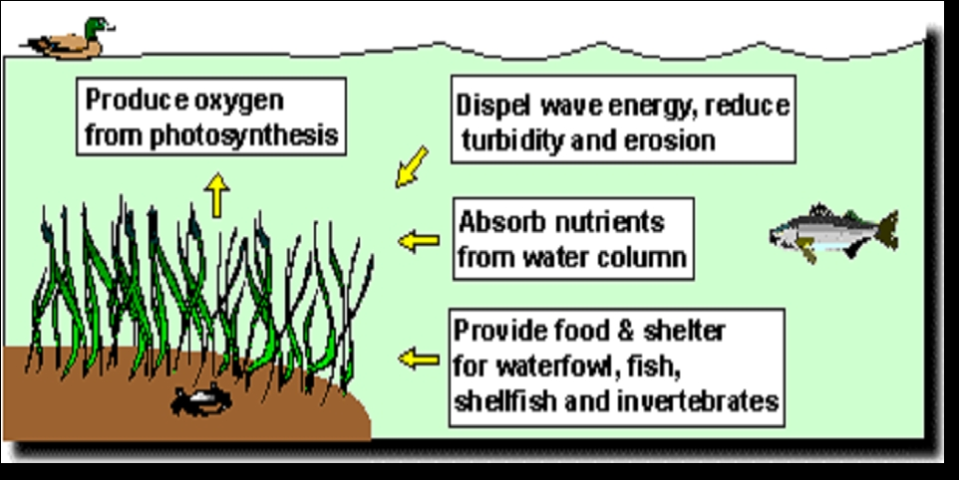
Submerged Aquatic Zone

Slide 26
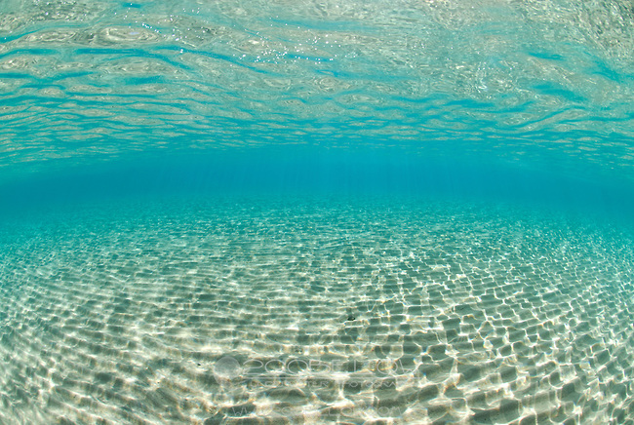
Soft Bottom Habitat

Slide 27
Soft Bottom
As you continue further out into the estuary moving toward the ocean, you will get to the soft bottom habitat.
Dominated by soft sediment like sand, or mud (examples: beaches, mudflats and sand bars)
This habitat acts as a storage area for nutrients, sediment and chemicals and circulates them between the bottom of the water and the water column.
Many burrowing animals exist here and shallow soft bottoms next to wetlands act as a nursery to many aquatic species.

Slide 28
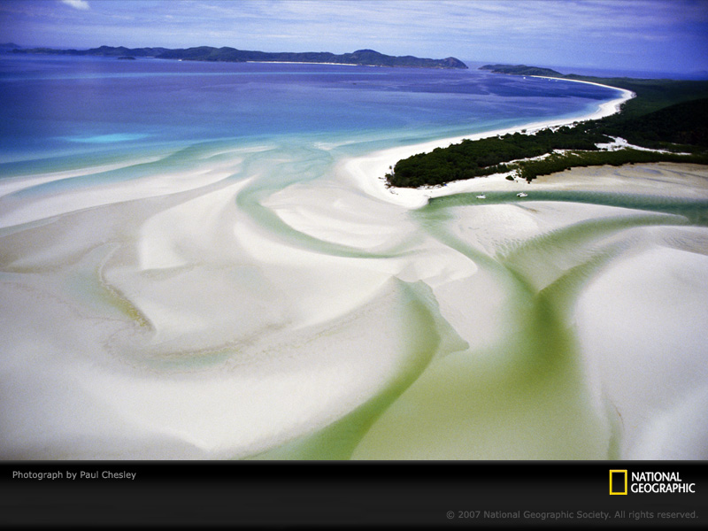
Soft Bottom- Sand Bars

Slide 29
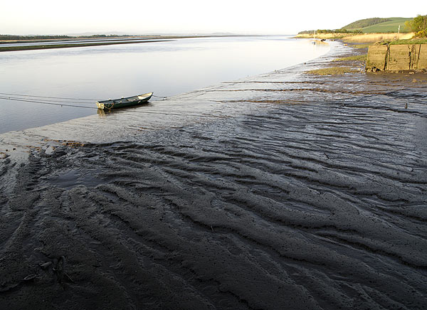
Soft Bottom- Mud flats

Slide 30
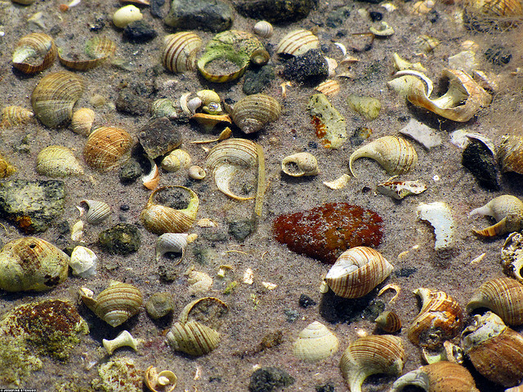
Shell Bottom- Oysters, clams and other shellfish actually filter the water naturally by feeding on bacteria and algae.

Slide 31
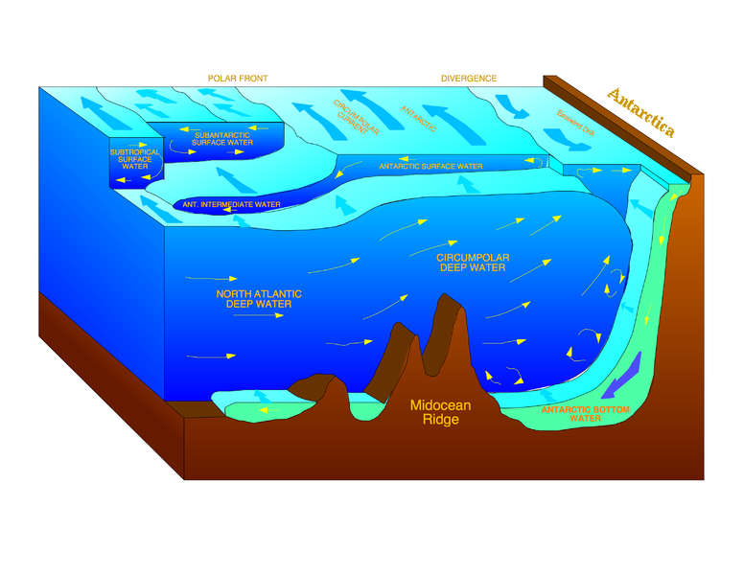
Water Column
A water column is a conceptual column of water from surface to bottom sediments.

Slide 32
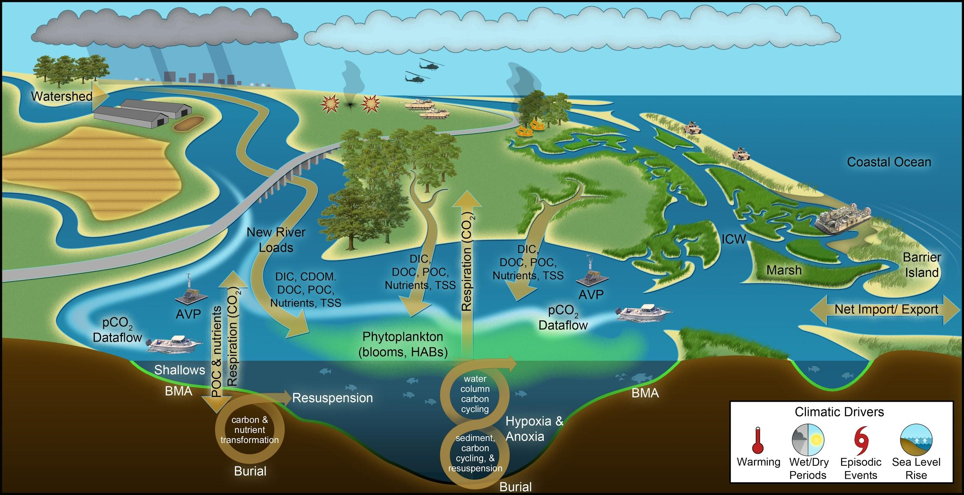
Water Column- Moving from the soft bottom habitats and towards the ocean will then take you to the water column.
The water is deeper here, but sometimes only a few feet deep.
Here, nutrients from the ocean mix with nutrients from the bay.

Slide 33
What consequences do the estuaries face because of human actions?
Human Effects on Estuaries

Slide 34
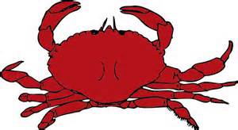
Over Fishing
As the human population continues to grow, we continue to eat seafood, commercialize it and mass produce seafood in restaurants and supermarkets.
Because of this we are starting to cause the extinction of many once-abundant estuarine species,
Example: The Maryland Blue Crab
  Because we have over- fished blue crabs in the Chesapeake Bay, they are hard to find which makes them very expensive in stores and restaurants (Supply and demand)
  Laws are set in place that require fishermen to toss back crabs that are under a certain size limit and female crabs and there are regulations as to how many crabs they are allowed to catch.
  It is usually from $50-$100 dollars for only a dozen crabs in MD

Slide 35

Also...
When we fish for organisms like oysters for us to eat, we are taking away natural filters to the bay. This leaves estuaries more susceptible to pollution.

Slide 36
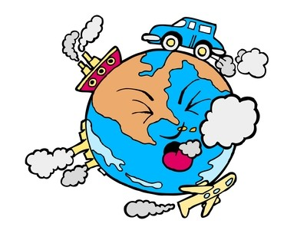
Pollution
Vegetative buffers, and various species of shellfish work to filter and clean contaminants in an estuary.
Pollution from human activity has overpowered these natural purifiers.
Basically , these aquatic plants and animals can’t keep up with the pollutants that humans are placing in water sources.

Slide 37
Eutrophication- Excess nutrients
Along with an increase of contaminants, we also have excess nutrients that run into the bay due to human activity on land.
Many of these nutrients come from phosphorus and nitrogen sources.
As these nutrients enter the water, the algae thrive and grow rapidly
Algae blooms develop from this which consequently causes there to be low levels of dissolved oxygen. (as algae decay, bacteria consuming them require and take away the DO from the water)
Low levels of dissolved oxygen = lower fish population = poor water quality
We call these areas DEAD ZONES because many species struggle to live in these conditions.

Slide 38
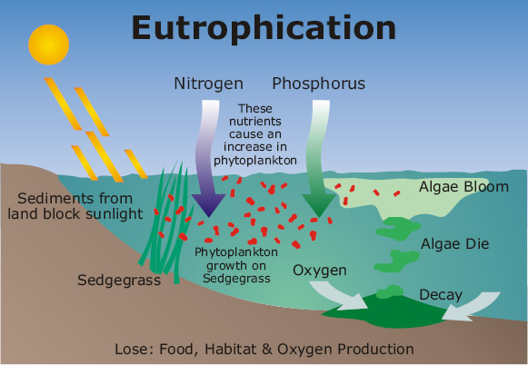

Slide 39
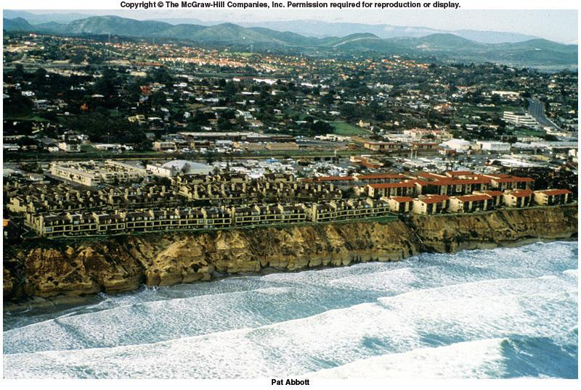
Shoreline Erosion
As humans continue to build homes and businesses along the coast we consequently leave the shore vulnerable to erosion.
How can we do this?

Slide 40
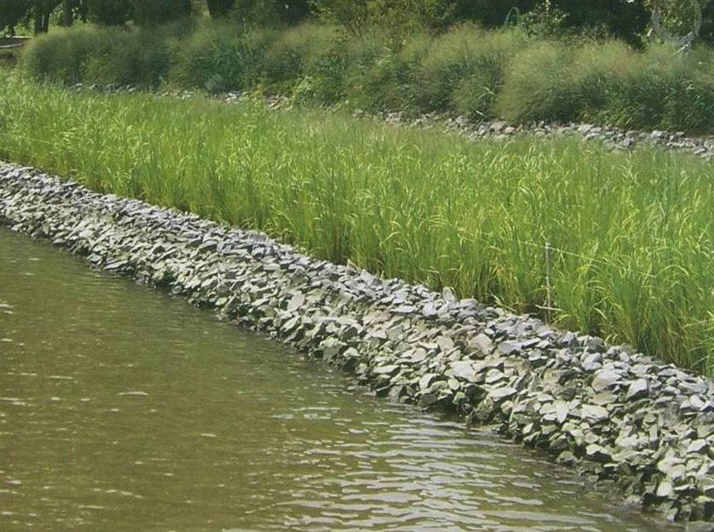
Living Shorelines

Slide 41
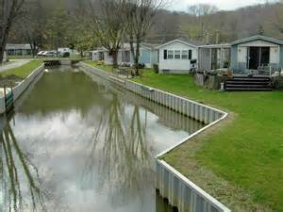
Unfortunatly…
coastlines are constantly changing naturally with tides, currents, soil deposits, and drastic weather conditions.
This tears away at our man- made structures and affects the natural circulation of water, sediments, and nutrients.
It also destroys beaches, which are important habitats to many species.

Slide 42
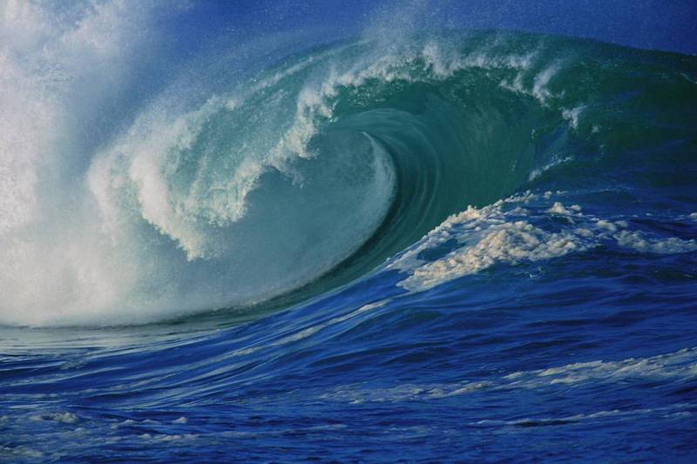
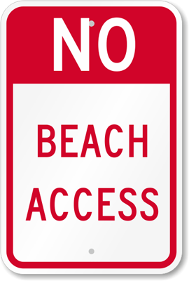
Wave Energy
Dissipates over surfaces of natural beach
Seawalls reflect wave energy
Reflected wave energy stirs up the sand
and washes it out to sea = no beaches

Slide 43
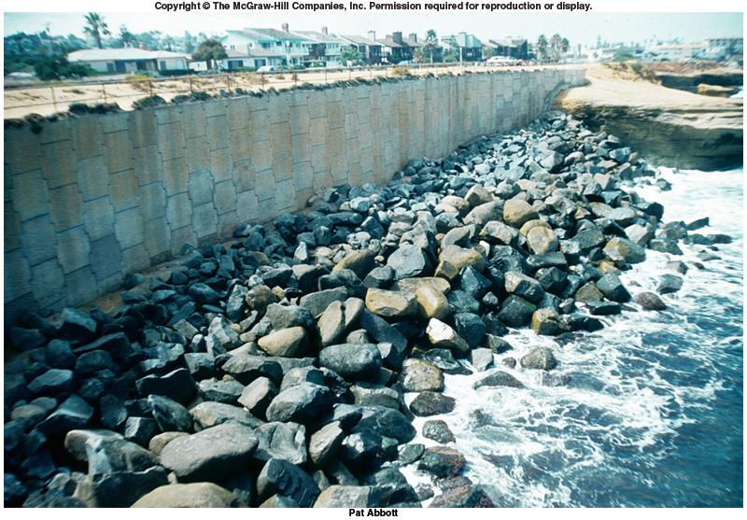
HUMAN EFFECTS ON COAST
CLIFF PROTECTION
Concrete wall and rocks
Sunset Cliffs San Diego. Protected by a cement wall and “riprap”.
Waves erode underneath and around the structure.
Also wall reflects waves hitting them. Rebounding water surges powerfully erode the beach.
“Riprap” reduces reflection but eventually waves work way under the “riprap”.
Eventually have very serious problem

Slide 44
