Slide 1
ENGLISH BIBLE STORY
1) TIMELINE/TRANSLATION LIST
(color-coded by language)
-check your handout (date, Bible name, language) by this
2) SUPER-FUN-HANDMOTIONS!!
-learn these with a partner
-know them 100%!!
3) ENGLISH BIBLE STORY CUTOUTS
-cut out shapes (scrolls, books, etc.) for each Bible in list
-use different colored paper per language
-write Bible Name on outside
-write translator, language, facts on inside
-attach them together by: string, staples, or glue them onto a larger sheet of paper

Slide 2
THE STORY OF THE ENGLISH BIBLE
Translations Order with color coding
500BC - TANAK/O.T. Hebrew
200BC - SEPTUAGINT Greek
100AD - NEW TESTAMENT Greek
382AD - LATIN VULGATE Latin
1384AD – WYCLIFFE BIBLE English
*1455AD - Gutenberg…Printing Press
Gutenberg Bible Latin
6. 1526AD – TYNDALE N.T. English
7. 1535AD - COVERDALE BIBLE English
*1539AD - The GREAT BIBLE English
8. 1560AD – GENEVA BIBLE English
*1609AD – Douay (OT)-Rheims (NT) Eng
9. 1611AD - KING JAMES BIBLE English

Slide 3
THE STORY OF THE ENGLISH BIBLE
Translations Order with color coding
WELCOME TO AMERICA!
10. 1782AD – Rob Aitken Bible English
*1808AD – Jane Aitken Bible English
MODERN ENGLISH BIBLES
11. 1901 – American Standard Version
12. 1971 – NEW American Standard Ver.
13. 1973 – NEW International Version
14. 1978 – NEW King James Version
15. 2000 – the MESSAGE Bible
*a paraphrase
16. 2002 – the English Standard Version

Slide 4
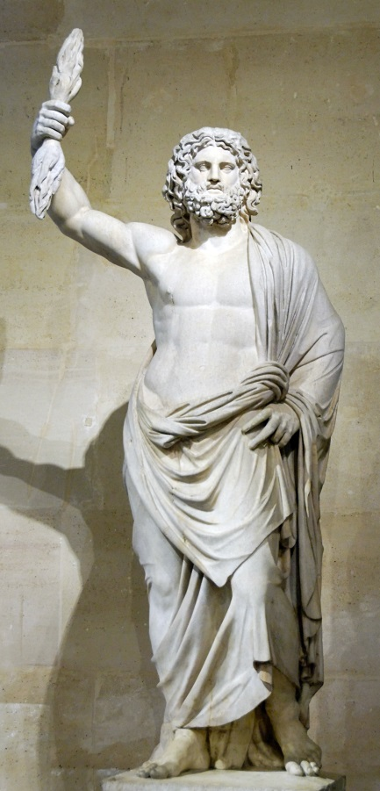
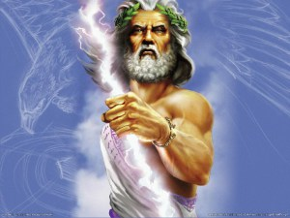
ENGLISH BIBLE HANDSIGNS!!
HEBREW O.T. – point to a male(“He”) - make a stirring motion (“Brew”); make “O” “T”
SEPTUAGINT GREEK O.T.- hold up 7 fingers; Zeus pose, “O” “T”
GREEK New Testament – Zeus pose (throwing a lightening bolt) - “New” (hold up pointer finger) “T”
LATIN VULGATE BIBLE- make “L” and “V” then open hands like a book
WYCLIFFE BIBLE – make “Y”; fall off a “cliff”…
1st English Bible – hold up index finger; drink a cup of tea with pinky finger extended; open hands like a book
TYNDALE BIBLE– ten fingers; drive a Nascar steering wheel (10-Dale!)
*1st Printed English Bible- index finger; slap palms like printing, drink tea with pinky finger out, open hands

Slide 5
ENGLISH BIBLE HANDSIGNS!! cont.
COVERDALE BIBLE – cover with hands; Nascar!; open book
GENEVA BIBLE- cup hands around mouth to “yodel!”; open book
KING JAMES– put on crown; make an air J.
1611 AUTHORIZED ENGLISH BIBLE- ten fingers+6 fingers; two index fingers; slam fist into palm; pinky tea cup; book
AITKEN BIBLE- 8 fingers; arms out for family photo; open book hands
1st Bible printed in America – index finger; book hands, slap palms for printing, statue of Liberty pose
MODERN BIBLES– (say date with each)
1901-“American Std. Bible”- Statue of Liberty pose/book
1971-“New! “ “ Bible – finger up/Statue of Liberty/book
1973-“New! International Bible”– finger up/make a globe
with hands/open hands like a book
1978- “New King James Bible”– index finger/ put crown on; open hands like a book
2000- “The Message” – act like typing a text message

Slide 6
ENGLISH BIBLE STORY PROJECT
Illustrate each Bible in the English Bible story from your handout
1. Make shapes– one for each Bible on the English Bible
story handout; use colored paper (different color per language)
2. SHAPES - Cut each into a shape to represent each Bible.
Be creative! Fold shapes if necessary
3. INFO – write the Bible Name on outside neatly & large
-write translator name, language, and facts about inside; be
neat and clear!
4. CONNECT together– with string, staples, or glue onto a larger sheet of
paper

