Slide 1
Science Starter:
Complete the next two questions on your EOG Chemistry Science Starter!
**Take out the ocean currents frame from yesterday**

Slide 2
Agenda:
Finish ocean currents frame
El Nino Notes
Ocean Resources

Slide 3
Let’s finish where we left off on currents …

Slide 4
What weather phenomena has the largest impact on weather in the western US ?

Slide 5
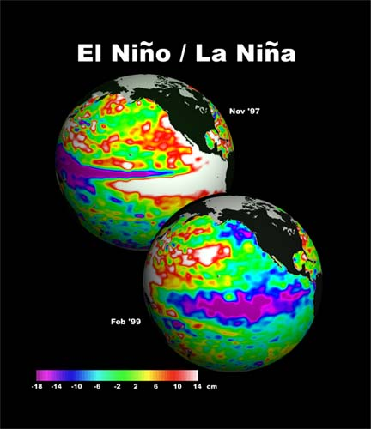
El Niño
and
La Niña

Slide 6
These weather phenomena's have to do with how the pacific ocean behaves

Slide 7
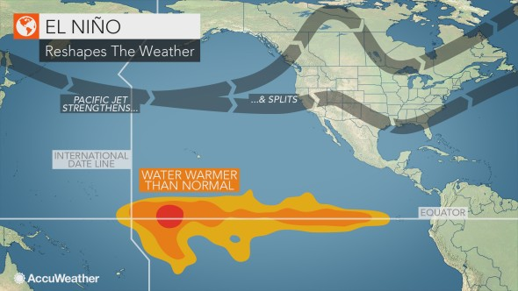
El Niño - Unusually warm surface water temperatures in the Pacific ocean

Slide 8
El Niño simplified…
WATCH
https://oceanservice.noaa.gov/facts/ninonina.html

Slide 9
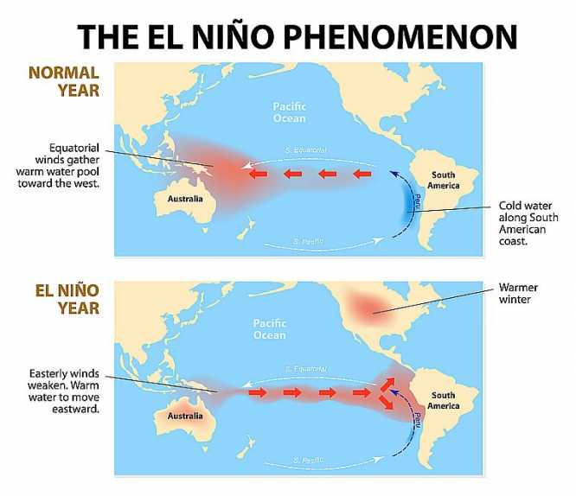

Slide 10
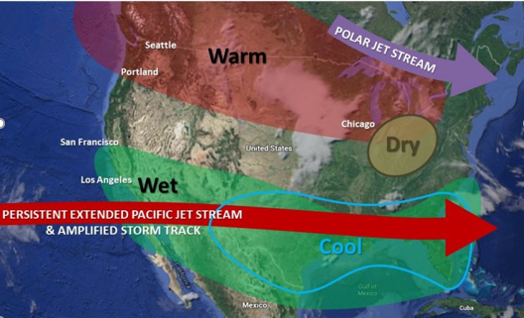
Causes:
El Nino is caused when easterly trade winds weaken allowing warm ocean water in the Pacific to dominate
WEAK SURFACE WINDS GIVES US…
WEAK UPWELLING

Slide 11
WEATHER EFFECTS
Strange phenomenon occur during an El Niño like...

Slide 12
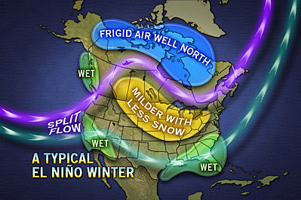
El Nino’s Damage Done- USA
Floods in the Pacific states
Causes severe thunderstorms in the south
Northeast typically has stormy winters, "Snowmageddon”

Slide 13
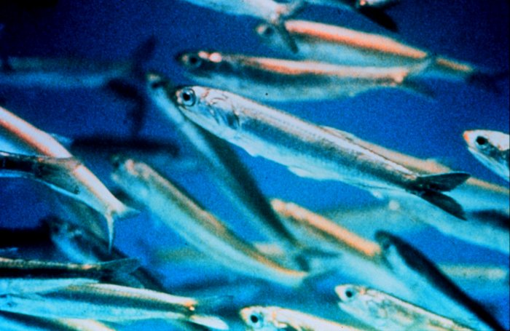
Peruvian anchovy populations declined (El Niño)
Notes:
Cooler, nutrient rich waters associated with El Niño drop along with the thermocline, driving the anchovy population down with it, or killing off a large portion.

Slide 14
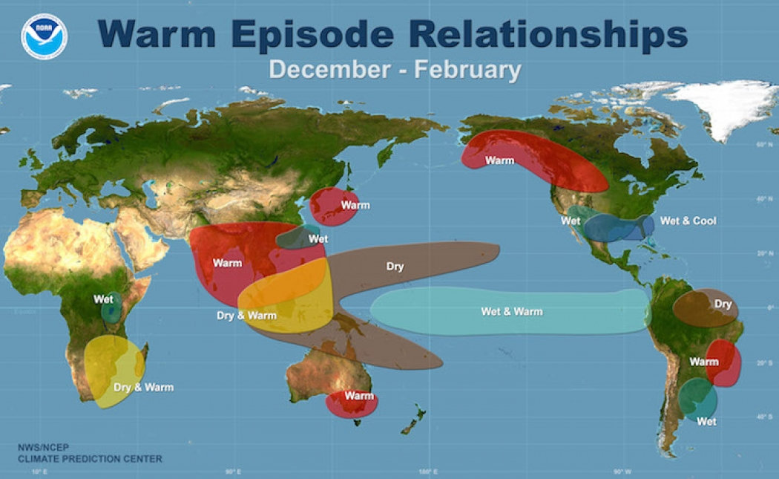
Different regions experience El Nino differently

Slide 15
How can we predict an El Niño or La Niña event?

Slide 16
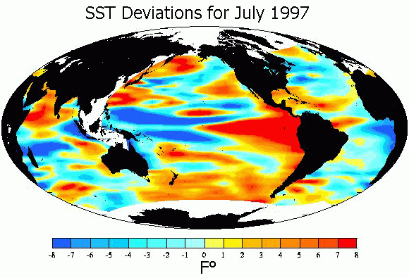
Need measurements to make predictions

Slide 17
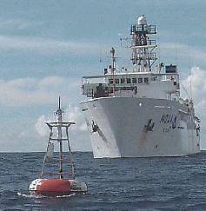
NOAA drifting buoys
Measures...
temperature
currents
winds
Notes:
Observations of conditions in the tropical Pacific are considered essential for the prediction of short term (a few months to 1 year) climate variations. To provide necessary data, NOAA operates a network of buoys which measure temperature, currents and winds in the equatorial band. These buoys daily transmit data which are available to researchers and forecasters around the world in real time.
But what about the rest of the ocean outside the equatorial band? Since oceans cover about 70% of the earth’s surface, our ships, buoys and other in situ (at the collection site) instruments can’t possible cover that much space. Thanks to advanced space technology, we can now use satellites to help us collect large amounts of ocean data.

Slide 18
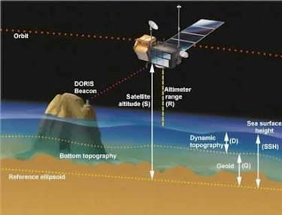
Satellites
Instruments on satellites measure wind, waves, temperature of the sea surface, ocean color, ocean surface currents, and tides.
Notes:
Satellites have revolutionized the ocean sciences. They have advanced our knowledge about the weather and ocean processes more than any other tool. Instruments on satellites measure wind, waves, temperature of the sea surface, ocean color, ocean surface currents, and tides. Oceanographers can use these satellite measurements for numerical modeling to predict what is happening in the deep ocean.

Slide 19
There’s also a La Nina...

Slide 20
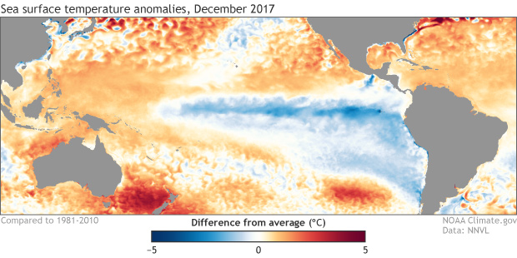
Definitions:
La Niña - Unusually cold surface water temperatures in the Pacific ocean

Slide 21
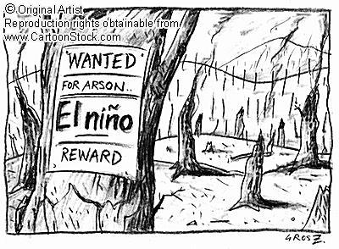

El Niño and La Niña simplified…
El Nino is the abnormal heating of Earth’s ocean surface in the Pacific.
La Nina is the abnormal cooling of Earth’s ocean surface in the Pacific.

Slide 22
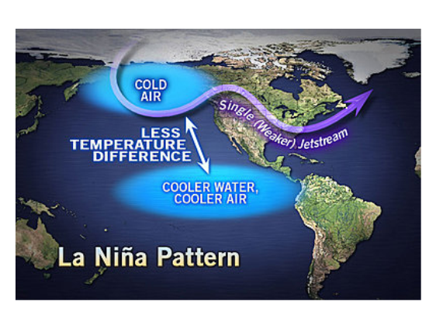

Slide 23
Causes:
La Nina is caused when the easterly trade winds are strong pushing away warmer water and allowing colder ocean temperatures to dominate
La Nina
STRONG SURFACE WINDS GIVES US…
STONG UPWELLING

Slide 24
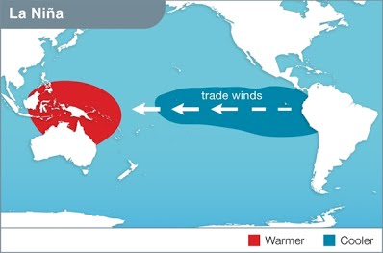

Slide 25
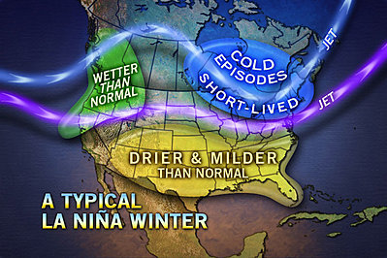
La Nina’s Damage Done - USA
Drier and Milder conditions in the south.
Cause severe droughts in the southeast.
Cause unusual cold temperature changes along the Pacific coast.
Causes wetter conditions for the Pacific states.
Northeast will have cold periods

Slide 26
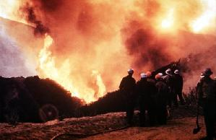
Brush fires caused by drought in Texas (La Niña)
Notes:
From the decline of anchovy populations to the increase of drought and tropical storms. All of these phenomenon have been linked to El Niño and La Niña events.

Slide 27
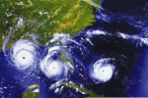
Increased Tropical Storms (La Niña)

Slide 28
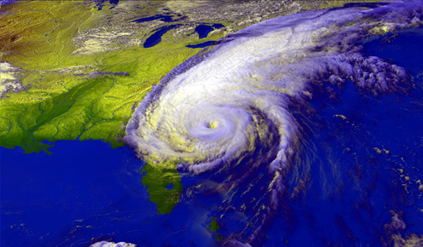
Hurricane Floyd was HUGE!
(1999 - La Niña)

Slide 29
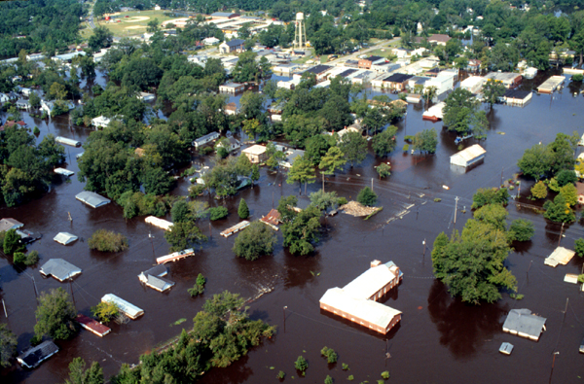
Causing devastating floods in Australia (2010-2011 La Niña)

Slide 30
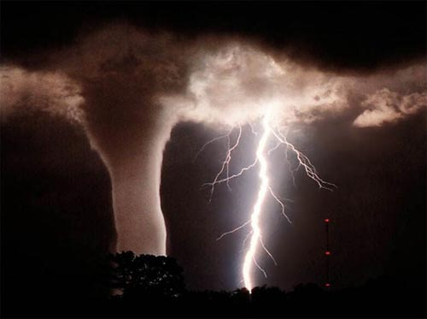
More tornadoes through tornado alley?
NO!!!
Scientists have found no significant correlation between El Niño and La Niña weather patterns and increased tornadoes.

Slide 31
Ocean Resources

Slide 32
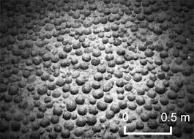
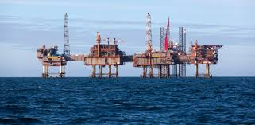
Ocean Resources
Oceans provide many resources.
1. On a sheet of paper, make a 2-column table with column titles “Biotic Ocean Resources” and “Abiotic Ocean Resources”.
2. Skim through pages 98-103 in the textbook and complete the table, listing a minimum of 5 biotic and 5 abiotic resources.
3. Beneath the table, explain fish farming and its purpose. What are some ocean organisms that are farmed?

Slide 33
Ocean Resources
Biotic Ocean Resources
Abiotic Ocean Resources
1. Fish
2. Seaweed (kelp/algae)
3. Shrimp
4. Clams
5. Oysters
6. Phytoplankton
1. Dissolved gases – oxygen, carbon dioxide, nitrogen
2. Petroleum(oil)/natural gas
3. Mineral nodules (manganese/iron/copper)
4. Fresh water – has to go through the desalination process
5. Wave and tidal energy for making electricity

Slide 34
Videos (3 minutes each)
Science Cheat Sheet
http://science.discovery.com/tv-shows/cheat-sheet/videos/el-nino-and-la-nina.htm
National Geographic Video
  http://video.nationalgeographic.com/video/environment/environment-natural-disasters/landslides-and-more/el-nino
Discovery Education
  El Nino and La Nina
  El Nino: The Driving-Force of Weather Patterns /

