Slide 1

Effective Communication
6th Grade

Slide 2

What are some ways that we Communicate?

Slide 3

What are some barriers to communication?

Slide 4

What are some things that help communication be effective?
*Why is effective communication especially important during your teen years (adolescence)?

Slide 5
Types of Communication
Verbal: speaking in person or written
Written: email, text, paper/pen, signs
Non-Verbal:
Visual: gestures, pictures, facial expressions
Body Language: stance, proximity, posture

Slide 6
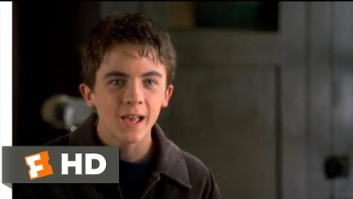
What is happening in this scene?

Slide 7

This Photo by Unknown Author is licensed under CC BY-NC-ND

Slide 8
Tone matters
I did not tell John you were late.
I did not tell John you were late.
I did not tell John you were late.
I did not tell John you were late.
I did not tell John you were late.
I did not tell John you were late.
I did not tell John you were late.

Slide 9
Body Language
Eye Contact: A sign of respect/trustworthiness in some cultures, a sign of disrespect in others
Touch: handshakes, fist bump, high fives, hugs, kissing
Proximity: US…we like our space

Slide 10
Behaviors for Good Communication
Eye contact
Interest in the other person (posture, facial, expressions, comments)
Imagining how the other person feels (empathy)
Asking questions for better understanding/clarifying
Resisting distractions

Slide 11
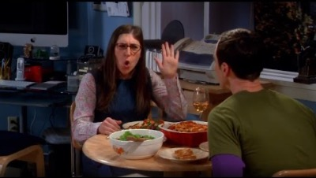
Active Listening

Slide 12
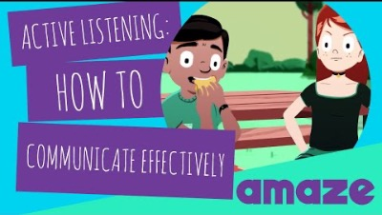

Slide 13
Behaviors of Poor Communication
Thinking only about your opinion
Interrupting others
Speaking loudly to overpower the other person
Lack of eye contact
Poor posture
Not asking questions/making comments
Being on your phone or other distractions

Slide 14
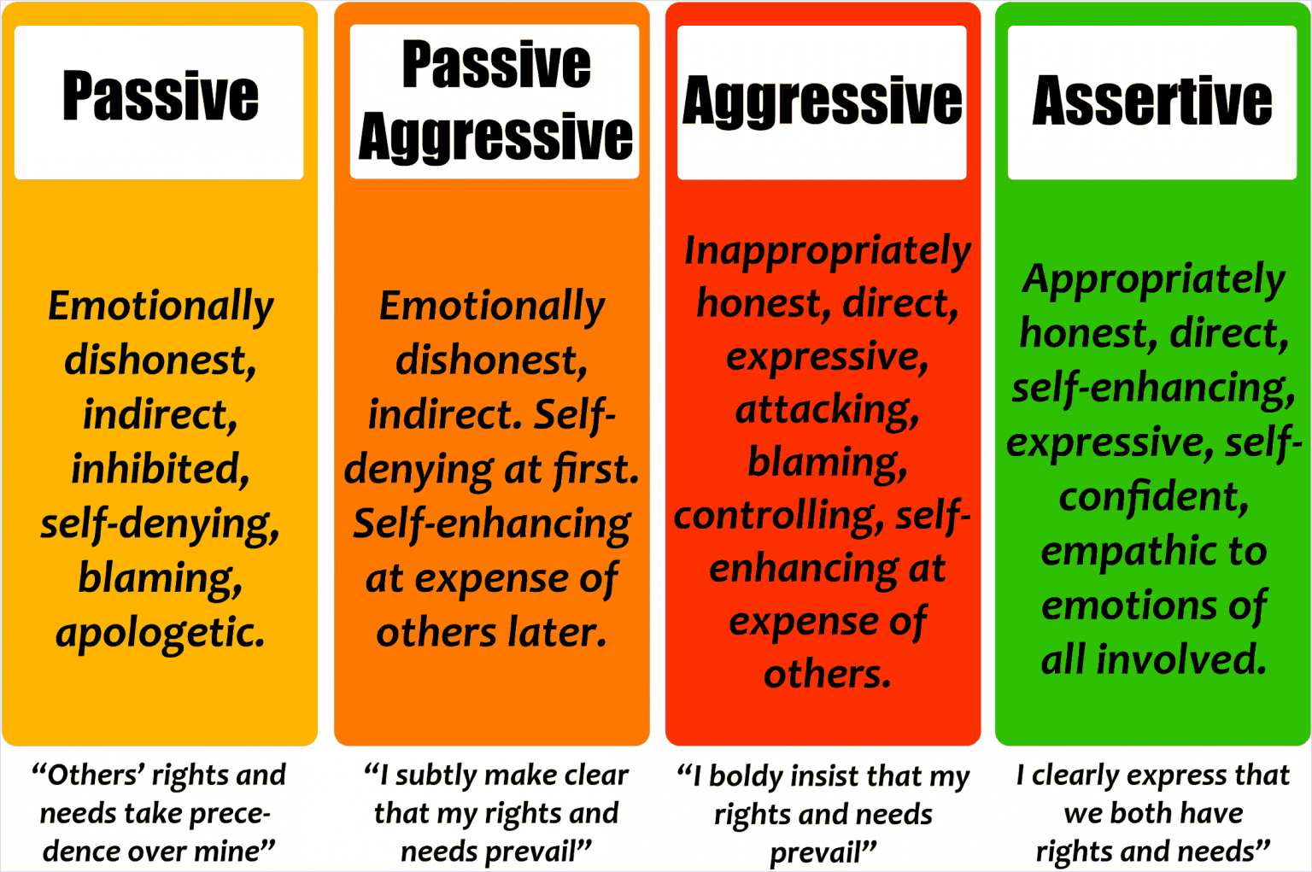
Passive…
Aggressive…
Assertive…

Slide 15
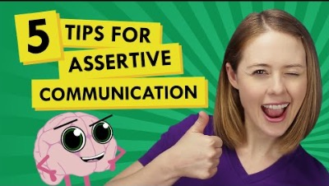

Slide 16
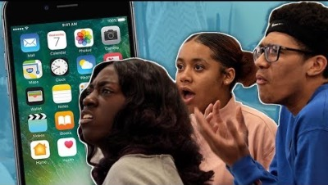
Is texting or f2f more effective/efficient?

