Slide 1
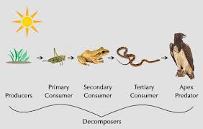
Food Chain
The flow of energy in an ecosystem from producer to primary consumer to secondary consumer

Slide 2
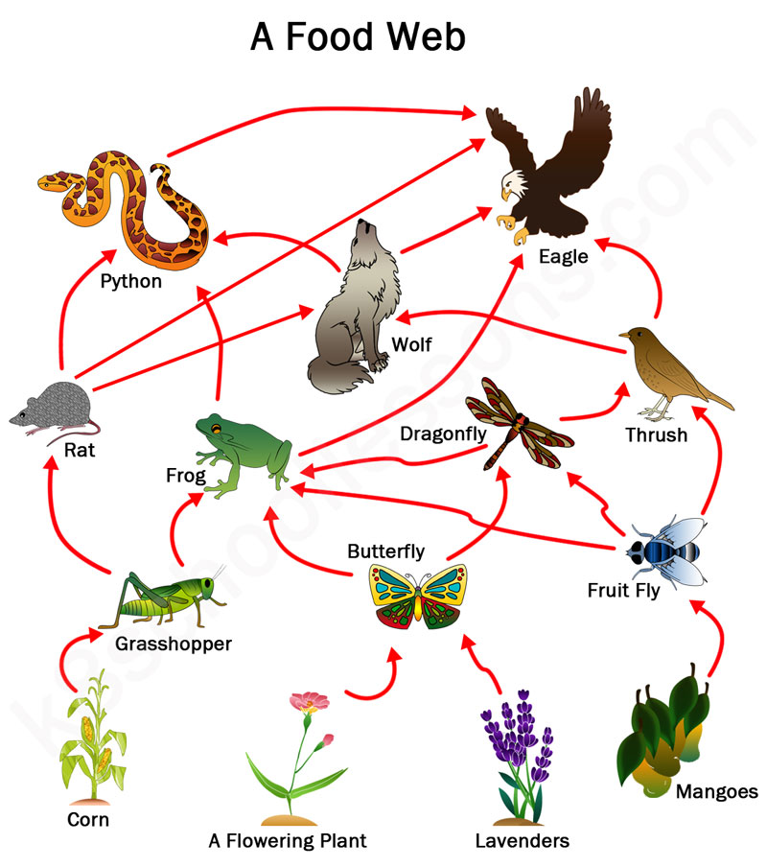
Food Web
Interconnected food chains with many food energy paths in an ecosystem

Slide 3
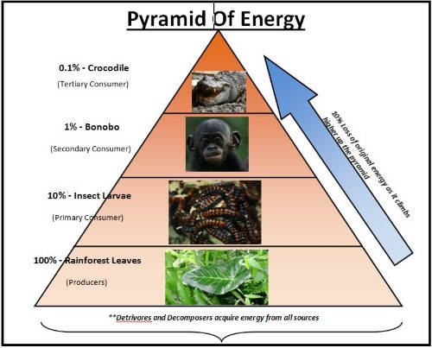
Energy Pyramid
A diagram that shows the amount of energy at each level of the food chain

Slide 4
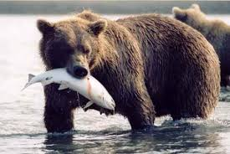
Prey
Animal caught or hunted for food

Slide 5
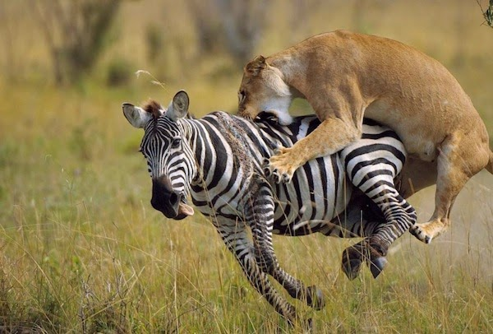
Predator
An animal that hunts another animal for food

Slide 6
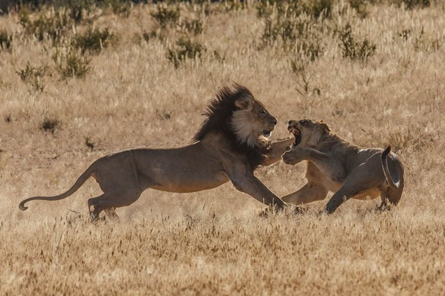
Competition
When 2 or more organisms use the same resource that is in short supply

Slide 7
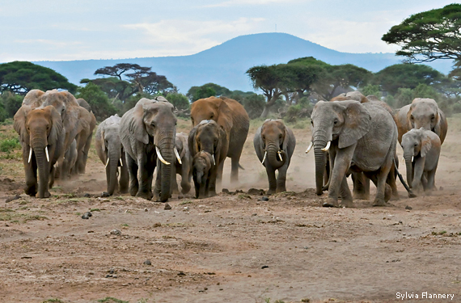
Population
A group of organisms of the same species in an ecosystem

Slide 8
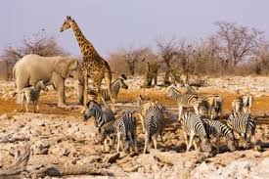
Communities
A group of organisms of different species in an ecosystem

Slide 9
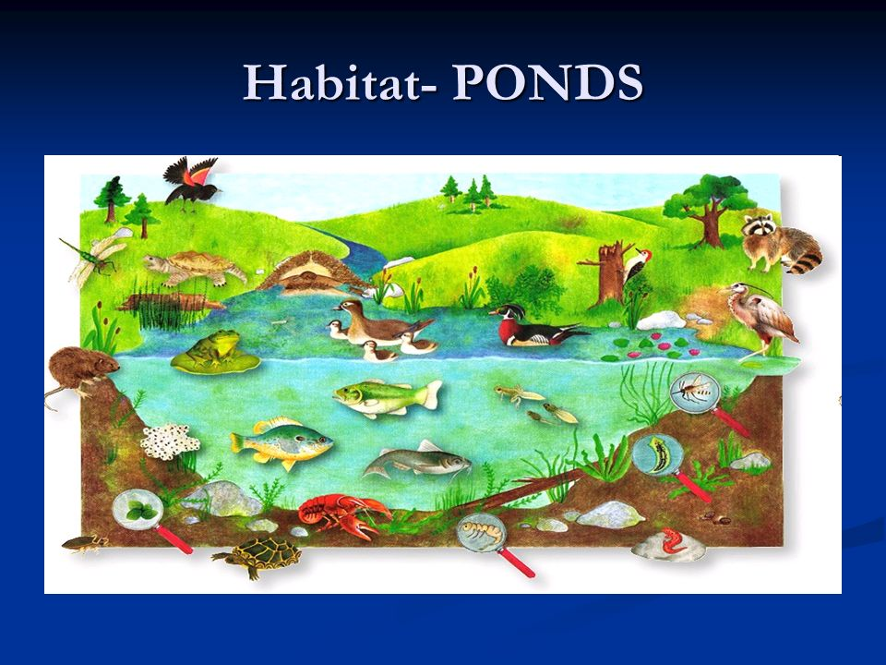
Habitat
The natural home or environment of a plant, animal or other organism.

Slide 10
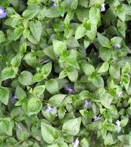
Producer
Plants that get energy from the sun through photosynthesis. Producers make their own food.

Slide 11
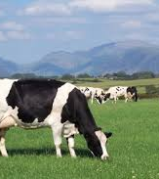
Consumer
An organism that gets energy from eating other organisms.

Slide 12
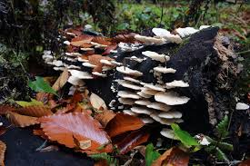
Decomposer
An organism that breaks down the cells of dead plants and animals

Slide 13
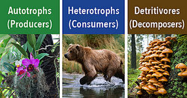
Biotic
Living things in an ecosystem

Slide 14
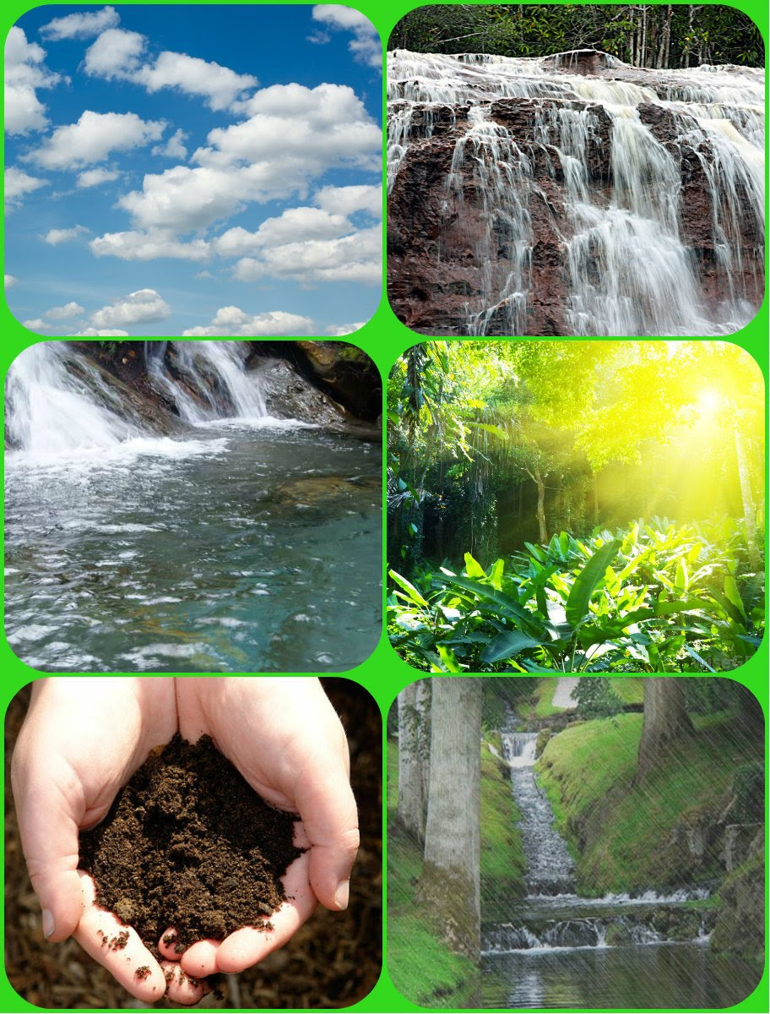
Abiotic
Non-living things in an ecosystem

Slide 15
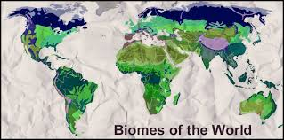
Biome
A large region with specific climate and certain plants and animals

Slide 16
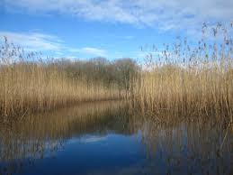
Aquatic Ecosystems
An ecosystem in a body of water (estuaries, salt marshes, oceans, lakes, ponds)

Slide 17
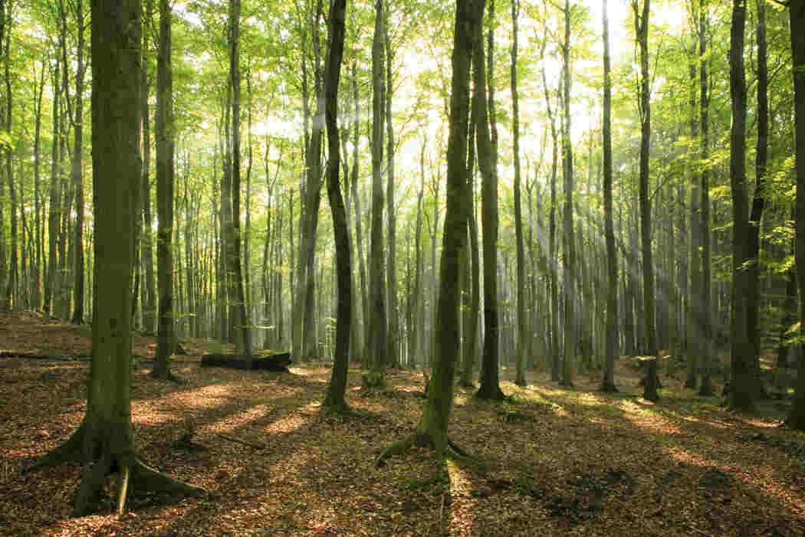
Terrestrial Ecosystem
An ecosystem on land (temperate/ deciduous forest, rainforest, grasslands/ savannas, taiga, tundra, desert).

Slide 18
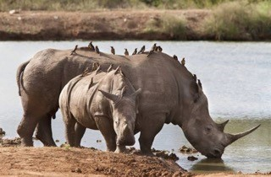
Mutualism
A mutualistic
relationship is when two organisms of different species “work together” each benefiting from the relationship

Slide 19
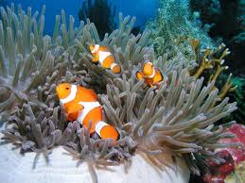
Symbiosis
Any of several living arrangements between members of two different species, including mutualism, commensalism, and parasitism (at least one organism benefits)

Slide 20
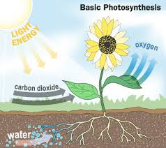
Photosynthesis
Photosynthesis is the process though which plants use water, light and carbon dioxide to create their food and release oxygen into the air.

Slide 21
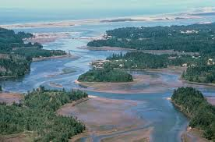
Estuary
An estuary is a partially enclosed, coastal water body where freshwater from rivers and streams mixes with salt water from the ocean

Slide 22
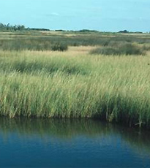
Salt Marsh
Salt marshes are coastal wetlands that are flooded and drained by salt water brought in by the tides.

Slide 23
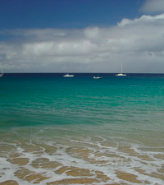
Ocean
An area of salt water which surrounds a land mass

Slide 24
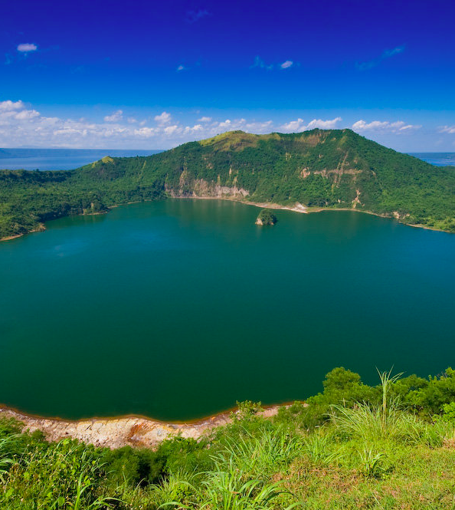
Lake
A body of fresh water completely surrounded by land

Slide 25
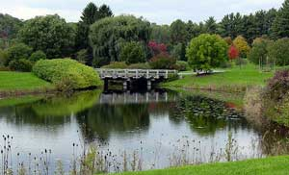
Pond
A body of freshwater, smaller than a lake, sometimes artificially formed

Slide 26
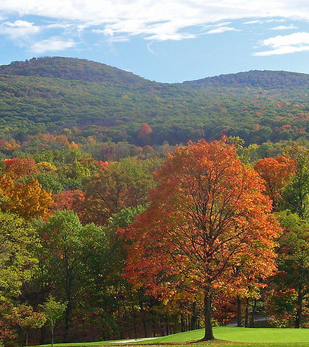
Deciduous/ Temperate Forest
A forest in which the leaves fall off the trees when the winter comes. This forest experiences all four seasons.

Slide 27
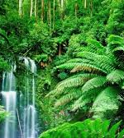
Rainforest
A forest with heavy annual rainfall. Thick canopy prevents sunlight from reaching forest floor.

Slide 28
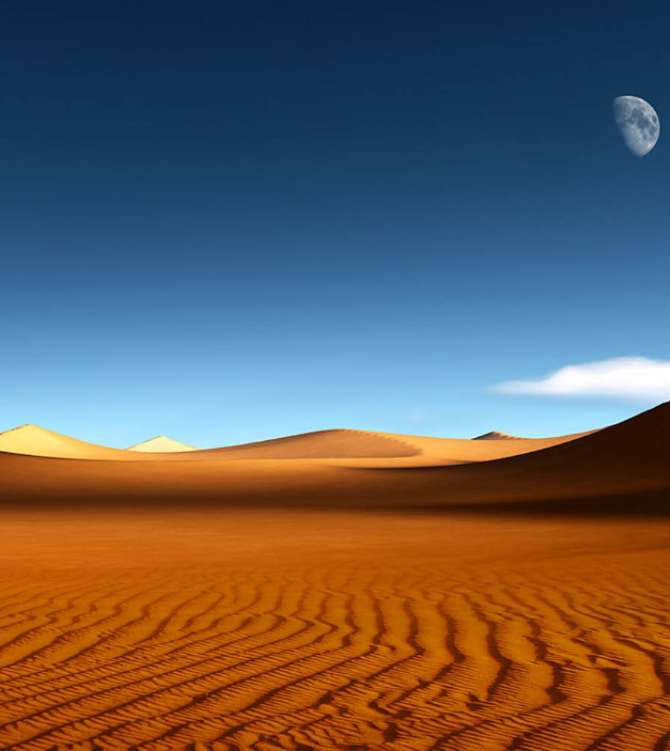
Desert
Hot and dry area with little or no rainfall

Slide 29
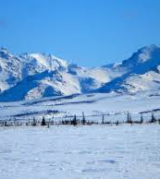
Tundra
A vast treeless plain in the Arctic regions where the ground is covered in permafrost

Slide 30
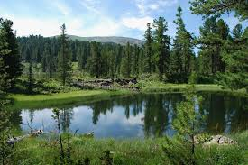
Taiga
The largest terrestrial biome on Earth, also known as the coniferous forest because of the abundance of pine trees.

Slide 31
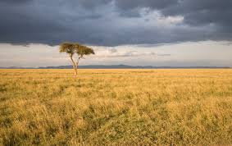
Grasslands
Land dominated by grasses rather than shrubs and trees

Slide 32
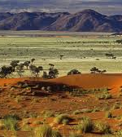
Savanna
A rolling grassland with scattered trees and shrubs

Slide 33
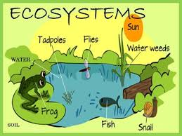
Ecosystem
Living and nonliving parts of the environment in a specific area

Slide 34
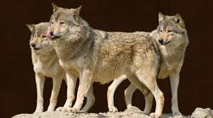
Carnivore
A consumer that eats only meat for energy.

Slide 35
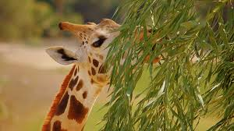
Herbivore
A consumer that eats only plants for energy.

Slide 36
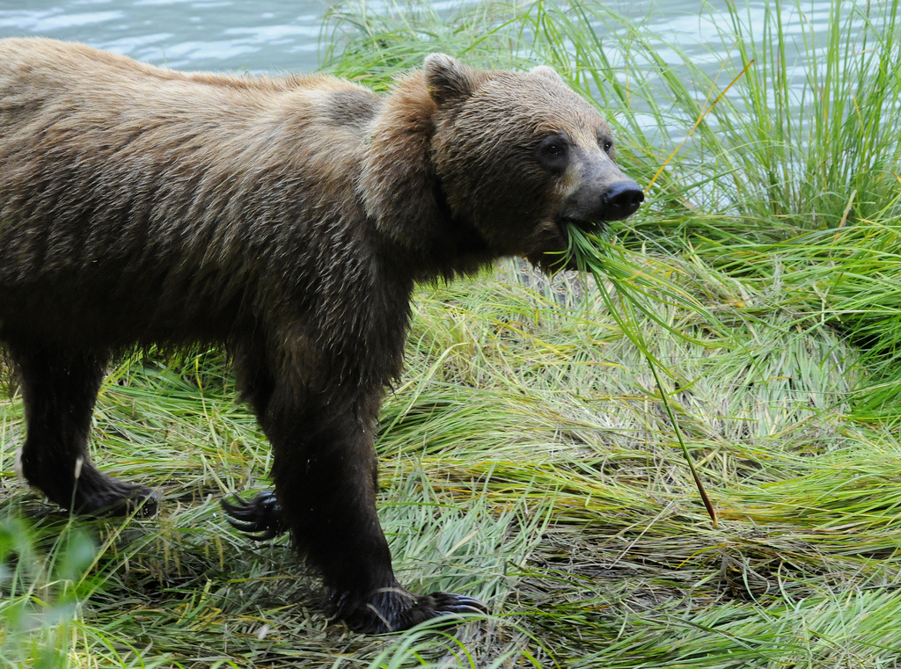
Omnivore
A consumer that eats both plants and animals for energy.

