Slide 1

Economy and Me!
View the following power point and take notes to help you understand economies.

Slide 2
What is economy?
Every country, region, state and city has an economy. The economy determines if the area is poor or wealthy. Economy is, the wealth and resources of a country or region having to do with the production (making) and consumption (using) goods and services.

Slide 3

Economies deal with three major issues:
What (good or service) is produced?
How it is produced? (businesses, industry)
Who gets what is produced? (consumer, or people)

Slide 4

So….what is a good and what is a service? Can you tell from the pictures below?

Slide 5


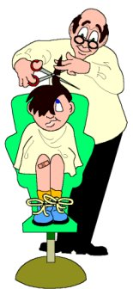


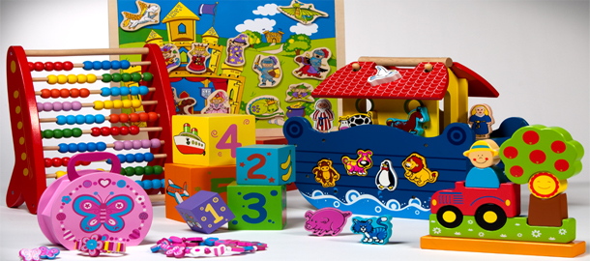
Goods and Services
Goods
Services

Slide 6
Good – Something you buy and consume, or use. They are things that you can keep, eat or use.
Service – Something that someone does for you. When you buy a service, you hire someone to do the work for you. You are not buying something you can touch or hold.

Slide 7
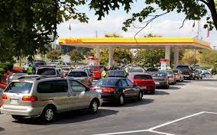
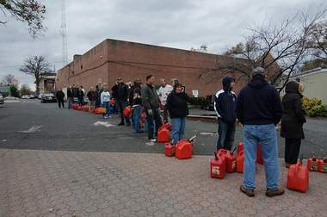
Most economies are determined by supply and demand of products. How much of a product is available and do the consumers, or people want or need that product.

Slide 8
Look at the pictures on the previous slide. What product do you think is in demand?
By looking at the picture do you think there is an abundance, more than enough or a shortage, not enough of this product? Do you think the cost of the product is high or low?

Slide 9
Supply is the amount of goods available at a given time. If there is a lot of something available for sale, the supply is high. A scarcity means that there isn’t enough of something available for sale.
Demand is how many people want the goods that are available. If many people want the goods available, there is a high demand. If not many people want the goods available, there is a low demand.

