Slide 1

EXPLORING SPACE
GUIDED NOTES:

Slide 2

EXPLORING SPACE
NOTES:
What are the first things that come to mind when you hear the term “Space Exploration”?
Why do you think people have always wanted to study and explore outer space?
Uummm…

Slide 3
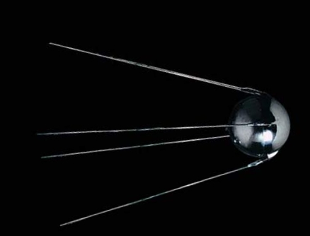
EXPLORING SPACE
NOTES:
An American, Robert Goddard launched the first rocket in 1926.
After World War II, the U.S.A. formed NASA to compete with the Soviet Union in the space race (a competition between the Soviet Union and the U.S.A.).
NASA – National Aeronautics and Space Administration.
The first satellite launched was Sputnik 1 in 1957.
A satellite is a natural or artificial body that revolves around a planet.
Arnold

Slide 4

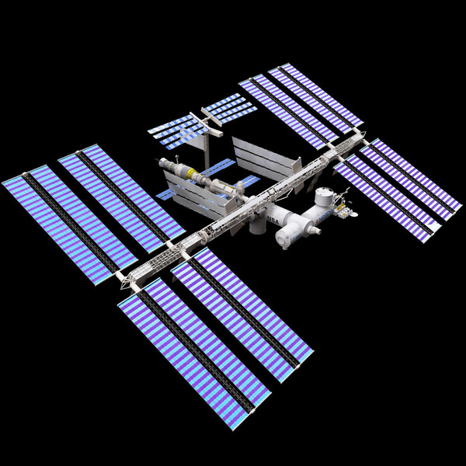
EXPLORING SPACE
NOTES:
Yuri Gagarin – 1st human to orbit Earth.
1969 – Apollo 11 lands on moon (USA- First on the moon).
Neil Armstrong – First person to walk on the moon.
Columbia – The first space shuttle launched in 1981.
June 18, 1983 – Sally Ride is the first American woman in space.
1998 the International Space Station started to be assembled by the U.S.A and Russia.
STS 119
STS 119 Landing
Challenger
Mars

Slide 5

WHY IS EXPLORING SPACE IMPORTANT?
NOTES:
Space Exploration Has Given Us
New Viewpoints.
Throughout history, the study of stars and planets has inspired new ideas. As we meet the challenges of space exploration, we gain valuable technology.

Slide 6

WHY IS EXPLORING SPACE IMPORTANT?
NOTES:
Space science has advanced knowledge in other scientific fields, such as physics. For example, observations of the Moon and other bodies in space helped scientists understand how gravity works. Scientists figured out that the same force that causes an object to fall to the ground causes the Moon to orbit Earth.

Slide 7

WHY IS EXPLORING SPACE IMPORTANT?
NOTES:
Finally, the study of other worlds can teach us about our own. Earth has changed considerably since its formation. By comparing Earth with different worlds, scientists can learn more about the history of Earth’s surface features and atmosphere.

Slide 8
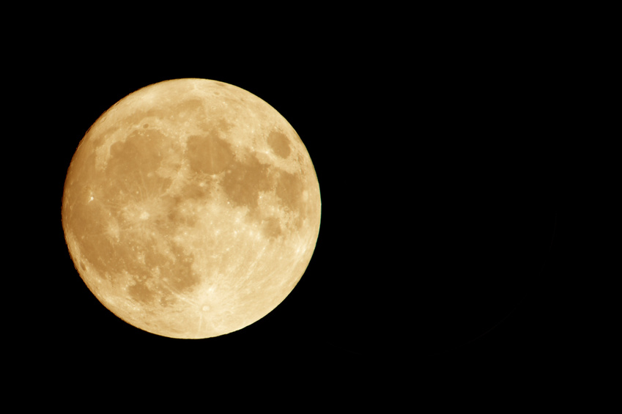
WHY IS EXPLORING SPACE IMPORTANT?
NOTES:
Surface Features
Exploration of other worlds has helped us learn about the impacts of space objects. When an object strikes the surface of a larger object in space, it explodes and leaves behind a round pit called an impact crater.

Slide 9

WHY IS EXPLORING SPACE IMPORTANT?
NOTES:
Atmosphere
We are also learning about Earth’s atmosphere from space exploration. Earth’s temperature allows liquid water to remain on the surface. Mars and Venus, the planets closest to Earth, have no liquid water on their surfaces. By comparing Earth with those planets, we can see how liquid water has affected the development of Earth’s atmosphere.

Slide 10
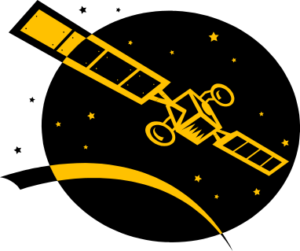
WHY IS EXPLORING SPACE IMPORTANT?
NOTES:
Satellite Views of Earth
One of the most important benefits of space exploration has been the development of satellite technology. Satellites collect data from every region of our planet. The data are sent to receivers on Earth and converted into images. Scientists have learned from the space program how to enhance such images to gain more information.
Satellite

Slide 11

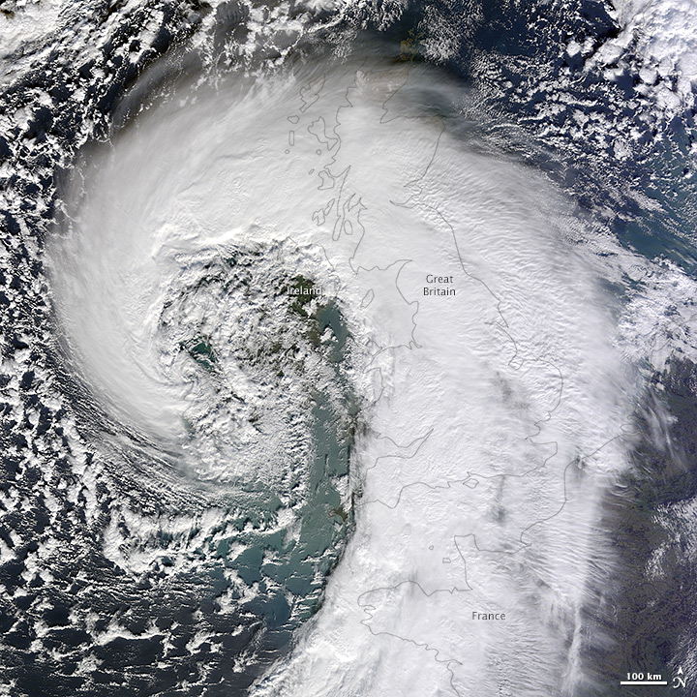
WHY IS EXPLORING SPACE IMPORTANT?
NOTES:
Weather satellites show conditions throughout Earth’s atmosphere. Images and data from weather satellites have greatly improved weather forecasting. Scientists can now provide warnings of dangerous storms long before they strike populated areas.
Live
Weather
Weather

Slide 12
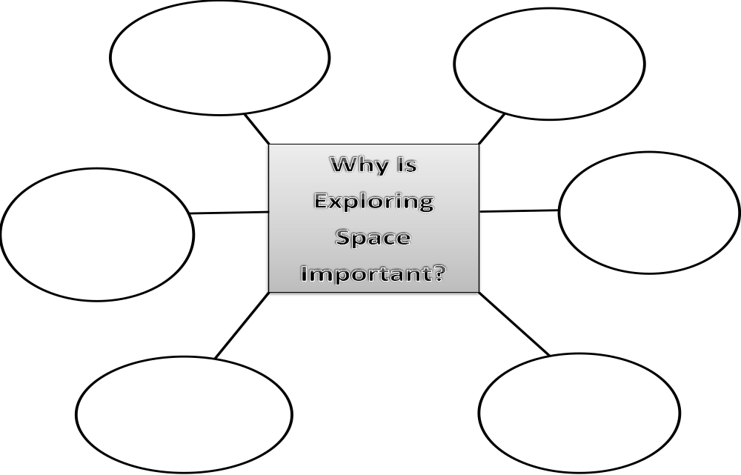
Fill In The Diagram!

Slide 13
Directions: The correct answer is given for the question below (in yellow). Explain how you know this answer is correct. Use evidence from your notes to justify the answer.
Which represents information that is gained as a result of space exploration?
  weather and climate patterns that occur on Earth
  existence of the sun and the moon in the solar system
  how to use coal and natural gas as energy resources
  location of plates found upon Earth’s surface

