Slide 1
Distance-Time Graphs Intro
Use this powerpoint to complete the guided notes.

Slide 2
Motion
A change in position measured by distance and time.

Slide 3
Speed
The rate at which an object moves.
Speed = Distance/Time

Slide 4
Velocity
Tells the speed and direction of a moving object

Slide 5
Acceleration
The rate speed or direction changes

Slide 6
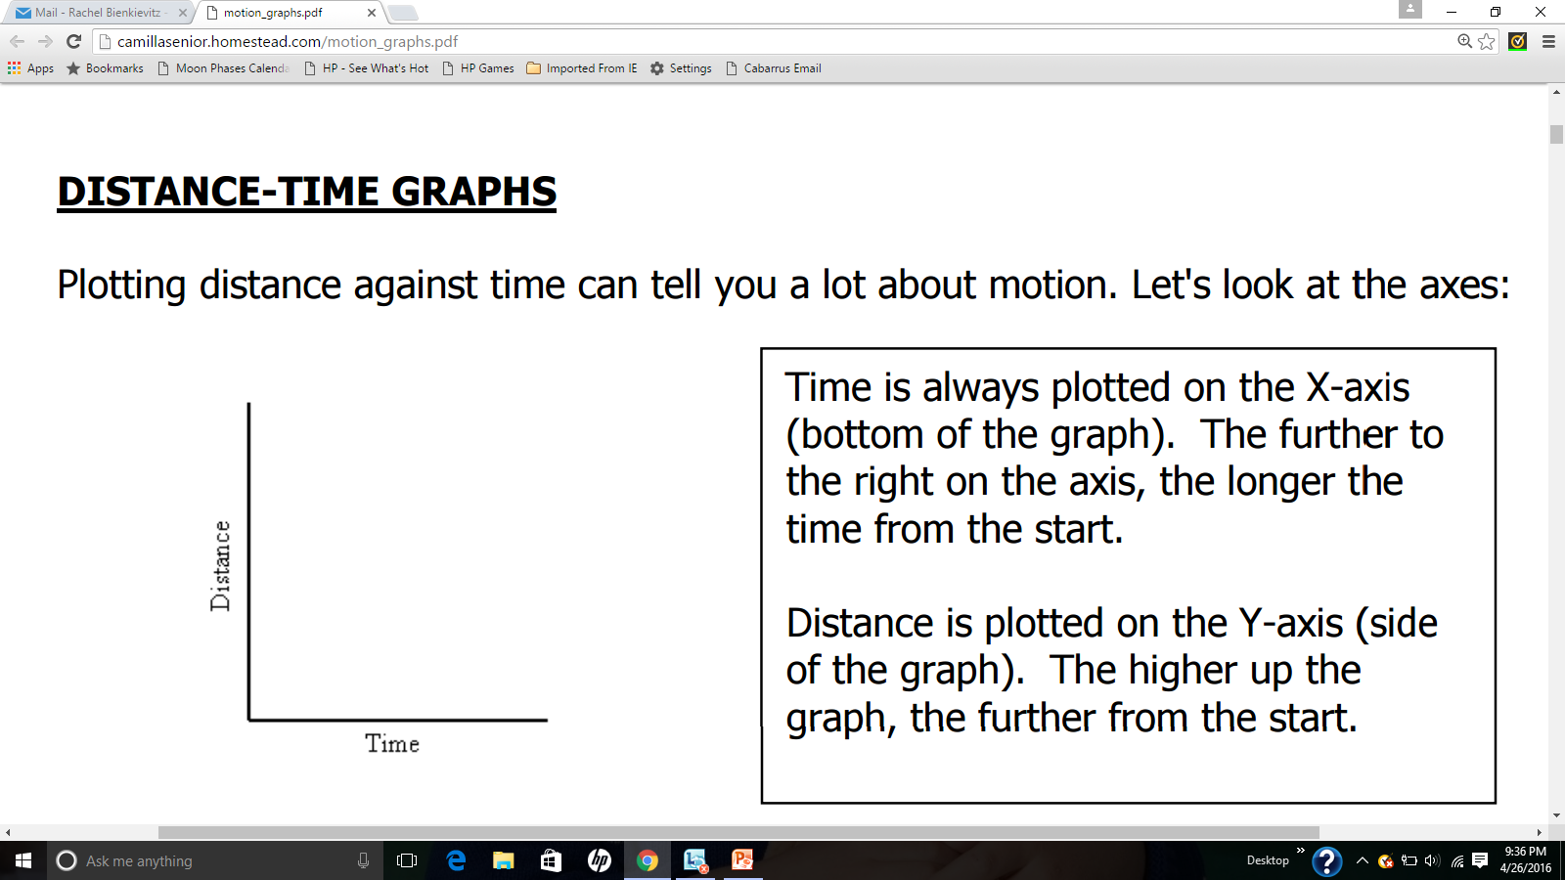
Distance vs. Time Graphs

Slide 7
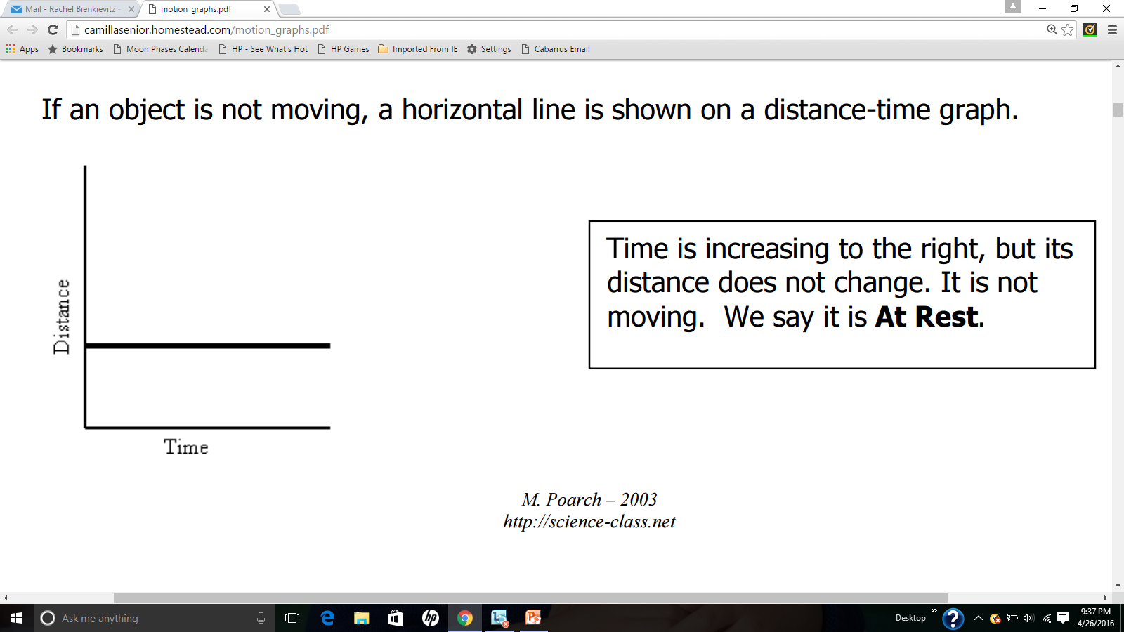
If an object is not moving, a horizontal line is shown.

Slide 8
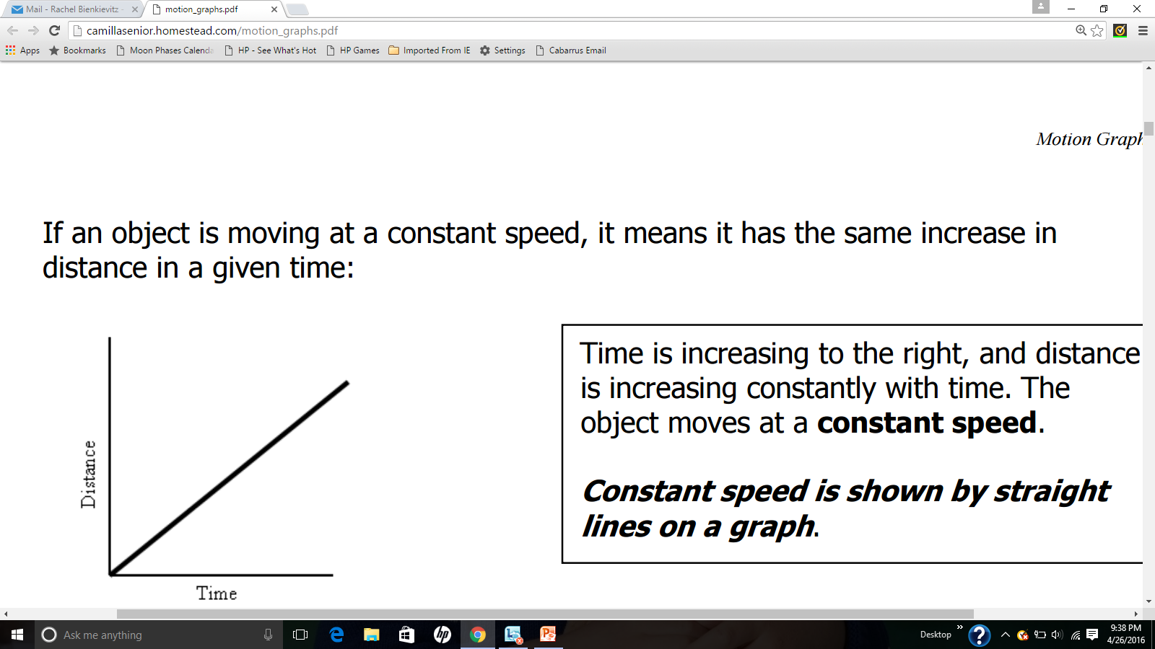

Slide 9
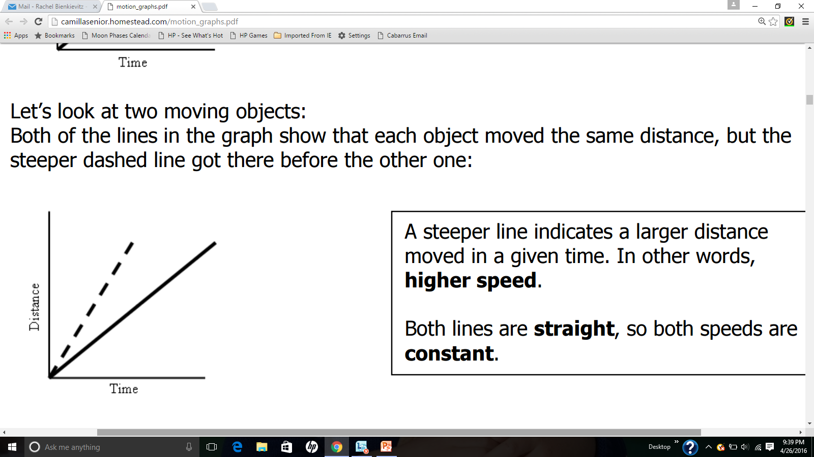

Slide 10
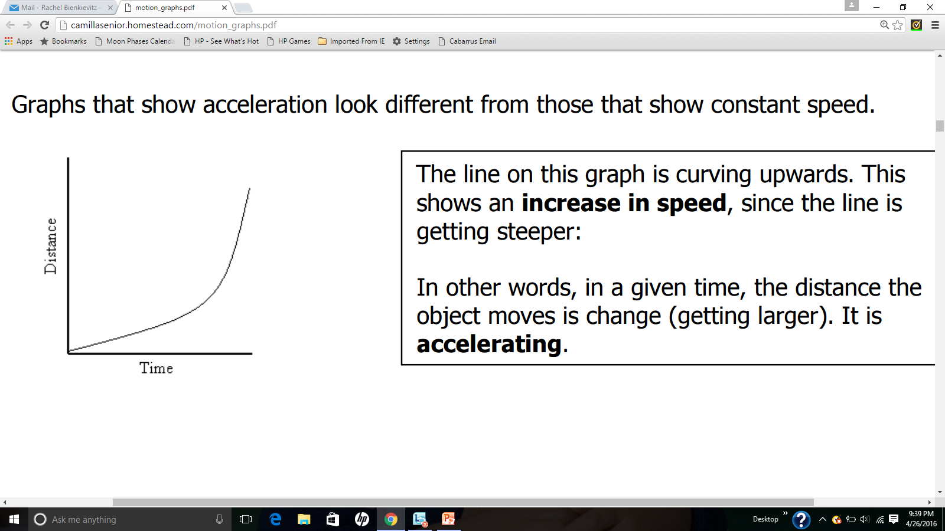

Slide 11
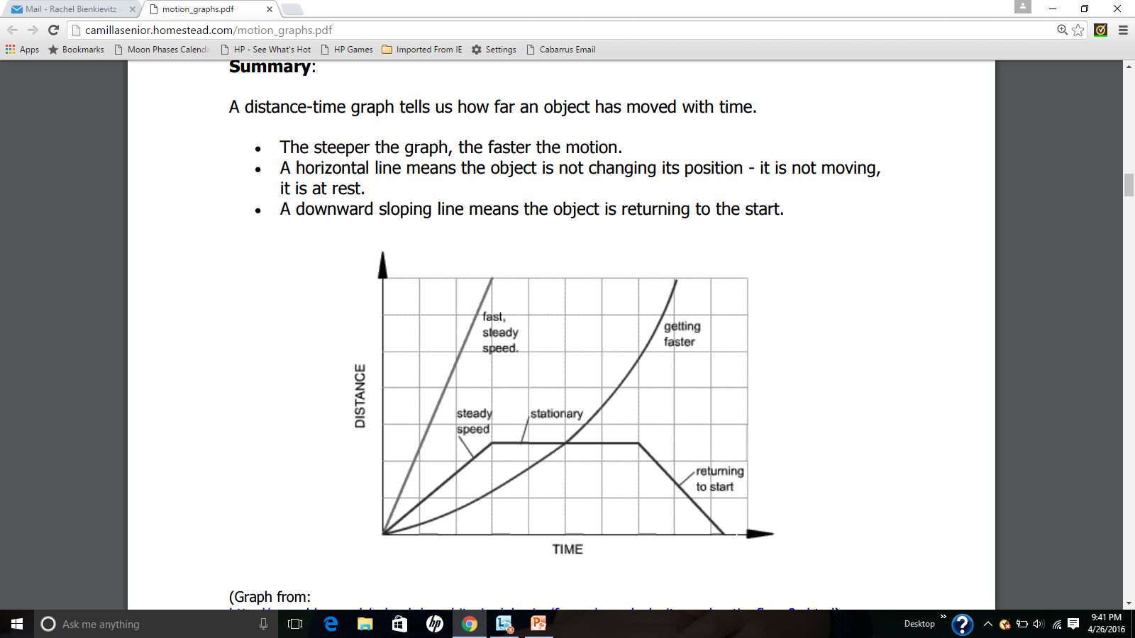

Slide 12
