Slide 1
Directions:
Complete your first journal entry, you can create any imagery as long as it relates to Comic Books.
Choose one the 7 elements of art and create a mini-poster featuring that element.

Slide 2
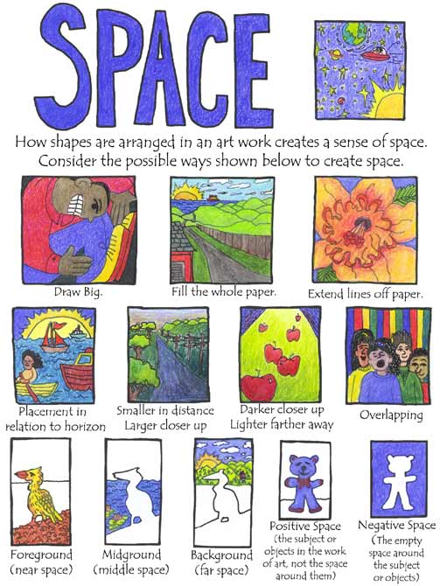
Mini Poster guidelines
Make sure you include:
Title
Descriptions
Visual Examples of your element
Tips:
Lightly write or block out with a pencil first.
Use a ruler
Check the examples located at the end of this slide show.
Check for spelling errors.

Slide 3
