Slide 1

Digital Citizenship
Technology Tips and Safety for Parents and Teens

Slide 2








Social Networks
Social Networks are internet applications which are used to facilitate communication between users. Some of the most popular among teens include:
  Facebook
Snapchat
Vine
Twitter
Ask.fm
Skype
Kik Text Message App

Slide 3
Vine
Vine is a video-sharing app. It’s designed in a way for you to film short, separate instances so they can be linked together for a total of six seconds. Each short video plays in a continuous loop and can be shared through social media sites.
*Click on icon
KIK
KIK Messenger is a free texting app available for iPhones, Android, Windows, and Blackberry phones. Remember, you don't need a phone to use iPhone apps; if your child has an iPod touch or an iPad, they can install iPhone apps.
Snapchat
You may have heard about Snapchat, the mobile app that allows users to capture videos and pictures that self destruct after a few seconds. When a user sends a message they get to decide whether it will live for between 1 and 10 seconds. After that it’s history, probably.
Screen Shots Are Possible
Photos can be undeleted, just like PC files.

Slide 4



Instagram
Instagram is an online photo-sharing, video-sharing and social networking service that enables its users to take pictures and videos, and share them on a variety of social networking services, such as Facebook, Twitter, Tumblr and Flickr. ...
Facebook
Facebook is a social networking site that allows users to connect with other users.
Twitter
Twitter is a social networking site that allows users to send “tweets” up to 140 characters.
Ask FM
Ask.fm is a Latvia-based social networking website where users can ask other users questions, with the option of anonymity. This website is set up in a question and answer format that is very popular with teens and tweens. It has received lots press attention lately and was referenced in bullying cases across the United States.
Skype
This application enables users to have video conversations through the use of webcams.

Slide 5
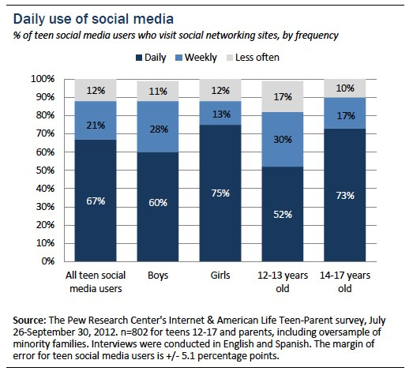

Slide 6

Social Media Use
Teens are using social media to:
  Interact with other social media users
  Post photos and videos
  Comment on photos and videos
  Share information
  Send private and group messages

Slide 7
Inappropriate Social Media Use
Posting/Sharing photos or videos that are inappropriate, embarrassing, or do not belong to you
Communicating Threats
Engaging in any behavior that could be considered cyberbullying
Interacting with someone you have never met in person
Giving out personal information such as address and phone number or any information that could be used against you or someone else in a harmful way

Slide 8

Cyberbullying
Bullying through Internet applications and technologies such as instant messaging (IM), social networking sites, and cell phones.
Cyberbullying 1

Slide 9
Did you know…
Misuse of technology could lead to legal consequences.
GS 14-458.1A Class 2 Misdemeanor: To use a computer or computer network to do the following: build a fake profile or website, posing as a minor, posting or encouraging others to post private, personal, or sexual information, post a real or doctored image of a minor on the internet
Students could face consequences at school if the incident negatively impacts the school environment, even if it occurred outside of school.

Slide 10
What should I do if this happens?
Take screen shots to document the bullying or print evidence online.
Protect your child. Delete accounts or take other appropriate steps to ensure the bully does not have access to your child. Make sure you do not delete evidence until the incident has been investigated.
Report the incident to the appropriate authorities.
Talk to your child about the emotional effects of the incident.

Slide 11

Reporting Inappropriate Activity
Does the incident pose physical or emotional danger to my child or others?
  Report the incident to the School Resource Officer or to local law enforcement
  CRIMESTOPPERS TIP BOX located outside the cafeteria and names are kept anonymous

Slide 12
Patriot Prevention
Classroom Guidance Lessons are taught by grade level counselors each year that address bullying and cyberbullying
G.R.E.A.T. Classes are taught by the School Resource Officer in 7th grade: decision making, peer pressure, conflict resolution, anger management
Health Classes focus on bullying, personal boundaries, and emotional health
School-wide report system located on Harris Road Middle School Website

Slide 13

Parent Tips
#1. Create Awareness
  Talk to your child about dangers on the internet.
  Share stories and news reports about online activity
Notes:
Though, at times, it can feel that technology causes more problems in our homes than anything else, it also offers a tremendous opportunity to connect with our teenagers during what can be turbulent years in any parent-child relationship.
Take texting. “When I see parents who are willing to connect with their kids in this way, those relationships tend to go much more smoothly,” Duffy says. “Even if it’s just, ‘I love you,’ or, ‘Hey how is your day going?’ it’s a great touchstone from parent to child.”

Slide 14

Parent Tips
#2. It’s Your House; Set Rules.
The best way to help teenagers manage their use of technology—and to reduce the chance that technology will be a source of conflict—is to set rules for technology use in your house.
Just like establishing rules for driving or curfew or anything else, parents need to make those rules clear—and use consequences to enforce them

Slide 15

Parent Tips
#3. Monitor Online Activities
Make it your job to have some idea what your teenagers are doing with their devices. But, be upfront about it.
Use privacy controls on all accounts.
Check App Store account frequently to see what apps have been downloaded or purchased.
Notes:
“I run into parents who don’t want their kids to know that they are monitoring them, so they find themselves snooping and then snooping becomes the issue, and the parent doesn’t have a leg to stand on in terms of the actual issue at hand,” Duffy says.
Stress to your teenagers that your expectation is that they will not do anything online or by text that they wouldn’t feel comfortable sharing with you. Friend them on Facebook, follow them on Twitter, and tell them that if you feel it’s necessary, you will spot-check their texts or email. Tread carefully. You can lurk, but resist commenting on your teenager’s status updates. If you feel you need to talk to your teenager about their online behavior, take it offline.
Your goal: To ensure that your teens’ overall lack of experience—and occasional impulsivity—doesn’t land them in trouble. Take sexting, which can include sending explicit pictures via text message. Being in possession of a nude picture of a minor—even if it’s your teenager’s long-time girlfriend—is against the law. Yet, teenagers continue to sext.

Slide 16
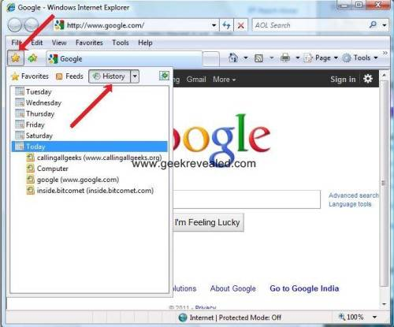
Check History
A list of websites the people using a particular computer have visited. Check your children’s website history to see what sites they have visited.

Slide 17
Resources
Facts & Statistics on Teens & Technology - Also check out the links for parents and teachers
99 Texting Acronyms Every Parent Should Know
Texting: 30 Teen Slangs Parents Should Know
Taking Charge of Technology
Set Up Parental Controls Article
Set Up Parental Controls Video

