Slide 1
Decimal Review

Slide 2
1
I have 42 meters of wood. I’m going to cut it into pieces that are 0.6 meter long. How many pieces can I cut?

Slide 3
2
David had $12.58.
-He purchased 5 carrots for $1.53 each and one bottle of juice for $1.76.
-There was no sales tax
How much money did David have after his purchase?

Slide 4
3
Ms. Graybeal traveled 0.5 mile. Mr. Richter ran for For 0.4 of that distance. How much of a mile did Mr. Richter run?

Slide 5
4
Adaya ran 4.6 miles. Lily ran 1.3 times as far as Adaya. How far did Lily run?

Slide 6
5
You have two apples. You split them into 0.5 pieces of an apple. How many pieces was I able to cut?

Slide 7
A leopard can run 240 times faster than a Three Toed Sloth. How fast can a Leopard run?
Animal | Maximum Speed (mph)
Lion | 50.5
Human | 27.89
Three Toed Sloth | 0.15
Garden Snail | 0.03
6

Slide 8
7
Ms. Culbreth has 0.24 liter of Dr. pepper. She is sharing it between 3 people. How much Dr. Pepper will each person get?

Slide 9
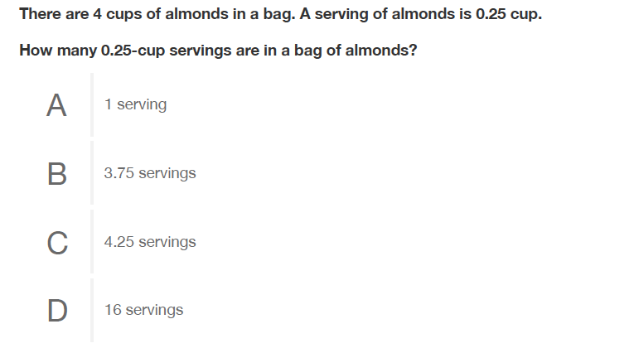
8

Slide 10
9
At a local food truck, tacos cost $0.54 per pound. How much will 3.5 pounds of tacos cost?

Slide 11
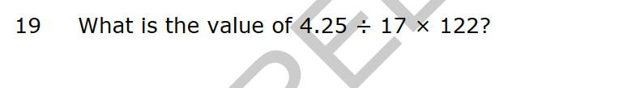
10

Slide 12
11
Mara loves apple picking. She picked a total of 3.5 pounds of apples and paid $14. How much does each pound cost?

