Slide 1
Chapter 33
The Reagan Era

Slide 2
Recap
How is Gerald Ford unlike any other President?
What problems did Jimmy Carter inherit? (can you name at least 2?)
How was Jimmy Carter’s Presidency a success?
What event is said to have cost Jimmy Carter re-election?

Slide 3
Are you a liberal or a conservative?
Protecting the environment is a primary social responsibility we have, regardless of how it effects businesses.
A. Not Exactly
B. True

Slide 4
Liberal or conservative?
Immigration policies
A. Should be more strict. Too many people enter illegally.
B. Should be less strict. Immigrants enhance this country.

Slide 5
Liberal or Conservative?
Gay marriage
A. Should not be legal. Marriage is between a man and a woman.
B. Should be legal and given the same rights as heterosexual marriage.

Slide 6
Liberal or Conservative?
Taxes should be...
A. Cut to stimulate the economy and give people more of their money back.
B. Increased to help the government pay for programs and state/federal employees.

Slide 7
Liberal or Conservative?
Everyone has a right to health care, even if they can't afford it
False
True

Slide 8
Liberal or Conservative?
Abortion should be...
A. Restricted, discouraged, or illegal
B. Completely legal and available

Slide 9
Liberal or Conservative?
The death penalty
A. Is appropriate in select cases
B. Is a violation of human rights

Slide 10
Liberal or Conservative?
The war in Iraq is justified
A. True
B. False

Slide 11
Liberal or Conservative?
The problem with the US justice system is:
Too many plea bargains and loose interpretations of law
Not enough rehabilitation and prisoner's rights

Slide 12
Liberal or Conservative?
Affirmative action
A. Is unfair, outdated, and hurts those with the most merit
B. Gives minorities and women a level playing field

Slide 13
Liberal or Conservative?
RESULTS TIME!!!
Count the number of times you answered A. Now count the number of times you answered B.
If you have mostly A’s- you are a conservative!
If you have mostly B’s- you are a liberal!
Were you surprised?

Slide 14
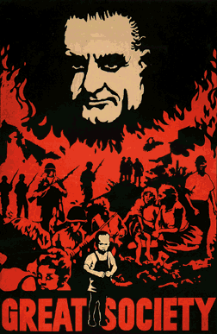
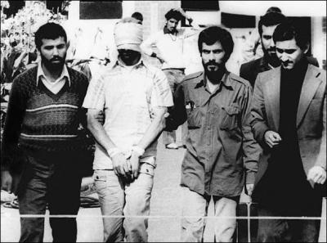
As the 1980 presidential election approached, why was America a nation ready for change?
Low Spirits
People lacked confidence in government.
The turbulent 1960s, Watergate, the Soviet invasion of Afghanistan, the Iranian Hostage crisis (1979), and long gasoline lines put Americans in an uneasy mood.
A conservative movement that opposed liberal social and racial policies was growing.

Slide 15
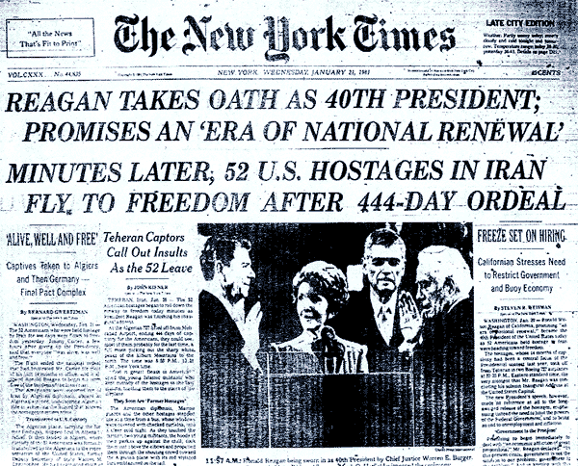
Iran Hostage Crisis

Slide 16
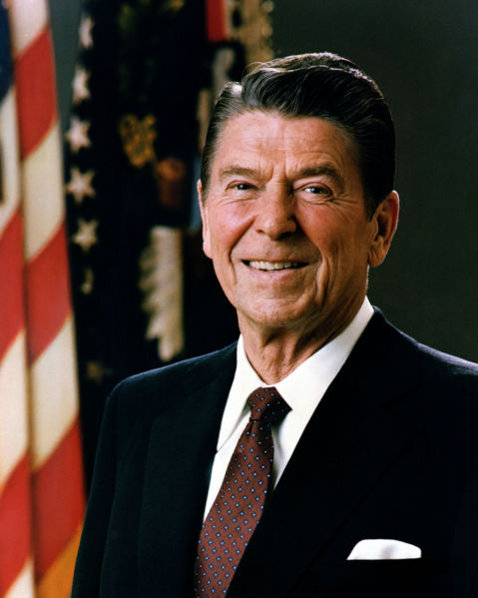
The 1980 Election
Reagan promised to return the country to a simpler time of conservative moral values.
Focused on “family, work, neighborhood, peace, and freedom.”
Reagan asked if people were better off than they were four years ago.
Reagan and his running mate, George H.W. Bush, won in a landslide; Republicans also gained control of the Senate.

Slide 17
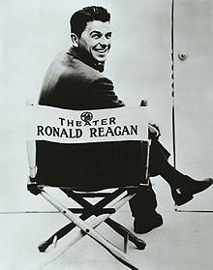
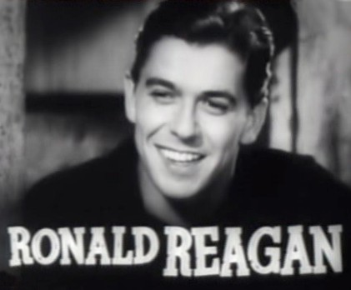
The Reagan Revolution
Began his political life as a Democrat
In 1962 he shifted to the Republican Party.
In 1966 he became the governor of California.
  Attempted to cut the size of government in Cali.
  After two terms as governor, he decided to run for president
Reagan was the hero of a growing movement called the New Right.
His powerful personality, optimism, and acting skills drew many Americans—even Democrats—to his side.

Slide 18
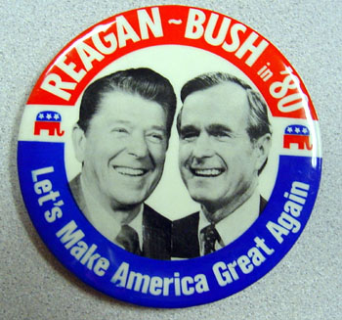
The New Right Emerges
Opposed
  Abortion
  Equal Rights Amendment
  Affirmative Action
  Gun control
  Homosexual rights
Supported
  School prayer
  Stronger Military
  Small Government
  Lower taxes

Slide 19
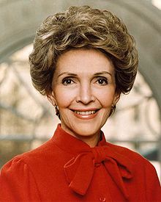
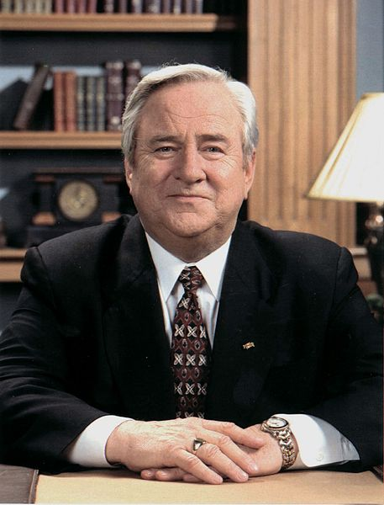
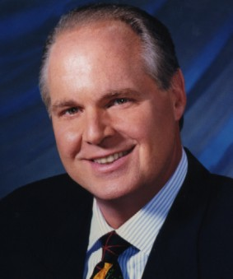
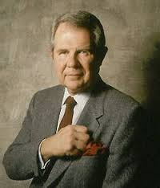
Reagan’s Allies
Religion
The New Right grew in influence with the rise of televangelism.
One leader of the New Right, Rev. Jerry Falwell founded a political activist organization called the Moral Majority in 1979.
Nancy Reagan
Reagan’s wife, Nancy Reagan, was one of his greatest allies.
She ran the White House, advised her husband, and fiercely protected his interests.

Slide 20
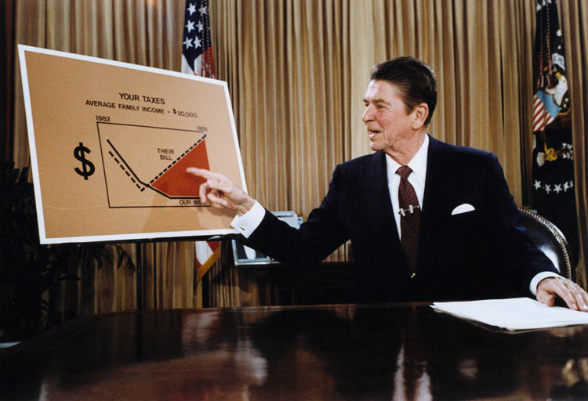
Economic Recovery
Reaganomics
  Reagan’s plan for tax and spending cuts
  Two goals
    Reduce taxes to stimulate economic growth
    Cut the federal budget
      Welfare, food stamps, job training
  Based on supply-side economics
    A.k.a. Trickle Down Effect
    Cut taxes at the top
        =
    Wealth, jobs created for the middle and lower class

Slide 21
The Effects of Reaganomics
Claimed the tax breaks benefited the wealthy and did not “trickle down” to the working class
Said that tax cuts combined with increased military spending would drive the federal deficit higher
Critics
of
Reaganomics
Vice President Bush had questioned plan to cut taxes and increase military budget during the Republican nomination race, calling Reagan’s plan “voodoo economics.”
“Voodoo
Economics”
During 1981 and 1982, the nation suffered the worst recession since the Great Depression. Unemployment at 10.1 %
Unemployment rose and government revenues fell.
Federal spending soared and the federal deficit skyrocketed.
1983, consumers went on spending spree, interests rates declined & inflation lowered
Recession
and
Recovery

Slide 22
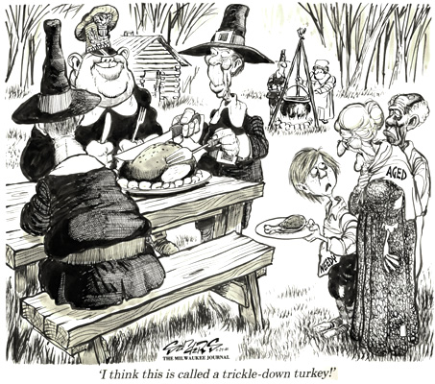

Slide 23
Reagan Assassination Attempt
http://www.youtube.com/watch?v=3Bj6aOgfcJU

Slide 24
Reagan and The Cold War
Rejected Containment and Détente
Wanted to destroy communism.
  Position worsened relations with the Soviets
  Critics of his policy called Reagan reckless
Reagan obtained massive increases in military spending.
  Much of the new spending went to nuclear weapons.
  Promoted the Strategic Defense Initiative (SDI)— lasers in space to protect the United States against incoming Soviet missiles.
    Critics called this Star Wars and said it wouldn’t work.

Slide 25
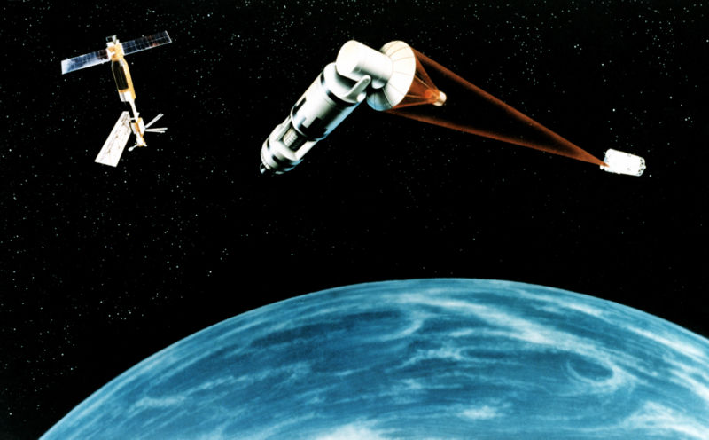
Star Wars

Slide 26
The Reagan Doctrine & Star Wars
http://www.youtube.com/watch?v=5-B7axhPwYg

Slide 27
A Thaw in the Cold War
The Soviet Union
By the late 1970s the Soviet economy was shrinking.
Industrial and farm production, population growth, education, and medical care all fell.
U.S.-Soviet Relations
A visionary leader came to power in the Soviet Union— Mikhail Gorbachev.
Believed the only way to save the Soviet Union was to strike a deal with the United States
Between 1985 and 1988 Reagan and Gorbachev met four times and produced the Intermediate-Range Nuclear Forces (INF) Treaty.
First treaty to actually reduce nuclear arms
INF Treaty destroyed a whole class of weapons (more than 2,500 missiles).

Slide 28
Trouble Spots Abroad
Lebanon
Muslim and Christian groups waged a civil war.
Israel invaded Lebanon to expel the PLO.
U.S. sent 800 peacekeepers.
A suicide bomber killed 241 marines.
Reagan withdrew the troops.
Grenada
1983 Communist coup stranded 800 U.S. students.
Cuba’s role and students’ safety concerned Reagan.
Reagan sent in soldiers who took the island in two days with a loss of 19 soldiers.
South Africa
Apartheid enforced legalized racial segregation.
Reagan’s policy was one of “constructive engagement” with the white minority government.
Congress overrode his veto and imposed trade limits and other sanctions.

Slide 29
Upheaval in Latin America
U.S-backed Anastasio Somoza Debayle was ousted by the Sandinistas—a Marxist group.
Reagan cut off aid to Nicaragua saying that the Sandinistas were backed by the USSR.
Reagan then allowed the CIA to equip and train a Sandinista opposition group called the Contras.
Congress cut off funds to the Contras and banned all further direct or indirect U.S. support of them.
Nicaragua

Slide 30
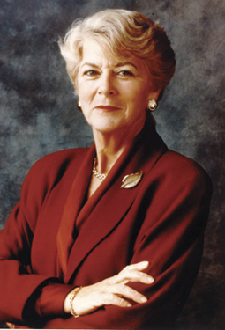
1984 Election
Reagan easily won re-election against Walter Mondale and Geraldine Ferraro, the 1st women on a major party ticket.
Reagan pointed to a strong economy under his leadership

Slide 31
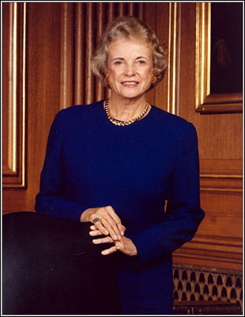
Judicial Power Shifts Right
Reagan and Bush appointed several conservative judges to Supreme Court
  Chief Justice William Renquist was the most conservative Chief ever
  Ended liberal control of court
Reagan appointed Sandra Day O’Connor- first woman on Supreme Court
Court restricted abortion rules, civil rights laws, and rights of the accused

Slide 32
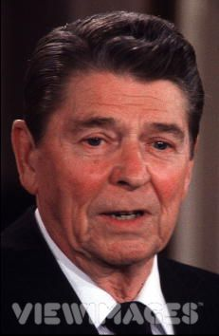
Iran-Contra Scandal
1983: Terrorists kidnap Americans in Lebanon
Reagan urged allies to not sell arms to Iran in their war with Iraq
1986: Reagan secretly approved the sale of arms to Iran in exchange for hostages
  Used profits to fund Contras

Slide 33
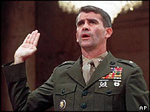
Iran-Contra Scandal
1987-88: Congress has hearings to investigate
  Lt. Col Oliver North found guilty for cover-up (later overturned)
  Members of Reagan administration found guilty but pardoned by President Bush

Slide 34
The 1988 Election
Wealthy, World War II pilot, congressman from Texas, U.S. ambassador to the United Nations, head of the C.I.A., and vice president
Republican nomination for president in 1988
George H.W.
Bush
Major civil rights leader and a liberal candidate who ran for the Democratic Party’s nomination
Won the most votes on Super Tuesday and had significant support from both white and black voters
Jesse
Jackson
Governor of Massachusetts who ended up winning the Democratic Party’s nomination
Running mate was Texas senator Lloyd Bentsen
Michael
Dukakis

Slide 35
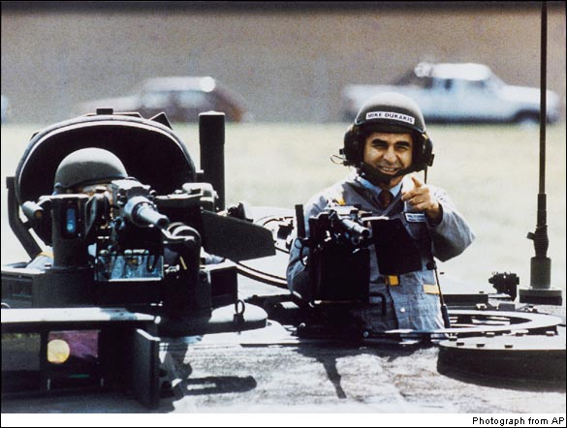
Dukakis

Slide 36
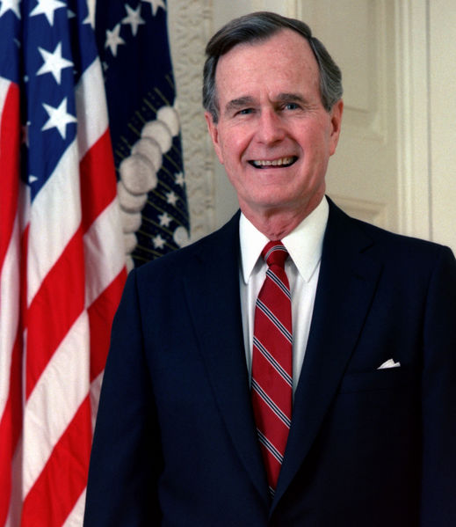
The 1988 Election
Low voter turnout (50.1 percent)
Most attribute low turnout to negativity of the campaign.
  Dukakis challenged Bush on the economy.
  Bush called Dukakis soft on crime and defense.
Bush won with the promise of no new taxes.

Slide 37
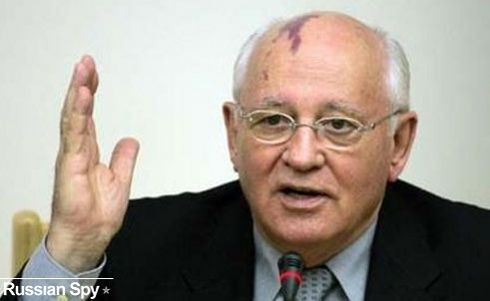
Gorbachev Rises
March 1985: Mikhail Gorbachev becomes head of Communist Party in Soviet Union
SU had a very bad economic situation
He begins to initiate drastic reforms

Slide 38
How did Soviet Society become more open?
Glasnost
Gorbachev announced a new era of glasnost, or “opening.”
Allowed public to criticize government
Gorbachev held press interviews.
Slowly Soviet citizens began to speak out.
They complained about the price of food, of empty store shelves, and of their sons dying in Afghanistan.
Perestroika
Gorbachev began the process of perestroika, the “restructuring” of the corrupt government bureaucracy.
Dismantled the Soviet central planning system
Free elections took place in 1989.
Withdrew from Afghanistan
Visited with China to ease tensions between the nations
Attempted to cover up the Chernobyl nuclear accident

Slide 39
The Collapse of the Soviet Union
The call for glasnost and perestroika awakened a spirit of nationalism in the subject nations of Eastern Europe.
Gorbachev knew the USSR could not support the ailing Eastern European economies.
He ordered a large troop pullback from the region and warned leaders to adopt reforms.
Revolutions swept across Eastern Europe in the late 1980s.

Slide 40
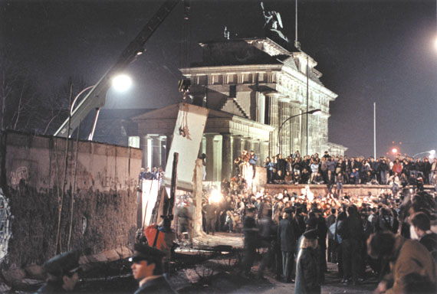
Fall of the Berlin Wall
Gorbachev encouraged European communist nations to move to democracy
Oct 1989: East Germany get rid of commie government
Nov 9,1989: Berliners tear down Berlin Wall
Czechoslovakia, Latvia, Hungary left SU
Yugoslavia left but ethnic conflicts hindered a smooth transition

Slide 41
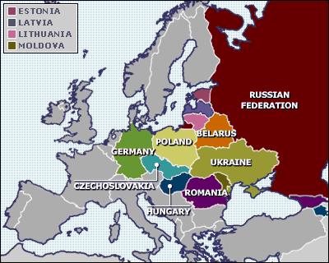
Soviet Union Declines
Dec 1991: 14 non-Russian republics declare independence from SU
Gorbachev forced to resign because reformers thought he was moving too slowly
Feb 1992: Bush and Boris Yeltsin (new Russian President) announce Cold War has ended

Slide 42
Global Conflicts near the end of the Cold War
China: Democracy Crushed
Chinese students called on their Communist leaders to embrace reforms.
Led huge pro-democracy demonstrations that filled Tiananmen Square.
Tanks surrounded the protesters and opened fire.
Hundreds of unarmed people were killed .
Bush announced an arms embargo.
Panama: A Dictator Falls
Colonel Manuel Noriega was a brutal dictator.
The United States tried to indict him for drug smuggling.
In 1989 Noriega declared a state of war with the United States.
Noriega’s soldiers killed a U.S. marine
Bush ordered an invasion of Panama. (War on Drugs)
Troops arrested Noriega and took him to Florida.

Slide 43
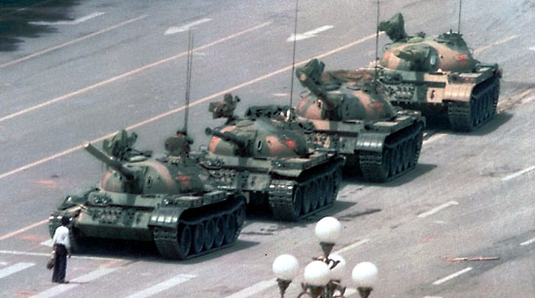
April 1989: Tiananmen Square
http://www.youtube.com/watch?v=u64A1x9WU44

Slide 44
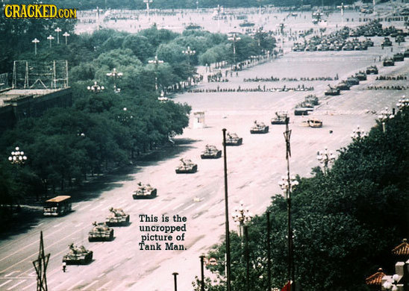

Slide 45
Other Bush Era Conflicts
The Persian Gulf War
Iraq’s Saddam Hussein invaded Kuwait in 1990.
The attack shocked the United States—who depended on the region’s oil—and other Arab nations.
Reports of atrocities by Iraqi troops surfaced.
The UN imposed sanctions but the deadline passed.
ON January 16, 1991, the U.S.-led force attacked.
Operation Desert Storm was a successful, conventional war.
South Africa: New Freedom
F.W. de Klerk sought a gradual, orderly lifting of apartheid.
He released political prisoners, including Nelson Mandela.
De Klerk and Mandela worked together to end apartheid.
A new constitution was written.
Nation’s first all-race elections were held in 1994.
Mandela and his African National Congress won.
De Klerk and Mandela won the Nobel Peace Prize in 1993.

Slide 46

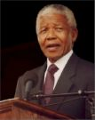
Persian Gulf
Nelson Mandela

Slide 47
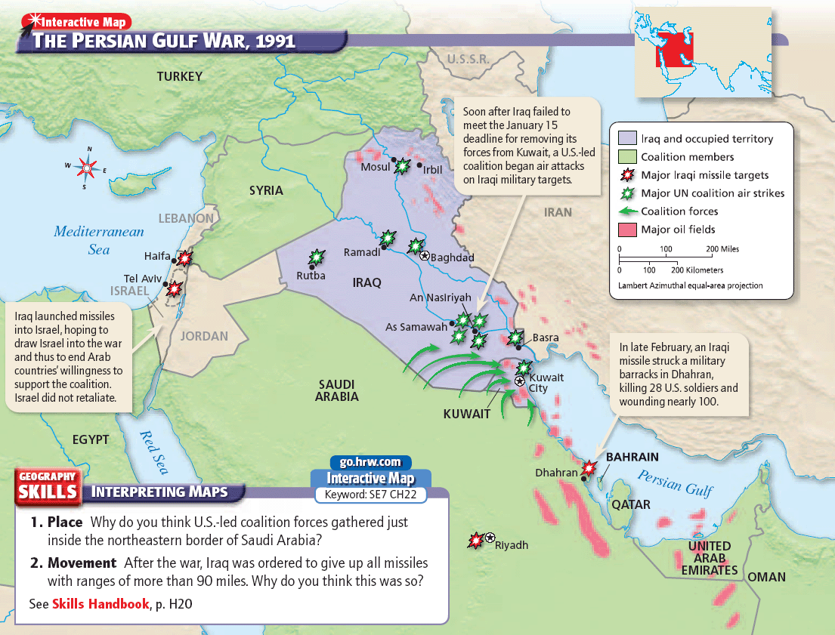
Persian Gulf War

Slide 48
http://www.youtube.com/watch?v=kzx7VEH9YUM

