Slide 1
Day 9 Independent Work

Slide 2
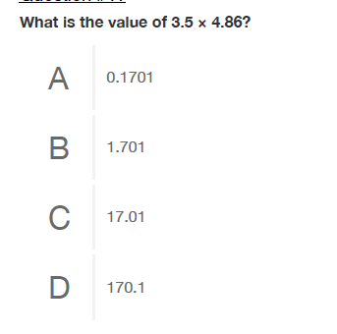
2

Slide 3
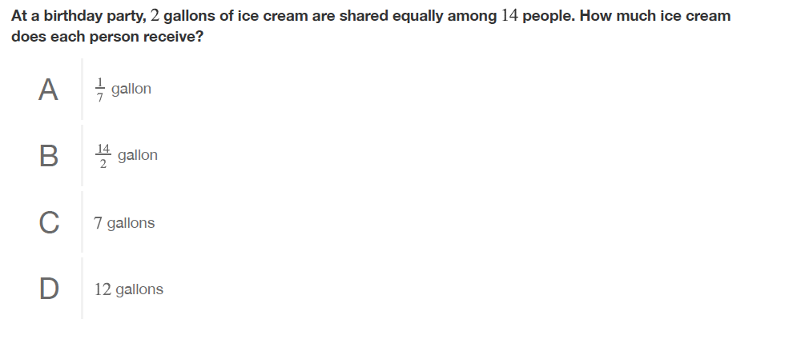
3

Slide 4


Slide 5

5

Slide 6

6

Slide 7

7

Slide 8
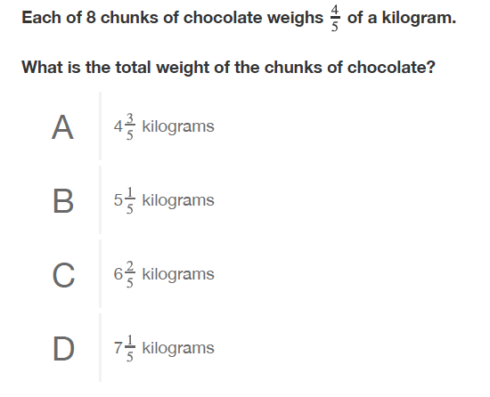
8

