Slide 1
Decimal Multiplication
Day 8

Slide 2
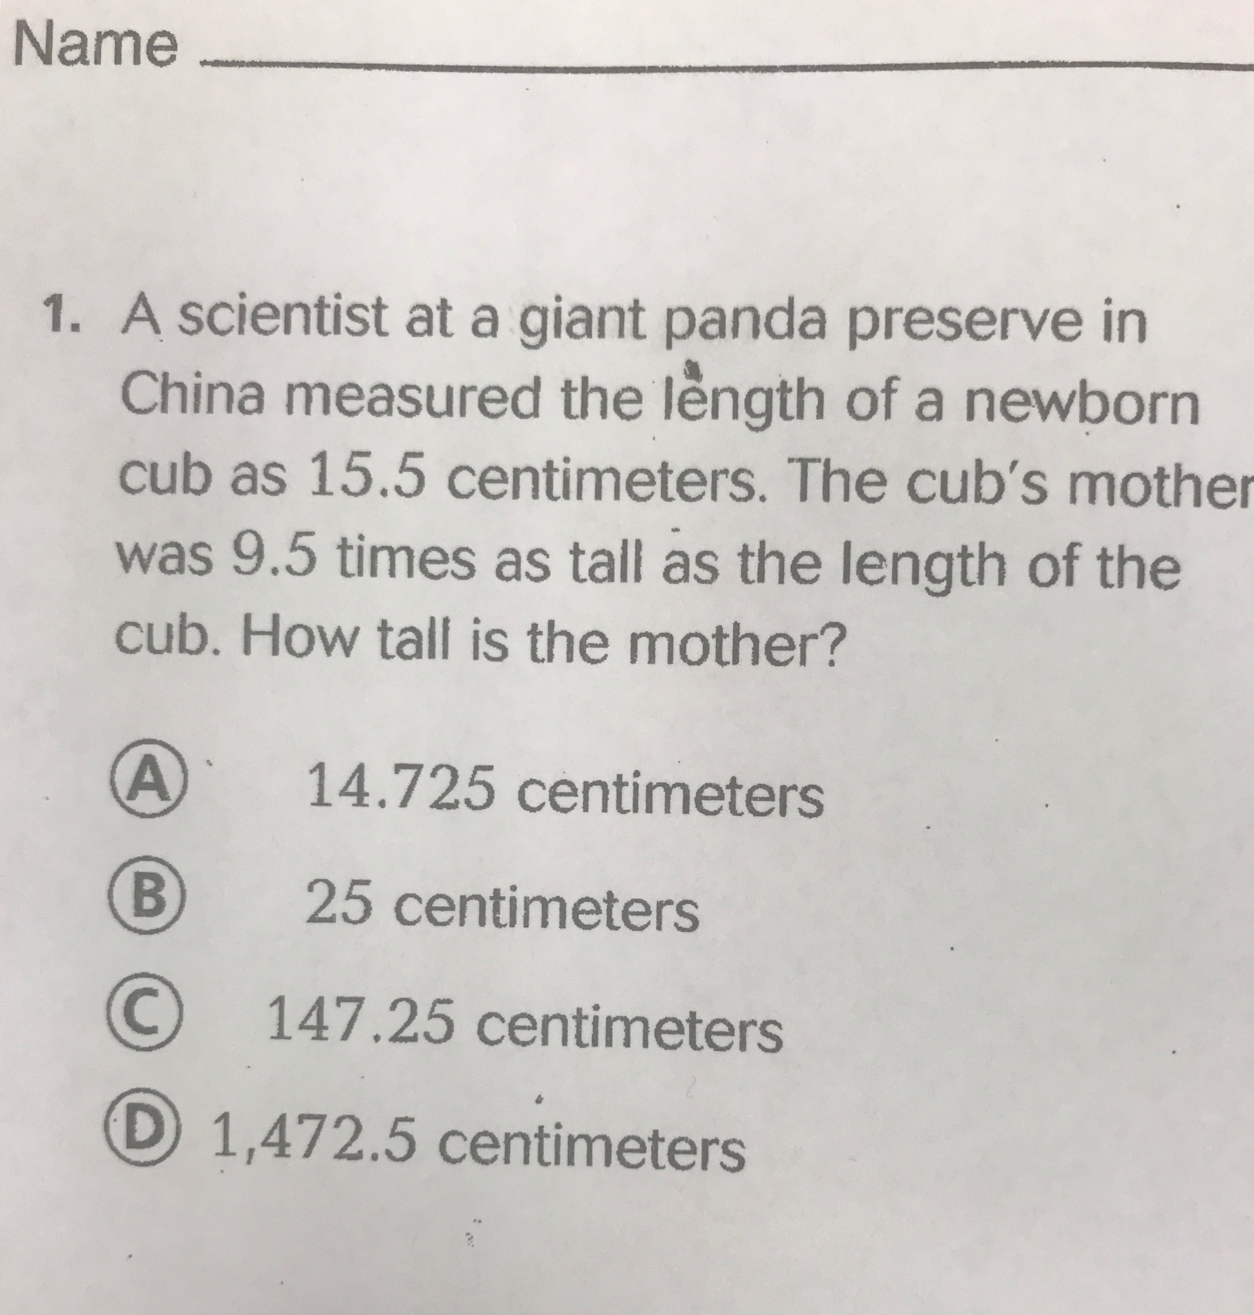
1

Slide 3
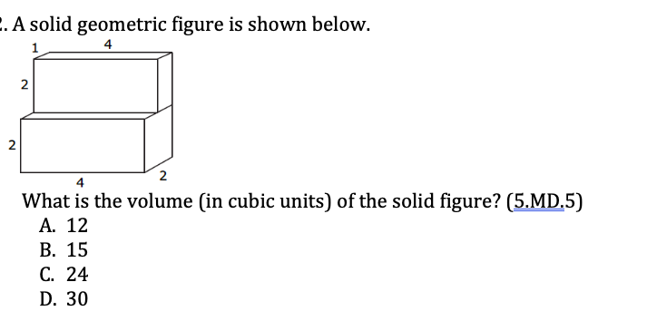
2

Slide 4
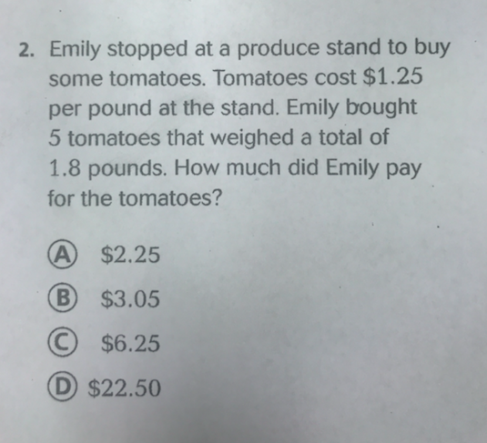
3

Slide 5
4
Take your answer for question number 3. This is the cost for the tomatoes you purchased. If you bought 5 tomatoes, how much did each tomato cost?

Slide 6
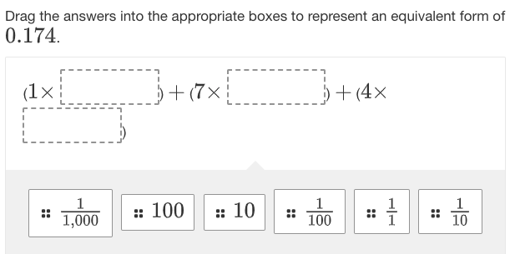
5

Slide 7
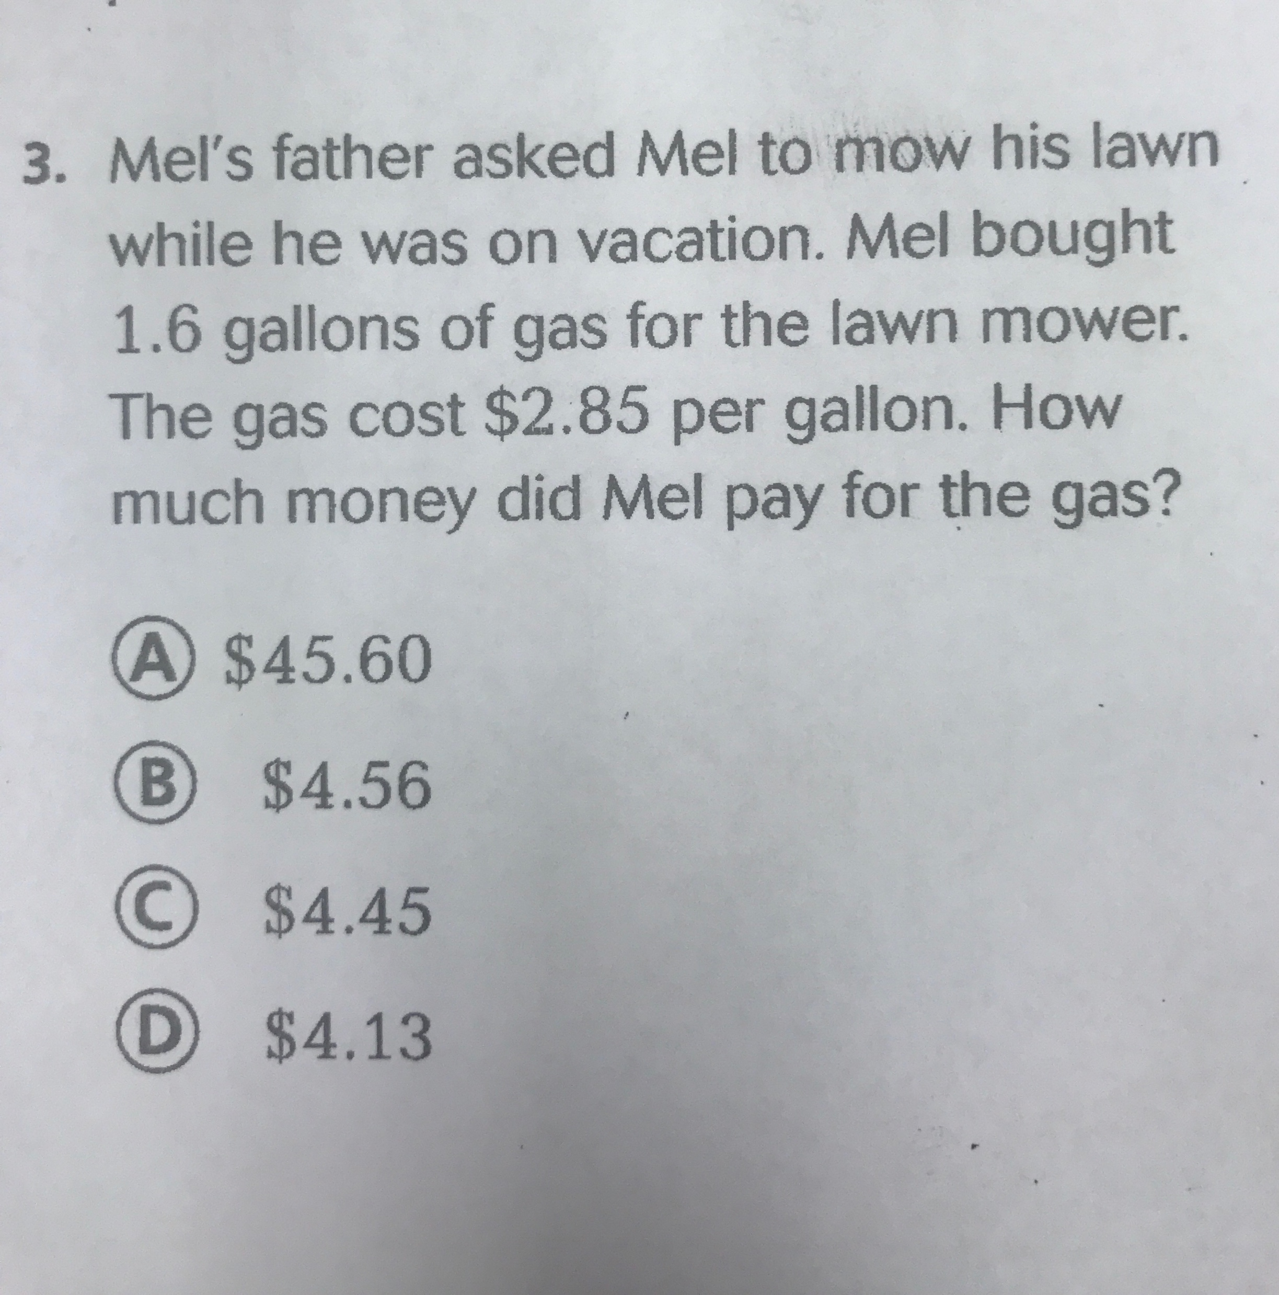
6

Slide 8
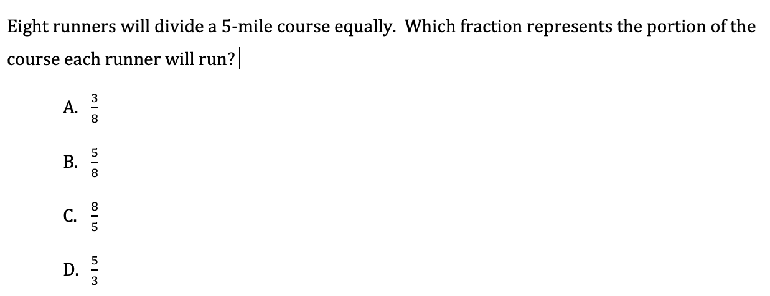
7

Slide 9
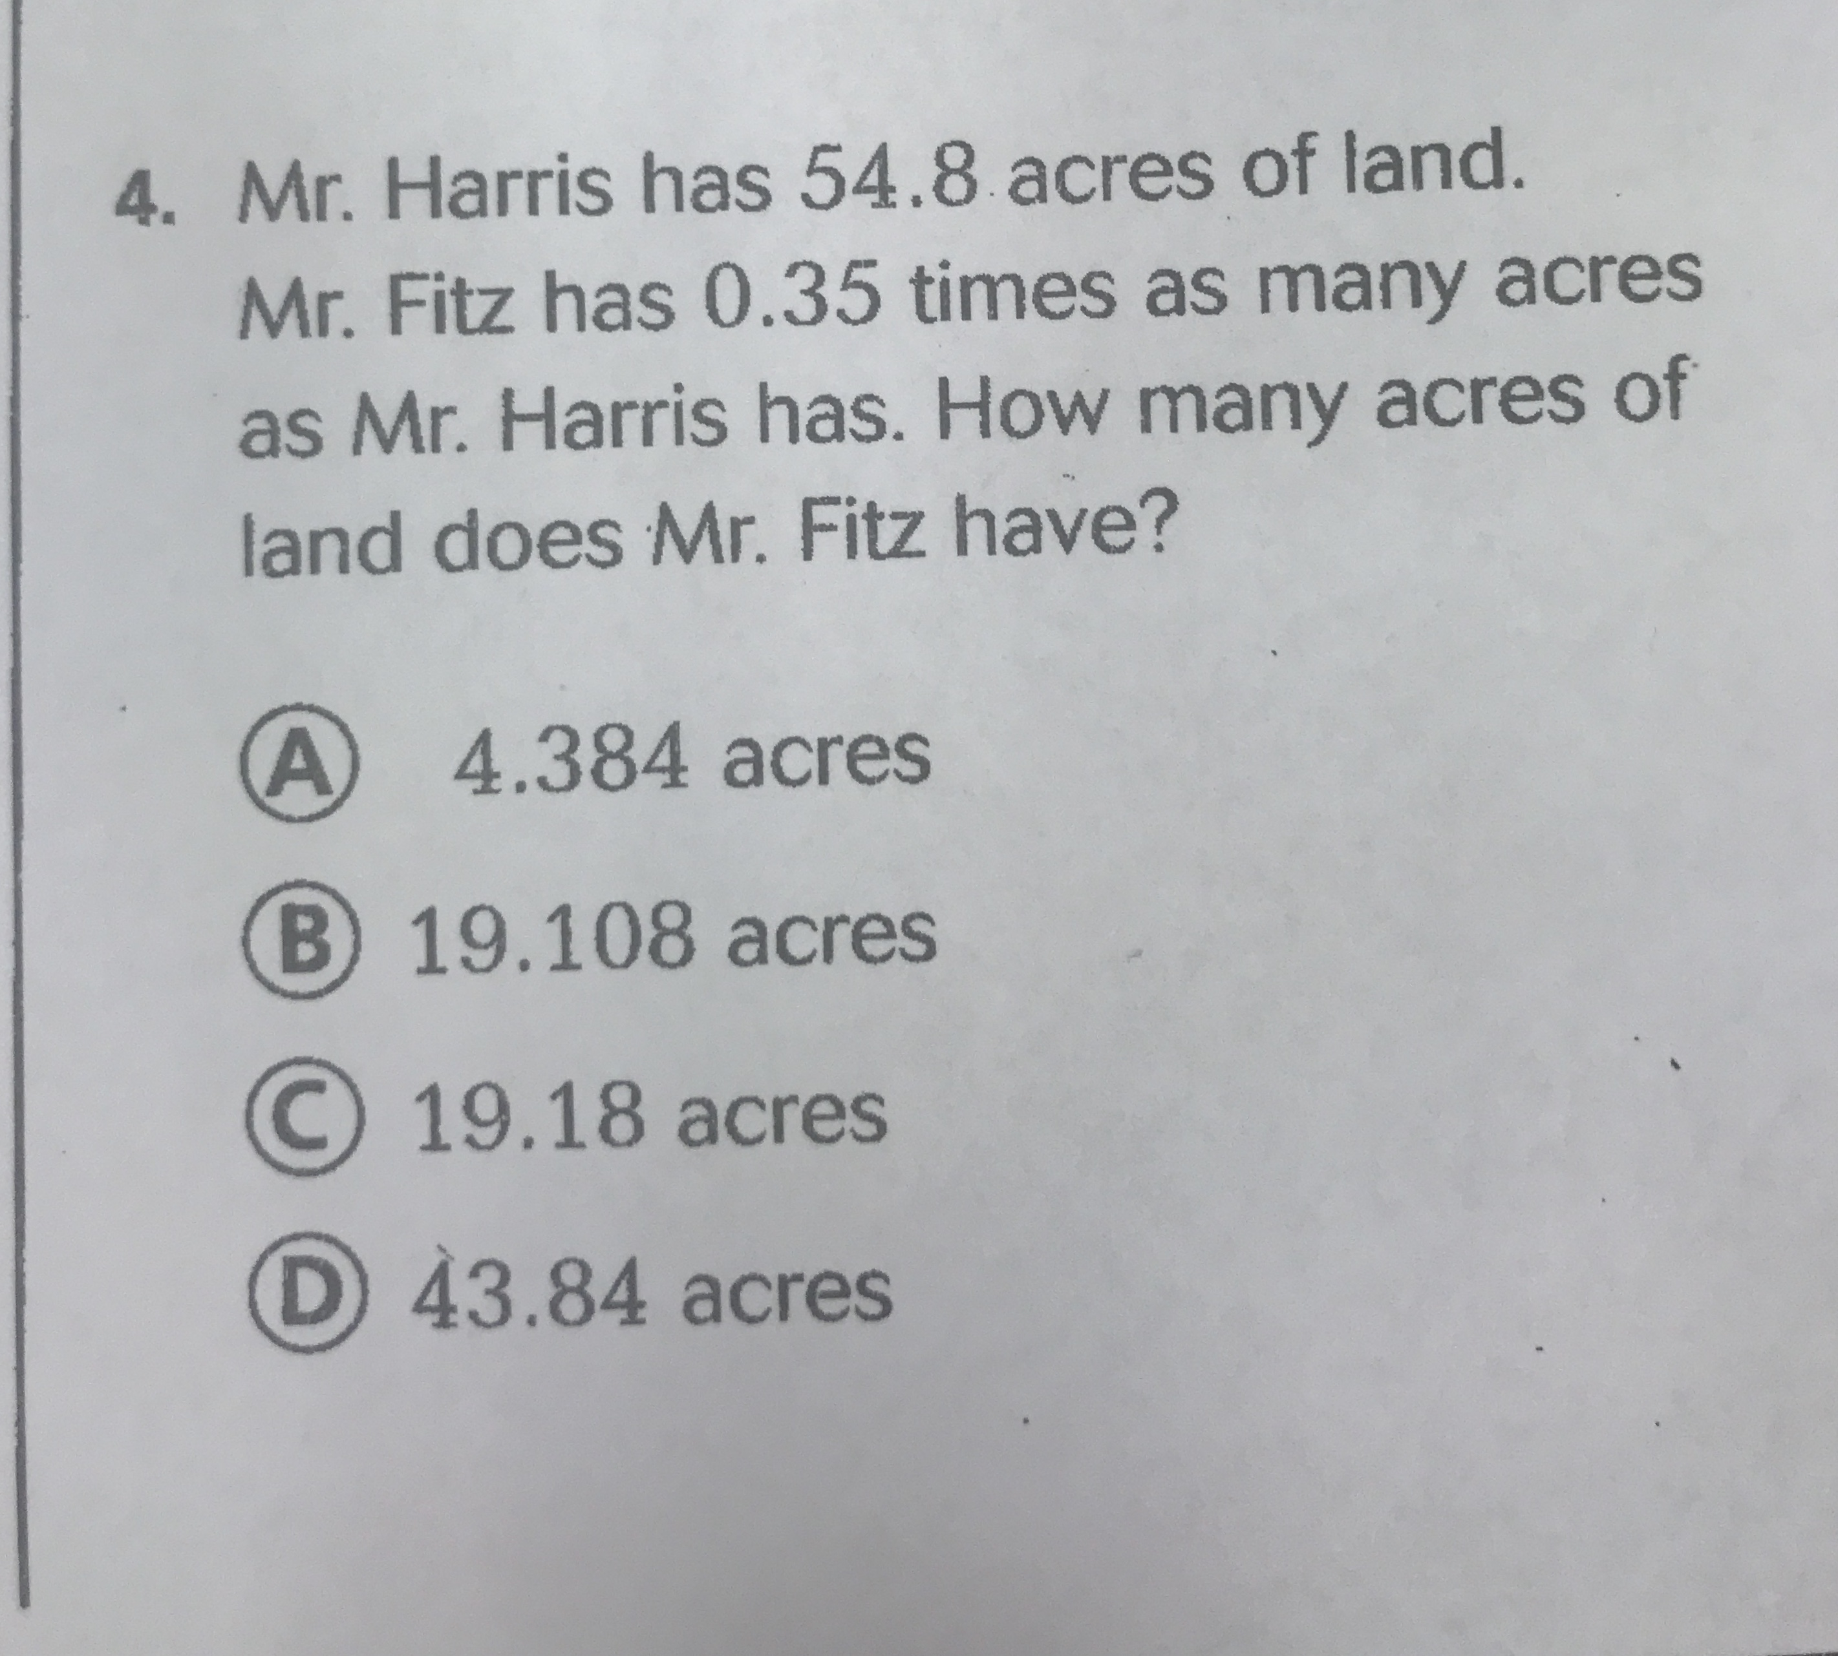
8

