Slide 1
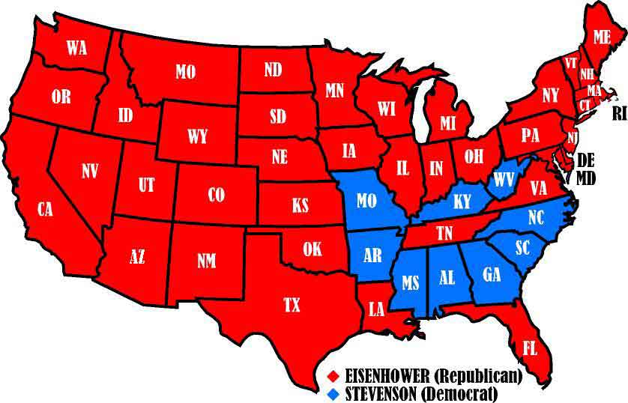
Meet President Dwight D. Eisenhower!
Elected in 1952
Nixon as V.P

Slide 2
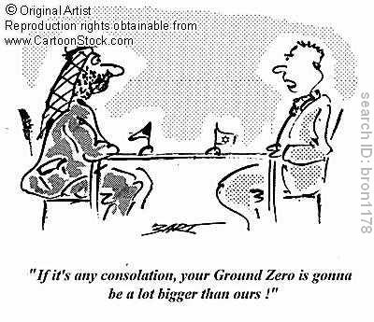
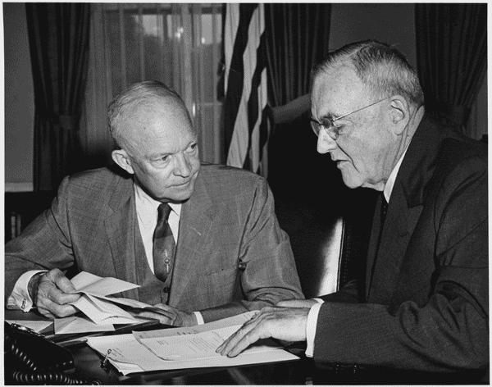
Eisenhower’s Foreign Policy
Emphasized Massive Retaliation
  Instead of spending lots of $$ on troops, ships, etc. , we should stockpile nuclear weapons!
Mutually Assured Destruction:
  Each country knows that the other has enough weapons to destroy one another.
Brinksmanship
  Pushing the USSR to the brink of war to convince them to cooperate

Slide 3
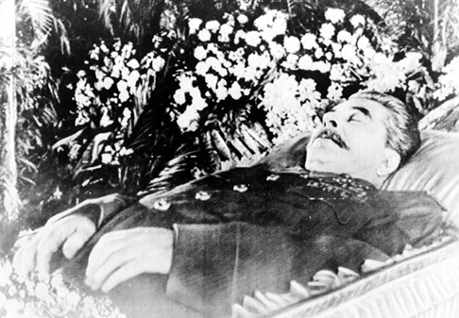
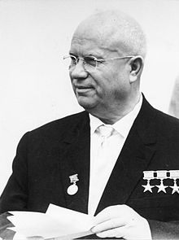
1953 Stalin Dies
Stalin dies of a Stroke
Nikita Khrushchev becomes head of the USSR
  Not as paranoid or cruel as Stalin
  Still an opponent of the US
Some talks of “peaceful coexistence” with US and “rolling back” Soviet borders

Slide 4
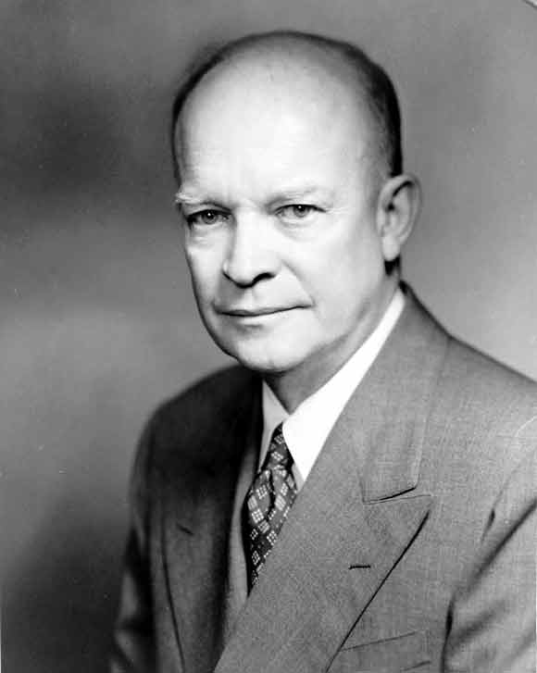
Eisenhower’s Foreign Policy
How is this similar and different to the Truman Doctrine?
The Eisenhower Doctrine - 1957
  Speech given to congress
  Promises financial and/or military aid to any country threated by another
  Focused on the Middle East
  Begins years of involvement om this region

Slide 5
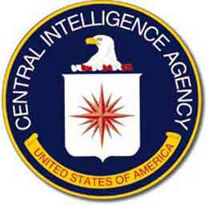
Central Intelligence Agency (CIA)
Eisenhower gave the CIA a new task- he allowed covert (secret) operations…
  “against hostile foreign states or groups or in support of friendly foreign states or groups …
  …but which are so planned and conducted that any U.S. government responsibility for them is not evident to unauthorized persons”

Slide 6
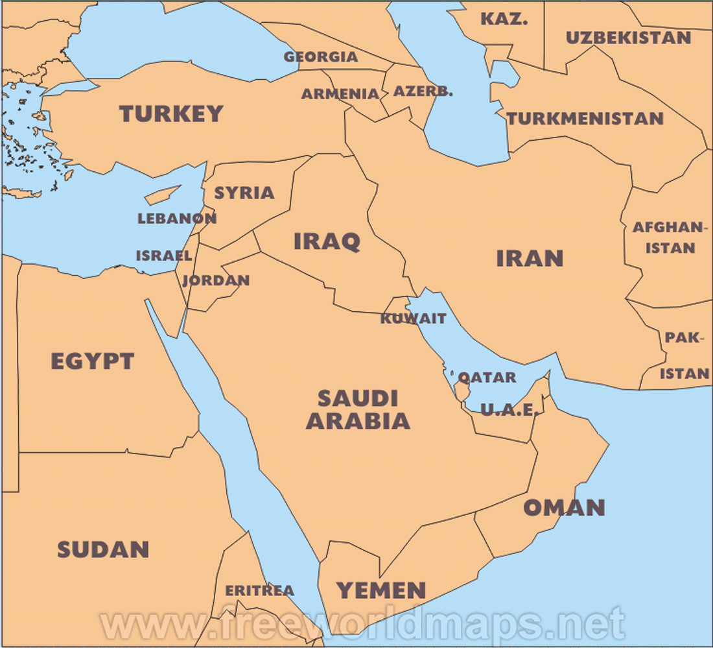
Involvement in the Middle East
Suez War
Cause
  Egypt (Nasser) began trading with USSR
  US cuts of funding for Dam across the Nile
  Egypt closes seizes Suez canal from Brits
  Brit and Fr. invade Egypt to regain control
Effect
  U.S. stops invasion
    Worried Egypt would Ally with USSR

Slide 7
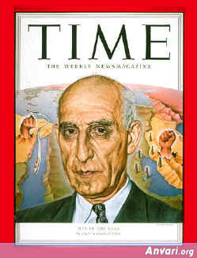
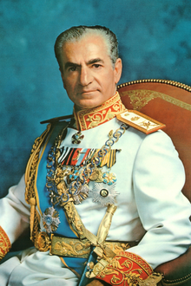
Involvement in the Middle East
Iranian Coup de Tat
Cause
  Mohammed Mossadegh chosen as P.M.
  Begins to push Western businesses out of his country
  US supports Iranian Coup de tat
Effect
  US aids the rise of the Shah (King)
  Transition from Const. Monarch to Dictatorship
  US keeps good ties for next 25 years

Slide 8
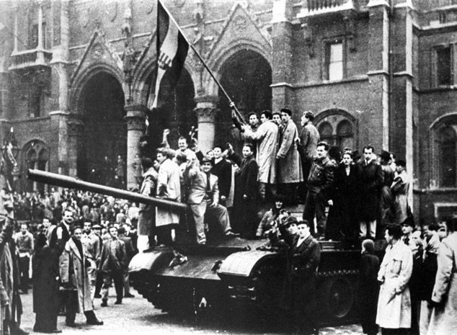
Involvement in Europe
Hungarian Uprising
  Cause
    Hungarians demanded the removal of Soviet Troops
    Soviets responded by crushing the revolt
    3,000 dead
    13,000 wounded
    200,000 fled country
  Eisenhower does not respond – doesn’t want to start WWIII!
1956

Slide 9
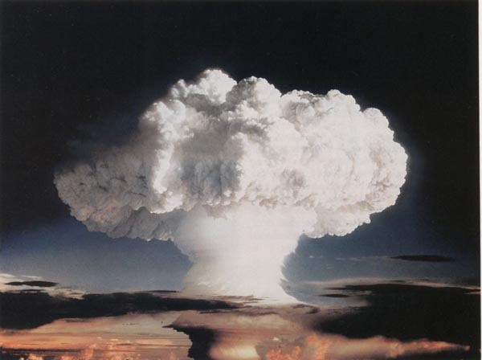
Soviets test a Hydrogen Bomb (1952)

Slide 10
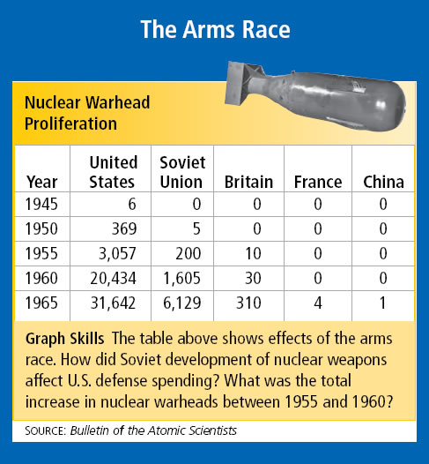

Slide 11
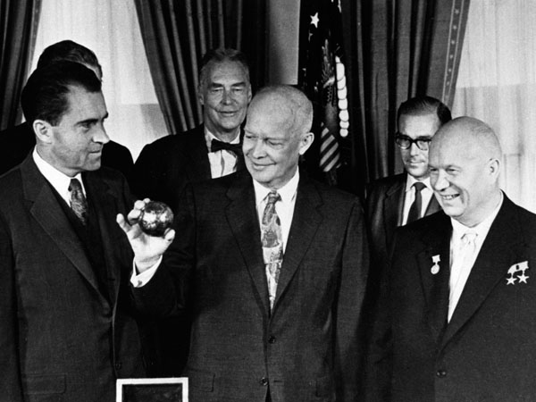
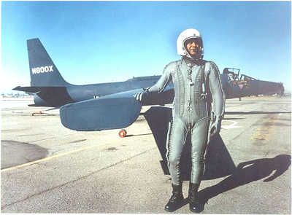
U-2 Incident: 1960
U-2
  American spy plane sent to do Reconnaissance over the Soviet Union and its satellite states
1960: flight flown by Francis Gary Powers gets shot down by a Soviet Plane.
  In the midst of peace talks
Further increases tension between the U.S. and the USSR.

Slide 12
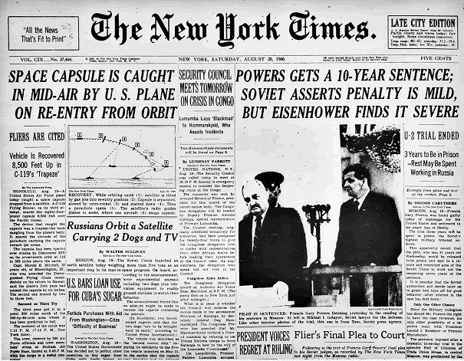

Slide 13
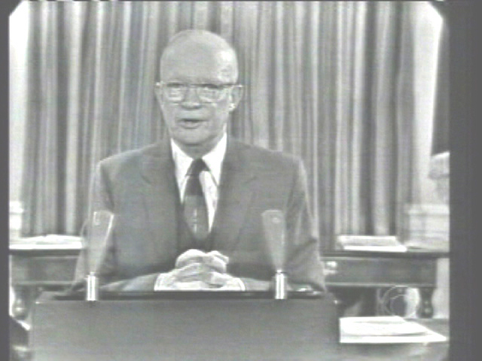
Eisenhower's Farewell Address
Warned about the dangers of the “Military-Industrial Complex.”
Argued that it was better to threaten the use of Nuclear Weapons than to allow the Military to become to powerful and costly.
Military
Industrial
Complex

