Slide 1
The Nixon Administration

Slide 2
Domestic Issues

Slide 3
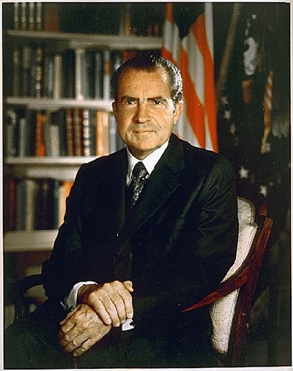
New Federalism
To reduce the Federal governments responsibilities from the Great Society
Wanted to put power (and money) back in the states’ hands

Slide 4
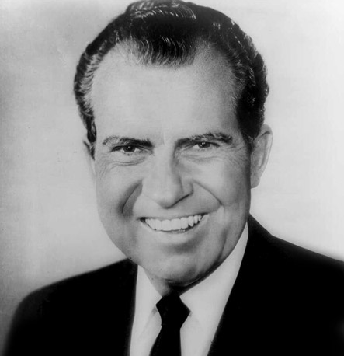
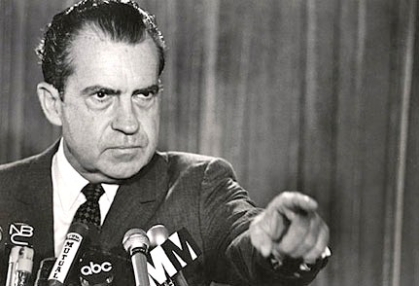
Two Faces of New Federalism
Failed to Support C.R. Movement
Abolished the office of Ec Oportunity
Expanded Social Security, Medicare and Medicaid
Created the EPA
Proposed Universal Healthcare

Slide 5
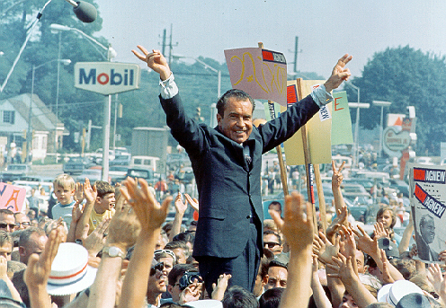
Southern Strategy
Nixon’s plan to attract unhappy southerners
Many became unhappy with democrats due to desegregation attempts
Nixon wanted these votes

Slide 6
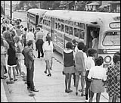
Implementing the Southern Strategy
Nixon tried to slow desegregating schools
  Violated 2nd Brown v. Board ruling to carry out “with all deliberate speed”
  NAACP filed a lawsuit and Nixon ordered to follow law
Nixon appointed 4 justices in an attempt to shift the Supreme Court to a more conservative agenda

Slide 7
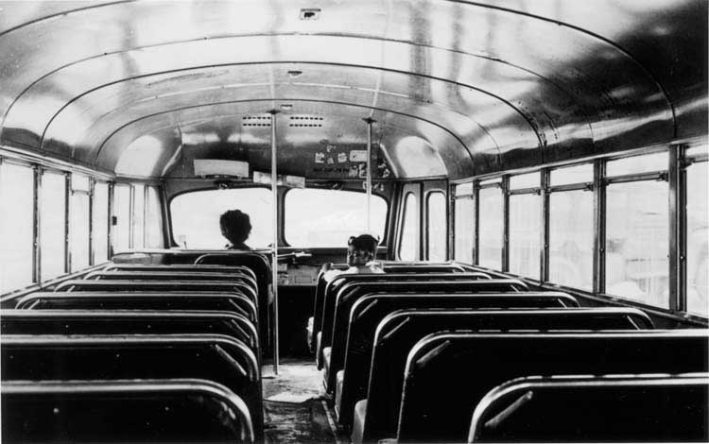
Swann v. Charlotte-Meck Board of Education
Stated that school districts may bus students to other schools to end pattern of all white or all black schools
Nixon went on TV to
urge Congress to stop this

Slide 8
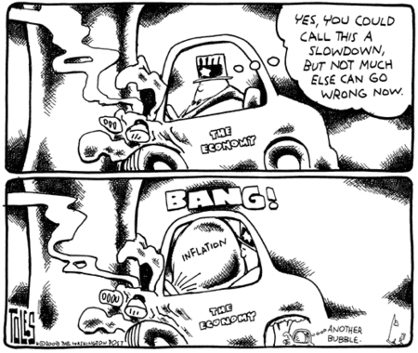
Jumpstarting the Economy
High inflation + high unemployment = Stagflation
  Due to too much federal spending on wars and Great Society programs
Froze business prices
and wages for 90 days
Increased Govt Spending
Eased inflation, but the
recession continued

Slide 9
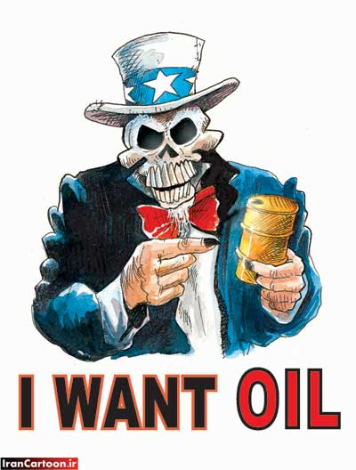
Organization of Petroleum Exporting Countries (OPEC)
Group of oil producing
countries who fix prices
(mainly from Middle East)
1973: Yom Kippur War
  Israel vs. Egypt and Syria
    Over border issues
  US aids to Israel and OPEC stopped sending oil to US
  After a cease-fire was worked out in 1974, OPEC resumed sending oil but raised the price 4 times from what it was

Slide 10
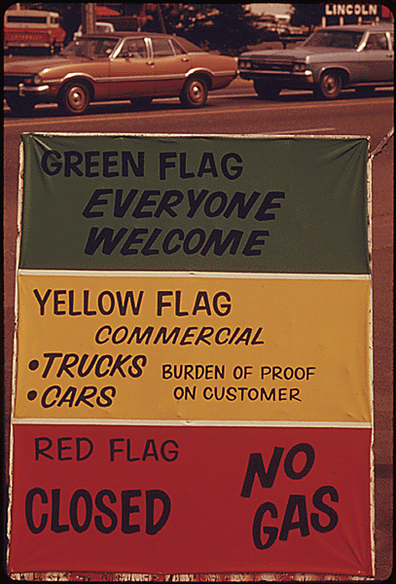
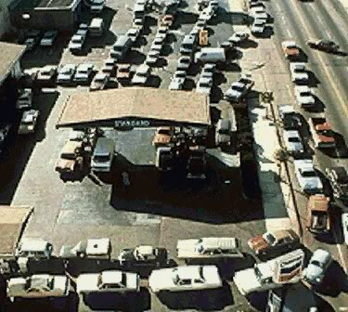

Slide 11
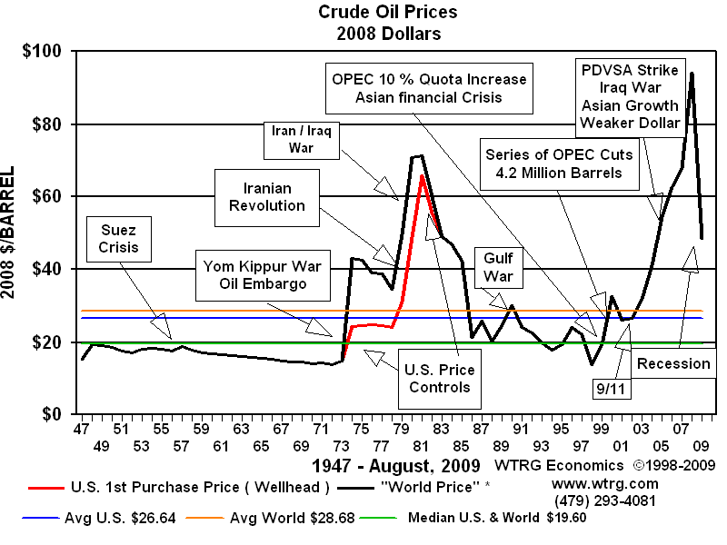

Slide 12
Foreign Policy

Slide 13
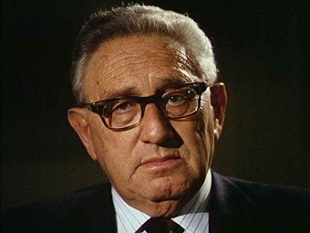
Nixon and Foreign Policy
Secretary of State Kissinger came up with idea of realpolitik
  Make foreign policy decisions a country’s power not morals
New policy to deal with communists called détente
  Willingness to negotiate and ease tensions with communist nations
Power > Morals

Slide 14
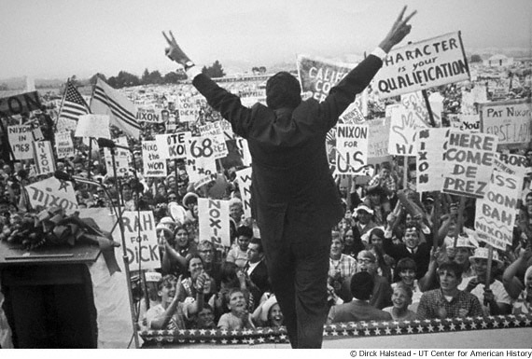
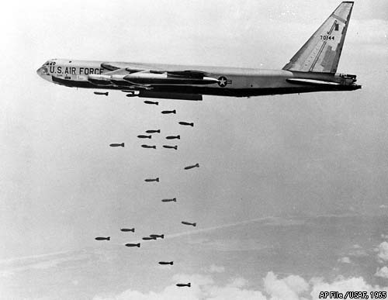
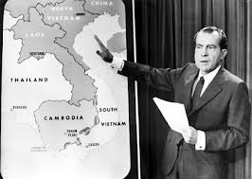
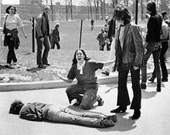
Vietnam War
Election of 68
  Pre Election Stance
    Vietnamization
    Bring an end to the War
  Post Election Reality
    Cambodia/Loas
    Pentagon Papers
    Kent State

Slide 15
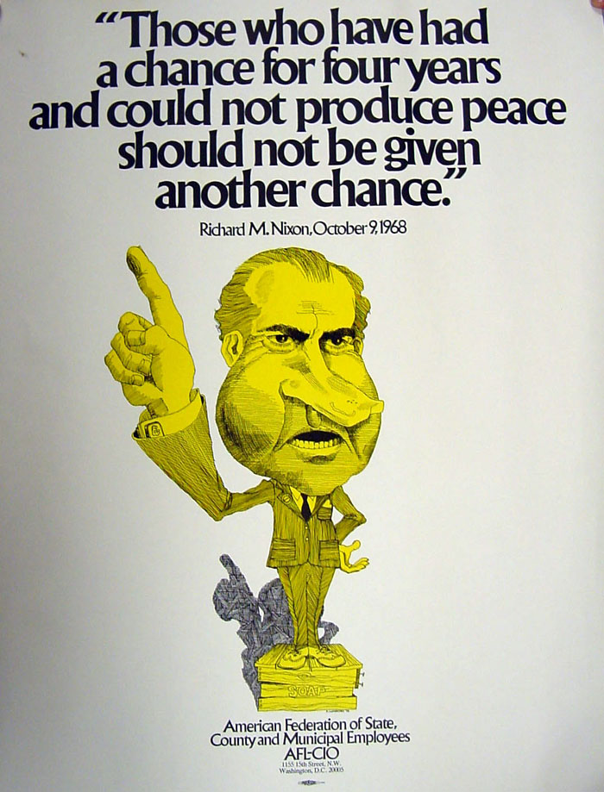

Slide 16
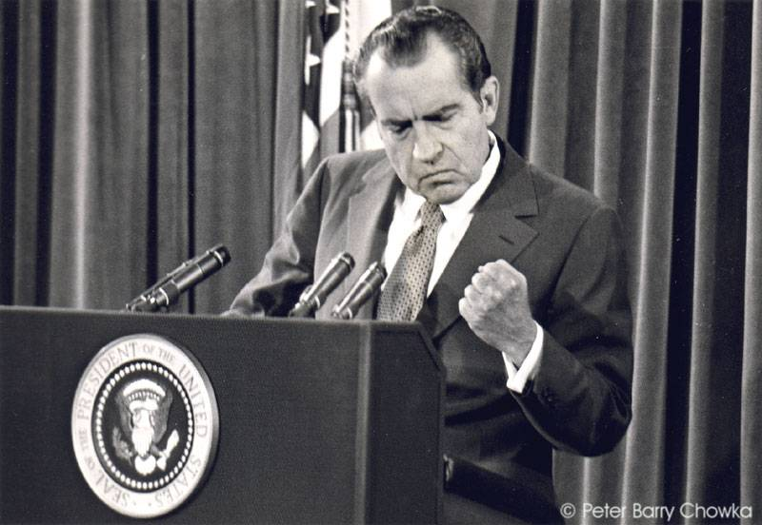
Foreign Policy
Nixon Doctrine - 1970
  Policy regarding “Third World” Countries
  "the United States would assist in the defense and developments of allies and friends,"
    but would not
  "undertake all the defense of the free nations of the world."

Slide 17
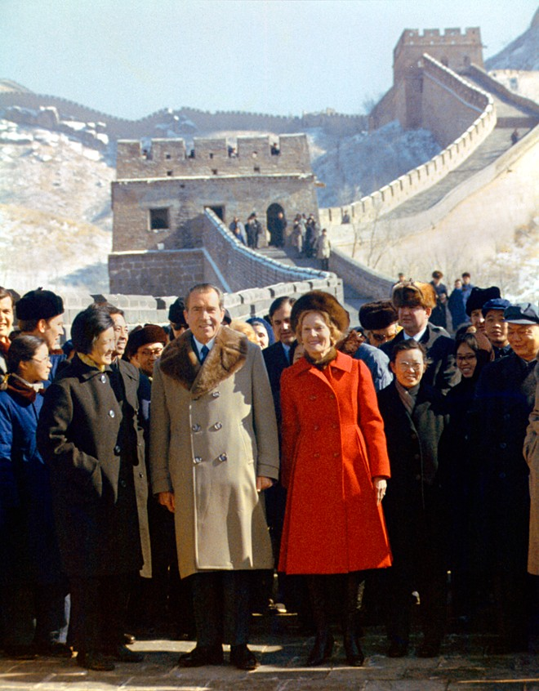
Only Nixon Can Go to China
US had not recognized China since communist takeover
1971: Nixon said he would visit China to begin a new relationship
Both nations agreed to cooperate in the future
  Both would work together to settle disputes peacefully
  Freer exchange of ideas

Slide 18
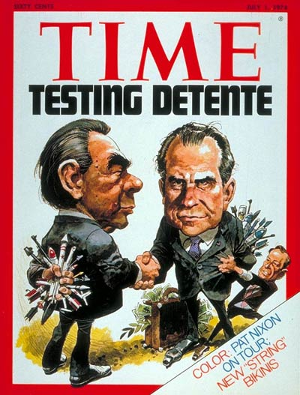
Nixon Visits Moscow
1972: First president to visit Moscow
Nixon and Brezhnev (new Soviet leader) signed SALT I Treaty
  Limited ICBM and submarine missiles
His achievements in China and Soviet Union met with huge acclaim and helped him win re-election in 1972
  Won 49 out of the 50 states

Slide 19
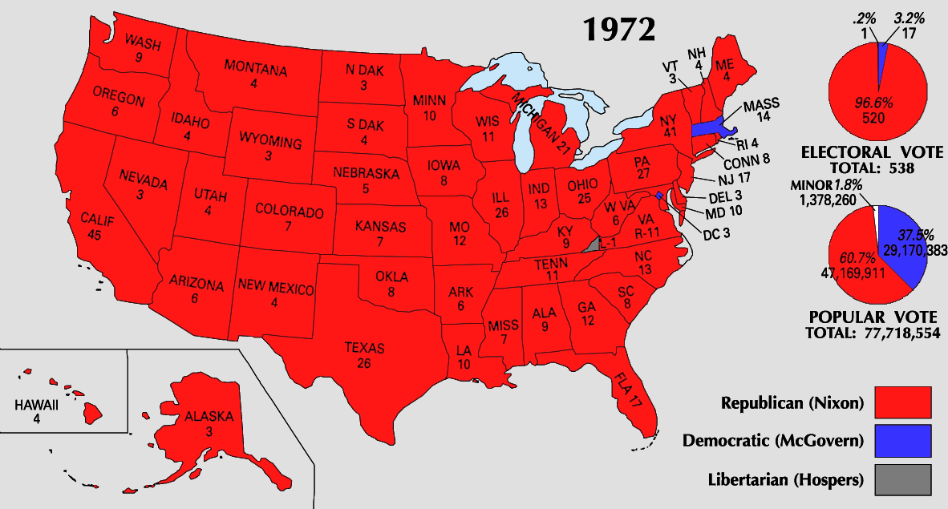
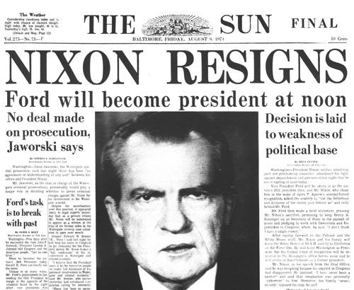
Vietnam War
Election of 72
  Pre Election Stance
    “Peace with Honor”
    Insistence on N Viet. Retreat
  Post Election Reality =
    “Christmas Bombings”
    Peace of Paris
    POW’s abandoned
    Watergate

Slide 20
Watergate: Nixon’s Downfall

Slide 21
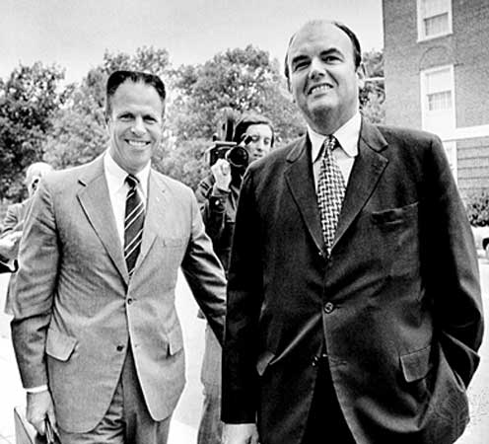
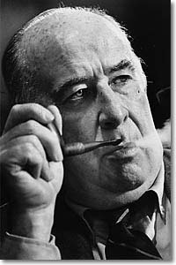
The President’s Men
Nixon confided in a select group of people
  H.R. Haldeman
    Chief of Staff
  John Erlichman
    Chief domestic advisor
  John Mitchell
    Former Attorney General
Very secretive and critics accused them of acting outside the law

Slide 22
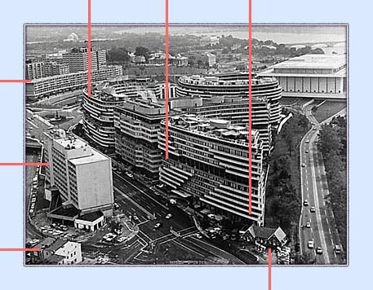
Bungled Burglary
June 17, 1972
  5 men caught breaking into Democratic HQ at the Watergate Hotel
  Trying to plant bugs and photograph papers
White House began to cover-up link to President by shredding documents

Slide 23
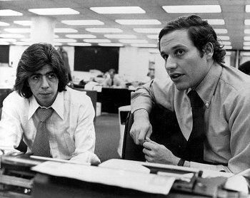
The Heroes
Woodward and Bernstein were two reporters from the Washington Post
  Found evidence linking burglary to White House
  White House continuously denied claims

Slide 24
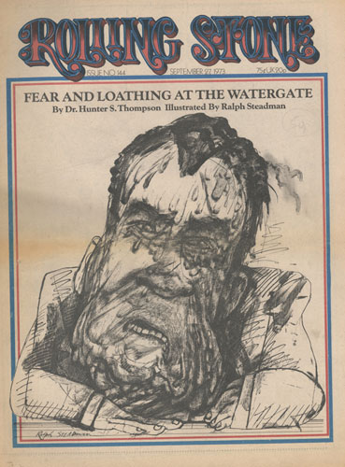
The Cover-Up Fails
One of the burglars admits lied under oath
  Said people in the white house were involved
Nixon fired his secret group and White House Counsel John Dean
Appoints special prosecutor to investigate Watergate
  Archibald Cox
Senate began own investigation

Slide 25
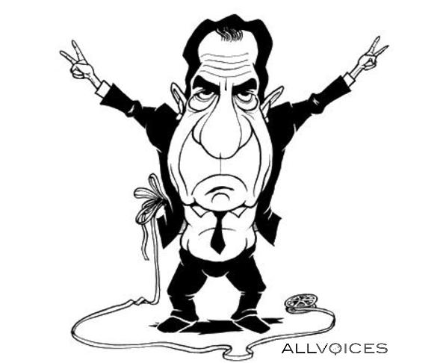
Startling Testimony
John Dean tell Senate that Nixon was directly involved in the Watergate cover-up
Presidential aide Alexander Butterfield revealed Nixon taped all his conversations

Slide 27
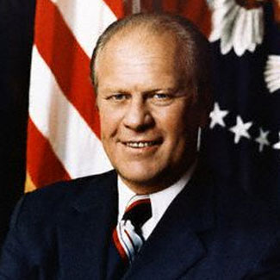
New VP
VP Spiro Agnew resigned because a grand jury indicted him for accepting bribes
Gerald Ford became new VP

Slide 28
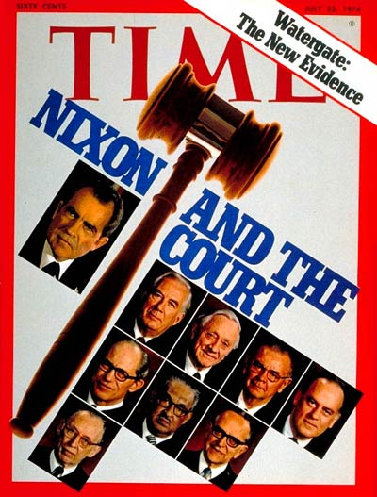
Fall of a President
1974: Nixon releases edited tapes and transcripts
Investigators wanted unedited tapes
US v. Nixon (1974)
  Supreme Court ordered him to give up the tapes
Nixon came on TV saying “I am not a crook”

Slide 30
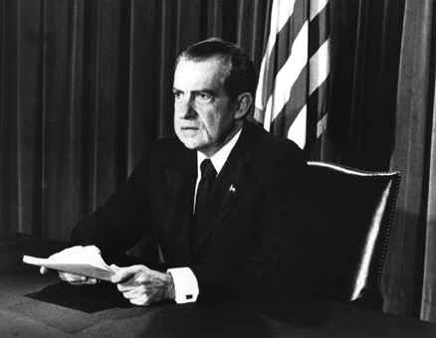
The Final Straw
July 27: House of Representatives approves 3 articles of impeachment of Nixon
May 5: Nixon releases tapes, but 18 minutes missing
August 8th: Nixon resigns, but admitted no guilt

Slide 32
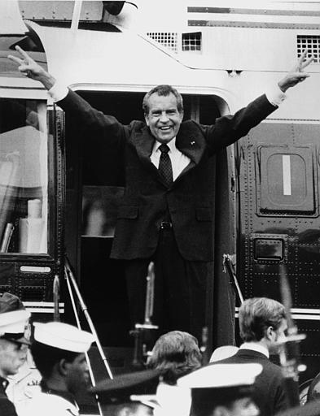
Effects of Watergate
25 Members of Nixon administration convicted for crimes connected to Watergate
American people and press image of presidency destroyed

