Slide 1
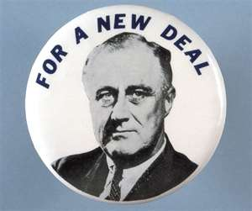
Affect of the New Deal on Different Groups
Chapter 23: Part II

Slide 2
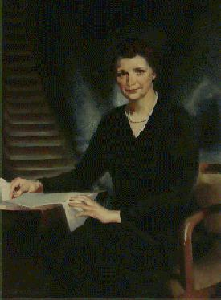
Women Make Their Mark
Francis Perkins became the first woman in the cabinet
  She was Secretary of Labor
Many women were heads of New Deal agencies
However, worker programs hired less women and paid them less.
Notes:
82% said wives should not work

Slide 3
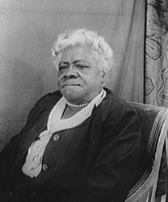
African-Americans Take Leadership Roles
Mary Bethune
  Head of Division of Negro Affairs of NYA
  Help Af-Am teens get an education and jobs
She organized “Black Cabinet” to advise FDR on racial issues

Slide 4
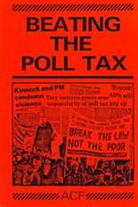
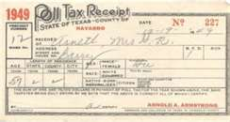
FDR Fails to Support Civil Rights
No support for anti-lynching law
No end for poll tax
New Deal agencies discriminated
Why? FDR blamed Southern Democrats for hindering any efforts FDR would attempt to help African-Americans

Slide 5
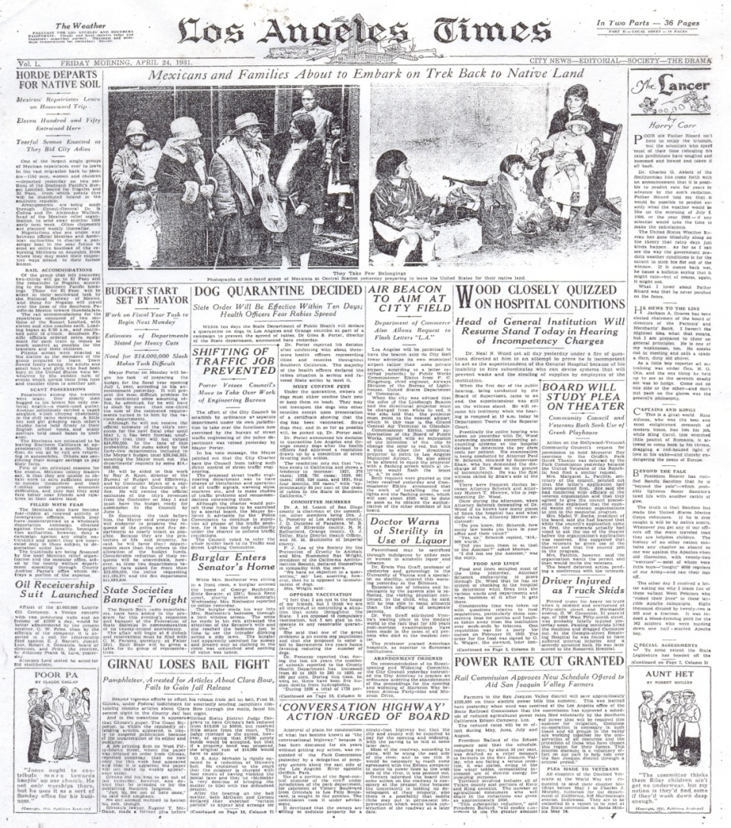
Mexican-American Fortunes
Supported FDR but got few benefits
Discriminated by agencies
Many were forced to move back to Mexico = Mexican Trail of Tears

Slide 6
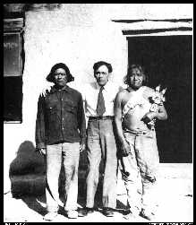
Native Americans Gain Support
John Collier appointed the Commissioner of Indian Affairs
He helped pass the Indian Reorganization Act which promoted Indian freedom to live as they want (autonomy), not making them become “American” (assimilate)

Slide 7
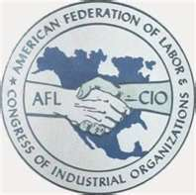
Labor Unions Flourish
Union membership increased from ‘33-’41
Congress of Industrial Organizations (CIO)
  Formed in 38’
  Unskilled and semi skilled workers since the AFL only let in “skilled” workers

Slide 8
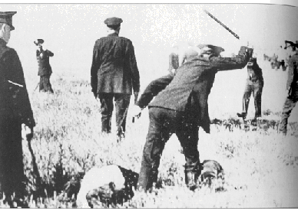
Memorial Day Massacre
(1937)
Republic Steel Plant in Chicago refused to recognize the CIO union at the plant
Workers went on a peaceful strike
For unknown reasons, the police fire at and beat strikers
Many are injured and killed
Congress ordered Republic Steel to negotiate with the union

Slide 9
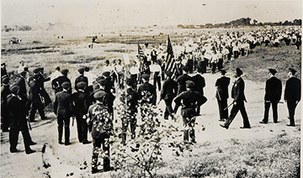
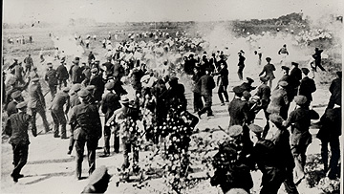
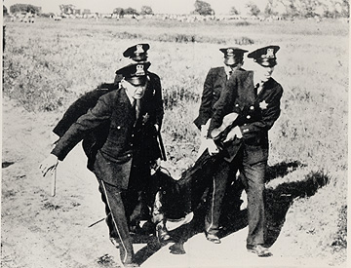
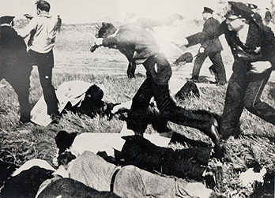
Reasonable Force?

Slide 10
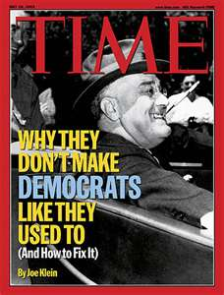
New Deal Coalition
One of FDR’s greatest contributions
Diverse groups supporting Democratic Party
- Southern Whites
- Urban Groups
- African Americans
- Unionized industrial workers

