Slide 1
A New Deal for America

Slide 2
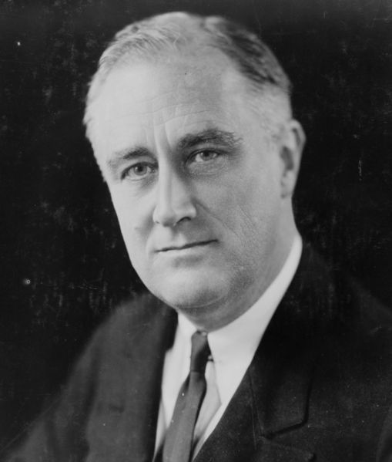
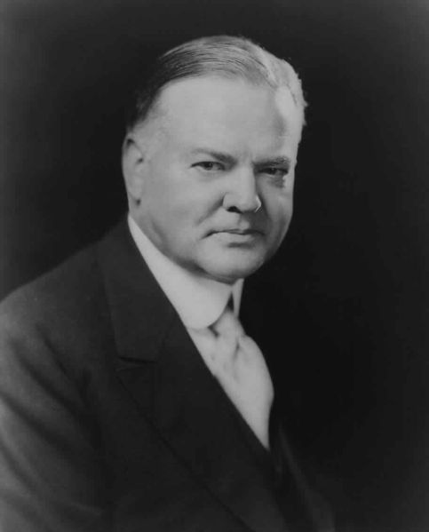
Election of 1932
Hoover vs. Roosevelt
FDR: 2-Term governor from New York
FDR wins in a landside
Notes:
2-Term governor from NY and distant cousin to TR
FDR: “Can Do” attitude
Roosevelt captured 23 million votes and Dems won nearly 2/3 of the Senate and ¾ of the House

Slide 3
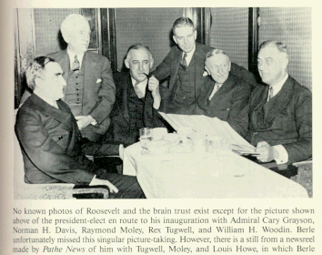
The Organizing of a Brain Trust
FDR had to wait 4 months to take office in March
  20th Amend. not until 1933
Selected a group of professionals (professors & lawyers) nicknamed the “Brain Trust”
Formulated the New Deal
3 Goals:
  Relief for the needy
  Economic recovery
  Financial reform
Notes:
Waited 4 months
20th Amendment not ratified until Feb ’33
Select group of lawyers, professors, journalists
Relief for the needy, economic recovery, and financial reform
Campaign Speech: “A New Deal for the American People”

Slide 4
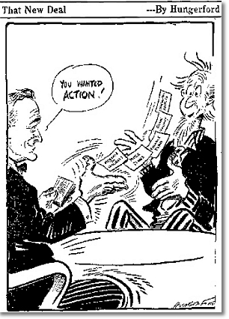
The First Hundred Days (March 9-June 16, 1933)
Passed 15 pieces of legislation
Declared a Bank Holiday
Emergency Banking Relief Act
  Authorizes Treasury to inspect banks
Helped to restore confidence in banks
Notes:
To prevent further withdrawals and failures
3 categories: those who were sound to reopen, those that were insolvent: those that could not pay their debts would remain closed and those that needed loans could get them
This restored confidence in the public that open banks were financially sound

Slide 5
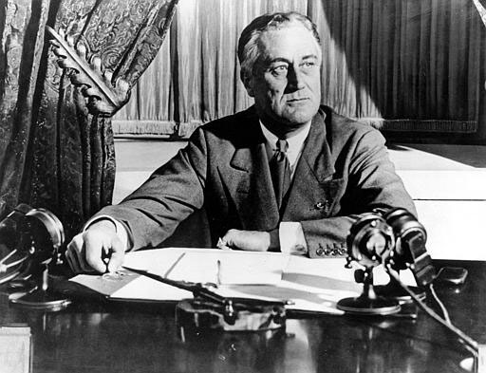
The Fireside Chat
March 12th First Fireside Chat
  A radio talk about public concern
He used clear, simple language
Success depended on public support
Notes:
Done on March 12
for people to understand
Told them all cant demand savings in cash, not weak but cant handle that from everyone; many returned their savings in the following weeks

Slide 6

Regulating Bank and Finance
Glass-Stegal Act
  FDIC est. insuring accounts to $5000
Federal Securities Act
  Corporations required to provide complete info
  on stock offerings and made them available
SEC established in 1934 to regulate stock market and stop insider trading

Slide 7
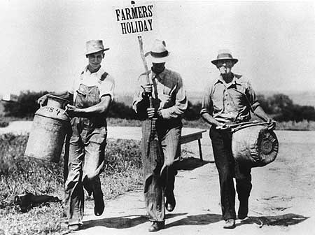
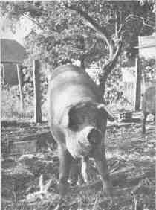

Rural Assistance:
Agriculture Adjustment Act (AAA)
AAA
  Sought to raise crop prices by lowering production
Government paid farmers to leave some land without crops
Paid them to destroy their crops and slaughter their livestock
Notes:
Agriculture Adjustment Act- paid farmers to leave amt of acres unseeded; $200million paid to plow 10million acres
Because too far along and many farmers were upset and people were starving;
Tennessee Valley Authority and and renovated 5 dams; gave jobs, flood control, and hydro power

Slide 8
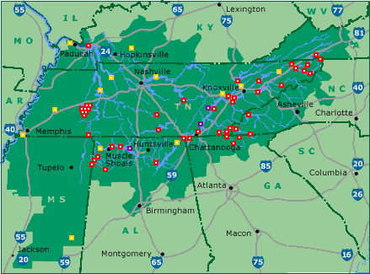
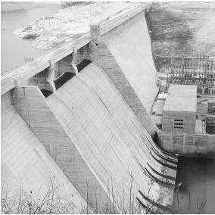
Rural Assistance:
Tennessee Valley Authority (TVA)
TVA created to bring power to rural areas through building dams
Provided many jobs
Notes:
Tennessee Valley Authority and and renovated 5 dams; gave jobs, flood control, and hydro power

Slide 9
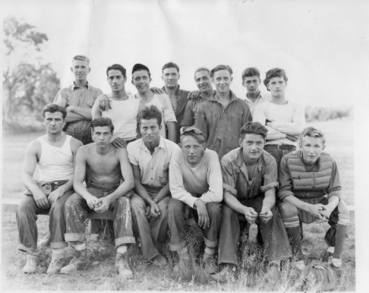
Providing Work Projects
Civilian Conservation Corps (CCC)
  Put men 18-25 to build public projects such as roads, libraries, and parks
  Paid $30 per month, $25 was sent home automatically
  Free food, lodging and uniform
National Industrial Recovery Act (NIRA)
  Provided states money to create jobs in construction of community buildings and schools
Notes:
Civilian Conservation Corp- Built parks, bridges, roads; sent $25 home
National Industrial Recovery Act- schools and community building construction
Civil Works Administration- claimed too many make work projects and a waste of money but built 40K schools and paid salaries of 500K rural school teachers and a half a million roads

Slide 10
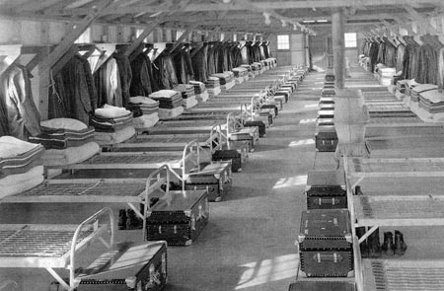
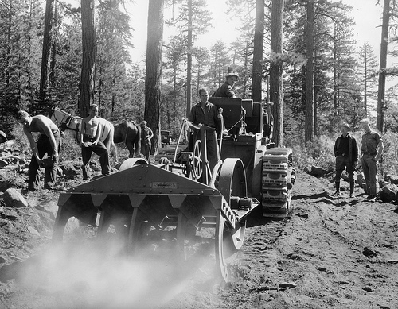


Slide 11
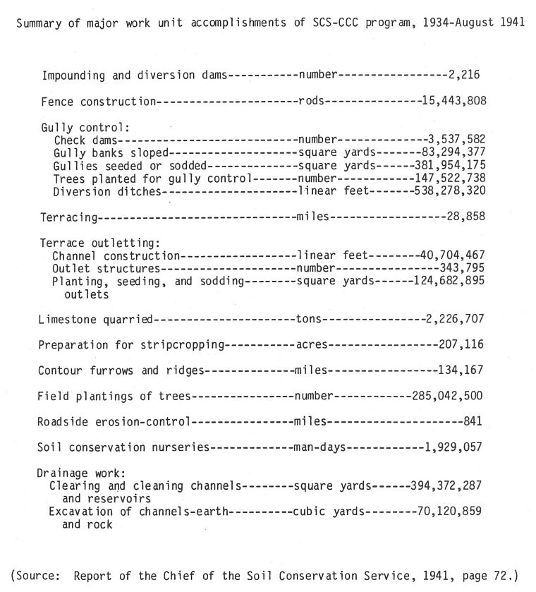

Slide 12

Promoting Fair Practices:
National Recovery Act (NRA)
Goals were to stop wage cuts, falling prices, and layoffs
Developed codes of fair practices in business relations
Limited production and set prices
Allowed worker’s right to unionize and bargain collectively
Notes:
National Recovery Administration- Set product prices and est. standards
Stop wage cuts, falling prices and layoffs
Set up by business and labor reps

Slide 13
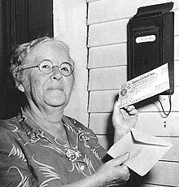
Social Security Act
Established a retirement program that would pay people after they stopped working
  Includes
    Elderly
    Unemployed
    Disabled
    Widows/Fatherless Children
he first monthly payment was issued on January 31, 1940 to Ida May Fuller of Ludlow, Vermont. In 1937, 1938 and 1939 she paid a total of $24.75 into the Social Security System. Her first check was for $22.54. After her second check, Fuller already had received more than she contributed over the three-year period. She lived to be 100 and collected a total of $22,888.92

Slide 14
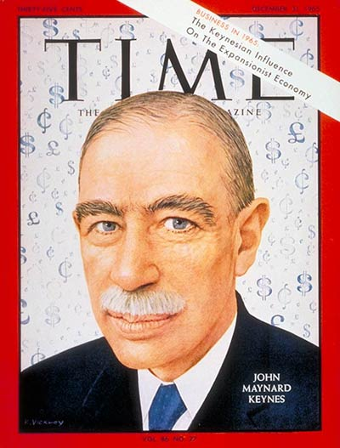
New Deal Under Attack
Policy of deficit spending was adopted to spend more money than the government receives in revenue developed by John Keynes
Liberal critics of the New Deal said it did not go far enough while Conservative critics said the programs spent too much

Slide 15
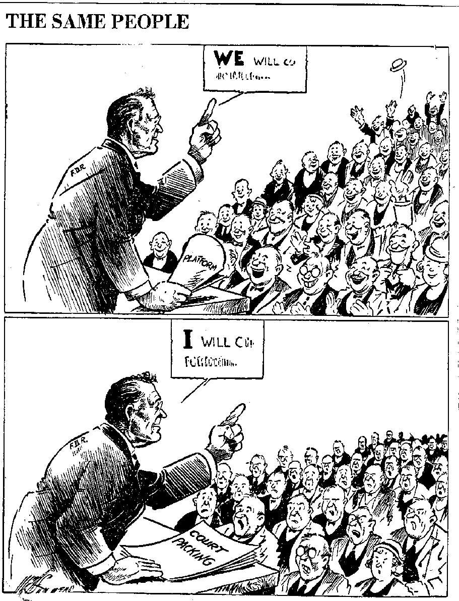
The Supreme Court Reacts
NIRA and AAA declared unconstitutional
In Response, FDR proposed a Bill to appoint 6 new Supreme Court justices
The public and press turned against FDR with this scheme
The bill failed, but FDR appointed 7 justices because many began to retire
Notes:
Enforcement of industry codes in states went beyond the federal gov constitutional power to regulate interstate commerce; and agriculture a state matter
Retiring judges let him have his way in 4 years appointed 7 new justices

Slide 16
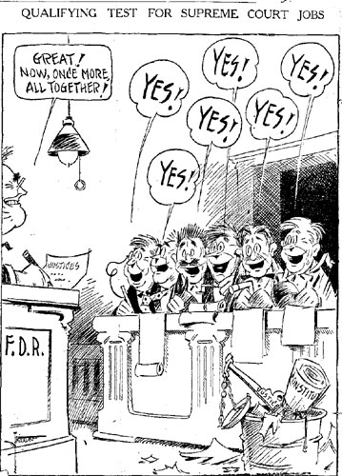

Slide 17
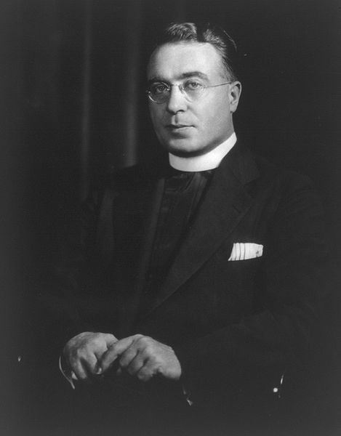
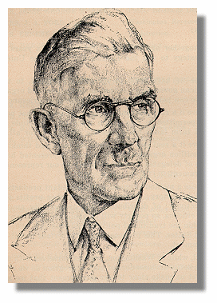
3 Fiery Critics
Father Charles Coughlin
  Initially supported FDR
  Later said FDR’s Reforms weren't enough
  Believed FDR was too easy on Bankers
  Favored guaranteed annual income and the nationalization of banks and railroads
Dr. Francis Townsend
  Promoted a plan to provide monthly benefits to the elderly
  His beliefs were eventually reflected by the Social Securities Act
Notes:
American Liberty League oppose New Deal Measures that violate rights of indiv and property
Caughlin supported then opposed the New Deal but became anti-semetic
Townend said not doing enough and got huge support

Slide 18
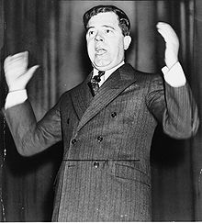
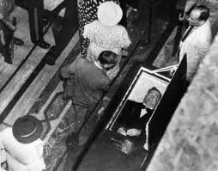
3 Fiery Critics
Huey Long (a.k.a. The Kingfish)
Louisiana Governor and Senator
Came up with a nationwide program called Share-Our-Wealth
Split from Dem Party and planned on running for President in 1936
Assassinated in ‘35
Notes:
Wanted to become president
Promised something for everyone
27K clubs with 7.5 million members; killed at height of popularity

Slide 19
Share-Our-Wealth
No person would be allowed to accumulate a personal net worth of more than 300 times the average family fortune, which would limit personal assets to between $5 million and $8 million. Annual incomes would be limited to $1 million and inheritances would be capped at $5 million.
Every family was to be guaranteed an annual family income of at least $2,000 to $2,500, or not less than one-third of the average annual family income in the United States. Yearly income, however, cannot exceed more than 300 times the size of the average family income.
An old-age pension would be made available for all persons over 60.
To balance agricultural production, the government would preserve/store surplus goods, abolishing the practice of destroying surplus food and other necessities due to lack of purchasing power.
Veterans would be paid what they were owed (a pension and healthcare benefits).
Free education and training for all students to have equal opportunities in all schools, colleges, universities, and other institutions for training in the professions and vocations of life.
The raising of revenue and taxes for the support of this program was to come from the reduction of swollen fortunes from the top, as well as for the support of public works to give employment whenever there may be any slackening necessary in private enterprise.

Slide 20
Effects of the New Deal
Many jobs are created
The banking system is stabilized
The Stock Market is regulated
Programs are created to help the elderly and the poor
Farmers are helped by the government
The government takes a more active role in the economy

Slide 21
Did it work?
Recession of 1937
WWII

