Slide 1
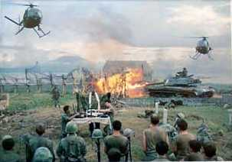

The Vietnam
War
1954 - 1975

Slide 2
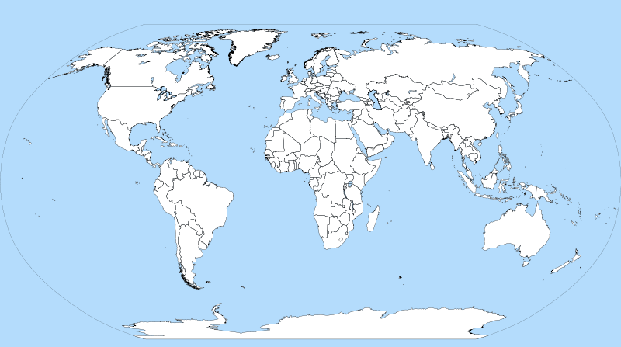

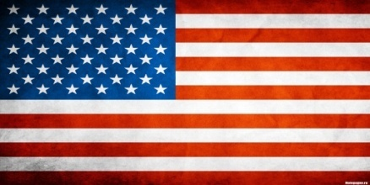



Slide 3
Background to the War
Pre WWII
  France controlled “Indochina” since the late 19th century
During WWII
  Japan took control
After WWII
  Ho Chi Minh declares Vietnam an independent nation
  France attempts to re-colonize
Notes:
Ho Chi Minh had been fighting for Vietnamese independence since World War I.
The U.S. gave France aid to win its support in American anticommunist efforts in Western Europe.

Slide 4
Background to the War
The U.S. provides military aid to prevent another Asian country from becoming communist
Eisenhower believes in the domino theory – one country after another falling to communism
Notes:
Ho Chi Minh had been fighting for Vietnamese independence since World War I.
The U.S. gave France aid to win its support in American anticommunist efforts in Western Europe.

Slide 5
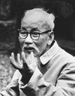
Background to the War
The French lost control to
Ho Chi Minh’s Viet Minh
forces in 1954
The French surrender and pull out of Vietnam
Notes:
Ho Chi Minh had been fighting for Vietnamese independence since World War I.
The U.S. gave France aid to win its support in American anticommunist efforts in Western Europe.

Slide 6
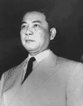
Background to the War
International Conference at Geneva, Switzerland
  →Vietnam was divided at 17th parallel
    Ho Chi Minh’s forces controlled the North
    Ngo Dinh Diem, a French-educated, Roman Catholic
    claimed control of the
    South
Notes:
Realizing he would Diem backs out of elections.

Slide 7
Background to the War
1956: Election were to be held
→ Diem backed out of the elections because he believed that Ho Chi Minh was going to win
→led to Civil war between N. & S. Vietnam
Notes:
Realizing he would lose, Diem backed out of elections.

Slide 8
U.S. Military
Involvement Begins
S. Vietnam under Diem
  →Diem’s family holds all power
  →Elite class takes all the wealth
  →Buddhist majority persecuted
  →Torture, lack of political freedom prevail
Despite this, the U.S. aided Diem’s government
  →Ike sent financial and military aid
  →675 U.S. Army “advisors” sent by 1960.
Notes:
Realizing he would Diem backs out of elections.

Slide 9
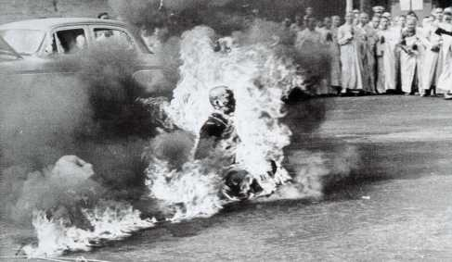
Early Protests of Diem’s Government
Self-Immolation by a Buddhist Monk

Slide 10
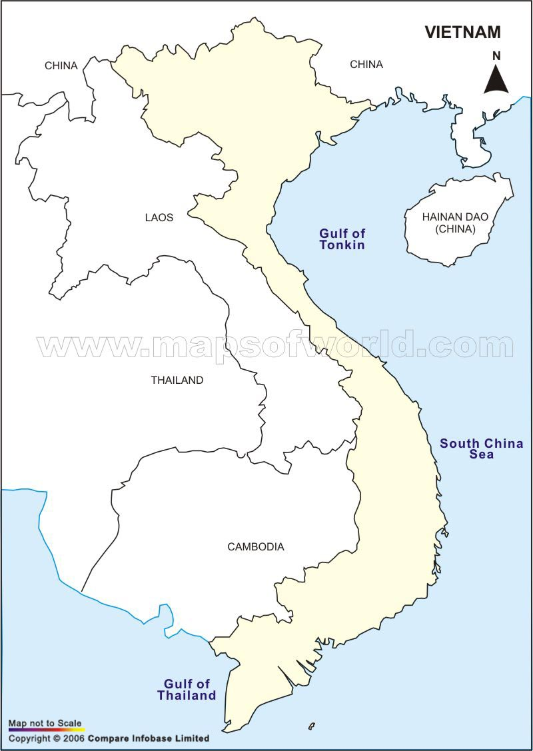



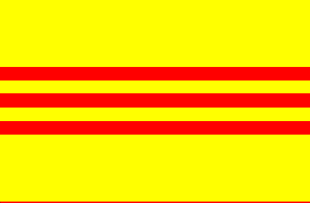

Pre WWII
Vietnam controlled by France
During WWII
Japan Takes Over
After WWII
Vietnam returned to Natives under Ho Chi Minh
France attempts to take back
After WWII
France defeated by Vietnamese
After WWII
Vietnam Divided into two zones
US supports non-communist South

Slide 11
U.S. Military Involvement Begins
Kennedy elected 1960
Increases military “advisors” to 16,000
1963: JFK supports a Vietnamese military coup d'état – Diem and his brother are murdered (Nov. 2)
Kennedy was assassinated just weeks later (Nov. 22)
Notes:
Kennedy’s advisors were clearly fighting a covert war by 1963.
MacNamara has suggested that he believes Kennedy would have pulled the U.S. out, but evidence in inconclusive.
JFK realizes Diem is a liability; offers quiet support to a Vietnamese military coup d’etat.
The coup results in the brutal murders of Diem and his brother
The Vietnamese generals overthrow one another. A relatively stable, but tyrannical government emerges. It is little better than Diem’s.

Slide 12
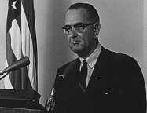
Escalation
LBJ remembers Truman’s “loss”
of China → Domino Theory
revived
I’m not going to be the president who saw Southeast Asia go the way China went.
Notes:
What Johnson told Congress
What he didn’t tell Congress:
He had already written the resolution before the “incident.”
The U.S. naval vessels were aiding ARVN in commando raids in North Vietnam at the time.
He learned that the attack probably hadn’t occurred.
The U.S. navy was not on the “high seas” but in N. Vietnam’s 12 mile territorial limit.

Slide 13
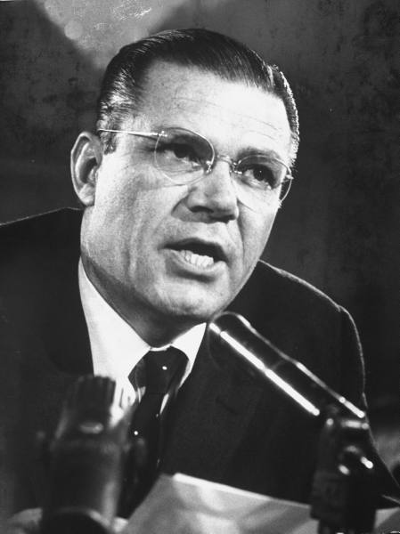
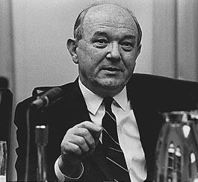
Escalation
Many people in the White House believe more action in Vietnam is necessary
Need a motive/excuse to send in troops
Dean Rusk
Secretary of State
Robert McNamara
Secretary of Defense
Notes:
What Johnson told Congress
What he didn’t tell Congress:
He had already written the resolution before the “incident.”
The U.S. naval vessels were aiding ARVN in commando raids in North Vietnam at the time.
He learned that the attack probably hadn’t occurred.
The U.S. navy was not on the “high seas” but in N. Vietnam’s 12 mile territorial limit.

Slide 14
Tonkin Gulf Incident
1964
U.S. Ship “attacked” off the coast of N. Vietnam
Tonkin Gulf Resolution
- Officially allows US to aid any Asian country resisting communism
- Unofficial beginning of the Vietnam War
Notes:
What Johnson told Congress
What he didn’t tell Congress:
He had already written the resolution before the “incident.”
The U.S. naval vessels were aiding ARVN in commando raids in North Vietnam at the time.
He learned that the attack probably hadn’t occurred.
The U.S. navy was not on the “high seas” but in N. Vietnam’s 12 mile territorial limit.

Slide 15
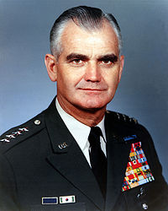
Escalation
American Public: at the time approved of Johnson’s policy of escalation
William Westmoreland
Commander of US Forces
Notes:
What Johnson told Congress
What he didn’t tell Congress:
He had already written the resolution before the “incident.”
The U.S. naval vessels were aiding ARVN in commando raids in North Vietnam at the time.
He learned that the attack probably hadn’t occurred.
The U.S. navy was not on the “high seas” but in N. Vietnam’s 12 mile territorial limit.

Slide 16
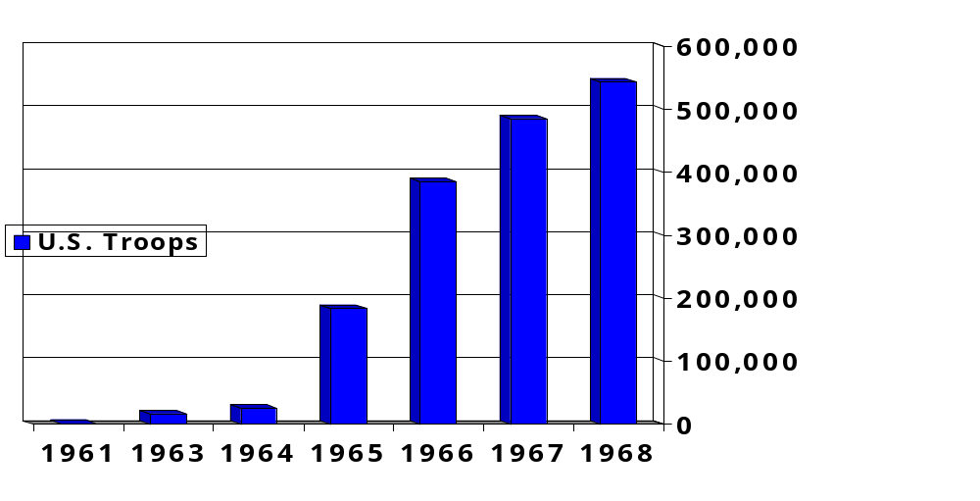
U.S. Troop
Deployments in Vietnam
Notes:
Kennedy’s advisors were clearly fighting a covert war by 1963.
MacNamara has suggested that he believes Kennedy would have pulled the U.S. out, but evidence in inconclusive.
JFK realizes Diem is a liability; offers quiet support to a Vietnamese military coup d’etat.
The coup results in the brutal murders of Diem and his brother
The Vietnamese generals overthrow one another. A relatively stable, but tyrannical government emerges. It is little better than Diem’s.

Slide 17
Vietnam Vocab
Vietminh
Enemy forces located in North Vietnam
Vietnam
Vocab
Vietcong - “VC”
Enemy soldiers in South Vietnam
- Used Guerilla Warfare
- Most of U.S. Casualties seen while fighting this group
Vietnam Vocab
Ho Chi Minh Trail
Series of trails used to supply Vietcong with weapons
Vietnam Vocab
Hanoi
Capital of N. Vietnam and location of POW prisons
Vietnam Vocab
Saigon
-Capital of S. Vietnam
- Renamed Ho Chi Minh City after War

Slide 18
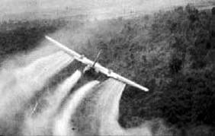
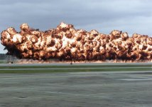
US Military
Advantages
Superior Weaponry
Napalm = Carpet Bombing
Agent Orange
Ability to sustain bombing of North Vietnam and the Ho Chi Minh Trail
→ Operation Rolling
Thunder

Slide 20
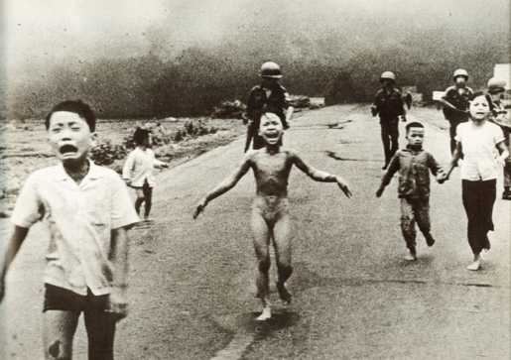
A Napalm Attack

Slide 21
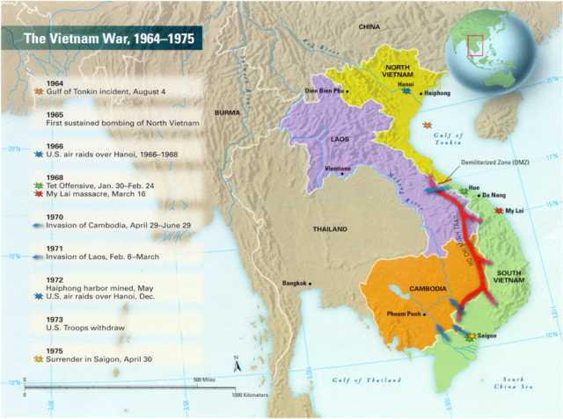
Operation
Rolling Thunder

Slide 22
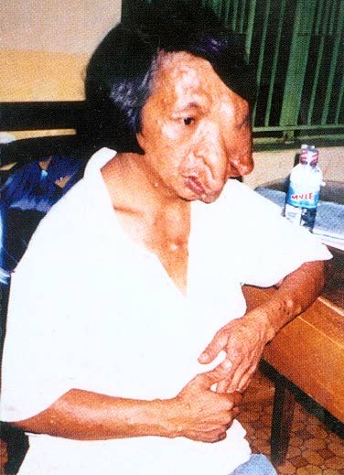
Agent Orange

Slide 23
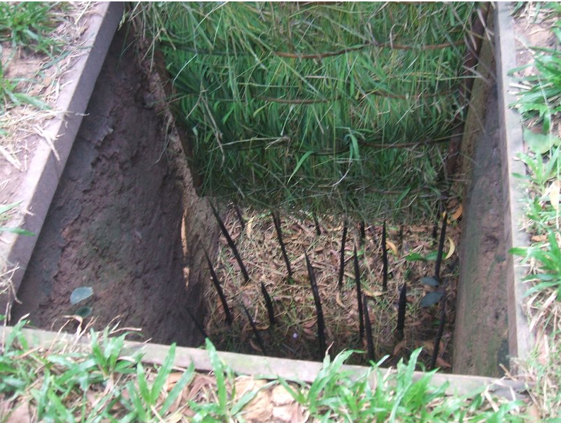
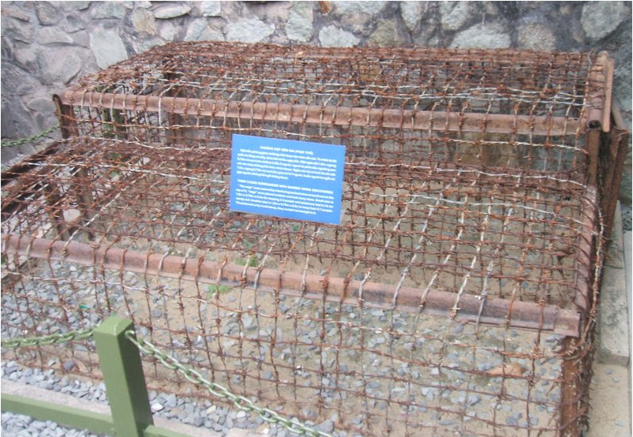
Vietcong
Military Advantages
Knowledge of terrain
Ability to blend in with the civilians
Willingness to pay any price for victory
Guerrilla warfare
  Hit-and-run ambushes
  Booby traps and land mines
  Surprise attacks
Fighting a defensive war
The guerilla wins if he does not lose, the conventional army loses if it does not win. -- Mao Zedong
Notes:
What Johnson told Congress
What he didn’t tell Congress:
He had already written the resolution before the “incident.”
The U.S. naval vessels were aiding ARVN in commando raids in North Vietnam at the time.
He learned that the attack probably hadn’t occurred.
The U.S. navy was not on the “high seas” but in N. Vietnam’s 12 mile territorial limit.

Slide 24
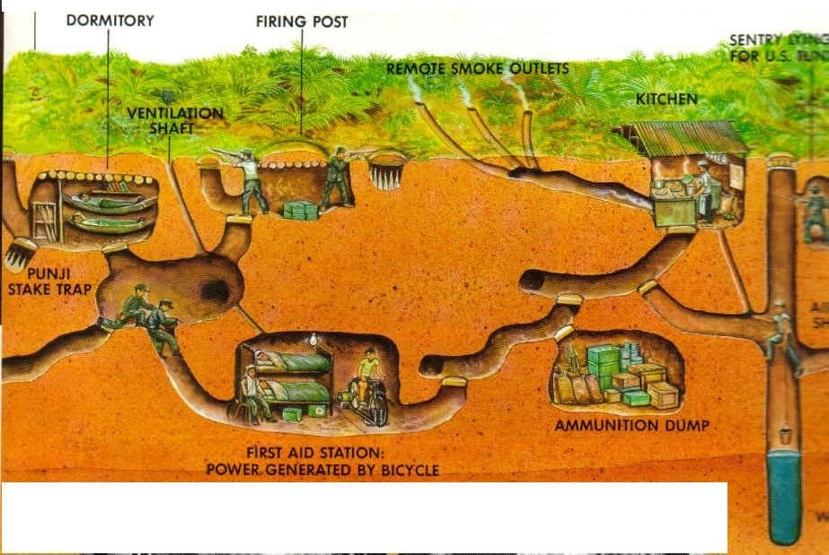

Slide 25
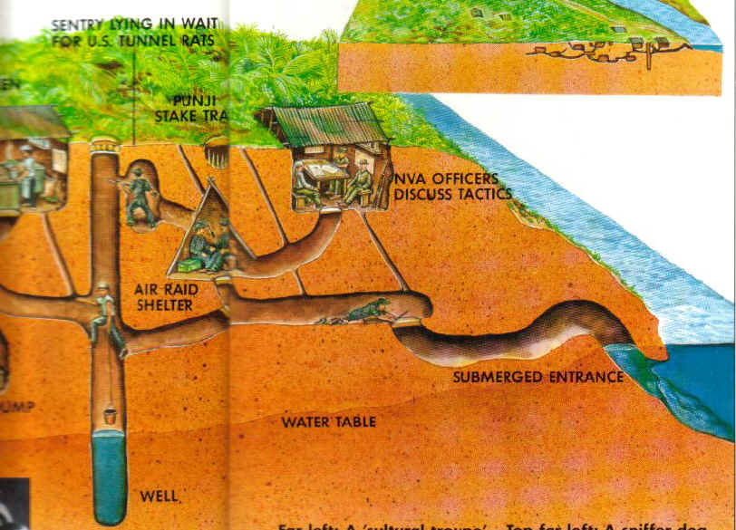

Slide 26
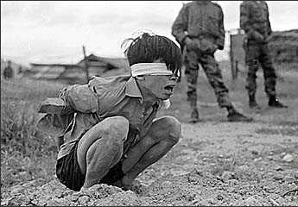
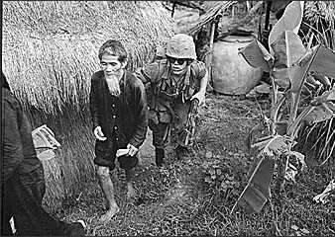
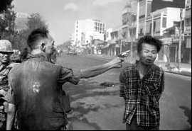
Who Is the
Enemy?

Slide 27
“The general killed the Viet Cong; I killed the general with
my camera. Still photographs are the most powerful
weapon in the world. People believe them, but photographs
do lie, even without manipulation. They are only halftruths...
What the photograph didn't say was, 'What would
you do if you were the general at that time and place on
that hot day, and you caught the so-called bad guy after he
blew away one, two or three American soldiers? How do
you know you wouldn't have pulled the trigger yourself?”
- Eddie Adams, Photographer

Slide 28
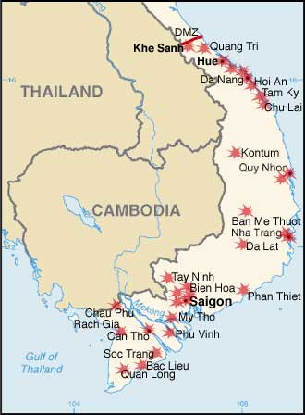
The Tet Offensive, January 1968
Turning point of the war
Massive Vietcong and Vietminh attack on U.S. Military bases and major cities
  Tet = Vietnamese New Years
Americans repel the attack despite being caught off guard
Gen. Westmorland declares “victory”

Slide 29
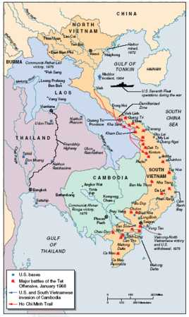
The Tet Offensive, January 1968

Slide 30
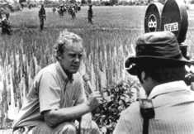
Impact of the
Tet Offensive
VC and Vietminh recover and continue attacks soon after
Becomes the first televised war
  Body counts on TV every night
  “living room” war
American started not supporting the war at home

Slide 31
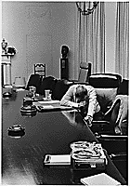
Impact of the
Tet Offensive
Domestic U.S. Reaction: Disbelief, Anger, Distrust of Johnson Administration
Hey, Hey LBJ! How
many kids did you
kill today?

Slide 32

→Johnson’s popularity dropped in 1968 from 48% to 36%.

Slide 33
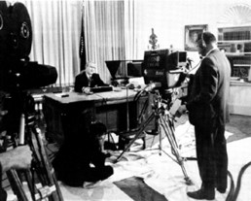
Impact of the Vietnam War
→ Johnson announces (March, 1968):
…I shall not seek, and I will not accept, the nomination of my party for another term as your President.

Slide 34
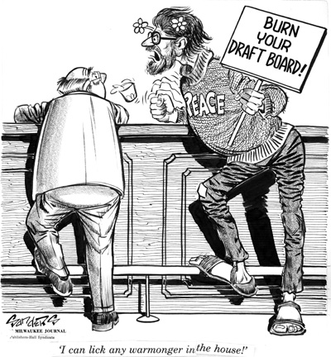
American Morale Begins to Drop
Draft: Ages 18-26
Men sought medical exemptions
  Changed residences
  Joined National Guard (Bush)
  Went to college (usually whites – well off)

Slide 35
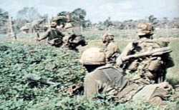
American Morale Begins to Drop
80% of soldiers from lower economic levels
“working class war”
Severe drug problems
Enlisted men in combat for 12 mo.
Racial tension leads to low morale

Slide 36
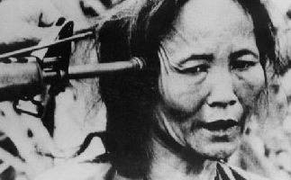
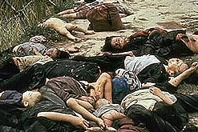
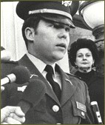
My Lai Massacre
March 16, 1968
US Soldiers killed 347 to 504 unarmed citizens in South Vietnam
Leads to widespread outrage around the world and reduced U.S. support at home for the Vietnam War.

Slide 37


Slide 38

Roots of Anti-War
Demonstrations
Students for a Dem. Society (SDS)
→ New Left: growing youth movement of the 60s
→ Demanding sweeping changes in American Society
→ Called for Participatory Democracy and individual freedom
• Teach-ins – students and teachers across US colleges abandoned their classes to discuss the Vietnam War and their opposition to it

Slide 39
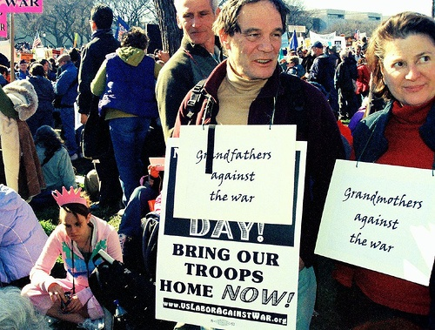
The Protest Movement
Emerges
Movements leads to protest of Vietnam – Why?
→ Conflict in Vietnam was a Civil War – US had no business being there
→ S. Vietnamese no better than Communist N.
Vietnam
→ U.S. cannot police the whole world
→ Morally Unjust

Slide 40
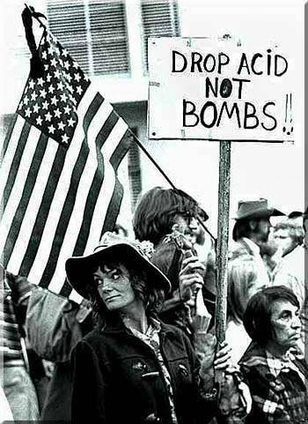
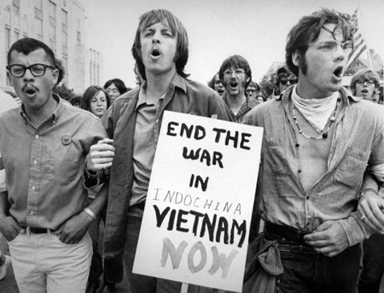
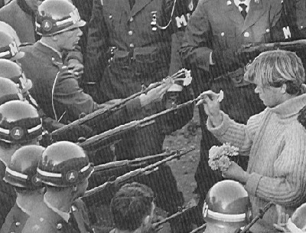
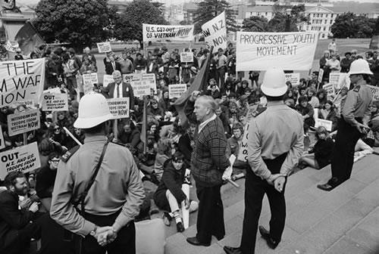

Slide 41
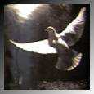
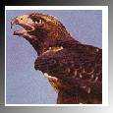
Protest to Resistance
Doves: People who strongly opposed the war
Hawks: People in favor of the war

Slide 42
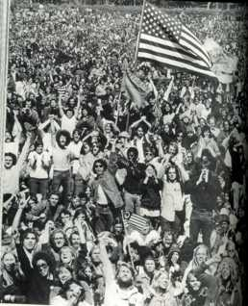
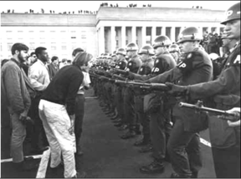
Anti-War
Demonstrations
Columbia University
1967

Slide 43
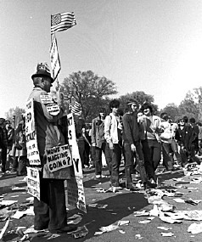
Hell no, we won’t go!

Slide 44
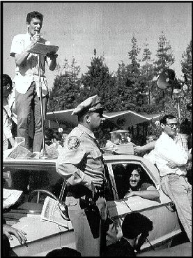
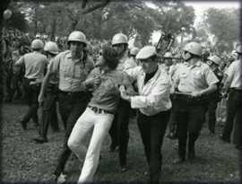
Anti-War Demonstrations
Student Protestors
at Univ. of CA
in Berkeley, 1968

Slide 45
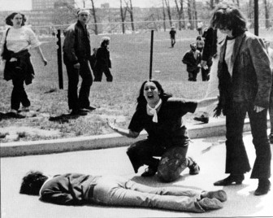
Anti-War Demonstrations
May 4, 1970
4 students
shot dead.
11 students
wounded
Four Dead in Ohio
Kent State University

Slide 46
Excerpt from “Ohio”
By Crosby, Stills, Nash and Young
Tin soldiers and Nixon's comin'.
We're finally on our own.
This summer I hear the drummin'.
Four dead in Ohio.
Gotta get down to it.
Soldiers are gunning us down.
Should have been done long ago.
What if you knew her and
Found her dead on the ground?
How can you run when you know?

Slide 47
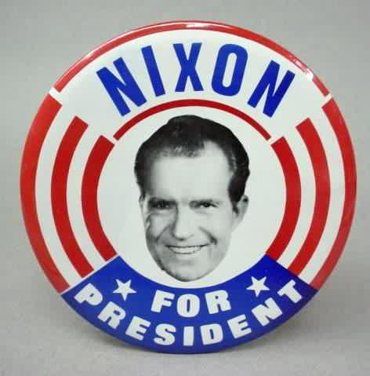
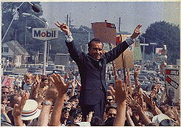
Election of 1968
Richard Nixon (R) vs. Hubert Humphrey (D)
• Nixon wins and promises to “Bring Us Together” and end the war
LBJ did not run for re-election due to unpopularity of the war

Slide 48

Nixon and ‘Nam
Vietnamization
Nixon’s strategy pulling out of Nam
  “Peace with Honor”
  a gradual withdrawal of US troops from Vietnam
  Turn control of the war over to the S. Vietnamese
Invasion of Cambodia
Nixon secretly expanded the war into Cambodia to stop VC
Sparked protests

Slide 49

Paris Peace Accords
Dr. Henry Kissinger & Le Duc Tho
Sec. of State
1973: Ceasefire signed between
  U.S & North Vietnam

Slide 50

The Ceasefire,
1973
Conditions:
U.S. to remove all troops
North Vietnam could leave troops already in S.V.
North Vietnam would resume war
No provision for POWs or MIAs
Last American troops left South
Vietnam on March 29, 1973
Notes:
Many U.S.-loyal South Vietnamese attempt to flee for fear of execution by the North.

Slide 51

The Fall of Saigon
South Vietnamese
Attempt to Flee the Country

Slide 52

The Fall of Saigon
April 30, 1975
America Abandons Its Embassy

Slide 53

The Fall of Saigon
1975: North Vietnam defeats South Vietnam
Saigon renamed Ho Chi Minh City
North Vietnamese
at the Presidential Palace

Slide 54

A United Vietnam
Formerly Saigon

Slide 55
The Costs
3,000,000 Vietnamese killed
58,000 Americans killed; 300,000 wounded
Under-funding of Great Society programs
$150,000,000,000 in U.S. spending
U.S. morale, self-confidence, trust of government, decimated
Notes:
Diversion of capital to the war indirectly caused economic recession: 11% inflation and 12% unemployment!

Slide 56
The Impact
26th Amendment: 18-year-olds vote
Nixon abolished the draft
Disregard for Veterans → seen as “baby killers”
POW/MIA issue lingered
Notes:
War Powers Act., 1973, passed over Nixon's veto, requires the President to
notify Congress within 48 hours of his use of military force in a foreign country or enlarging an ongoing conflict.
The President must secure Congressional approval if he intends to keep these troops overseas for more than 60 days. If he doesn't, he must withdraw the forces.
Congress can pass a joint resolution to withdraw the troops before the 60 day deadline. (Each President since has denied its validity, though the issue has never been tested.)
No welcome home (shamed and ashamed), high unemployment, alcohol & drug abuse; poor care of disabled vets: underfunded vets hospitals, Post-Traumatic Stress Disorder; Agent Orange health problems, birth defects in vets’ children.

Slide 57
Effects of Vietnam
Distrust of Government
70% - To avoid a humiliating U.S. defeat.
20% - To keep [South Vietnam] (and the adjacent) territory from Chinese hands.
10% - To permit the people [of South Vietnam] to enjoy a better, freer way of life.
ALSO - To emerge from the crisis without unacceptable taint from methods used.
NOT - To 'help a friend'
Pentagon Papers - 1971
Secret study of US involvement in Vietnam that was leaked to the NY Times
Revealed that American leaders lied to Congress and the American people regarding Vietnam
NY Times v. United States

Slide 58
Effects of Vietnam
Distrust of Government
War Powers Act - 1973
Passed in response to Pent. Papers and the expansion into Cambodia
limited President’s powers, had to get consent from Congress before sending troops

Slide 59


Some American POWs Returned from the
“Hanoi Hilton”
Senator John McCain
(R-AZ)

Slide 60

2,583 American
POWs / MIAs
still unaccounted for today.

Slide 61

And
in the End….
Ho Chi Minh:
If we have to fight, we
will fight. You will kill
ten of our men and we will kill one of yours, and in the end it will be you who tires of it.

Slide 62
Lessons for Future
American Presidents
Wars must be of short duration.
Wars must yield few American casualties.
Restrict media access to battlefields.
Develop and maintain Congressional and public support.
Set clear, winnable goals.
Set deadline for troop withdrawals.

Slide 63

The Vietnam Memorial, Washington, D.C.

Slide 64

Memorial to US Servicemen in Vietnam

Slide 65

Memorial to US Nurses in Vietnam

Slide 66

58,000

Slide 67
President Clinton formally recognized Vietnam on
July 11, 1995

Slide 68




Where Were You in the War, Daddy?
This war haunts us still!

