Slide 1

The War Ends?

Slide 2
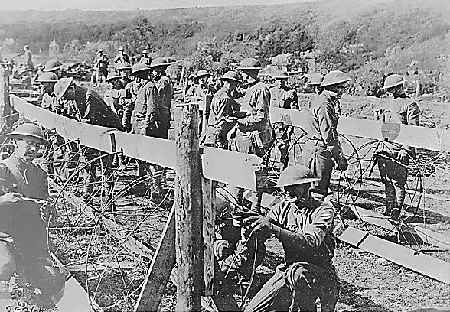
America Enters the WAR!
1917 - Bolshevik Revolution
  Monarchy overthrown
  Russia signs a peace with Germany
  Germans shift full attention to France
US now ready to enter the War
  Bring fresh troops to the front
American Engineers at the Battle of Saint-Mihiel

Slide 3
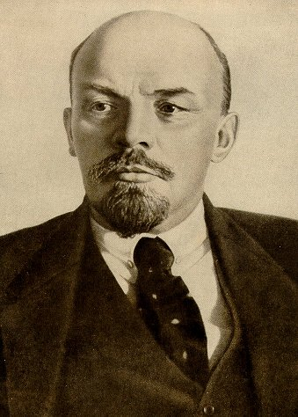
Vladimir Lenin
His early years
  exiled to Siberia in 1897
Committed to class struggle and revolution
Bolshevik Party renamed Communist Party in March 1918

Slide 4
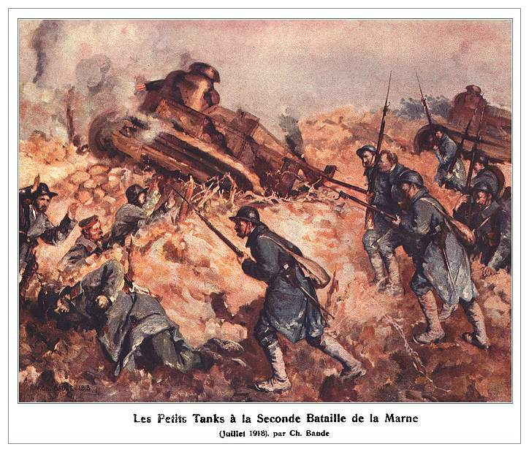
Second Battle of Marne - 1918
Turning point of the War
  Germans kept out of Paris
  Allies begin to push Germans out of France
  Central powers begin surrendering

Slide 5
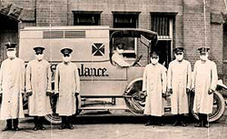
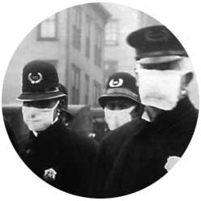
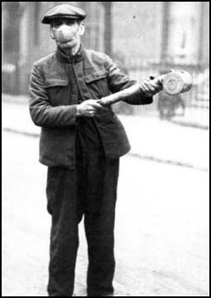
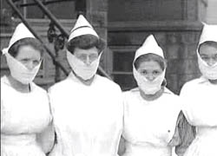
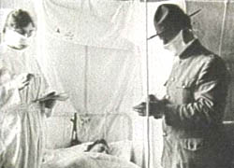
1918 Flu Pandemic:
Depletes All Armies
20 – 50 million deaths world wide

Slide 6
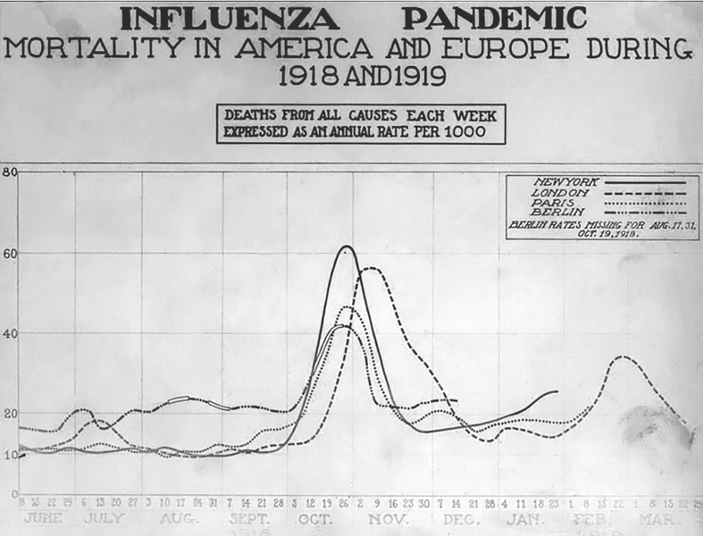

Slide 7
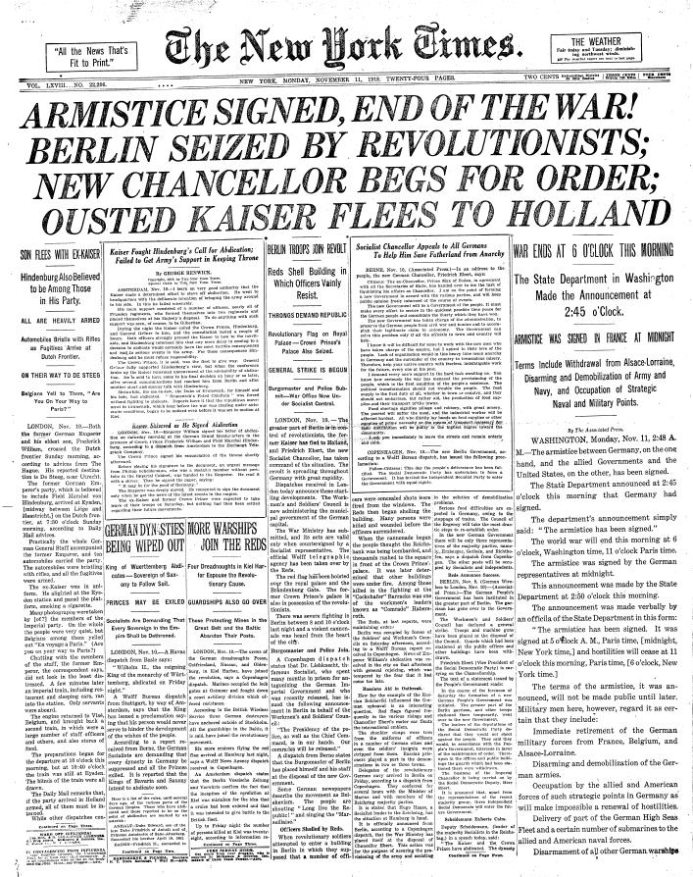
Germany Collapses
Nov. 3, 1918:
  Austria-Hungary surrenders
Germans begin to rebel
  Too exhausted to fight
Nov. 9 1918
  Socialist leaders seize Berlin
  Kaiser gives up throne
Armistice - ceasefire
  Nov. 11 at 11pm.
Notes:
22 million dead costing about $338 billion, 48K dead US and 200K wounded

Slide 8
“The war to end all wars?”
Nations Involved – 30
Deaths - 26 million
Injuries – 20 million
Refugees - 10 million
Estimated cost –
  $350,000,000
Notes:
22 million dead costing about $338 billion, 48K dead US and 200K wounded

Slide 9
Final Toll of War
Mobilized Dead Wounded Missing/POW
Russia 12,000,000 1,700,000 4,950,000 2,500,000
Germany 11,000,000 1,773,700 4,216,058 1,152,800
Great Britain 8,904,467 908,371 2,090,212 191,652
France 8,410,000 1,375,800 3,266,000 537,000
Austria-Hungary 7,800,000 1,200,000 3,620,000 2,200,000
Italy 5,615,000 650,000 947,000 600,000
US 4,355,000 126,000 234,300 4,526
Turkey 2,850,000 325,000 400,000 250,000
Bulgaria 1,200,000 87,500 152,390 27,029
Japan 800,000 300 907 3
Romania 750,000 335,706 120,000 80,000
Serbia 707,343 45,000 133,148 152,958
Belgium 267,000 13,716 44,686 34,659
Greece 230,000 5,000 21,000 1,000
Portugal 100,000 7,222 13,751 12,318
Montenegro 50,000 3,000 10,000 7,000

Slide 10
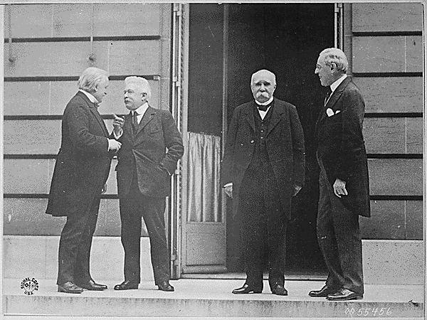
The Peace Conference
Invited - “Big Four”:
  Clemenceau- France
  George- Britain
  Orlando- Italy
  Wilson- United States
Not Invited
  Russia
  Central Powers
Wilson brings his plan to prevent future wars
  “Wilson’s 14 Points”
The Big Four

Slide 11
Wilson’s 14 Points
Points # 1-5
  No secret treaties
  Freedom of the seas
  Tariffs among nations should be lowered
  Militaries should be reduced
Points # 6-13
  Self Determination
  Let the people choose
Point #14
  League of Nations
Wilson gives up most of 14 points to keep League of Nations
The Big Four

Slide 12
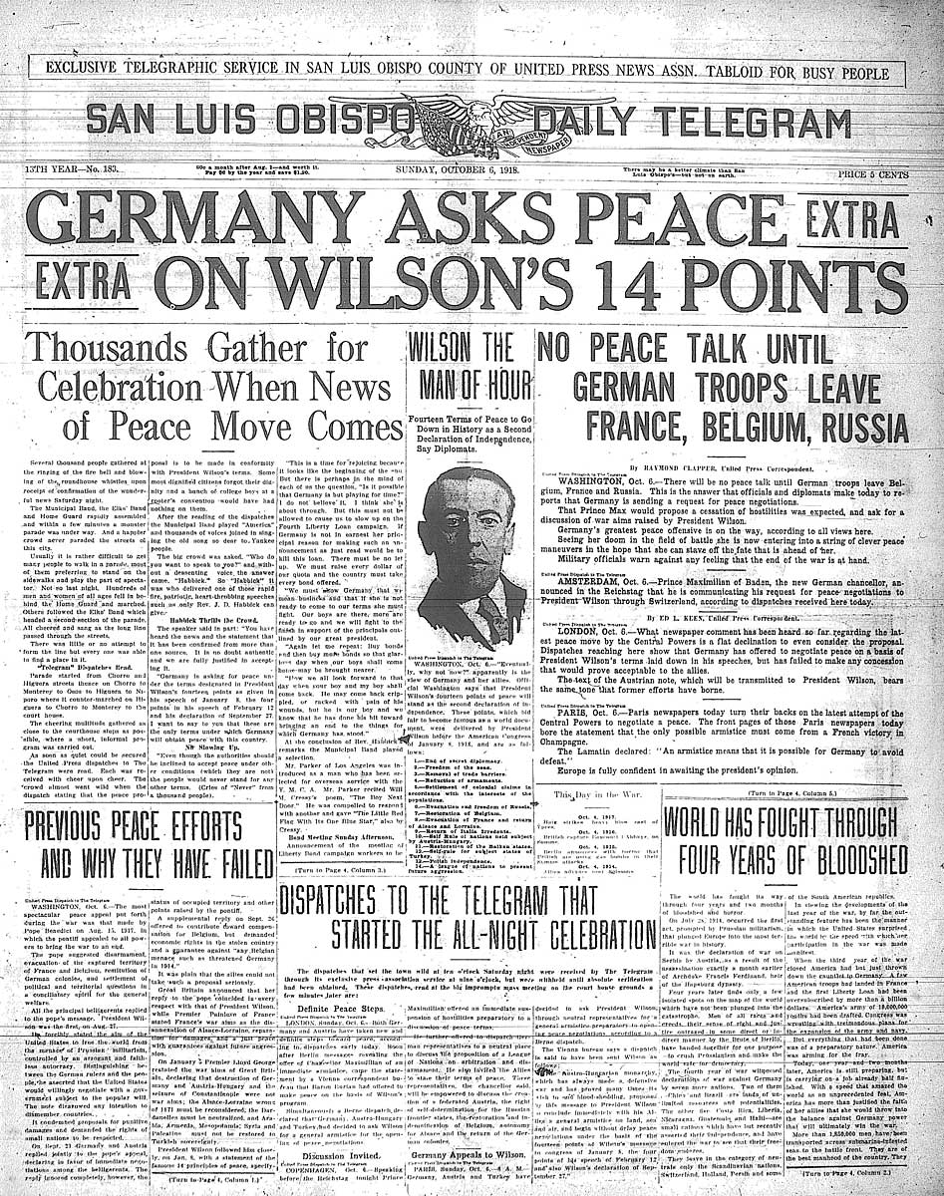
Wilson’s 14 Points

Slide 13
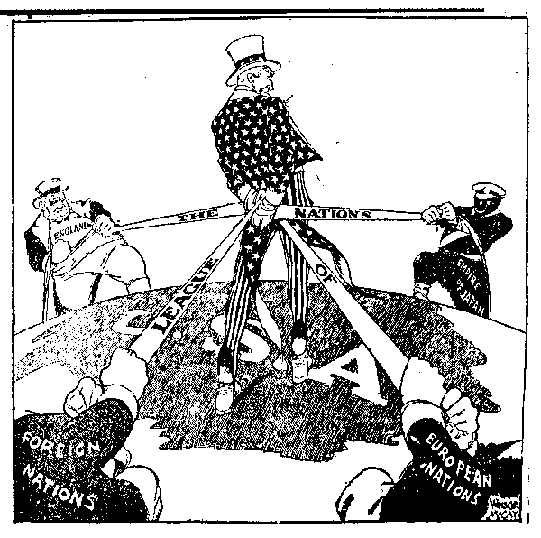
League of Nations

Slide 14
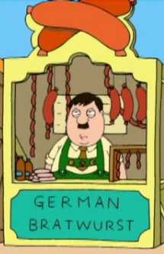
Treaty of Versailles - 1919
Terms
  Ottoman Empire and Austria-Hungary broken up
    9 New nations (Poland, Czech., Yugoslavia)
  Germany Punished
    Blame
      Forced to sign war guilt clause
    Reparations
      Forced to pay $33 Billion in war reparations
    Army
      Army reduced to 100,000 soldiers
    Territory
      – Lost land to France, Poland, Denmark and Belgium

Slide 15
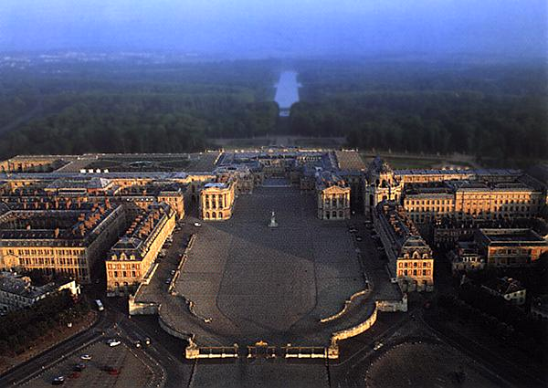
Treaty of Versailles - 1919
The Great Hall of Palace of Versailles
  Located in France
  War Guilt Clause
The Allied governments affirm, and Germany accepts, the responsibility of Germany and her allies for causing all the loss and damage to which the Allied governments and their peoples have been subjected as a result of the war.
- Clause 231

Slide 16
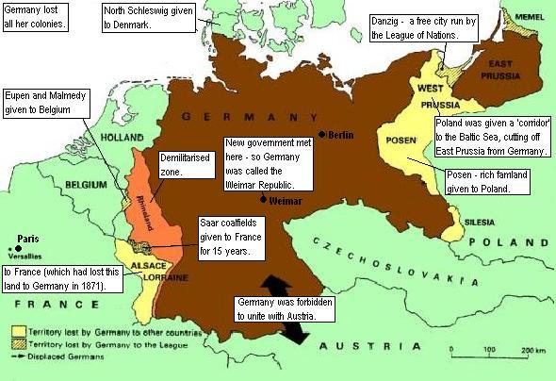

Slide 17
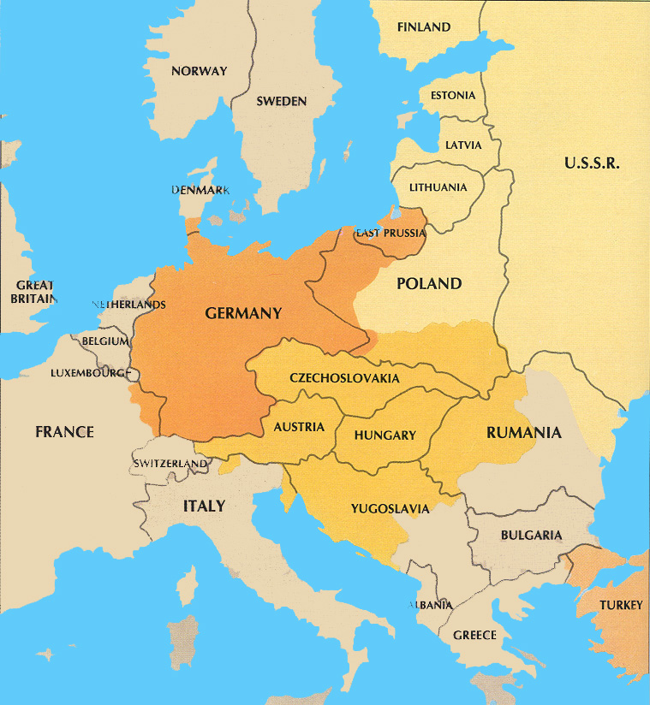
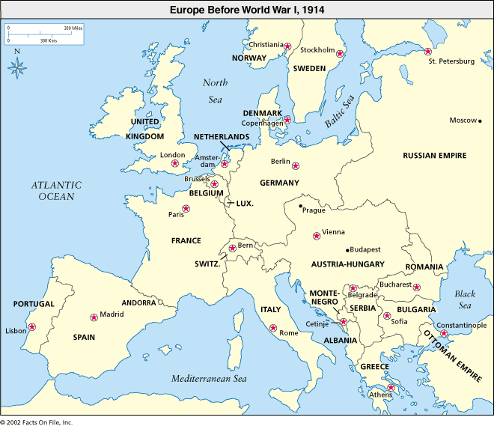
Before and After

Slide 18
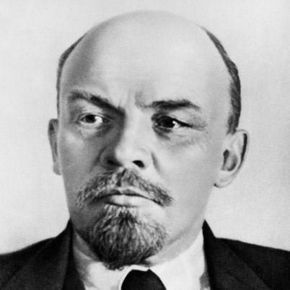
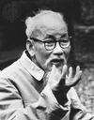
Weaknesses of the Treaty
Humiliated Germany
  Depression hits
  Eventually leads to rise of Adolf Hitler
Russia ignored
  Leads to bitterness towards winning countries
  Rise of Communism
Colonized people in S.E. Asia ignored
  Vietnam still controlled by French
  Philippines still controlled by U.S.

Slide 19
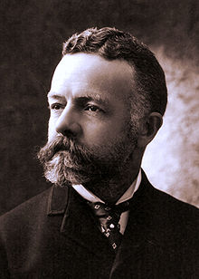
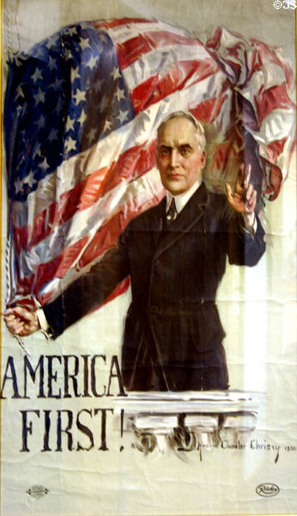
Weaknesses of the Treaty
The U.S. refuses to ratify
  Republicans want “amended” version
  Worried alliance would drag US into future wars
  Led by Henry Cabot Lodge
    Lodge Reservations
Wilson’s Illness
  Has stroke during Pro- Treaty tour of the country.
  Unable to drum up support for treaty
Election of 1920
  Harding wins on slogan “Return to Normalcy”
  Shows Americans are tired of progressivism/war

Slide 20
Domestic Consequences of the War
Social
Immigration
  First RED SCARE!!!
  Reemergence of KKK
Women
  19th Amendment
African American’s
  Great Migration
Economic
  U.S. = Industrial Power
  Labor Unrest
Political
  Isolationism
  “Return to Normalcy”
  End of Progressivism

Slide 21
Source
Chris Balga – Hickory Ridge HS, NC

