Slide 1
Section 9-2
Manifest
Destiny

Slide 2
Trends in Antebellum (Pre-Civil War) America: 1810-1860
New intellectual and religious movements.
Social reforms.
Beginnings of the Industrial Revolution in America.
Re-emergence of a second party system and more political democratization.
Increase in federal power → Marshall Ct. decisions.
Increase in American nationalism.
Further westward expansion.

Slide 3
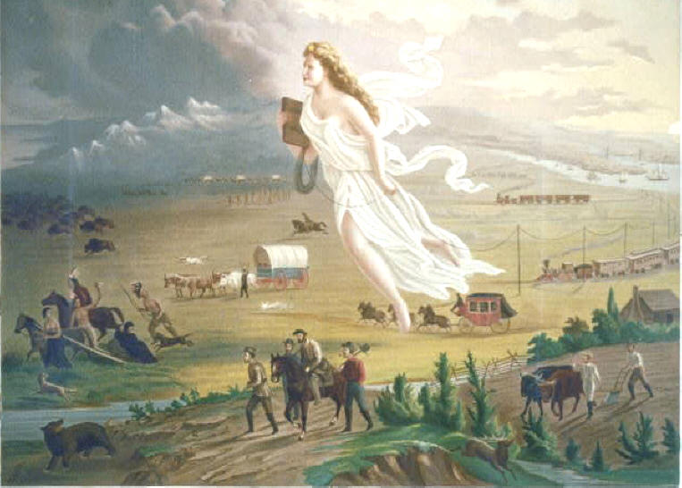
“Manifest Destiny”
First coined by newspaper editor, John O’Sullivan in 1845.
The belief that America had the god given right to expand the U.S.’s borders from “sea to shining sea”
by John Gast, 1872

Slide 4
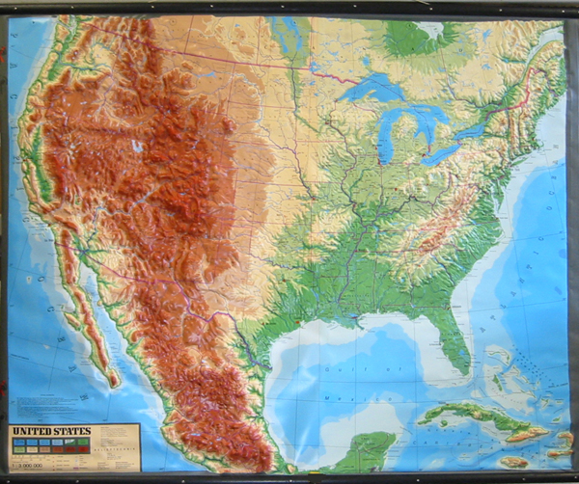
LAND ACQUISITIONS
How the borders of the continental U.S. are formed.

Slide 5
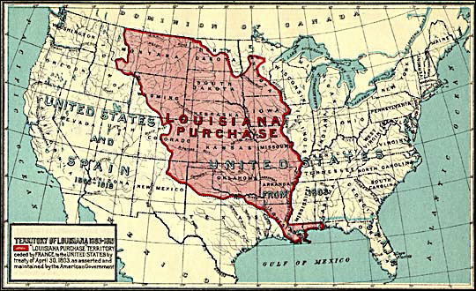
Louisiana Purchase
1803
Thomas Jefferson
Doubled the size of the nation

Slide 6
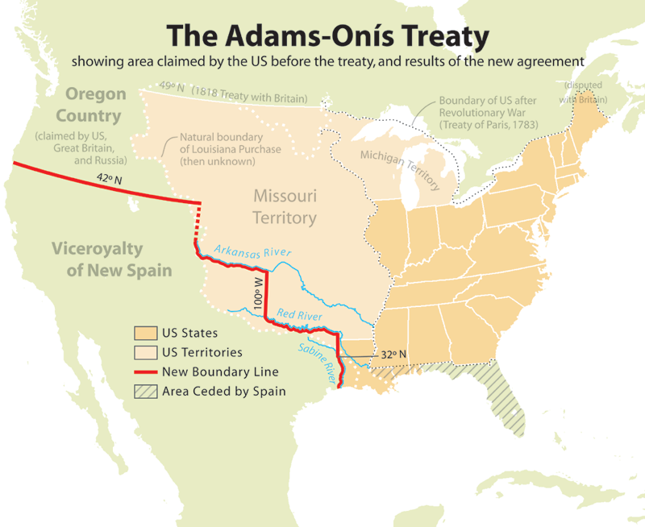
Adams-Onis Treaty
Ceded Florida to U.S. (1819)
Set U.S./Spanish Border at 42 degrees North

Slide 7
Missouri Compromise of 1820
Missouri enters as a slave state
Maine enters as a free state
Line between free and slave states set at 36º30’ latitude for states formed out of Louisiana Territory
SIGNIFICANCE: The nation compromises! The nation will maintain a balance between free and slave states.

Slide 8
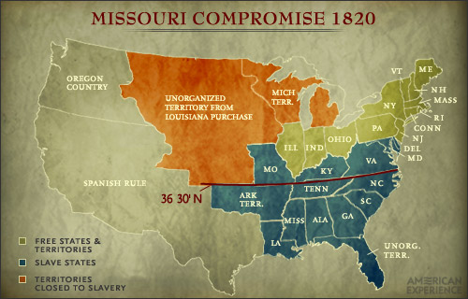
http://www.pbs.org/wgbh/amex/lincolns/politics/es_shift.html

Slide 9
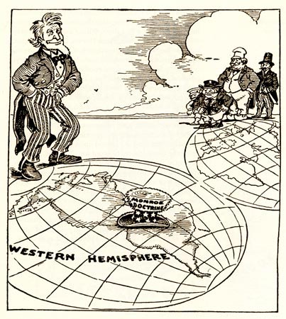
FOREIGN POLICY
Monroe Doctrine
  1823
  President Monroe
  European nations cannot interfere in the affairs of the Western Hemisphere

Slide 10
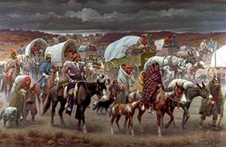
Indian Removal Act of 1830
President Andrew Jackson
Native Americans east of the Mississippi River must move west
Cherokee Indians were forced on the Trail of Tears

Slide 11
Aroostook “War,” 1839
The only war ever declared by a state.
  Between the Canadian region of New
  Brunswick and the state of Maine.
  Cause: The expulsion of Canadian lumberjacks in the disputed area of Aroostook by Maine officials.
Congress called up 50,000 men and voted for$10,000,000 to pay for the “war.”
General Winfield Scott arranged a truce, and a
border commission was convened to resolve the issue.

Slide 12
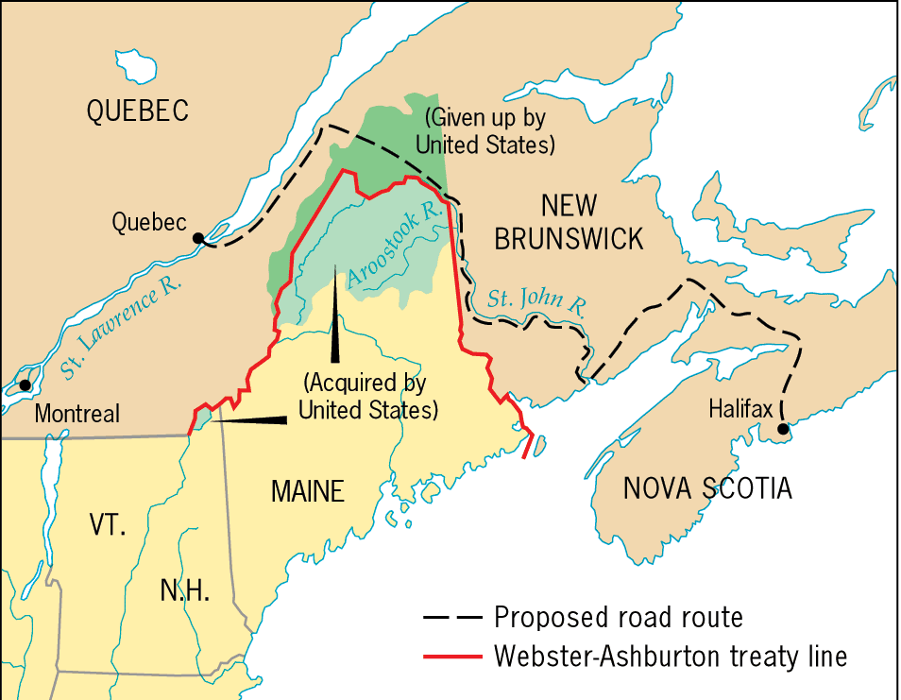
Maine Boundary Settlement, 1842

Slide 13
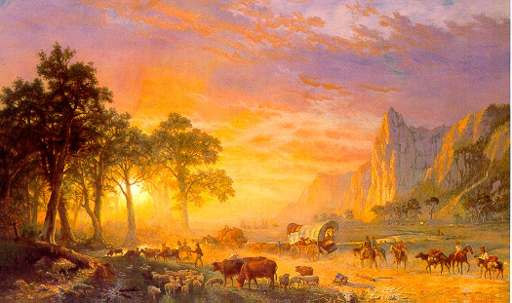
Settlers Headed to Oregon

Slide 14
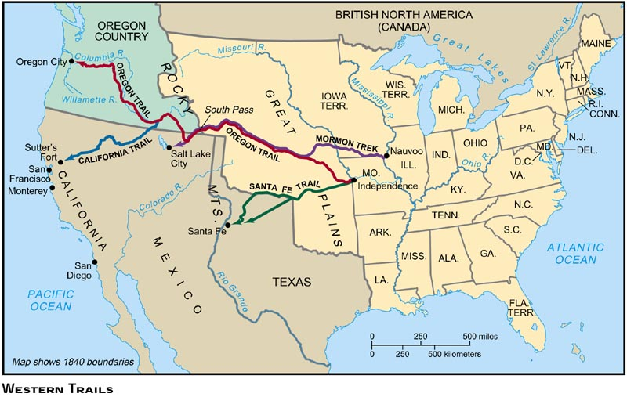
The Oregon & Santa Fe Trail (1840s)

Slide 15
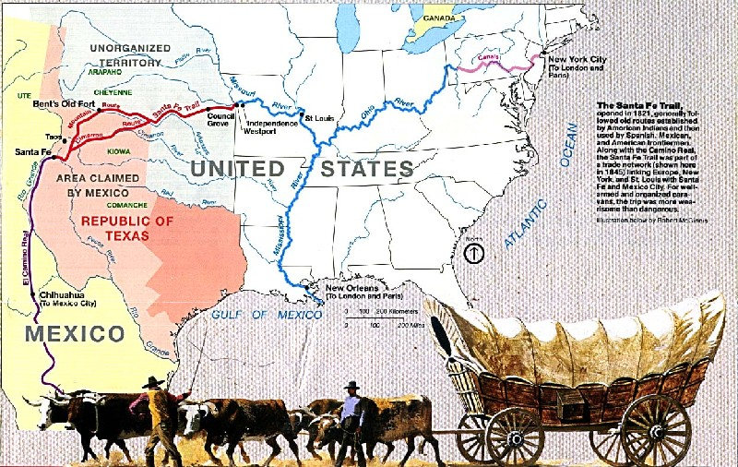
Settlers Headed to New Mexico
A trade route between U.S. & Mexico before the war
During the war, a military route for the U.S. Army

Slide 16
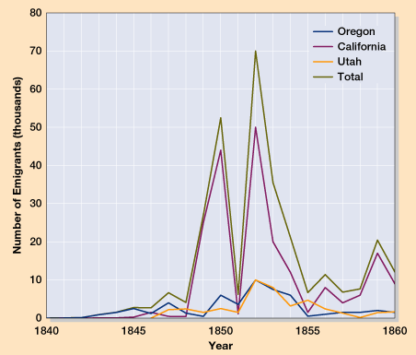
Overland Immigration to the West
Between 1840 and
1860, more than
250,000 people
made the trek
westward.

Slide 17
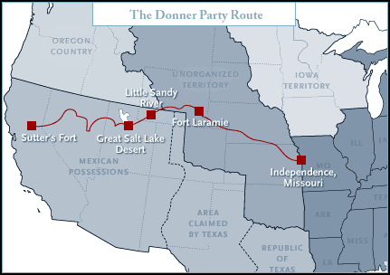
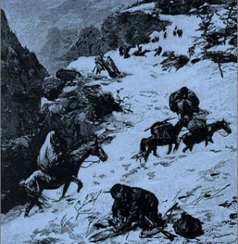
The Doomed Donner Party
April, 1846 – April, 1847

Slide 18
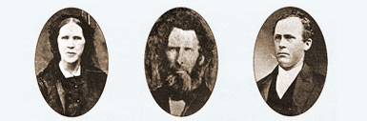
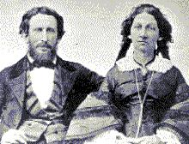
The Doomed Donner Party
CANNIBALISM ! !
Margaret Patrick John
Breen Breen Breen
Of the 83 members of the Donner Party, only 45 survived to get to California!
James Reed & Wife

Slide 19
Mormons Headed to Utah
1846-57
Joseph Smith established the Latter Day Saints (Mormons) in the Midwest
In the Midwest, they experienced conflict because of social, political, and religious beliefs
Brigham Young established The Church of Jesus Christ of Latter-day Saints and moved west to the Great Basin in Utah

Slide 20
"Fifty-Four Forty or Fight!"
1844 – Presidential Candidate James Polk supported the 54°, 40’ as boundary for annexation of Oregon
  Idea of manifest destiny
  Entrance of Texas as slave state, Oregon as free state
  "Fifty-Four Forty or Fight!“ (northern border of Oregon Country)
1846 – Britain cedes Oregon Country to the U.S.
  Establish the 49th Parallel as the border between British Canada and the U.S.
1848 – U.S. portion of Oregon Country became Oregon Territory

Slide 21
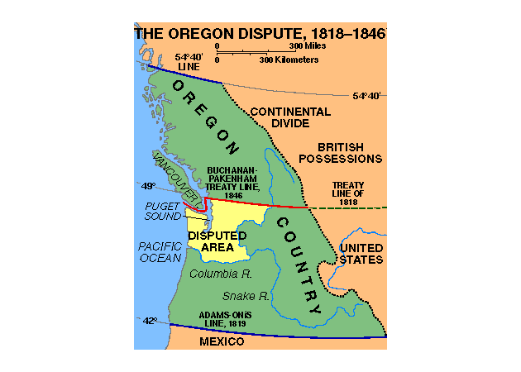
The Oregon Dispute: 54’ 40º or Fight!
http://spider.georgetowncollege.edu/htallant/courses/his325/OREGON.gif

Slide 22
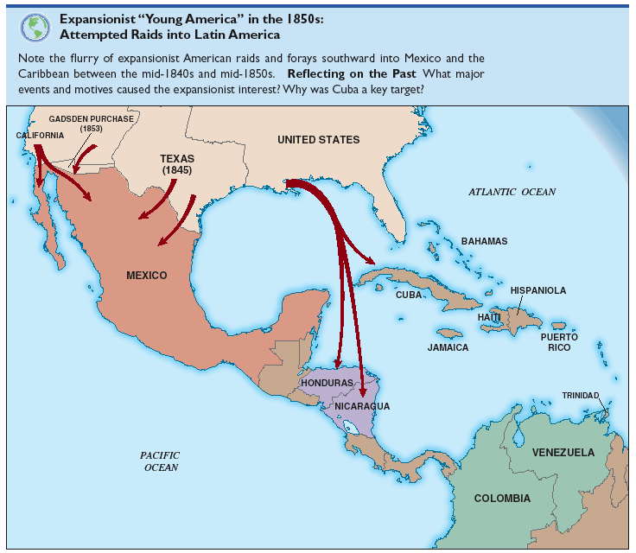
Expansionist Young America in the 1850s
America’s Attempted Raids into Latin America
Ostend Manifesto: Secret document leaked to public in 1854. Proslavery Southerner hoped Pres. Pierce would annex Nicaragua and steal Cuba from Spain

Slide 23
Old School

