Slide 1
World War I
On the Homefront

Slide 2
War
Mobilization

Slide 3
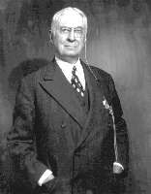
War Industries Board
In 1917 the War Industries Board is established and led by Bernard Baruch
  1. Encouraged companies to use mass-production techniques
  2. Helped to eliminate waste
  3. Set prices for goods sold causing profits to soar during the war
Bernard M. Baruch
Notes:
Congress gave Wilson direct control over much of the economy (fix prices and regulate war related industries)
Production increased 20%
Retail prices soared b/c applied price controls at wholesale level

Slide 4
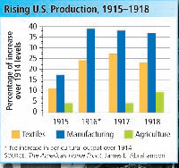

Slide 5
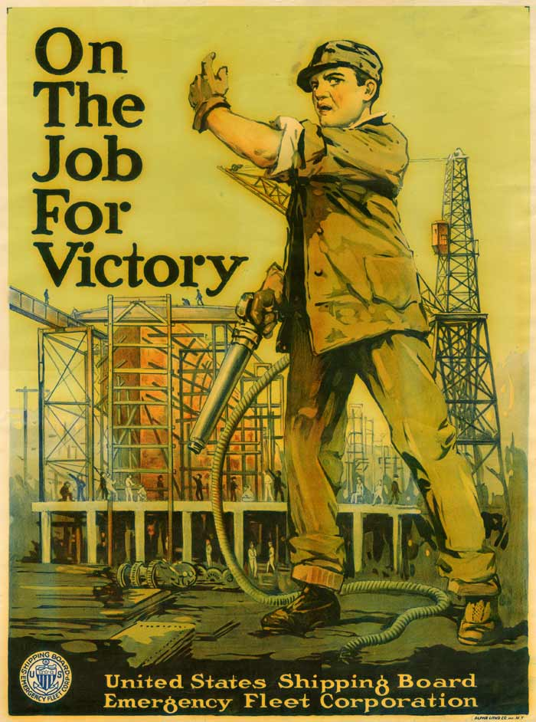
U. S. Shipping Board

Slide 6

U. S. Fuel Administration
Gas-Less Sundays
Day Light Saving Time

Slide 7

Food Administration (FA)
Led by Herbert Hoover
No rationing but “–less days”
  Meatless days
  Sweetless days
  Wheatless days
  Porkless days
Promoted Victory Gardens
  Plant your own food
Notes:
Blue color wages increased 20%
Household income reduced because of rising food and housing costs
Stockholder profits rose 1600% between 1914-18
Union membership rose to 4 million due to pay discrepancy and dangerous conditions
6000 strikes broke out during war months
No rationing but one day is “meatless”, another “porkless”

Slide 8
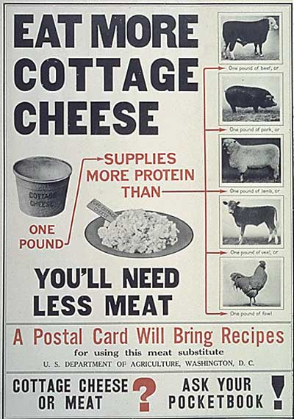

Slide 9

U. S. Food Administration

Slide 10
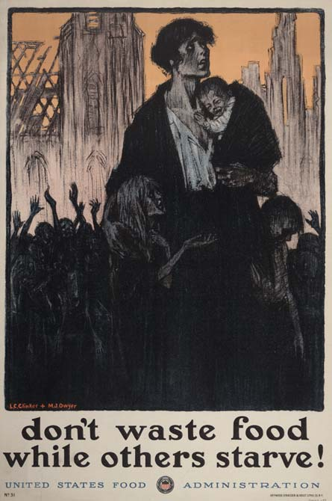
U. S. Food Administration

Slide 11
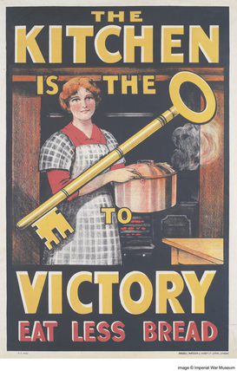

Slide 12
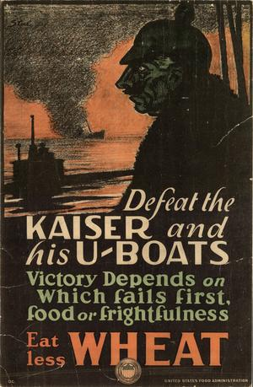

Slide 13
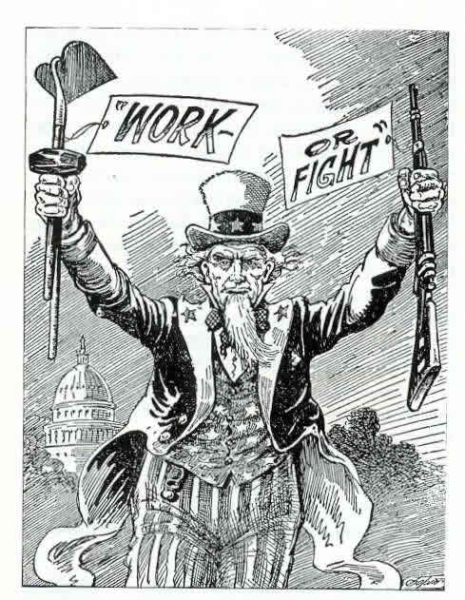
War Labor Board (WLB)
War Labor Board
  Work or FIGHT!
  Worked for better working conditions
  Enforced ban on child labor
Notes:
Blue color wages increased 20%
Household income reduced because of rising food and housing costs
Stockholder profits rose 1600% between 1914-18
Union membership rose to 4 million due to pay discrepancy and dangerous conditions
6000 strikes broke out during war months
No rationing but one day is “meatless”, another “porkless”

Slide 14

Committee on Public Information
Spread propaganda to promote the war
Headed by George Creel
Top artists and writers designed propaganda
Notes:
US spent $35.5 billion
Raised through various taxes (income tax), war-profits tax, and higher excise taxes on tobacco, liquor, luxury goods and sold bonds
Distributed 75million pamphlets, books and leaflets in different languages

Slide 15
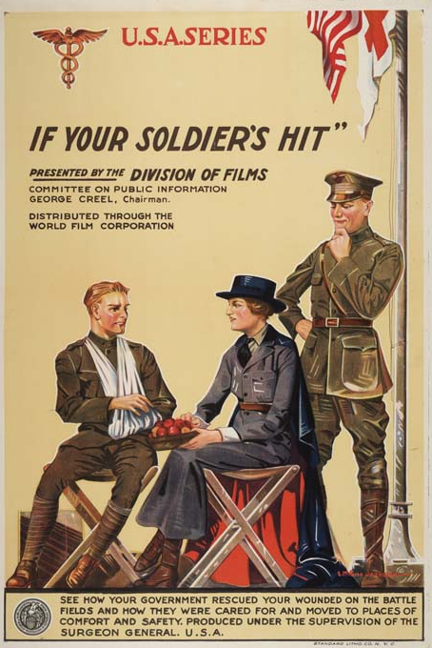
Creel Commission Film

Slide 16
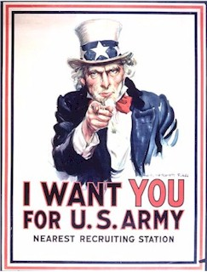
The Most Famous Recruitment Poster
propoganda

Slide 17
Civil Liberties

Slide 18
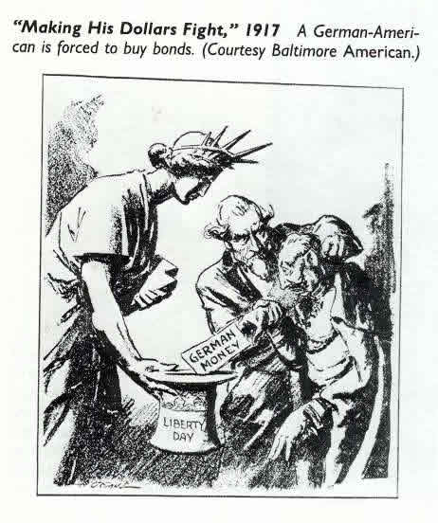
Espionage and Sedition Act
1917-18 Congress passed Espionage and Sedition Acts
  Could be fined or go to jail for hindering the war effort
  Very vague law
Americans targeted Germans
Led to over 2000 prosecutions for “loose” offenses
Notes:
Attacks against German Americans rose
Lost their jobs, refused to play German music (Mozart, Bach), changed town names, removed German authors’ books
Renamed hamburger “Salisbury Steak” or “liberty sandwich”

Slide 19


Schenck v. United States
Charles Schenck
  Socialist
  Distributed leaflets saying the draft was wrong
Put in prison under Sedition Act
Supreme Court upheld conviction
  Freedom of speech not always protected during War Time

Slide 20
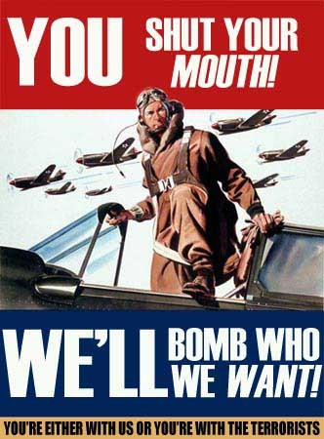

Slide 21
Immigrants

Slide 22


Immigrants
Germans faced anti-immigrant attacks
People with German last names lost their jobs
Schools stopped teaching German language
Orchestras refused to play music of German artists
Hamburger renamed Salisbury Steak or Liberty Steak
Dachshunds renamed “liberty pups”

Slide 23
African-Americans

Slide 24
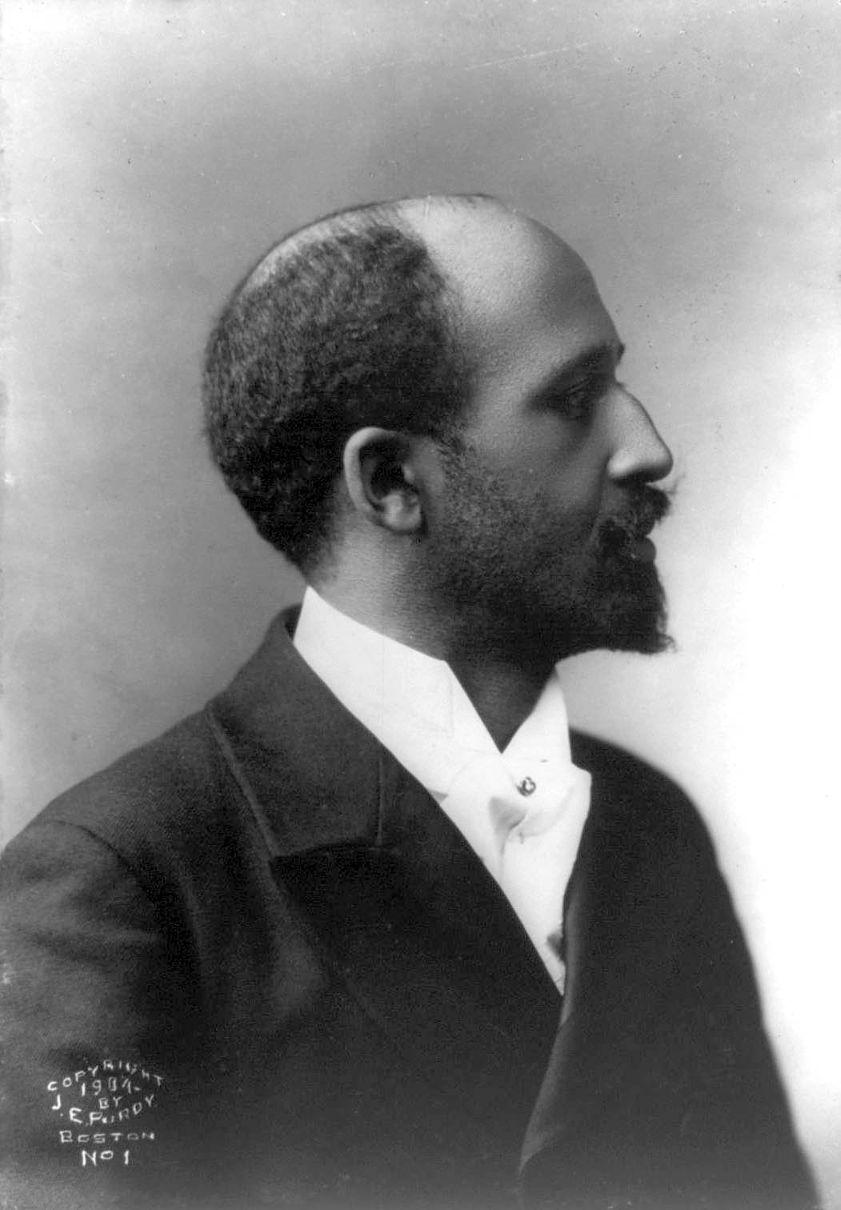
The War Brings Social Change
W.E.B. Du Bois said Af-Am support for war would lead to racial justice
William Trotter believed African-Americans should not support a racist government
W.E.B. Du Bois
Notes:
Escape racial injustice in south
More job opportunities
Racial prejudice still in the North

Slide 25
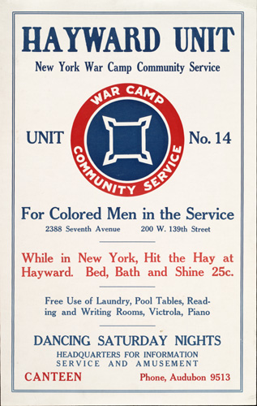
For “Colored” Men in Service

Slide 26
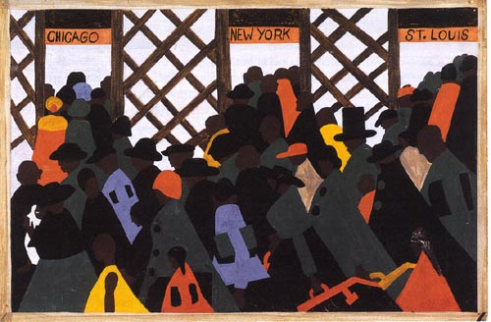
African-American Response
Most African-Americans backed the war
The Great Migration (1910-30)
  - Escape racist south and move North
  - More job opportunities

Slide 27
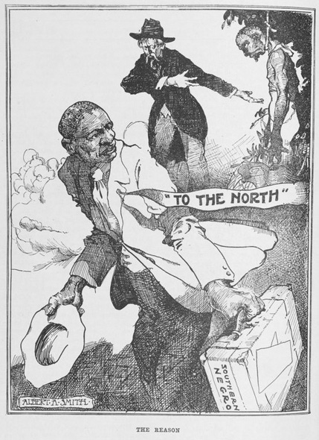

Slide 28
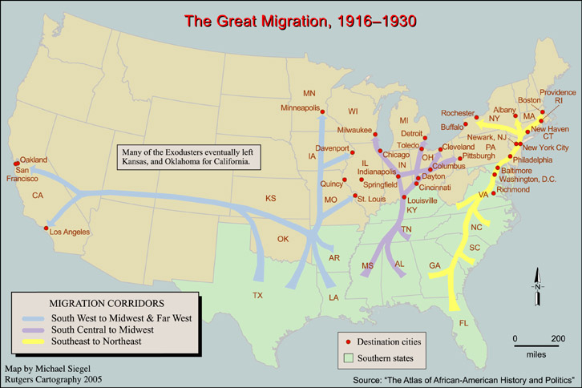

Slide 29
Women

Slide 30

Women and the War
Worked “men’s” jobs
Served as volunteers in Red Cross
Railroad Workers, Cooks, Bricklayers, Coal Miners
Gained respect leads to the 19th Amendment
Notes:
Jane Addams founded Women’s Peace Movement
1920 ratified by states

Slide 31
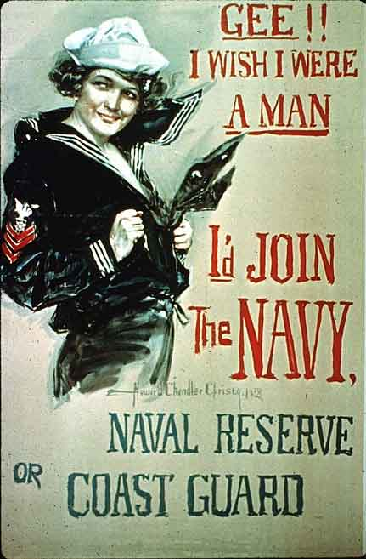
Women Used In Recruitment

