Slide 1
The American Revolution and Beginning a New Nation
1775 - 1787
Due to continuous conflict over British treatment of the colonies, America entered into a revolution that would ultimately lead to the creation of a new, independent country.

Slide 2
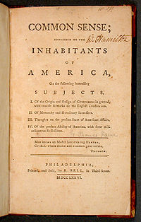
Goals of the War
2nd Cont. Congress meets shortly after war begins
  Disagree on goals
Some desire reunification with Brit
Others desire Independence
  Common Sense
    Thomas Paine
    Argues against Brit system of Govt
  This idea wins out

Slide 3
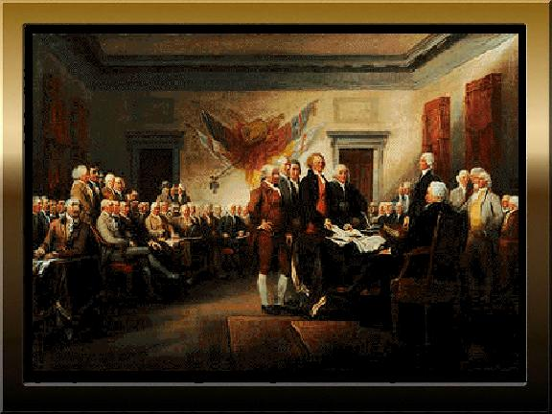
Documents Guide the Colonists
Declaration of Independence
  Drafted by Cont. Congress
  Life, Liberty, Pursuit of Happiness
  Listed complaints against the king
Articles of Confederation
  Created in 1777 to unite colonies under decentralized Government

Slide 4
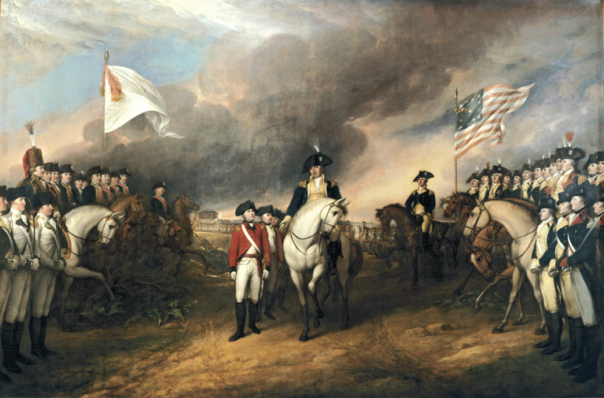
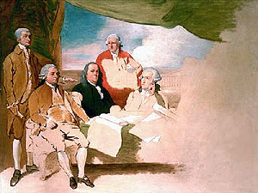
End of the War
Yorktown
  Cornwallis surrenders after surrounded by Colonists on land and French at sea
Treaty of Paris 1783
  Ben Franklin, John Adams, John Jay
  U.S. Gets colonies from S Canada to N Florida

Slide 5
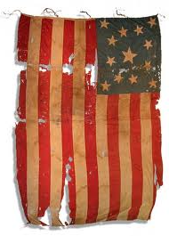
Treaty of Paris - 1783
Acknowledged Independence
1. Acknowledging the United States to be a free, sovereign and independent nation, and that the British Crown and all heirs and successors relinquish claims to the Government, property, and territorial rights of the same, and every part thereof;

Slide 6
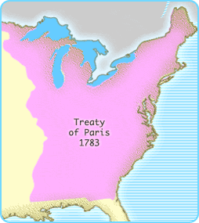
Treaty of Paris - 1783
Setting Boundaries
2. Establishing the boundaries between the United States and British North America;

Slide 7
National Government
Articles of Confederation
Could…
  Declare war
  Make treaties
  Print/Borrow $
  Set up new settlements in the “West”
*Each state one vote
  9 vote minimum
  13 for amendments
Could Not…
  Regulate Trade
  Draft Army
  Impose Taxes/Laws

Slide 8
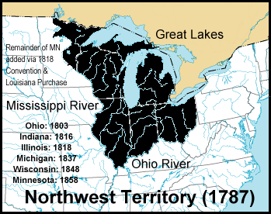
Northwest Territory - 1787
Northwest Ordinance
  Chunks of 60,000 people would be granted statehood
  Guarantees..
    Freedom of speech
    Trial by Jury
    No Slavery
Ordinances Speed up Expansion
  Problems?

Slide 9
Postwar Depression 1784-1787
Result of Inflation and War Debt
  Govt owes money to…
    Private Lenders
    Foreign Nations
    Soldiers
  No Power to tax
  “Continental Impost” – Boycott against Britain goods
    Attempt to create first protective Tariff

Slide 10
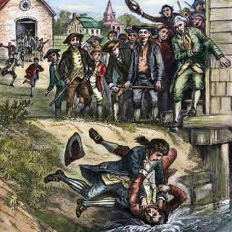
Postwar Depression 1784-1787
State Debts
  Each state forced to raise money on their own through taxes
  Farmers HATE these taxes and refuse to pay
  Shays Rebellion - Massachussetts
    Daniel Shay – Former soldier
    4000 people involved
    The government has no way to force their citizens to pay taxes
      Shows need for stronger central governement

