Slide 1
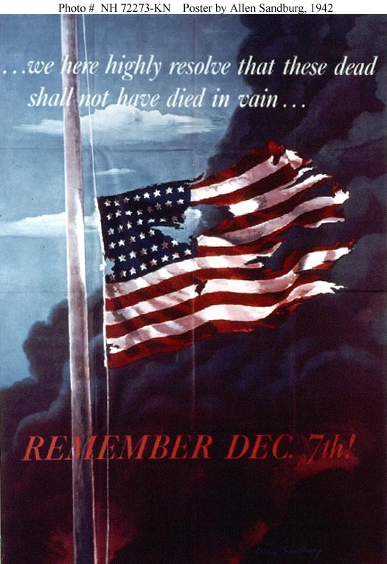
Major Battles of World War II

Slide 2
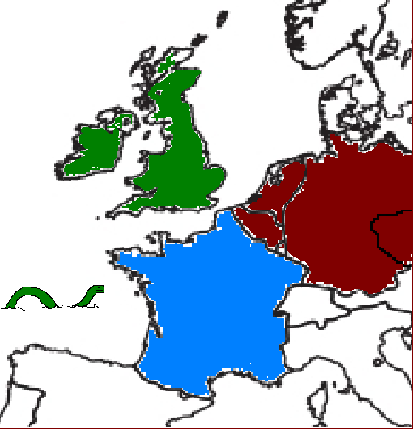

The “Sitzkrieg”
Netherlands and Belgium
  Fall Quickly to German Army
French prepare for Attack
  “The Phony War”
  7 month Standoff between French/British and German Soldiers along the “Maginot Line”
Only left one area unprotected (Ardennes Forrest)

Slide 3
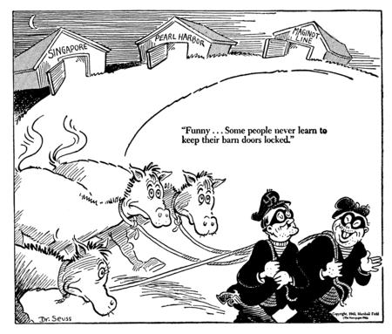
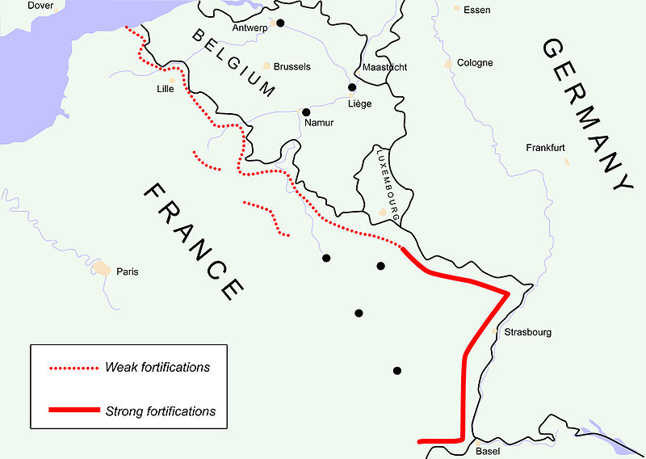

Slide 4
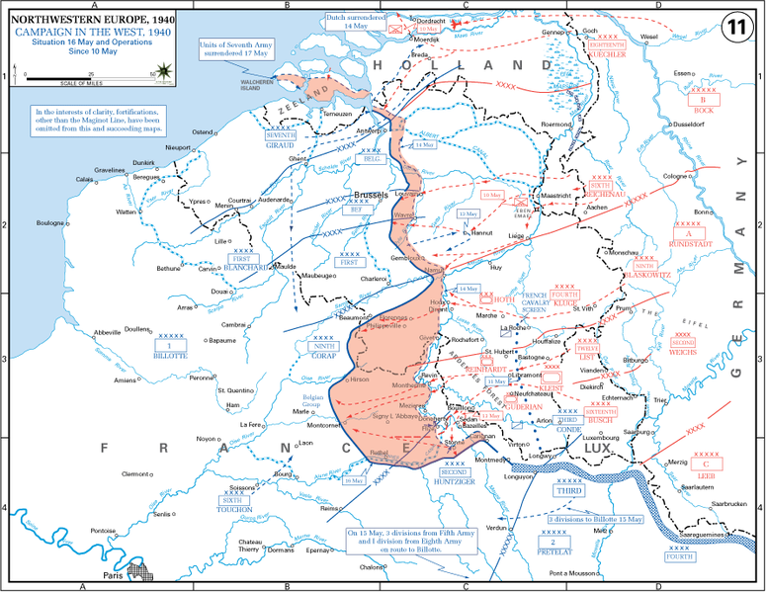
MAY 16th

Slide 5
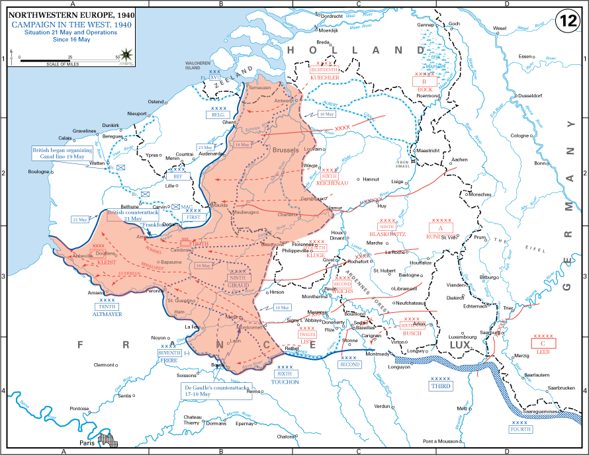
MAY 20th

Slide 6
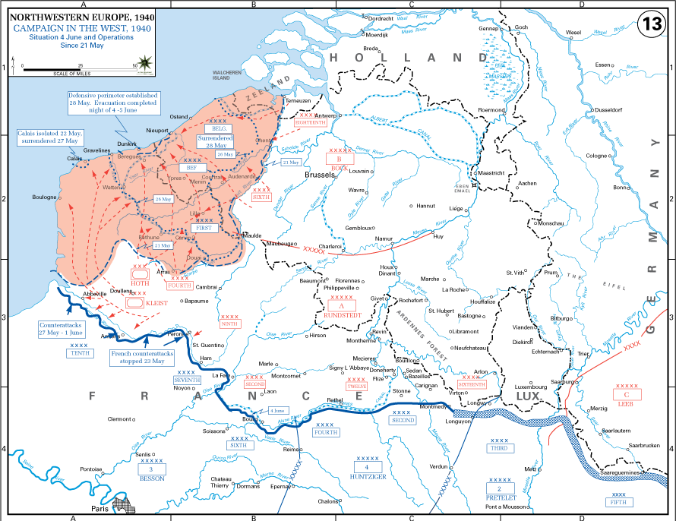
June 4th

Slide 7
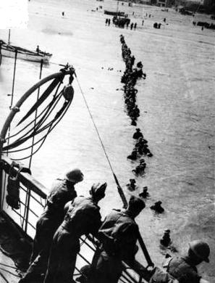
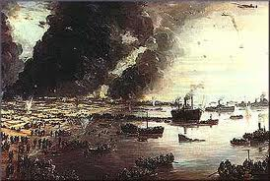
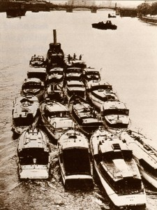
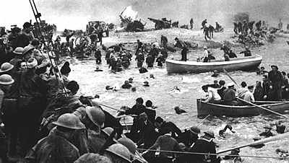

Slide 8
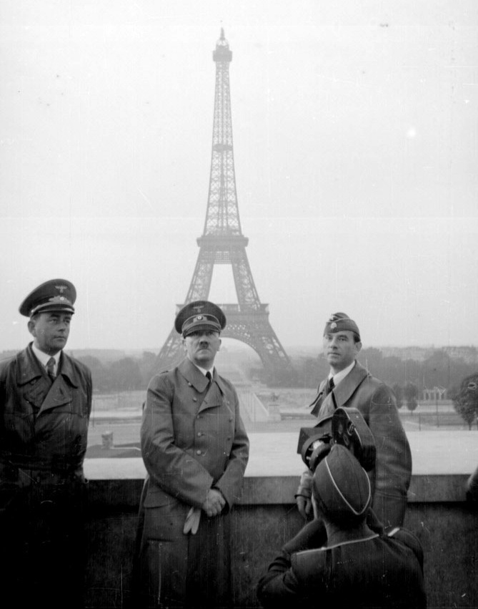
Invasion of France
May 16
  German tanks forced their way through the Ardennes Forest
  Italy joins from the south
May 20
  Allied forced back to the English Channel
June 22
  France falls to Germany
I hope he tags me on instagram

Slide 9
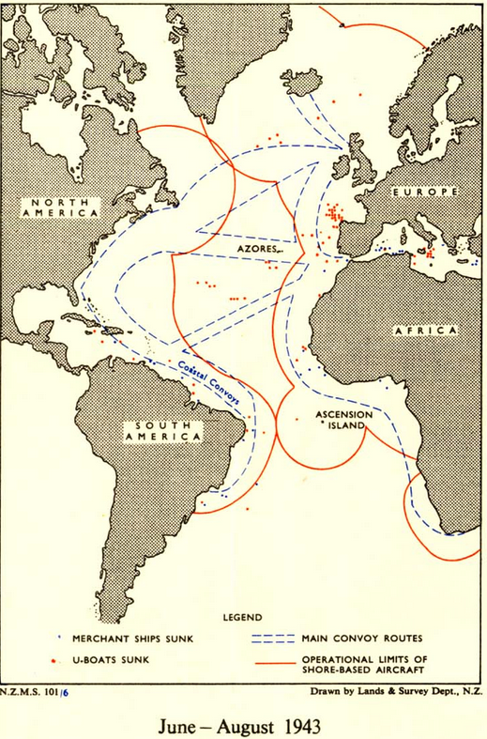
The Battle of The Atlantic
Who – US/Allies v. German Navy
What – “Tonnage War”
Where – Atlantic Ocean
When – 1939-1945
Why – Germany hopes to cut off American resources to Allies
Result – Allies Win
Significance
  Provides supplies needed for allied victory
  Helps Bring US out of Depression

Slide 10
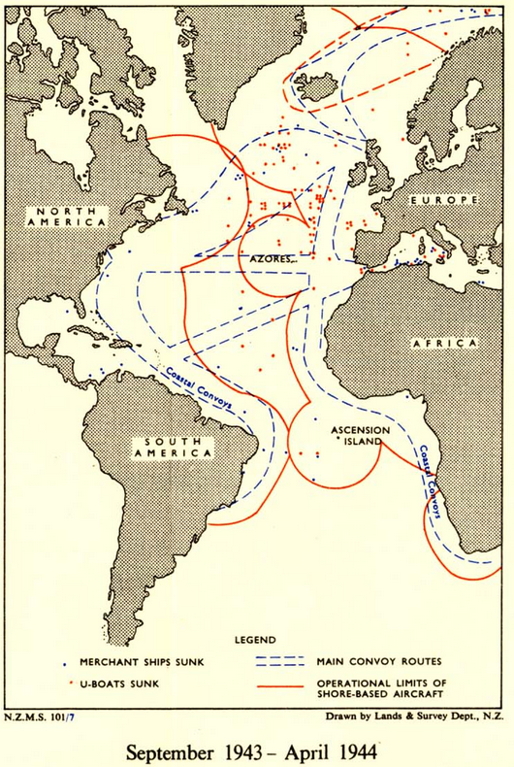
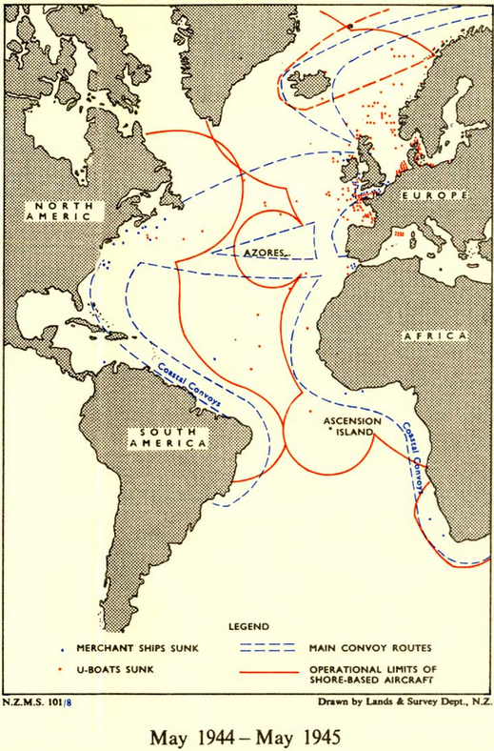

Slide 11
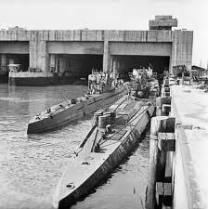
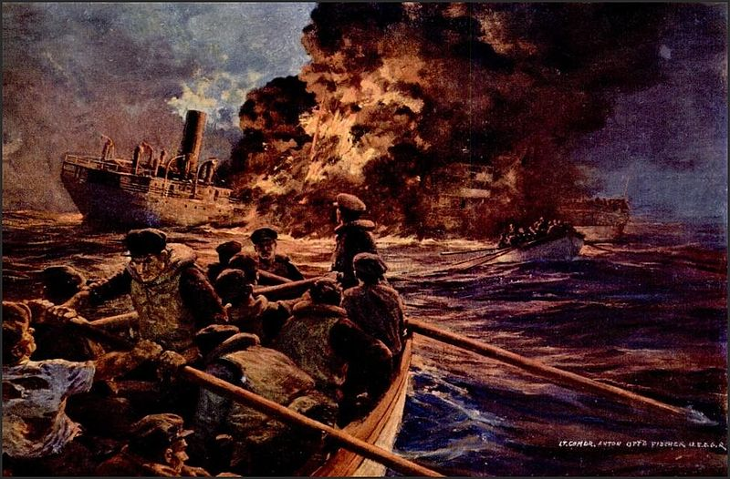
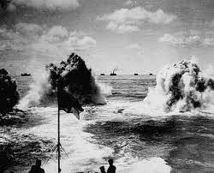
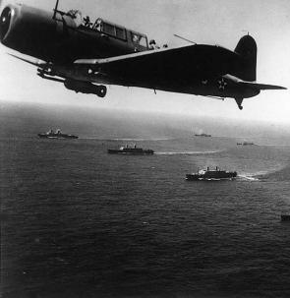

Slide 12
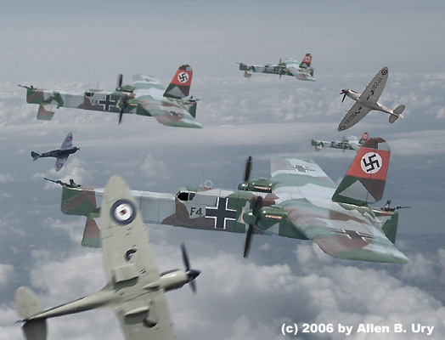
The Battle of Britain
Who – RAF vs. Luftwaffe
What – Aerial Battle/Bombing
Where – Over Great Britain
When – July-October 1940
Why – Germany hopes to force Britain to sign treaty
Result - Brits hold off Germans
Significance - U.S. maintains ally in Europe
Chronicles of Narnia opening scene

Slide 13
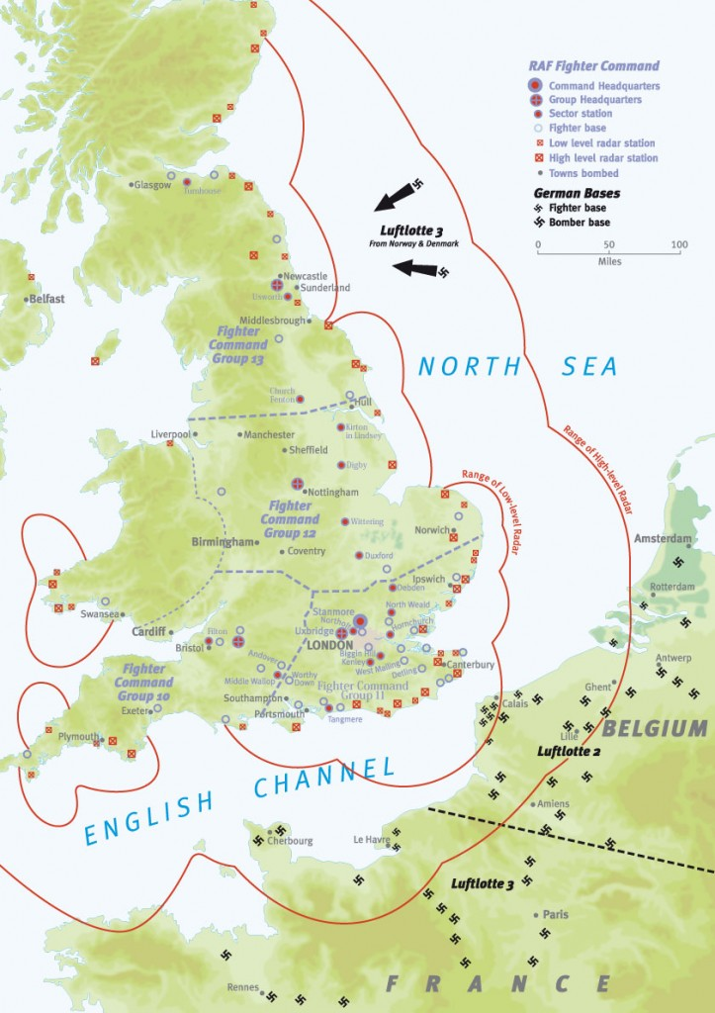
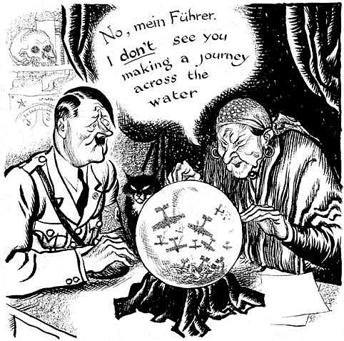

Slide 14
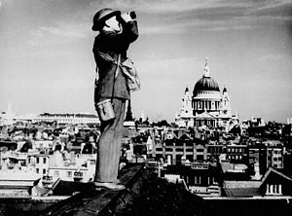
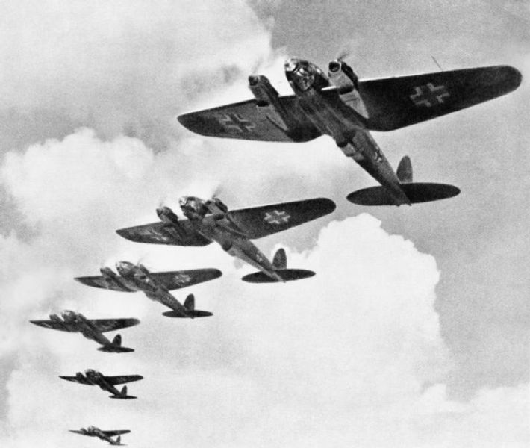
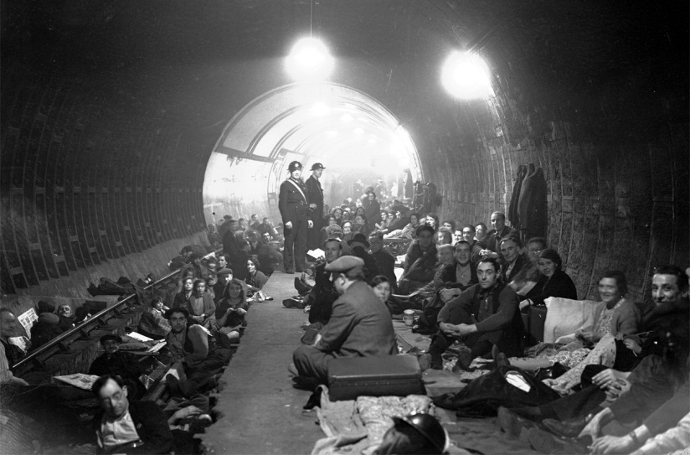
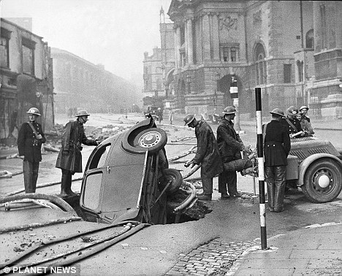
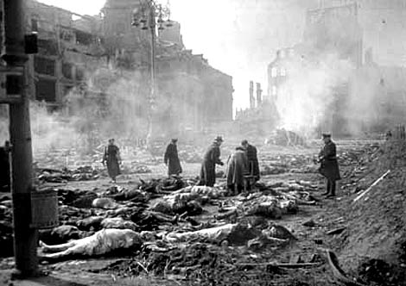

Slide 15
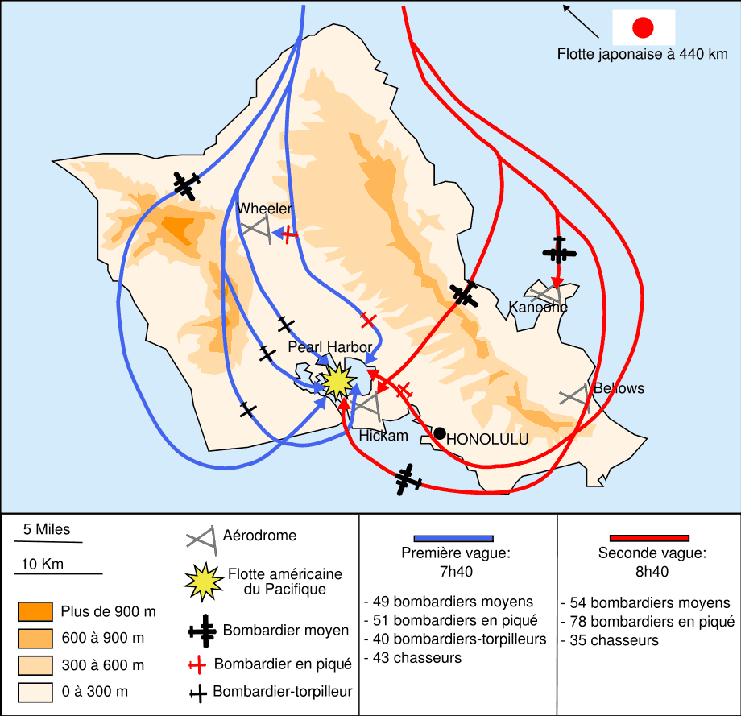
Pearl Harbor
Who – U.S. vs Japanese Navy
What – Surprise Bombing
Where – Pearl Harbor
When – December 7, 1941
Why – Japan hopes to cripple the American Pacific Fleet
Result – Severe Damage Sustained by American Navy
Significance – Convinces American people to support entering the war

Slide 16
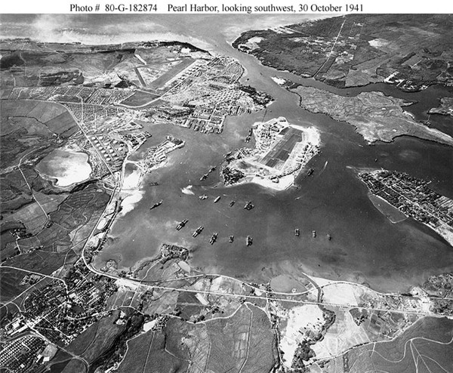
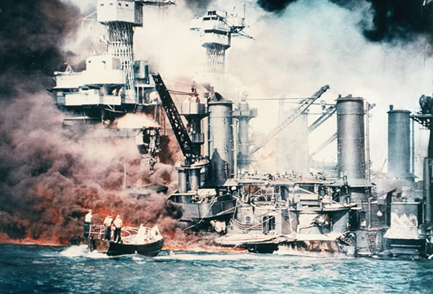
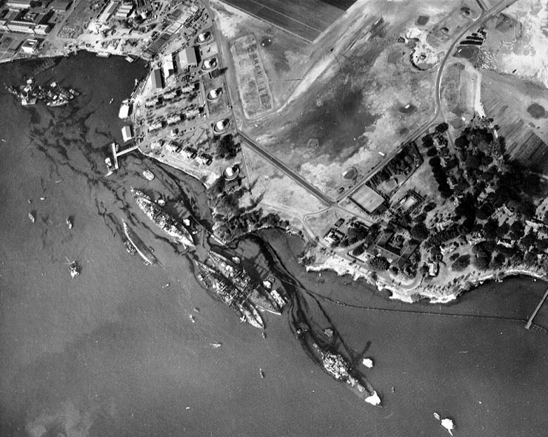
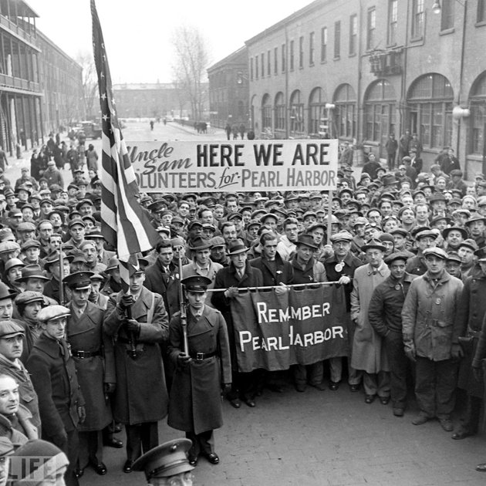

Slide 17
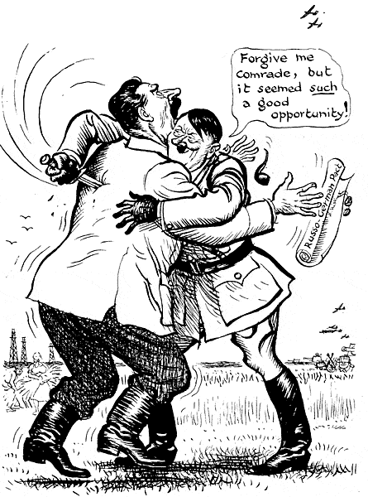
The Battle of Stalingrad
Who – USSR vs Germany
What – German invasion of USSR
Where – Russia
When – Aug 1942 - Feb 1943
Why – Germany hopes to take major city in USSR
  Result – Over 2 million casualties
  Germans lack supplies to survive Russian Winter
  Soviet Union holds city and launches a successful counter attack
Significance – Turning point on the Eastern Front

Slide 18
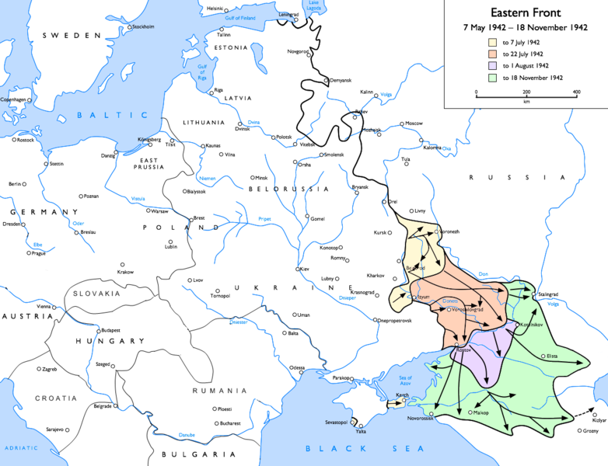

Slide 19
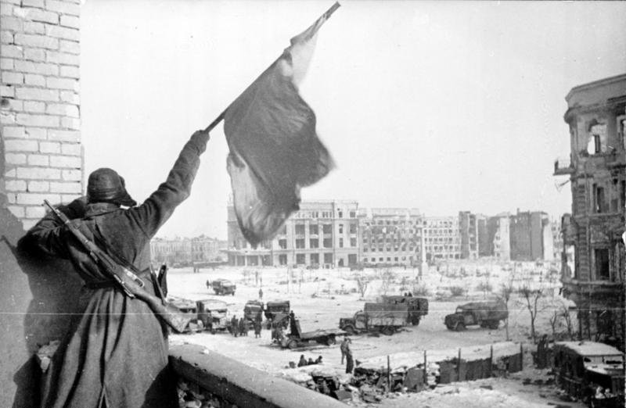
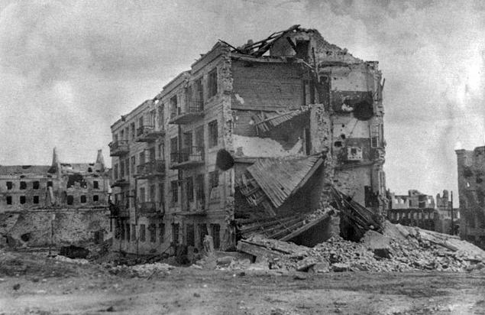
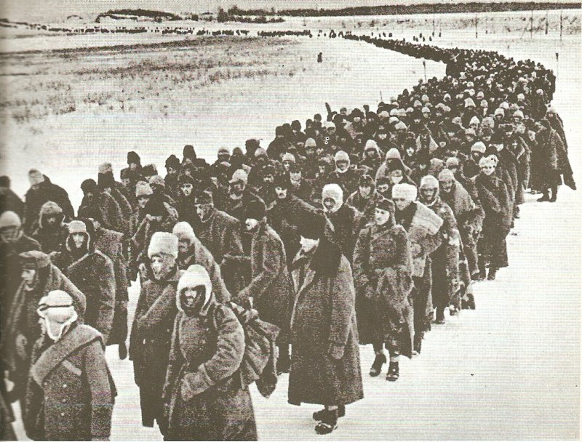
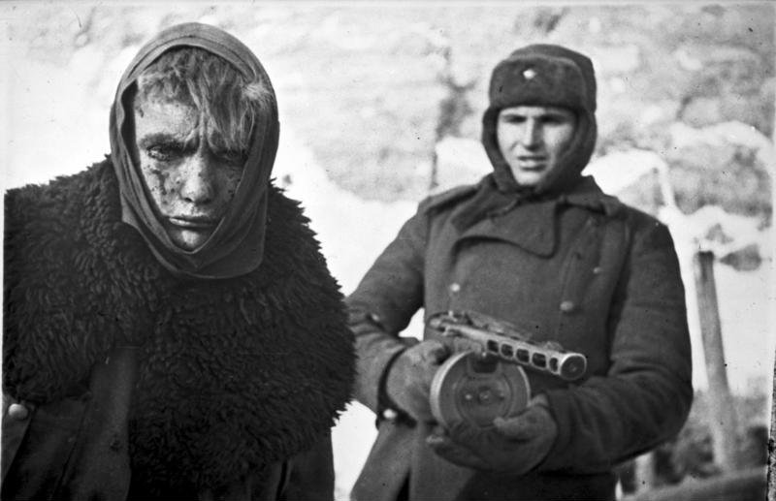
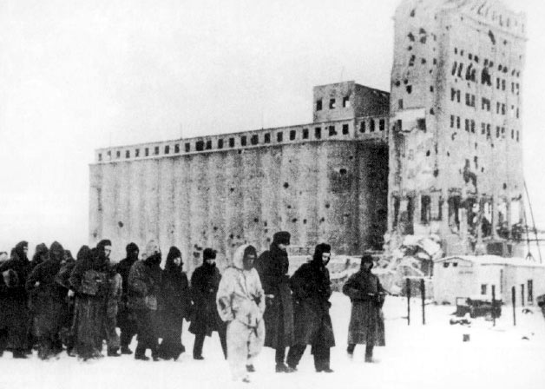

Slide 20
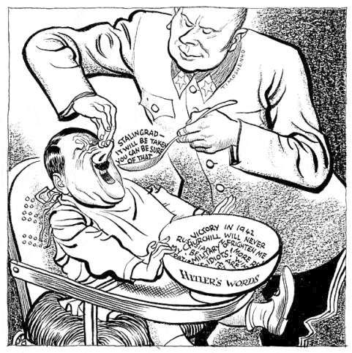
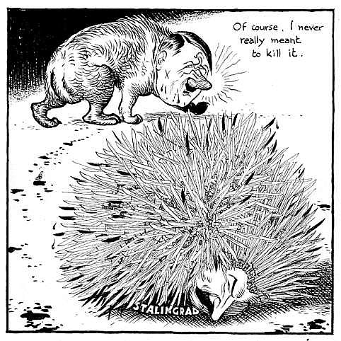
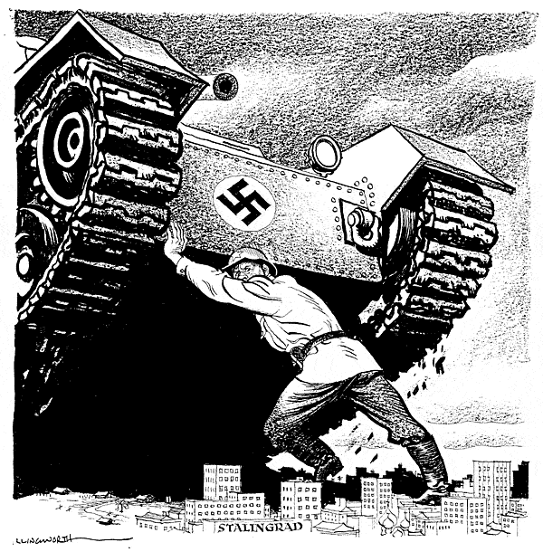
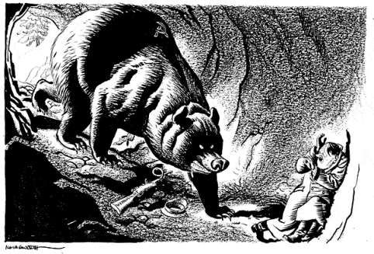

Slide 21
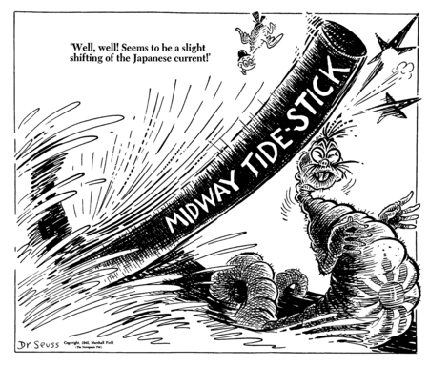
The Battle of Midway
Who – US vs Japan
What – Air/Sea Battle
Where – Near Midway Island
When – June 1942
Why – Japan hopes to occupy U.S. Military base at Midway and eliminate US as Pacific Threat
  Result
  US code breaking allows US to ambush Japanese Fleet
  4 Japanese Carriers Sunk
Significance – Turning point of the Pacific

Slide 22
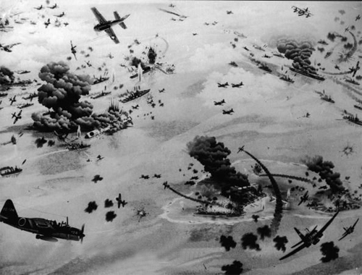
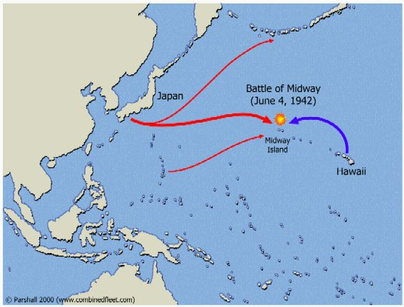
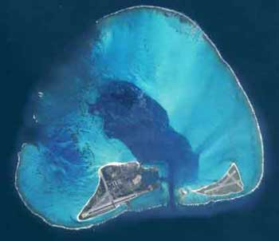

Slide 23
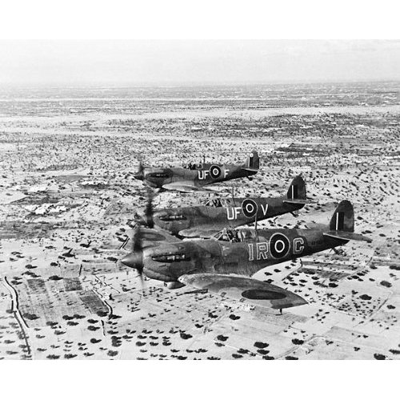
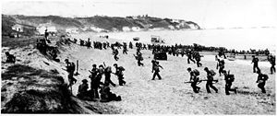
Operation Torch
Who – Allies vs Germany
What – Amphibious Assault
Where – Northern Africa
When – Nov 1942 – June 1943
Why –
  Remove Axis powers from Africa
  Establish bases to attack Europe
  Result - Allied Victory
  Significance – Germany now fighting a war on 3 fronts

Slide 24
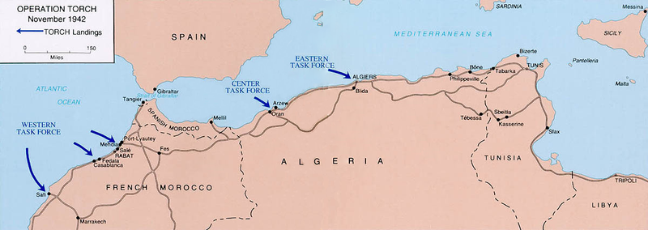
Operation Torch: Invasion of N. Africa

Slide 25


Slide 26

D-Day: Operation Neptune/Overlord
Who – Allies vs Germany
What – Amphibious Assault
Where – Normandy, France
When – June 6, 1944
Why – Liberate France from German Occupation
  Result - Allied Victory
  Significance – France gradually liberated over next several months

Slide 27


Slide 28


Slide 29


D-Day
Saving Private Ryan

Slide 30


The Battle of the Bulge
Who – Allies vs Germany
What – Land Battle
Where – French/German Border
When – December 1944
Why – Final offensive attempt by Germans
  Result - Allied Victory
  Significance –
  German generals begin surrendering
  First concentration camps found

Slide 31


V-E Day
http://www.youtube.com/watch?v=RCn7Xk_6sb8&safety_mode=true&persist_safety_mode=1
April 1 - Soviet and American troops encircled Berlin
April 30 – Hitler commits suicide during Battle of Berlin
May 7-8, 1945 - Unconditional surrender of Nazi Germany
Hitler’s ignorance of military strategy costs him the war and his life

Slide 32

Battle of Iwo Jima
Who – US vs Japan
What – Land Invasion
Where – Island near Japan
When – Feb, March 1945
Why – Need for airstrips near Japan
  Result - US Victory despite high number of casualties
  Significance –
  Allows US a launching point for mainland bombing on Japan

Slide 33


Slide 34


Iwo Jima
U.S. Marine Corps Memorial in Arlington National Cemetery based on the famous photo by Rosenthal
U.S. flag over Mount Suribachi

Slide 35

Battle of Okinawa
Who – US vs. Japan
What – Land Battle
Where – Island South of Japan
When – June 1945
Why – US wants to gain launching point for mainland Invasion
  Result - US Victories despite High Casualties
  Significance – Shows U.S. that mainland invasion would cost thousands of American lives.

Slide 36


Slide 37

Battle of Okinawa

Slide 38

Manhattan Project
FDR received a letter from Einstein warning that Germans developing a weapon after discovering how to split the atom
Manhattan Project (1942)
  To develop an atomic bomb
  J. Robert Oppenheimer was the head of the project

Slide 39

Einstein’s Letter
In the course of the last four months it has been made probable - through the work of Joliot in France as well as Fermi and Szilard in America - that it may become possible to set up a nuclear chain reaction in a large mass of uranium, by which vast amounts of power and large quantities of new radium-like elements would be generated. Now it appears almost certain that this could be achieved in the immediate future.
This new phenomenon would also lead to the construction of bombs, and it is conceivable - though much less certain - that extremely powerful bombs of a new type may thus be constructed. A single bomb of this type, carried by boat and exploded in a port, might very well destroy the whole port together with some of the surrounding territory. However, such bombs might very well prove to be too heavy for transportation by air...
Yours very truly,
(Albert Einstein)
Notes:
Einstein sent a letter to F.D.R. on August 1939 regarding the construction of an atomic bomb. The letter helped start the American atomic bomb project, but the United States did not immediately begin a crash program to build nuclear weapons. Leo Szilard was a Germany refugee physicist who discovered the nuclear chain reaction as a means of liberating atomic energy and creating an atomic bomb. Szilard worked for the Manhattan Project's Chicago laboratory. Einstein’s letter was taken seriously and America prepared itself for a top secret nuclear program.
PRIMARY SOURCE FROM - http://www.theenolagay.com/study.html#DECIDING%20TO%20BUILD%20THE%20BOMB

Slide 40


Slide 41


Slide 42

Hiroshima
August 6, 1945
U.S. drops atomic
bomb on Japan
- Little Boy dropped by B-29 bomber Enola Gay
- Casualties: 90,000-140,000 + several hundred thousand due to radiation
Hiroshima

Slide 43





Slide 44


Slide 45


Slide 46



Slide 47

Nagasaki
August 9, 1945
U.S. drops atomic
bomb on Japan
- Fat Man dropped by B-29 bomber
- Casualties:
73, 884 + several hundred thousand due to radiation
Mushroom cloud from the nuclear explosion over Nagasaki rising 60,000 feet into the air on the morning of August 9, 1945

Slide 48


Slide 49

Atom Bomb
Compilation
How many atomic bombs have been expoded since WWII?
How much damage would these do in Concord?

Slide 50

V-J Day
August 15, 1945: Official end of WWII
- Emperor Hirohito accepted terms of Potsdam Declaration
Formal signing took place @ Tokyo Bay on battleship USS Missouri on September 2, 1945

Slide 51


