Slide 1
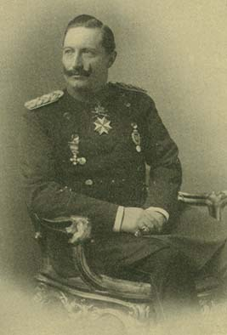
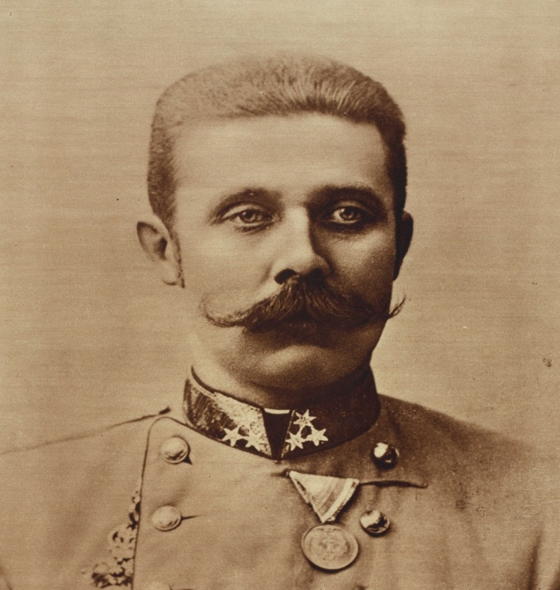
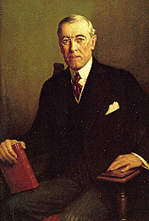
The First World War
Section 19-1 & 19-2

Slide 2
Long Term Causes of the War
Militarism
Alliance System
Imperialism
Nationalism

Slide 3
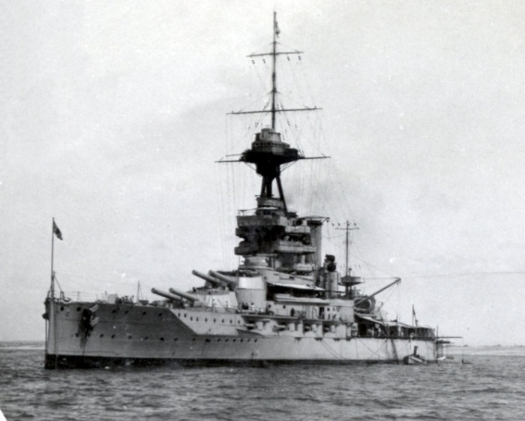
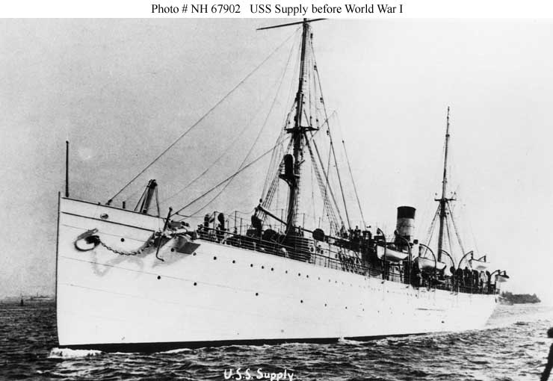
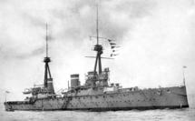
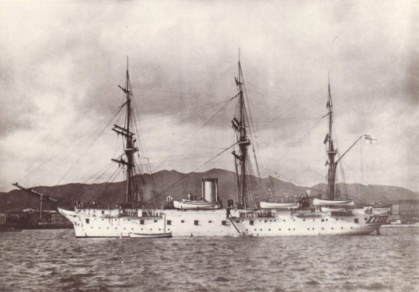
Militarism
The race to develop the world’s largest navy/army
The U.S., Germany, Japan, Great Britain, Italy and France were engaged in a naval arms race.

Slide 4
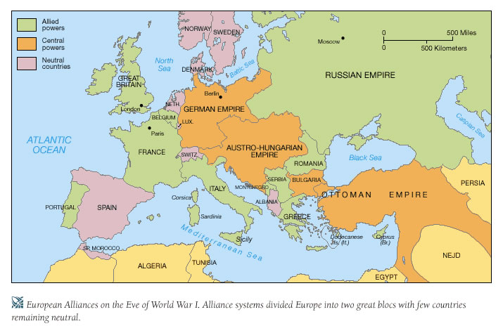
Alliance System
European countries create SECRET alliances

Slide 5
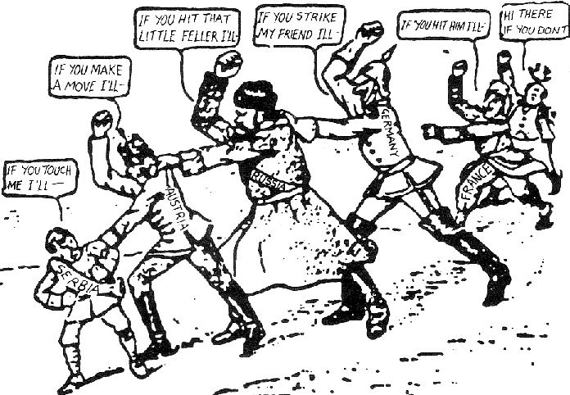
Alliance System
Two major alliances
Central Powers
  Germany
  Austria-Hungary
  Ottoman Empire
Allied Powers
  Russia
  France
  Great Britain

Slide 6
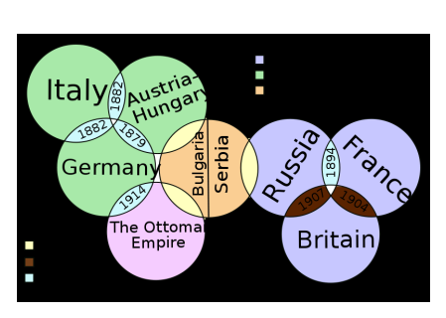

Slide 7
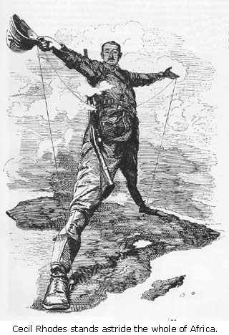
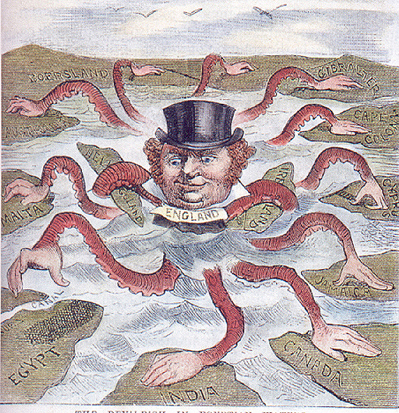
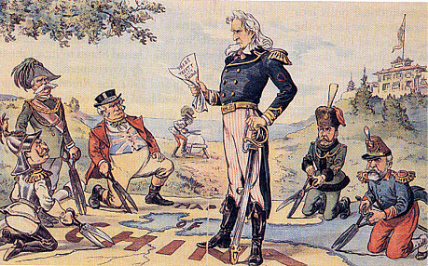
Imperialism
Europeans had been extending their empires for centuries
Available land is running out
Leads to disputes over who will control weaker countries.

Slide 8
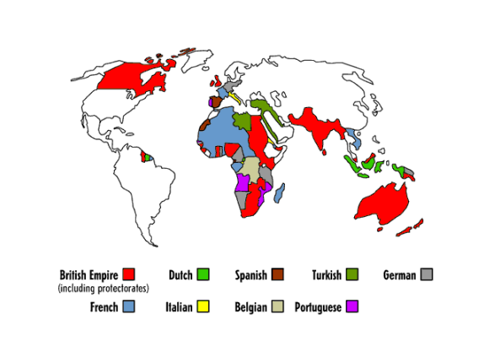

Slide 9
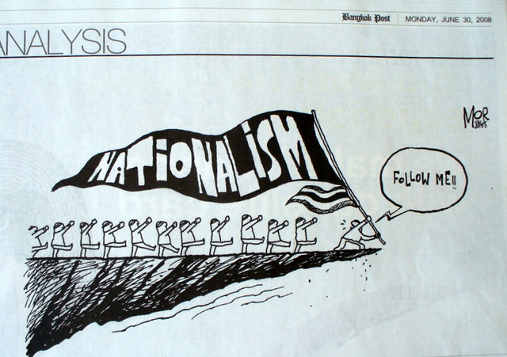
Nationalism
Belief that one group of people (country, race, ethnicity) is better than another
Led to competition between countries and cultures.

Slide 10
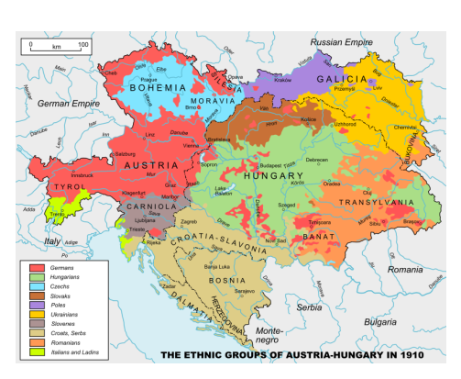

Slide 11
The Domino Effect
Archduke Franz Ferdinand assassinated by Serbian
Austria-Hungary declares war on Serbia
July 31: Russia sends troops to aid Serbia
Aug 1: Germany declares war on Russia
Aug 3: Germany uses opportunity to declare war on France & neutral Belgium.
Aug 4: Great Britain feels threatened and declares war on Germany

Slide 12
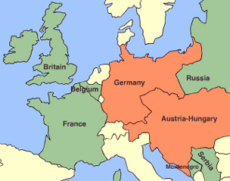
The Schlieffen Plan:
Plan to avoid fighting a war on two front
Take France quickly, then focus on Russia
Plan fails when France resorts to Trench Warfare

Slide 13
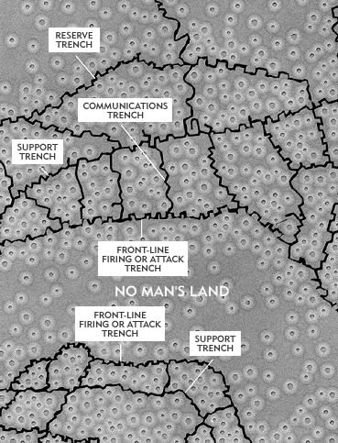
The Great War Begins
Trench Warfare
  Armies fight using system of ditches
No Man’s Land
  Area between trenches where soldiers were killed
Won very little land
Why WWI Was No Fun
Notes:
Hold Russia, attack Fr. fast and then hit Russia
Dug in creating vast system of trenches
Had a front line, support and reserve trenches
60K casualties for Brits during first day of Somme
1.2 million dead but only 7 miles of land changed hands

Slide 14
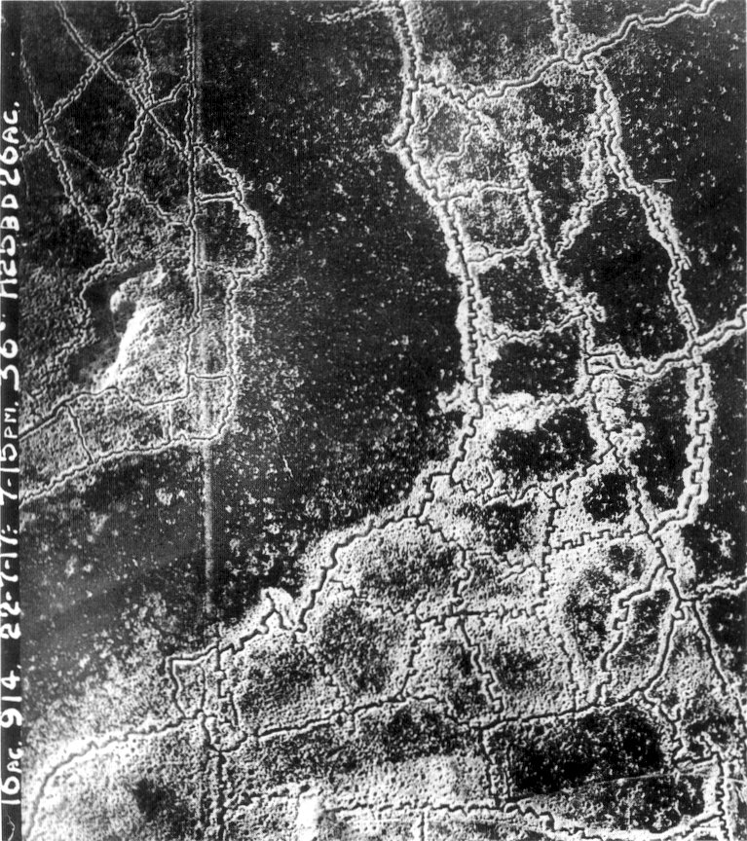

Slide 15
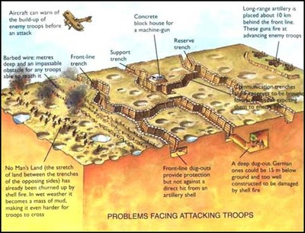
Trench Warfare

Slide 16
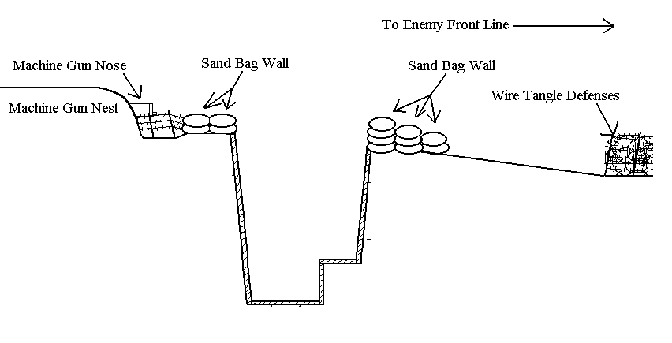
Trench Warfare
Life in the Trenches

Slide 17
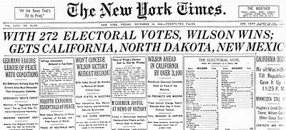
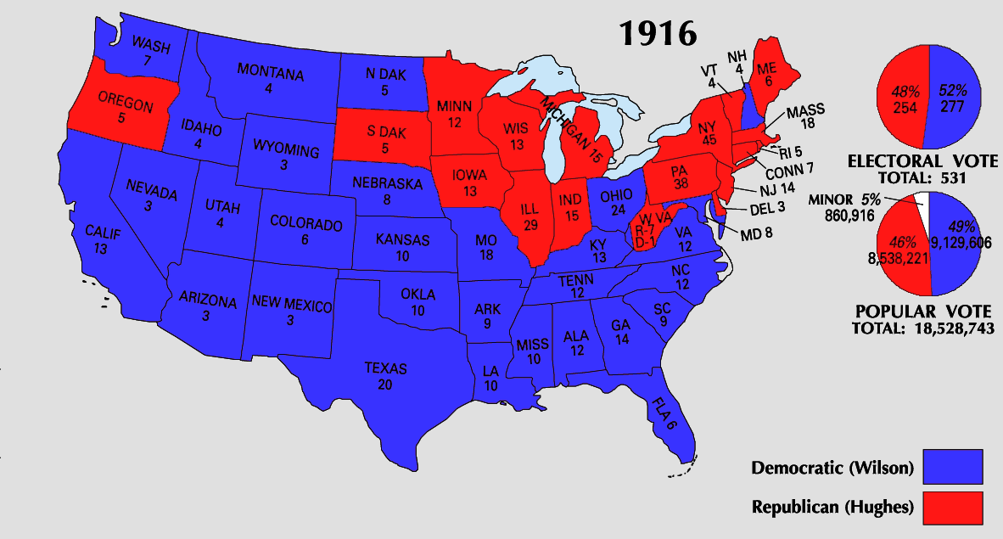
Wilsons Proclamation of Neutrality
Why did the US Refuse to get involved in the beginning?
  Territory not directly affected
  Americans had cultural and economic ties with both sides
Wilson wins re-election in 1916 with slogan
  “He kept us out of War!”

Slide 18
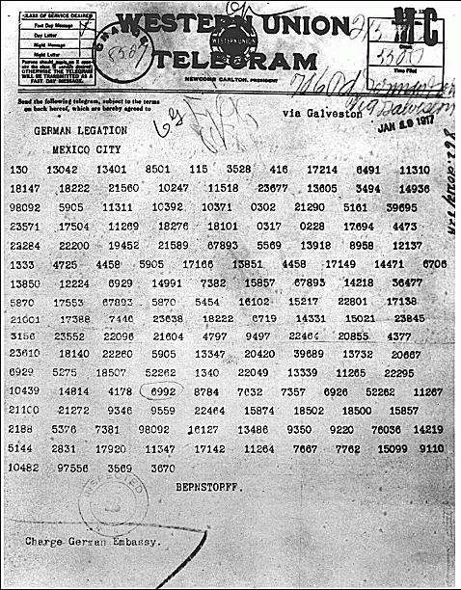
Reasons the US Enters the War
Zimmerman Telegram
  From Germany to Mexico
  Proposing an alliance
  Promises reclamation of Mex. land lost to USA
  Intercepted by British

Slide 19
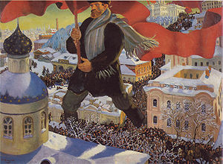
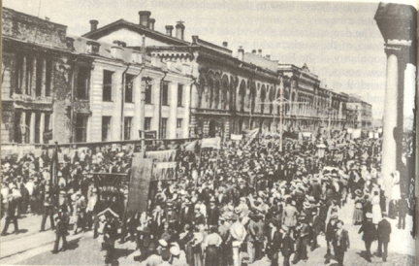
Reasons the U.S. Enters
2. Bolshevik Revolution
Pre Revolution –
  America did not want to ally with non/democracies
  “Moral Diplomacy”
Post Revolution -
  Russia becomes Communist!
  Leaves the War
America can now join

Slide 20
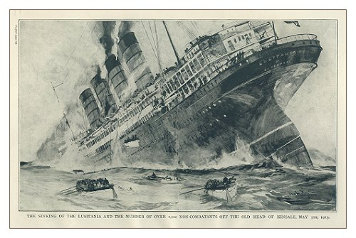
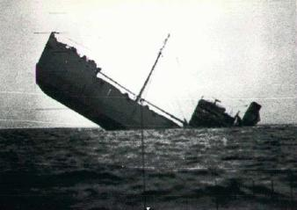
Reasons the US Enters the War
3. Unrestricted Submarine Warfare
Lusitania
  1915- British passenger ship is sunk
  128 Americans killed
German’s initially back off
Later resume Unrestricted Sub Warfare
  Germans realize they must stop supplies going to Allied Powers

Slide 21
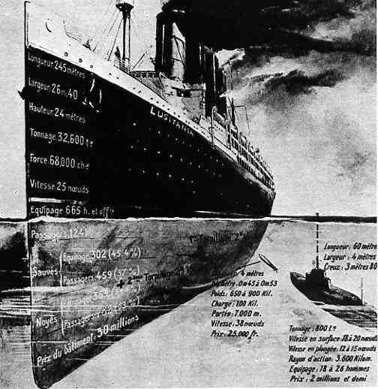

Slide 22
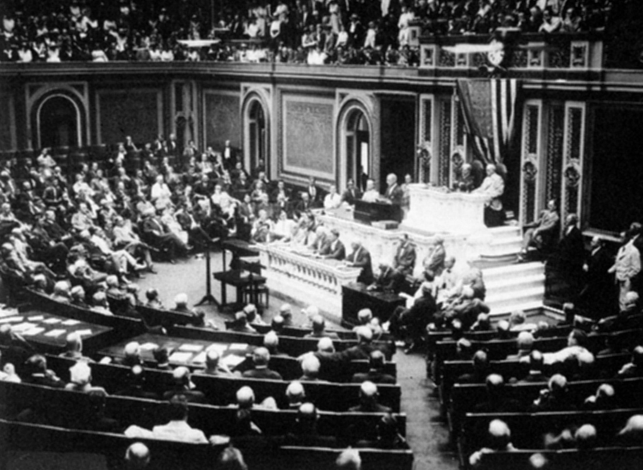
America enters the War
April 2nd, 1917 Wilson asks Congress to declare war
Reasons
  “Make the world safe for Democracy.”
  Protect trading rights
Wilson addresses Congress

Slide 23
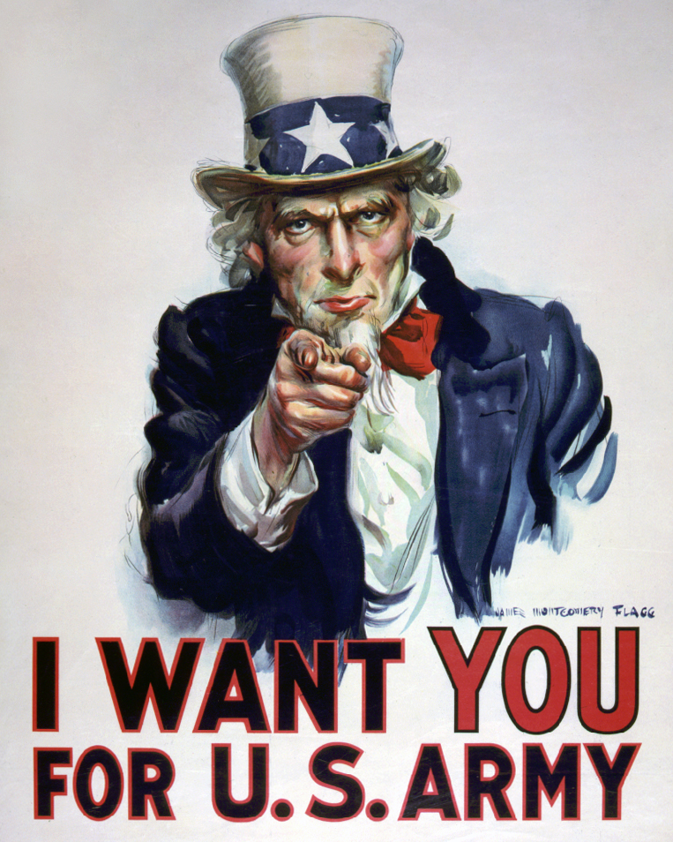
Mobilizing
May 1917: Selective Service Act
  All men to register to be randomly selected to serve in the military
  21 – 31 years of age
24 million registered
Notes:
8 month training period

Slide 24
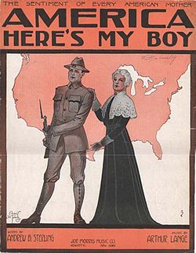
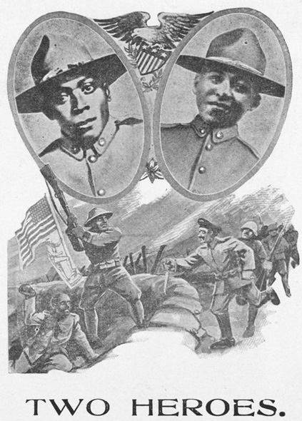
1917 – Selective Service Act
Total Registered
  24,000,000 men registered
Served in the War
  4,800,000 men served
Saw active combat
  2,000,000
African American Soldiers
  400,000 – Army only
  Segregated units
  Most were put in non-combat duties.

Slide 25
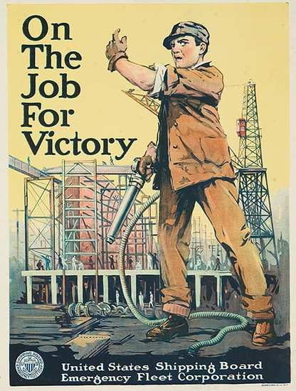
Expanding the U.S. Fleet
Shipyard workers protected from draft
Parts built elsewhere then assembled in the shipyard
Government took over private and commercial ships

Slide 26
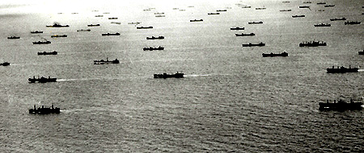
Here Come the Yanks
Convoy System
  Countered to German U Boats
  Shipping losses were cut in half
US troops bring…
    … numbers
    …fresh (naïve) soldiers
    …supplies
Convoy System
Notes:
US troops brought numbers and enthusiasm

Slide 27
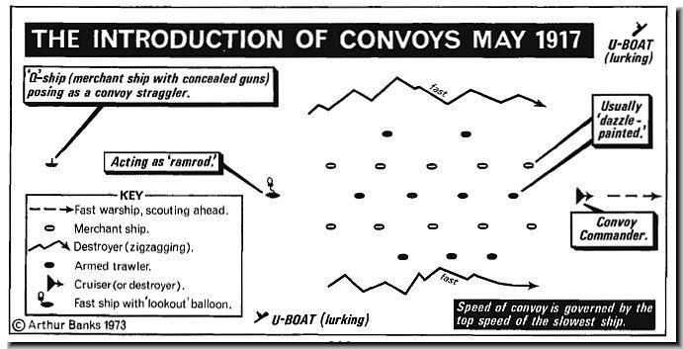

Slide 28
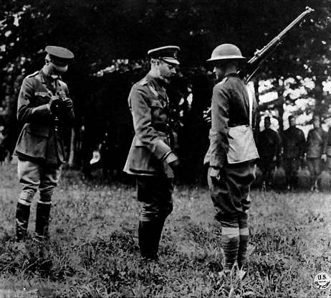
The Yanks
  The American Expeditionary Force was led by General John Pershing
  U.S. troops nicknamed doughboys
Notes:
First Battle was in Chateau-Thierry in June 1918 where they helped to stop the German advance on Paris

Slide 29
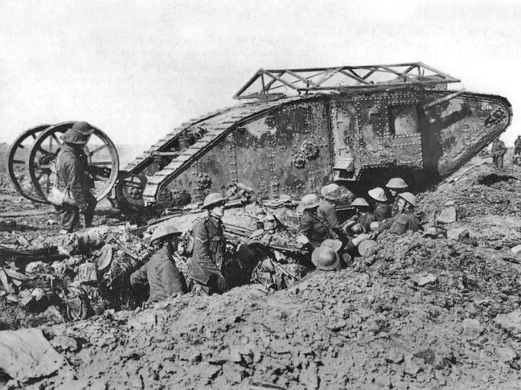
New Weapons: Tanks
British Mark IV Tank
Tanks were used for the first time in the First World War. They were developed to cope with the conditions on the Western Front. The first tank was called ‘Little Willie’ and needed a crew of 3. Its maximum speed was 3mph and it could not cross trenches.
The more modern tank was not developed until just before the end of the war. It could carry 10 men, had a revolving turret and could reach 4mph.
Notes:
First Battle was in Chateau-Thierry in June 1918 where they helped to stop the German advance on Paris

Slide 30
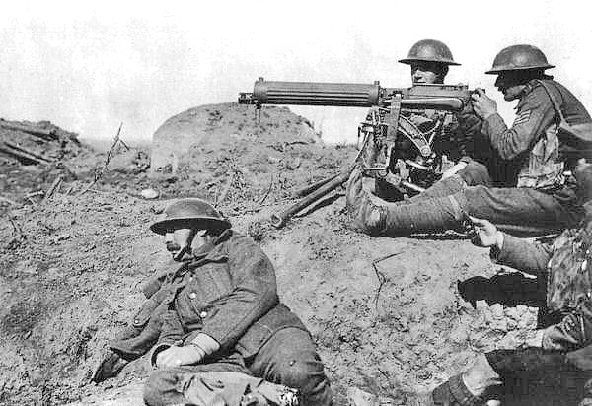
New Weapons: Machine Guns
Vickers Machine Gun

Slide 31
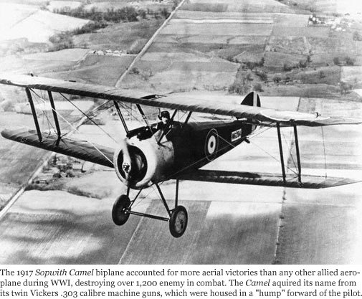
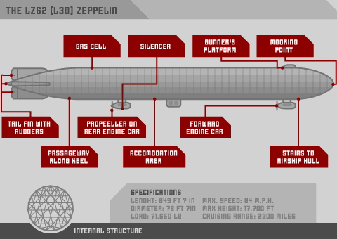
New Weapons: Airplane and Airships
Sopwith Camel Biplane
Zeppelin

Slide 32
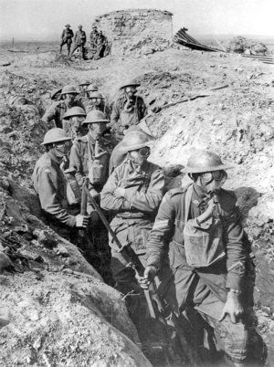
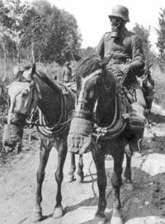
New Weapons: Poison Gas
The German army were the first to use chlorine gas. Chlorine gas causes a burning sensation in the throat and chest pains. Death is painful – you suffocate! The problem with chlorine gas is that the weather must be right.
Mustard gas was the most deadly weapon used. It was fired into the trenches in shells. It is colourless and takes 12 hours to take effect. Effects include – blistering skin, vomiting, sore eyes, internal and external bleeding. Death can take up to 5 weeks.

Slide 33
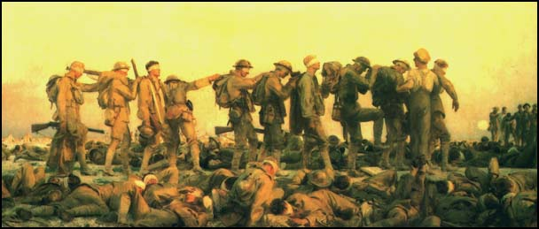
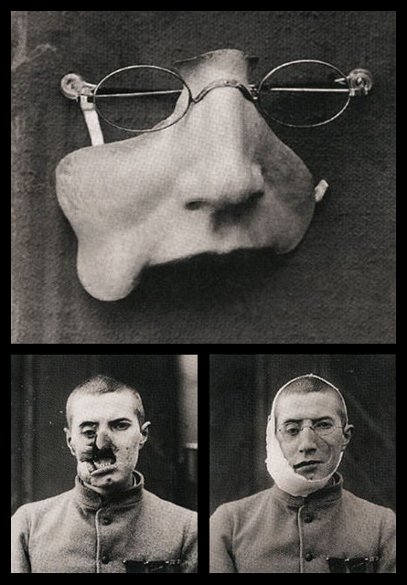
Hazards
Trench life was horrid
Soldiers had emotional collapses AKA “Shell Shock”
Virtually no government assistance for Veterans upon returning home

