Slide 1
Civil Rights

Slide 2
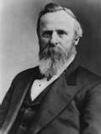
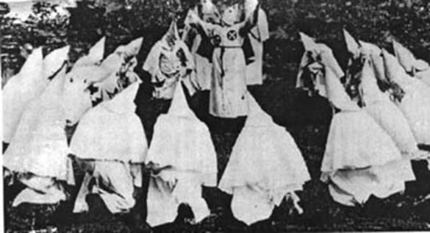
Background
Failure of Reconstruction
Compromise of 1877
Military Removed from south
No enforcement of Reconstruction ideas
1896 Plessy v. Ferguson
“separate but equal”
Many states pass Jim Crow laws separating the races
Facilities for blacks always inferior to those for whites
Also…
KKK
Tenant Farming and Sharcropping
Poll Taxes and Literacy Tests

Slide 3
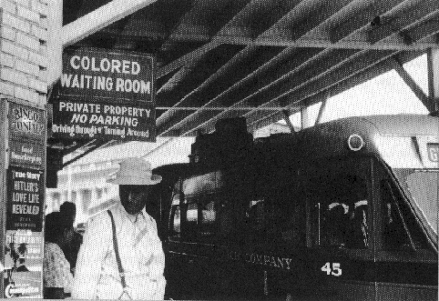
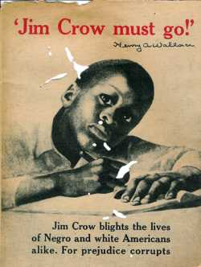
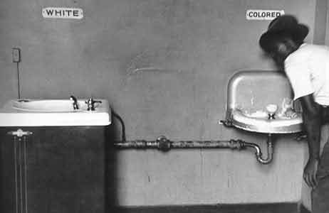
Jim Crow Laws

Slide 4

A Developing Civil Rights Movement
WW II creates job opportunities for African Americans
Need for fighting men makes armed forces end discriminatory policies
FDR ends government/war
industries discrimination
Returning black veterans fight for
civil rights at home
Dori Miller – Pearl Harbor

Slide 5
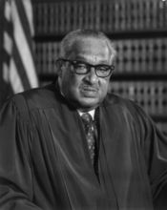
Challenging Segregation in the Court
NAACP challenges Jim Crow Laws
Focused on segregated public education
Places team of law students under Thurgood Marshall
- wins 29 out of 32 cases argued before the Supreme Court

Slide 6
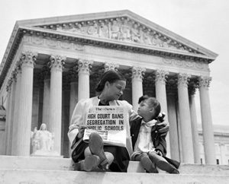
Brown v. Board of Education - 1954
Marshall’s greatest victory is Brown v. Board of Education of Topeka
In 1954 case, Court unanimously strikes down school segregation

Slide 7
Thurgood Marshall
1908-1993
1st African American on the Supreme Court

Slide 8
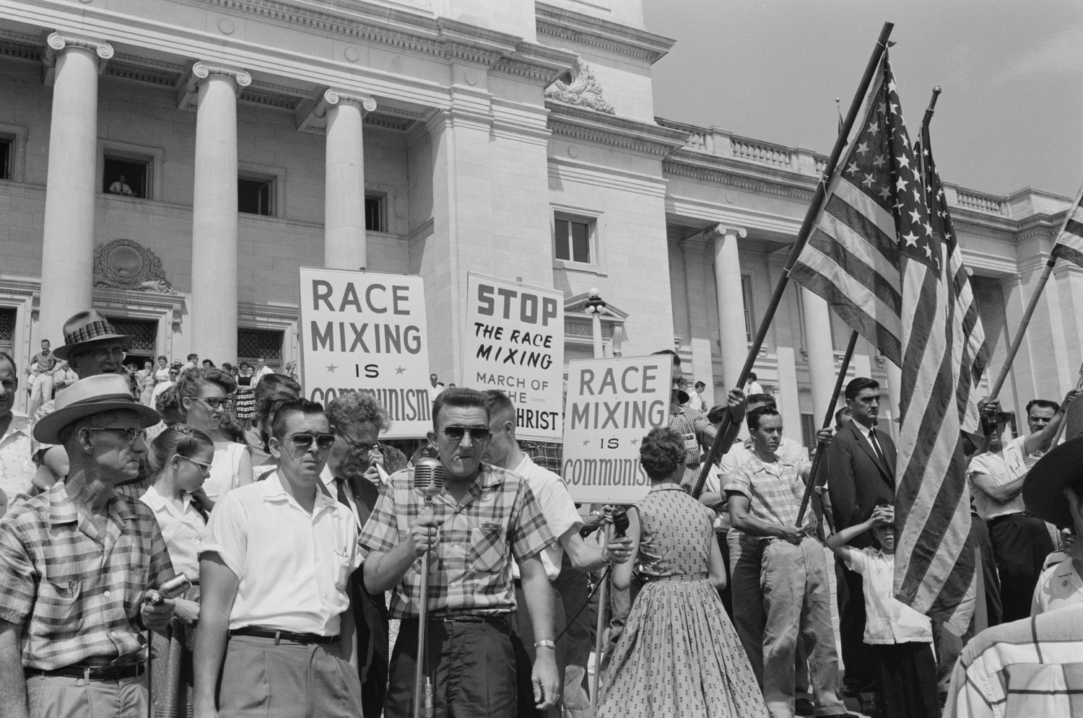
Reaction to the Brown Decision
Within 1 year, over 500 school districts desegregate
  Primarily Middle/Northern States
White Citizens Councils boycotts businesses that support desegregation
  KKK reappears
Court hands Brown II, orders desegregation at “all deliberate speed”
Eisenhower refuses to enforce compliance; considers it impossible

Slide 9
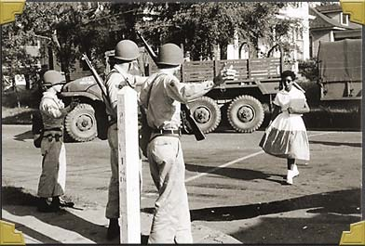
Crisis in Little Rock - 1957
Little Rock High School is chosen as the site to “test” desegregation
Nine students volunteer to be the first to enter the school.
  “Little Rock Nine”
Governor of Arkansas orders Nat. Guard to prevent the nine from entering the school.
Eisenhower calls in the U.S. Army to force the integration.
  Also takes control of National Guard

Slide 10
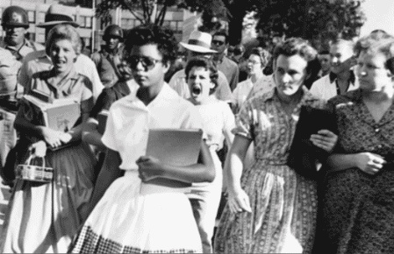
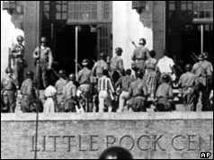
Little Rock, Arkansas - 1957
“They moved closer and closer... Somebody started yelling... I tried to see a friendly face somewhere in the crowd—someone who maybe could help. I looked into the face of an old woman and it seemed a kind face, but when I looked at her again, she spat on me.”
- Elizabeth Eckford

Slide 11
Little Rock High School
The Students faced constant discrimination for the entire year
White students also faced consequences for being kind to the “Nine”
“I was one of the kids 'approved' by the school officials. We were told we would have to take a lot and were warned not to fight back if anything happened. One girl ran up to me and said, 'I'm so glad you’re here. Won’t you go to lunch with me today?' I never saw her again”
White students were not punished unless the offense was seen by an adult

Slide 12
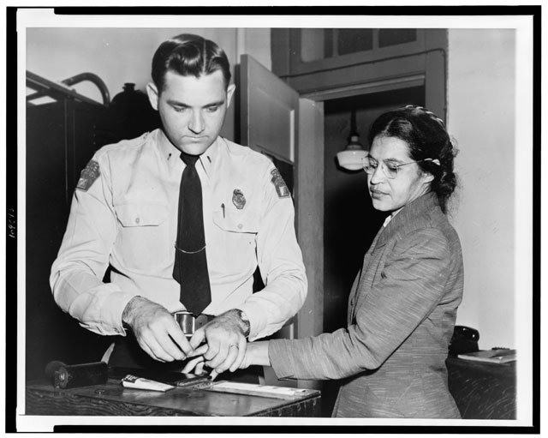
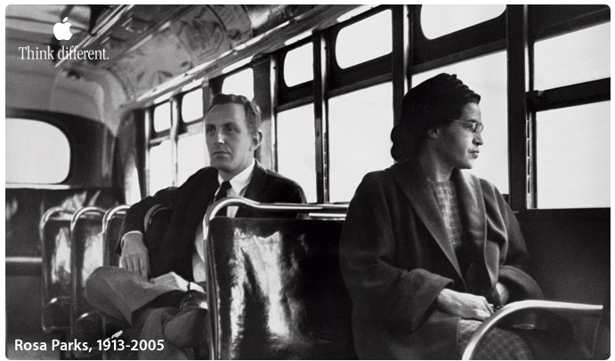
The Montgomery Bus Boycott
1955 NAACP officer Rosa Parks arrested for not giving up seat on bus
Montgomery Improvement Association formed, organizes bus boycott
Elect 26-year-old Baptist pastor Martin Luther King, Jr. leader

Slide 13
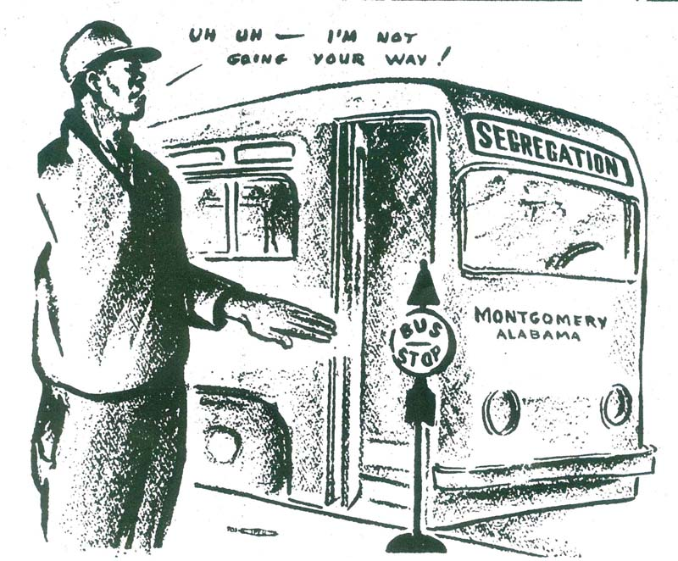
Walking for Justice
African Americans file lawsuit, boycott buses, use carpools, walk
Get support from black community, outside groups, sympathetic whites
1956, Supreme Court outlaws bus segregation

Slide 14

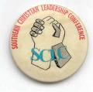
Martin Luther King & The SCLC
King calls his brand of nonviolent resistance “soul force”
- civil disobedience,
- massive demonstrations
-King, others found Southern Christian Leadership Conference (SCLC)
- Join Student Nonviolent Coordinating Committee (SNCC)

Slide 15
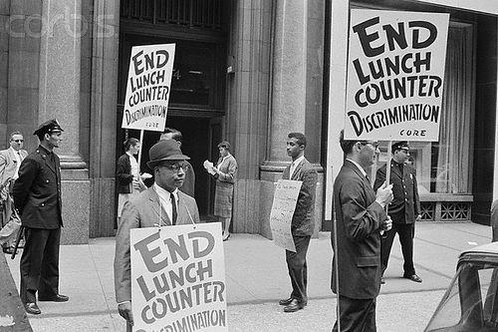
Demonstrating For Freedom
SNCC calls for more confrontational strategy
  In 1969 change “Non-Violent” to “National”
Influenced by Congress of Racial Equality (CORE) to use sit-ins:
  refuse to leave segregated lunch counter until served

Slide 16
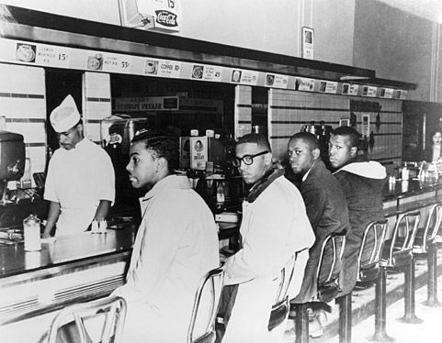
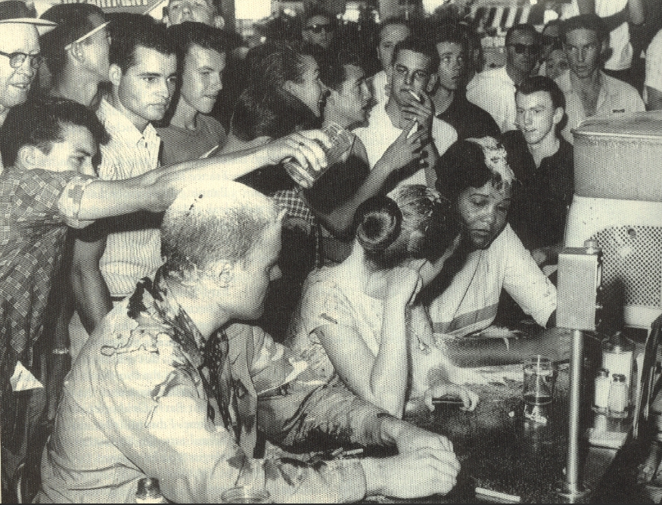
Greensboro Sit-Ins

Slide 17
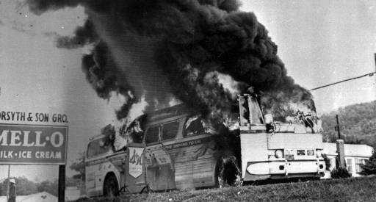
Riding For Freedom
1961, CORE tests Court decision banning interstate bus segregation
Freedom riders—blacks, whites sit, use station facilities together
Riders brutally beaten by Alabama mobs; one bus firebombed

Slide 18
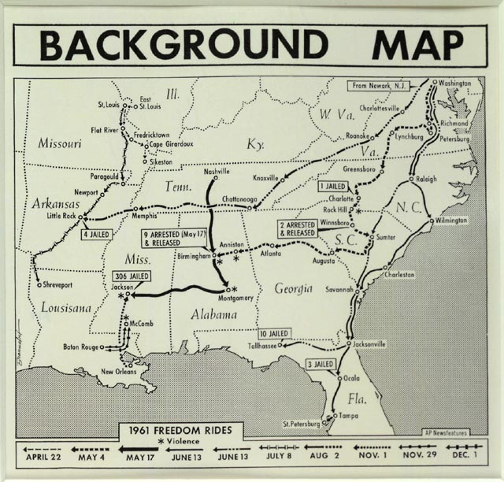
Freedom Riders

Slide 19
Arrival of Federal Marshalls
Alabama officials don’t give promised protection; mob attacks riders
Newspapers throughout nation denounce beatings
JFK sends 400 U.S. marshals to protect riders
Attorney general, Interstate Commerce Commission act:
- ban segregation in all interstate travel facilities

Slide 20
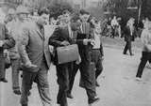
Integrating Ole Miss
1962, federal court rules James Meredith may enroll at U of MS
Governor Ross Barnett refuses to let Meredith register
JFK orders federal marshals
to escort Meredith to
registrar’s office
Barnett makes radio appeal;
thousands of white demonstrators riot
Federal officials accompany Meredith to classes, protect his parents
News Footage

Slide 21
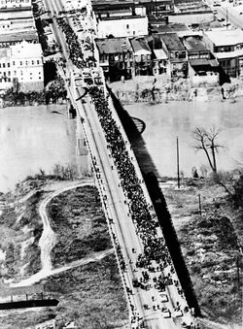
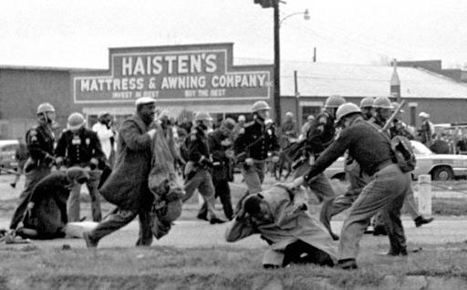
Ole Miss

Slide 22
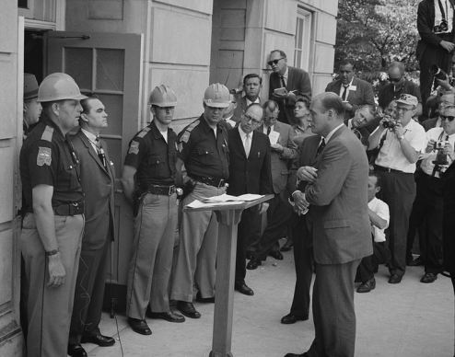
Kennedy Takes a Stand
June 1963, JFK sends troops to force Gov. Wallace to desegregate University of Alabama

Slide 23
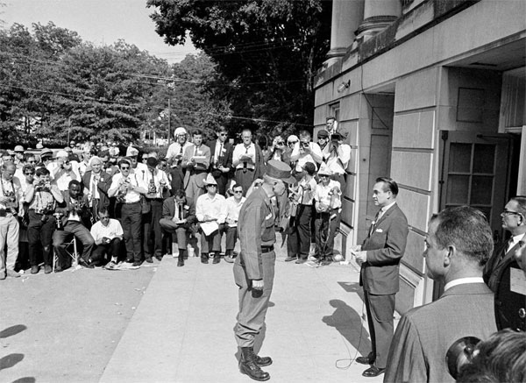
University of Alabama

Slide 24
Activity Time!
Yay!

Slide 25

Marching to Washington
August 1963, over 250,000 people converge on Washington
Speakers demand immediate passage of civil rights bill
King gives “I Have a Dream” speech

Slide 26
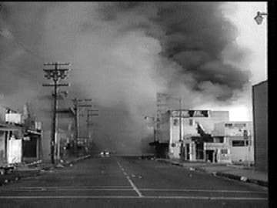
More Violence
September 1963, 4 Birmingham girls killed when bomb thrown into church
LBJ signs Civil Rights Act of 1964
- prohibits discrimination because of race, religion, gender

Slide 27

Voting Rights Act of 1965
Congress finally passes Voting Rights Act of 1965
Stops literacy tests, allows federal officials to enroll voters
Increases black voter enrollment

Slide 28
African American Solidarity
Nation of Islam, Black Muslims, advocate blacks separate from whites
- believe whites source of black problems
Malcolm X - controversial Muslim leader, speaker; gets much publicity
Frightens whites, moderate blacks; resented by other Black Muslims
Malcolm X speech

Slide 29
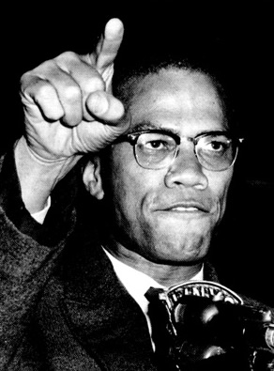
Malcolm X

Slide 30

Ballots or Bullets?
Pilgrimage to Mecca changes Malcolm X’s attitude toward whites (he becomes a Sunni Muslim)
Splits with Black Muslims; is killed in 1965 while giving speech

Slide 31
Black Power
CORE, SNCC become more militant; SCLC pursues traditional tactics
Stokely Carmichael, head of SNCC, calls for Black Power:
- African Americans control own lives, communities, without whites

Slide 32
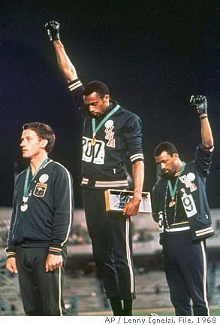
Black Power

Slide 33
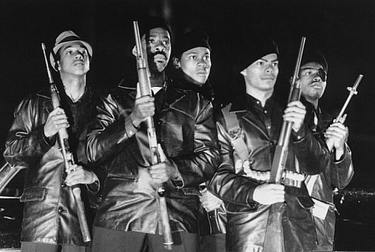
Black Panthers
Black Panthers fight police brutality, want black self-sufficiency
Preach ideas of Mao Zedong; have violent confrontations with police
Provide social services in ghettos, win popular support

Slide 34
Death of MLK & RFK
King objects to Black Power movement, preaching of violence
Seems to sense own death in Memphis speech to striking workers
Is shot, dies the following day, April 4, 1968
- by James Earl Ray
King’s death leads to worst urban rioting in U.S. history
- over 100 cities affected
Robert Kennedy assassinated two months later
- By Sirhan Sirhan

Slide 35
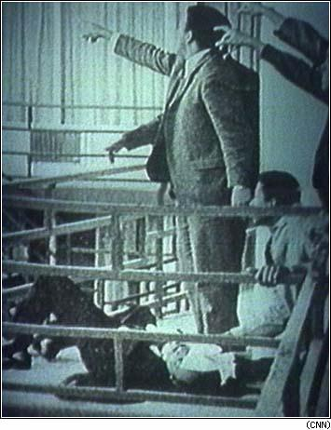
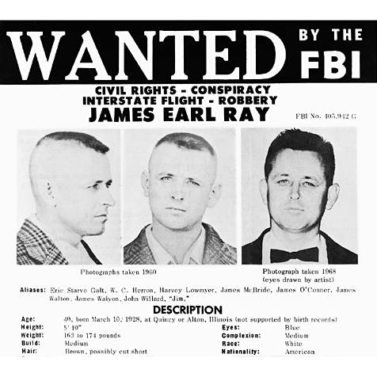
James Earl Ray

Slide 36
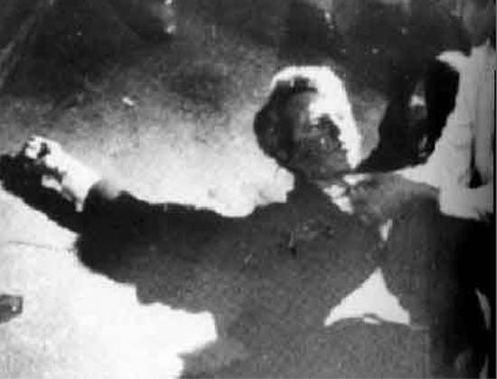
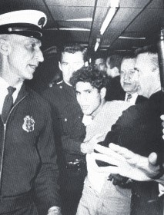
Sirhan Sirhan

Slide 37
Civil Rights Gain
Civil Rights Act of 1968 prohibits discrimination in housing
More black students finish high school, college; get better jobs
Greater pride in racial identity leads to Black Studies programs
More African-American participation in movies, television
Increased voter registration results in more black elected officials

Slide 38
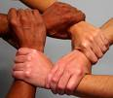
Unfinished Work
White flight reverses much progress toward school integration
Unemployment, poverty higher than for whites
Affirmative action—extra effort to hire, enroll discriminated groups

Slide 39
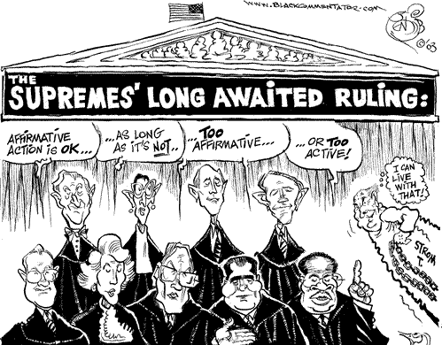
Affirmative Action

