Slide 1
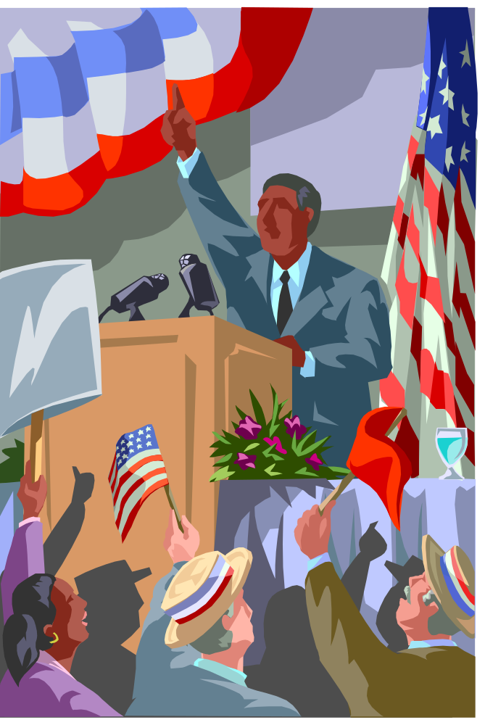
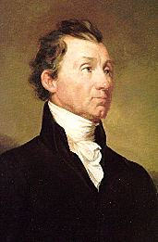
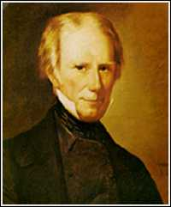
NATIONALISM
at Center Stage

Slide 2
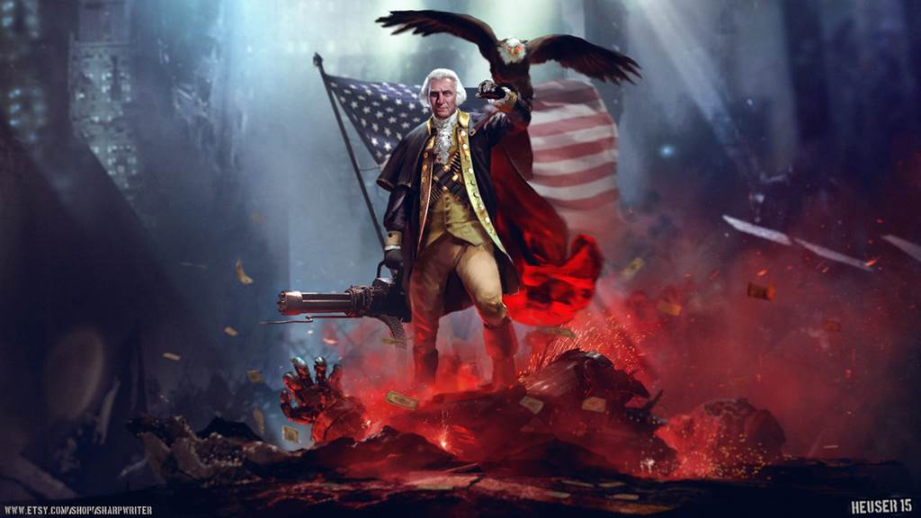
NATIONALISM – a shared group feeling that holds that group together
Promoting NATIONAL interests is #1
….Often at the expense of individual states, regions, and/or foreign nations

Slide 3
Nationalism
Post War of 1812 the United States is starting to grow into it’s own…
Nationalism promoted in..
1. Supreme Court
2. Domestic Policy
3. Foreign Affairs
Nationalism Leads to…
4. Westward Expansion

Slide 4
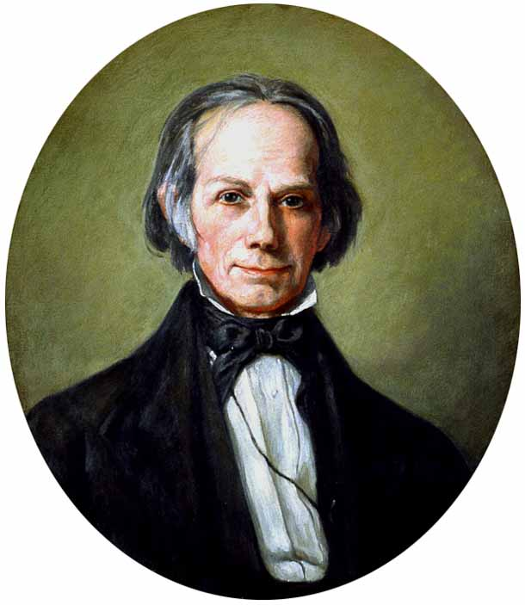
Post War Cause/Effects:
During War
Inflation and counterfeiting
Lack of trade with Europe
Difficulty mobilizing troops
Effect
Shows need for a Central Bank
U.S. forced to be self reliant → Textile Boom
Rebuilding of Military – call for improved internal transportation
American System

Slide 5
The American System
Henry Clay
(and several other politicians)
promotes the
"American System”
to help solve these issues
Don’t forget this face

Slide 6
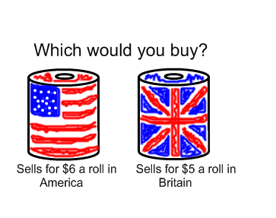
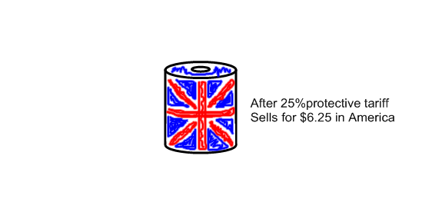
Henry Clay’s American System:
1. Improve internal transportation system
2. Protective Tariff
3. Resurrect the National Bank

Slide 7
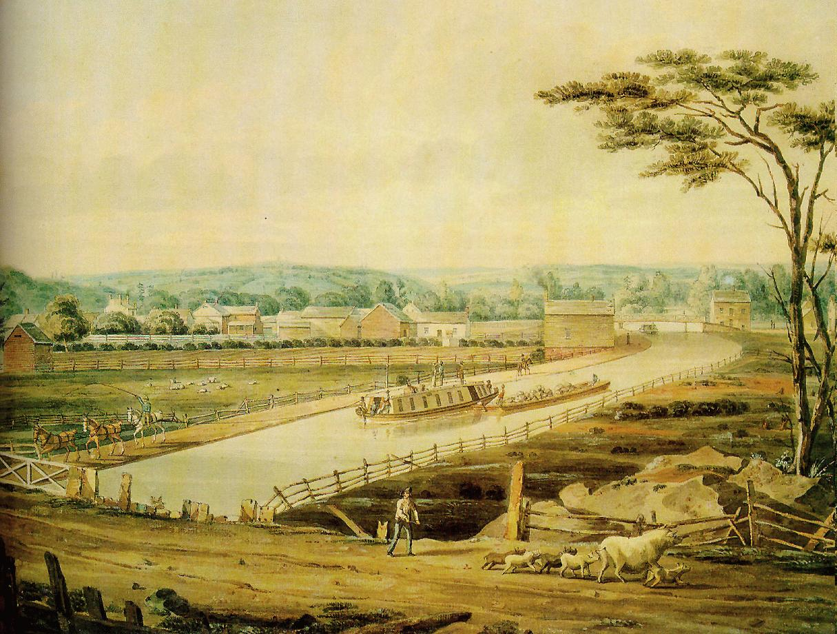
Erie Canal
Construction: 1817-1825
http://www.youtube.com/watch?v=HcNJ2RMOd3U&safety_mode=true&persist_safety_mode=1

Slide 8
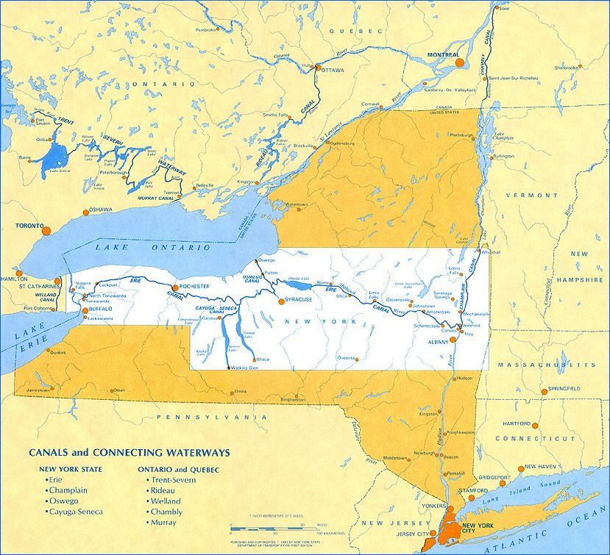

Slide 9
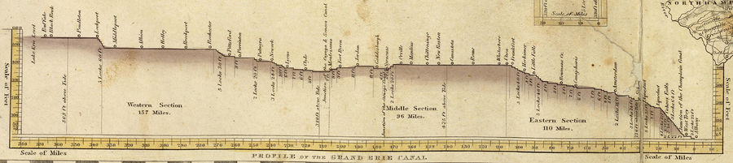


Slide 10
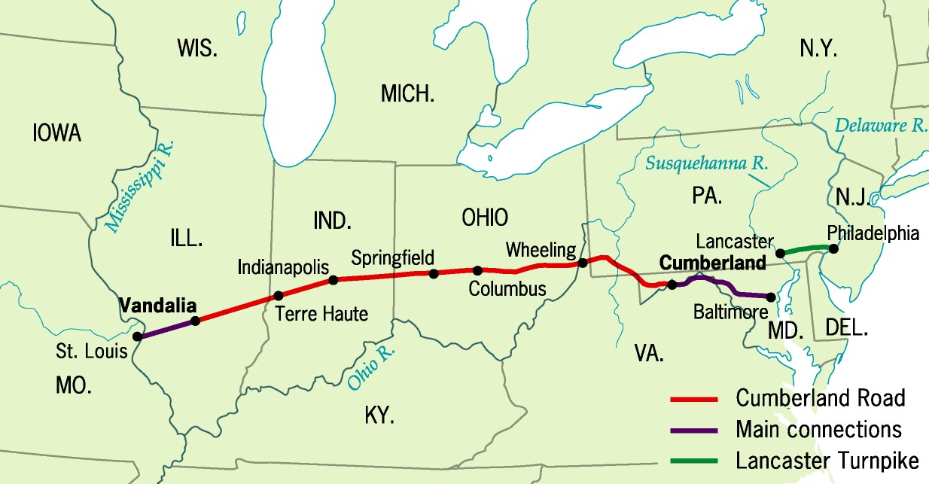
Cumberland
“National Road,” 1811

Slide 11
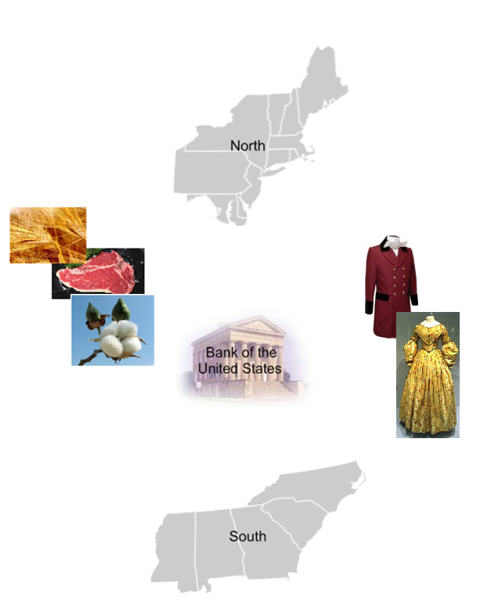

Slide 12
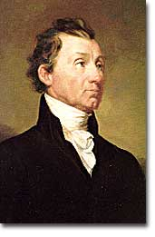
Era of Good Feelings?
Temporary end to 2 party system
  “VA Dynasty” destroys Federalist party
  More Bi Partisan
  “Monroe’s Good Will Tour”
  Virtually no opposition in 1820

Slide 13
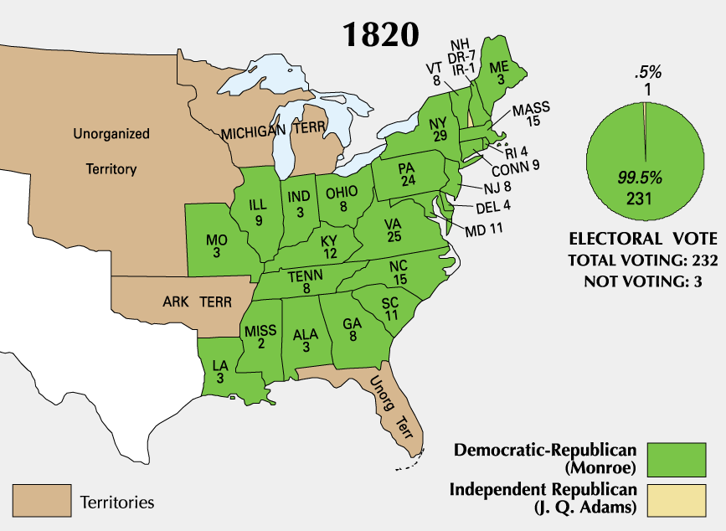

Slide 14
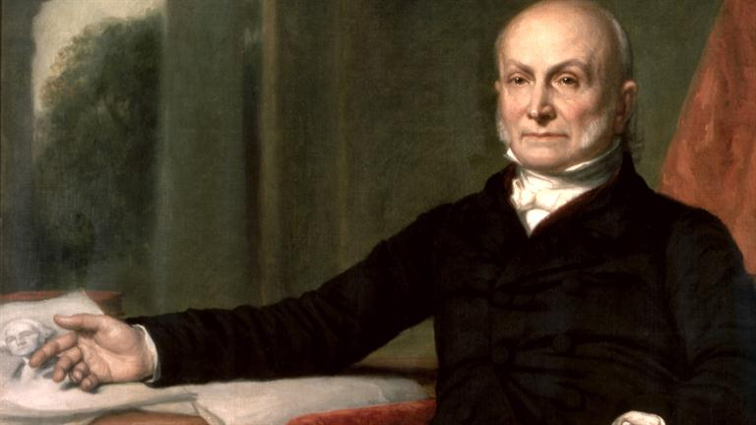
Nationalism & Foreign Policy
Secretary of State - John Quincy Adams

Slide 15
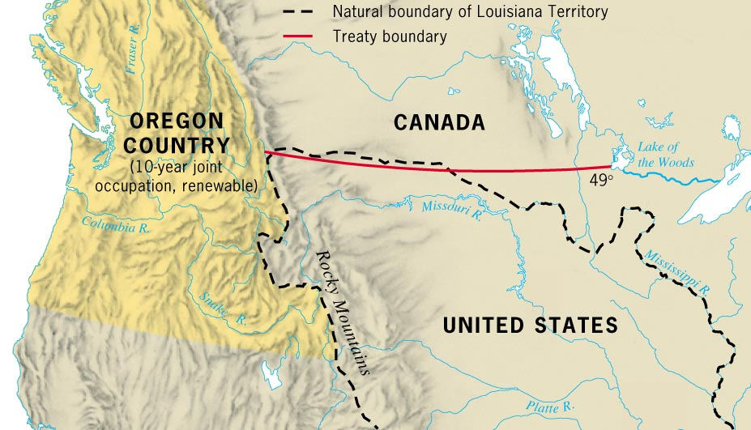
Nationalism Shapes Foreign Policy
Secretary of State,
John Quincy Adams,
makes treaties defining
U.S. northern border
- Established on
49th Parallel
Convention of 1818
Establishes Boundary @
Lake of the Woods
Rush Bagot Treaty
Demilitarized Great Lakes

Slide 16
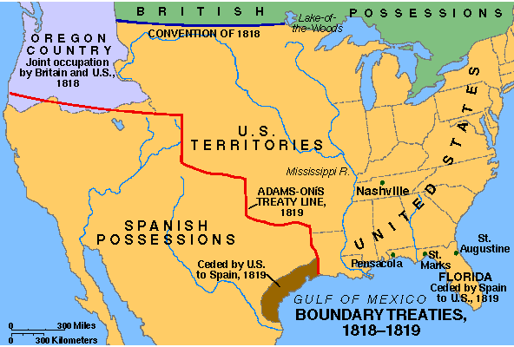
Adams-Onis Treaty, 1819
Seminole Wars
Andrew Jackson
Spain cedes Florida to U.S. in Adams-Onis Treaty of 1819
Spain gives up claims to Oregon Territory

Slide 17
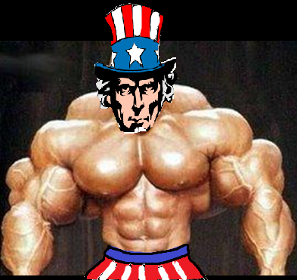
Foreign Policy
The United States is also starting to flex it’s muscle a little with Europe
How?
Secretly supports L.A. uprisings
Examples
Argentina, Chile, Peru, Columbia, Mexico
Why?
Protect trade relationships in Latin America
Prevent European Colonization

Slide 18
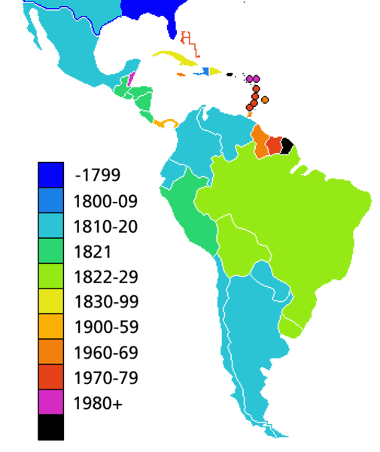

Slide 19

MONROE DOCTRINE (1823)
Actually created by JQ Adams
Americas are closed to
further colonization
United States is a
protector of Latin America
You stay out of our
hemisphere… we’ll stay out of yours

Slide 20
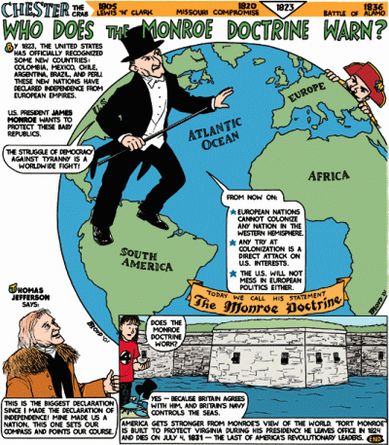

Slide 21
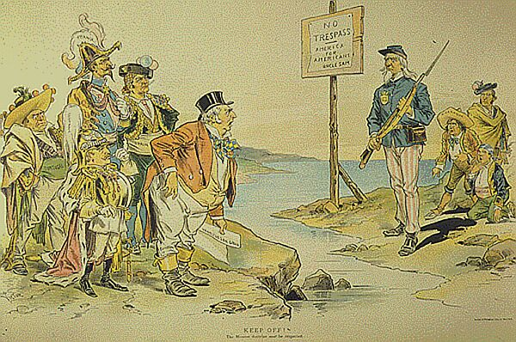
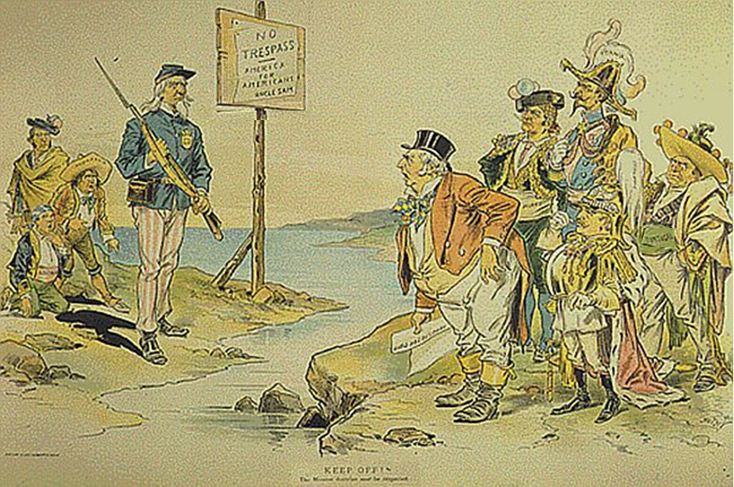

Slide 22
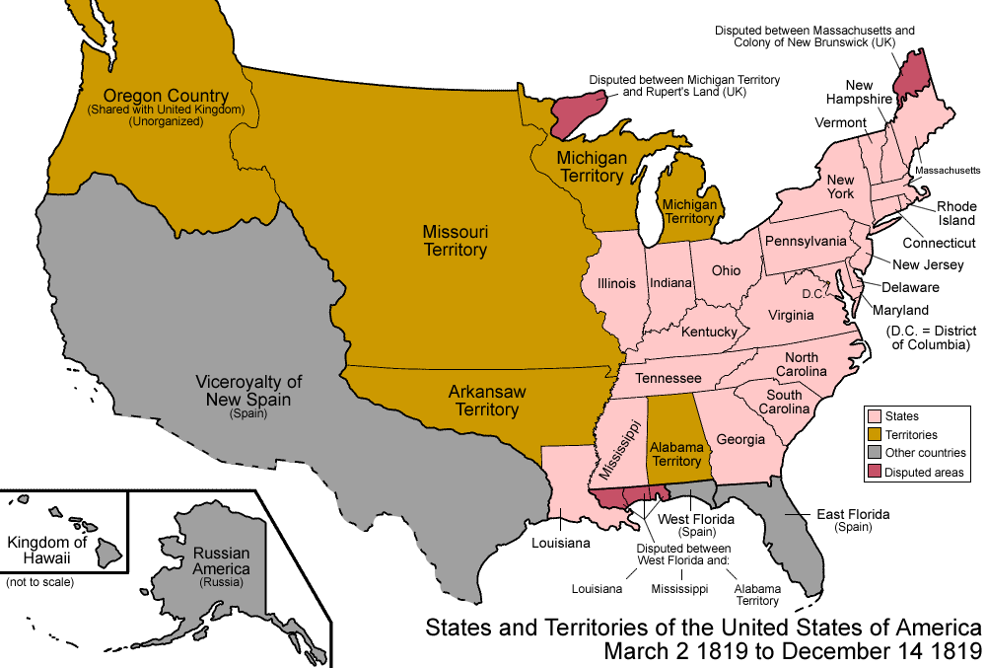
Expansion
Migration
  Population Boom
    1800 – 5 Million
    1820 – 10 million
    Need for new farmland
    “Panic of 1819”
Where?
  “Northwest”
    Natives less of an issue
  Far West
    Mexican gain Independence from Spain in 1821
    Invite Americans
  “Southwest”
    “Black Belt” soil
    Ideal for cotton

Slide 23
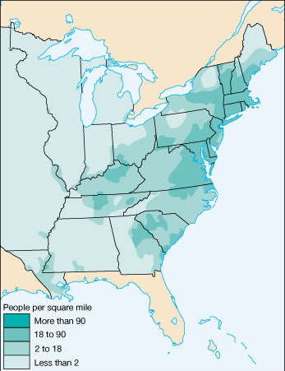
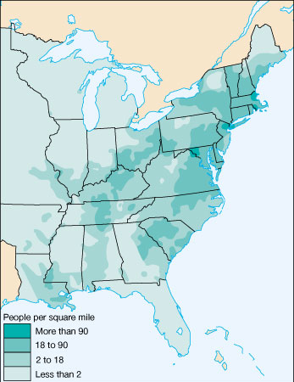
Most settlers go west for land & economic opportunity
1810
1820

Slide 24


Missouri Compromise (1820) Each time a new state is added to the United States there is a big controversy about whether it will be a free state or a slave state
OR

Slide 25
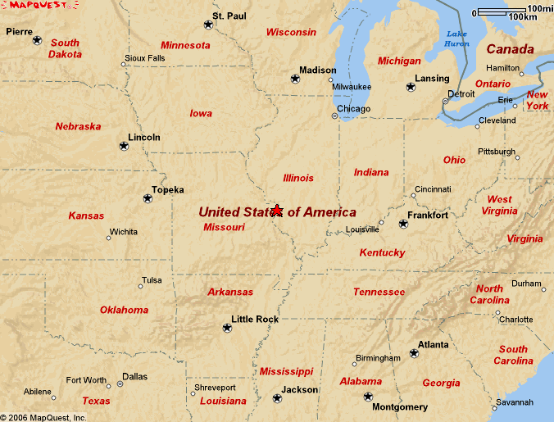
The Issue….
-Missouri has enough people to request statehood
-Missouri already has a number of slaves

Slide 26
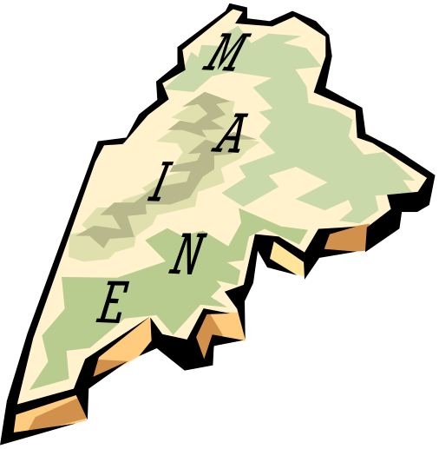

Missouri Compromise
-Henry Clay’s plays key role
Missouri would enter as a slave state
Maine would enter as a free state
Slavery was to be banned north of parallel 36 degree, 30 minutes

Slide 27
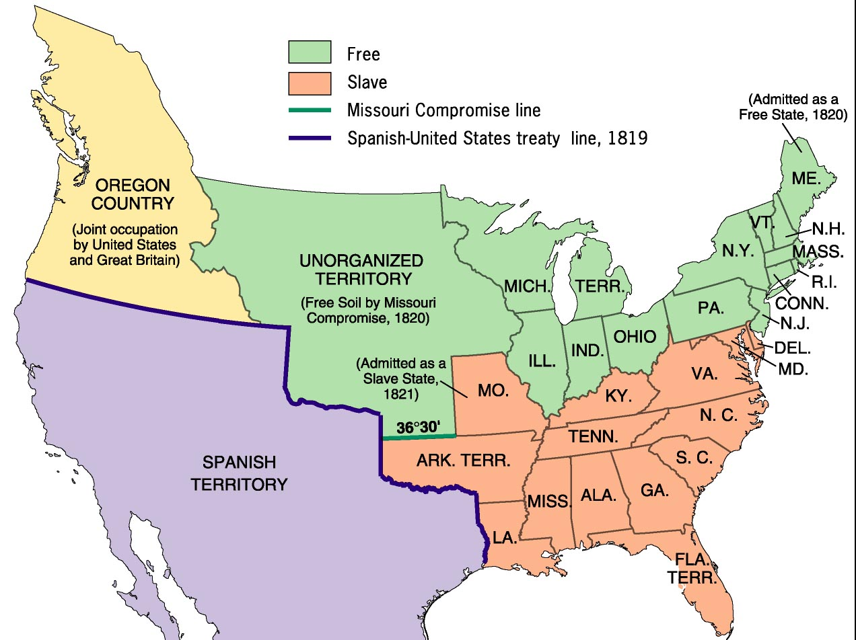
The Missouri Compromise(1820):

Slide 28

United States flag in 1820
THE
END

