Slide 1
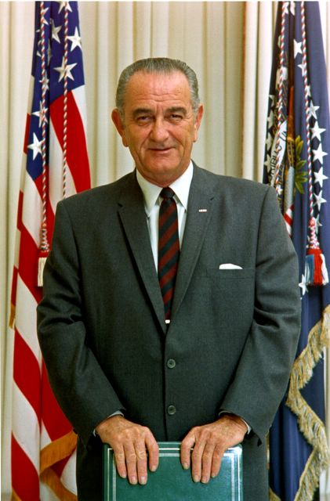
Lyndon B Johnson
The Great Society

Slide 2
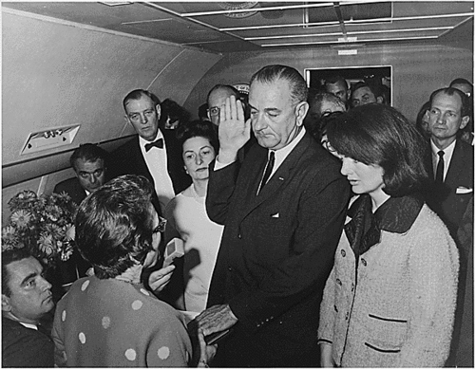

Slide 3
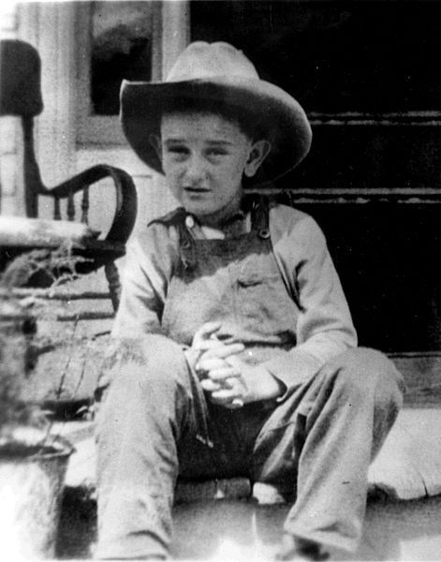
Background on LBJ
Texas Native
Dropped out of College
  Returned to obtain teaching degree
Taught High School in TX
  Mostly poor Mexican-American children
  This shaped his future political beliefs
  "I shall never forget the faces of the boys and the girls in that little Welhausen Mexican School, and I remember even yet the pain of realizing and knowing then that college was closed to practically every one of those children because they were too poor. And I think it was then that I made up my mind that this nation could never rest while the door to knowledge remained closed to any American."

Slide 4
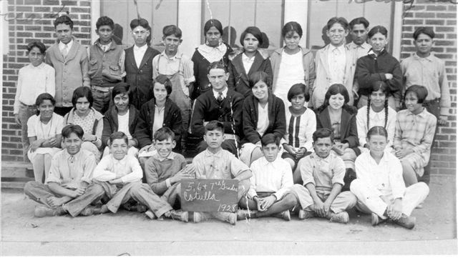

Slide 5
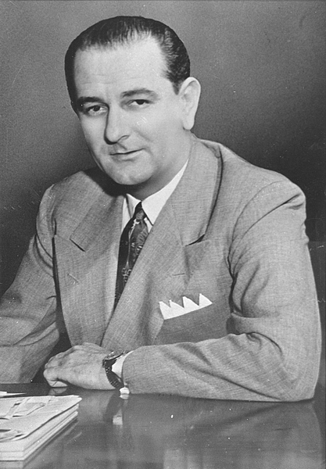
Background on LBJ
One of only 4 people to serve in every elected position in the Federal Govt
  House of Reps (1937-49)
  Senate (1949-61)
  Vice Prez (1961-63)
  Prez (1963-69)

Slide 6
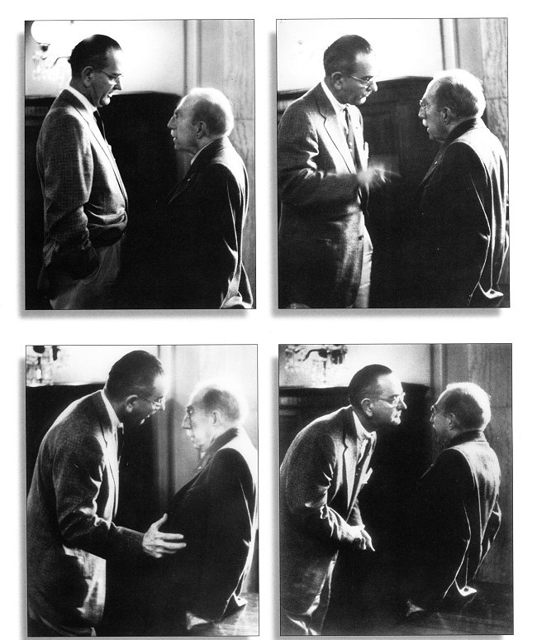
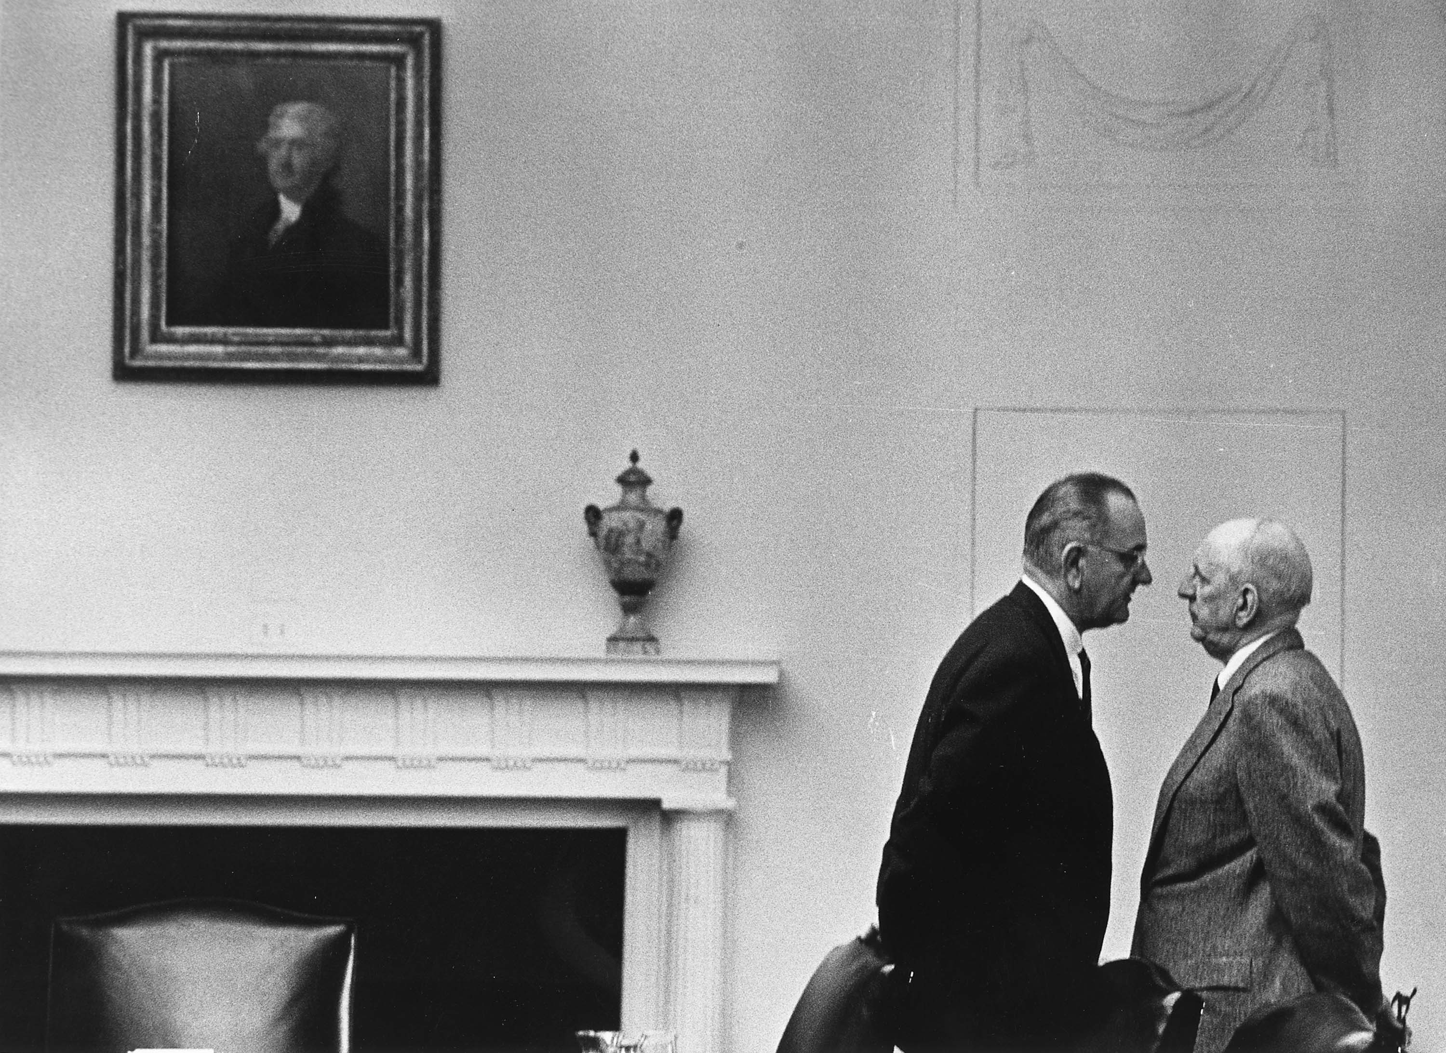
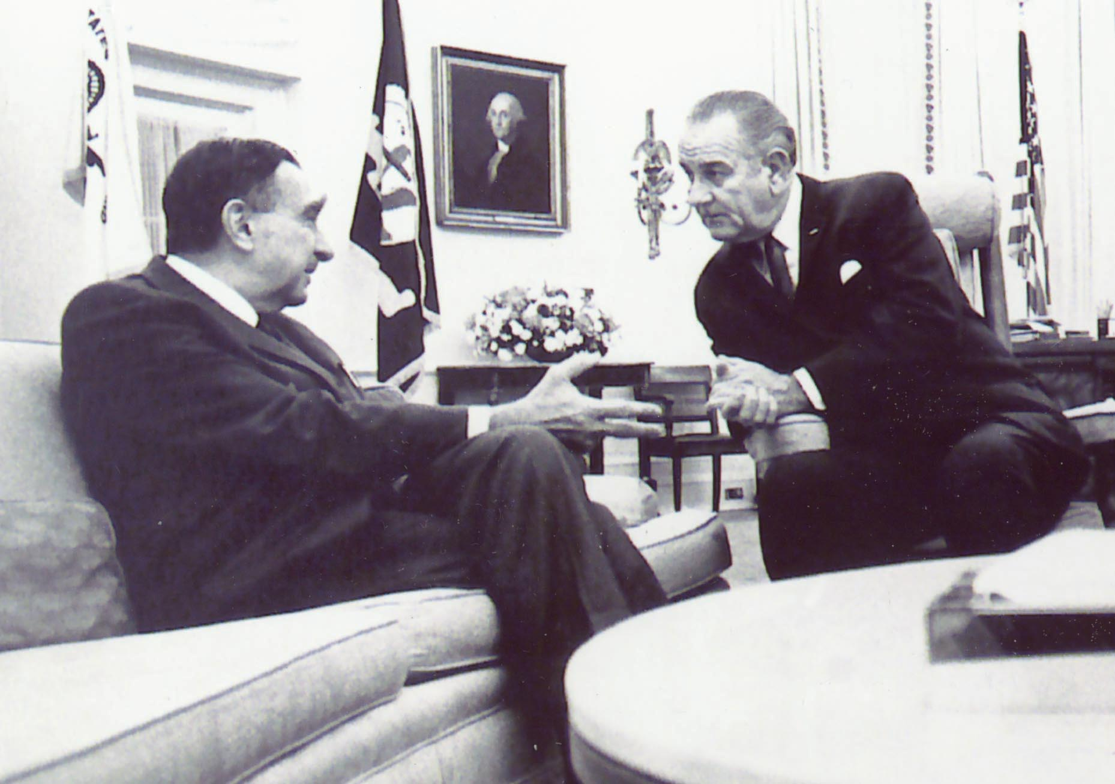
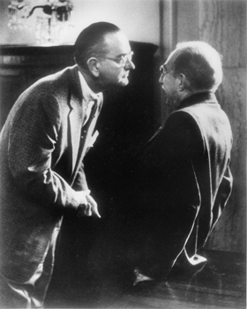
“The Johnson Treatment”
Reputation of being “overpowering and intimidating”
Invaded personal space: nose to nose
“persuasive and personable rather than elegant and charming”
Glencoe American History text p.855
Notes:
6
Pic 1 Dr. Teller: scientist/image 2: Civil rights bill discussed: President Lyndon Johnson with Senator Richard Russell at the White House, December 7, 1963, Washington, DC. image 3 senate majority leader Johnson works over Chairman of the Senate Foreign relations cmmittee in 1957

Slide 7
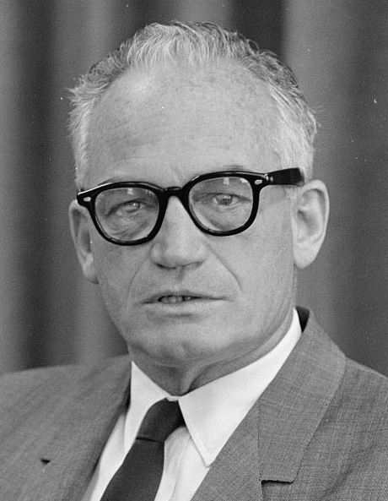
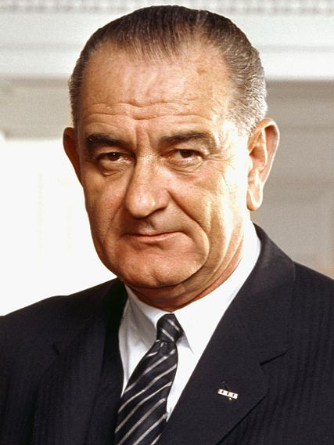
1964 Election
LBJ vs. Barry Goldwater
Goldwater believed government should stay out of our lives
LBJ portrayed Goldwater as Extremist
Said we should nuke Cuba and Vietnam
LBJ said this idea gave to real solution to the problem
LBJ won 61% of the vote - (6th most lopsided)
VS

Slide 8
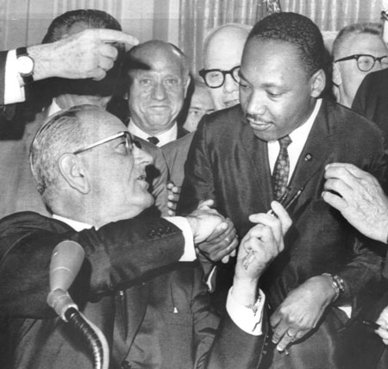
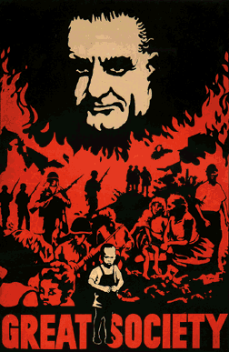
Legacy
Domestic Policy (Great Society) = Huge Success
  Upholds and passes Civil Rights laws
  War on Poverty
  Additional Funds for Education
  Medicare/Medicaid
  Environmental Protection
Foreign Policy = Enormous Failure
  Vietnam War

Slide 9

War on Poverty
Economic Opportunity Act
  Approved $1 billion for programs
    Youth Programs
    Volunteers in Service to America (VISTA)
      Volunteered to help poor in U.S.
    Head Start: education program for underprivileged kids

Slide 10
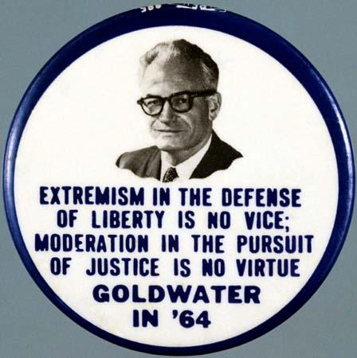
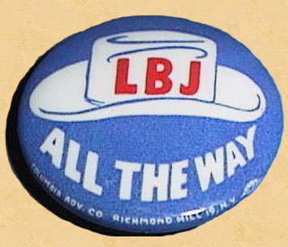
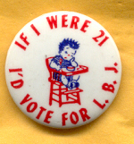

Slide 12
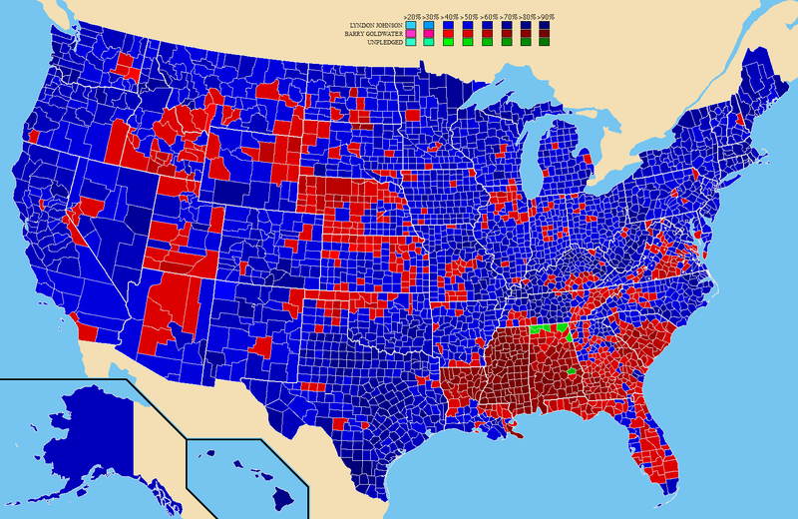

Slide 13
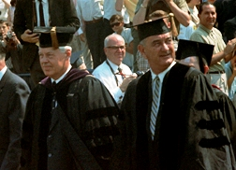
Education
The key to unlocking the “Great Society”
Elementary and Secondary Education Act of 1965
  Gave $1 billion to help schools purchase texts and library materials

Slide 14
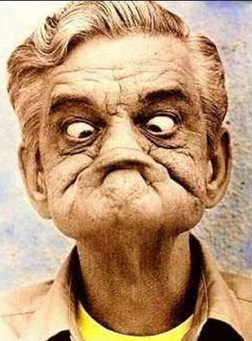

Healthcare
Medicare
  Provides low cost insurance to the elderly
Medicaid
  Provides low cost insurance to welfare recipients

Slide 15

A New Cabinet Position: HUD
Congress approves decisions to give money to build low income housing.
Established the Dept of Housing and Urban Development (HUD) to supervise this.
  Robert Weaver chosen as Secretary (First African American cabinet member)

Slide 16

Legacy of the Great Society
Number of “poor” dropped from 21% to 11%
Huge extension of government power
Activist attitude in all three branches of govt.

Slide 17
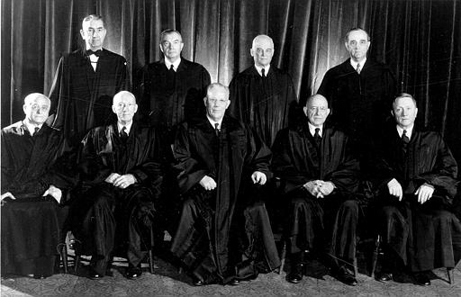
The Warren Court
Most liberal reform court in history
Known for rulings that…
  … upheld Civil Rights laws
    Ending Segregation
  … reinforced Civil Liberties
    Rights of the accused
Brown v. Board of Education
  Overturns Plessy v. Ferguson
    Unconstitutional to segregate schools

Slide 18
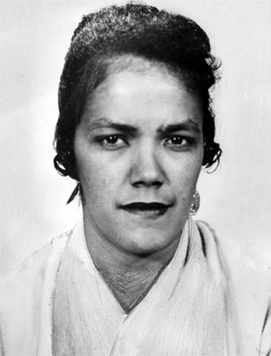
Warren Court: Rights of the Accused
Mapp v. Ohio (1961)
  Evidenced seized illegally cant be used in court

Slide 19
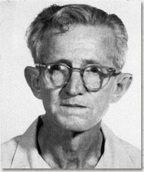
Warren Court: Rights of the Accused
Gideon v. Wainwright (1963)
  Criminal courts must provide and attorney to those who cant afford one

Slide 20
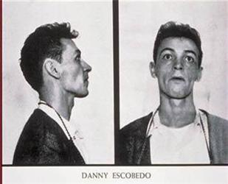
Warren Court: Rights of the Accused
Escobedo v. Illinois
  During questioning you must have a lawyer present

Slide 21
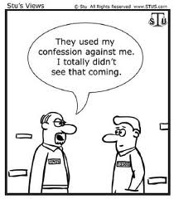
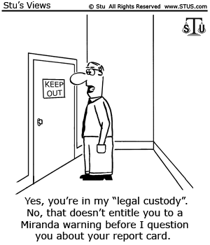
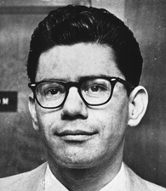
Warren Court: Rights of the Accused
Miranda v. Arizona
  Suspects must be informed of their rights before questioning

