Slide 1
The Great Depression Begins
Causes of the Great Depression

Slide 2
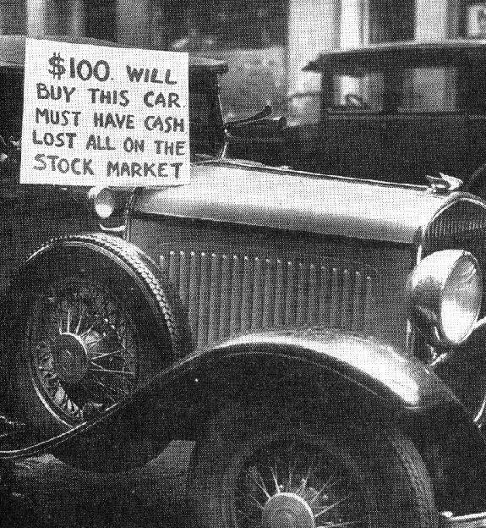
1. Industry
Overproduction of goods
Railroads lost business to new forms of transportation.
Coal mining was hit hard due to competition with new forms of energy like fuel, oil and natural gas.
The number of houses being built also dropped dramatically

Slide 3
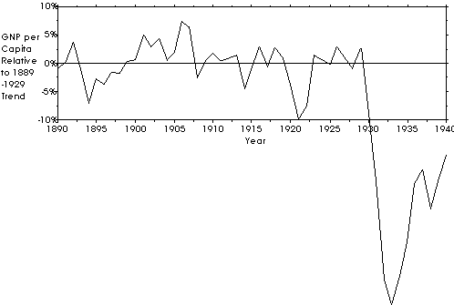

Slide 4
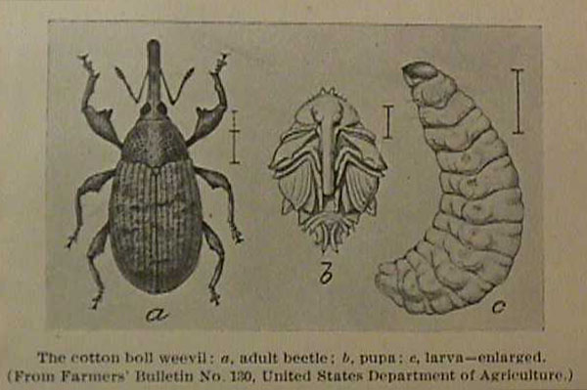
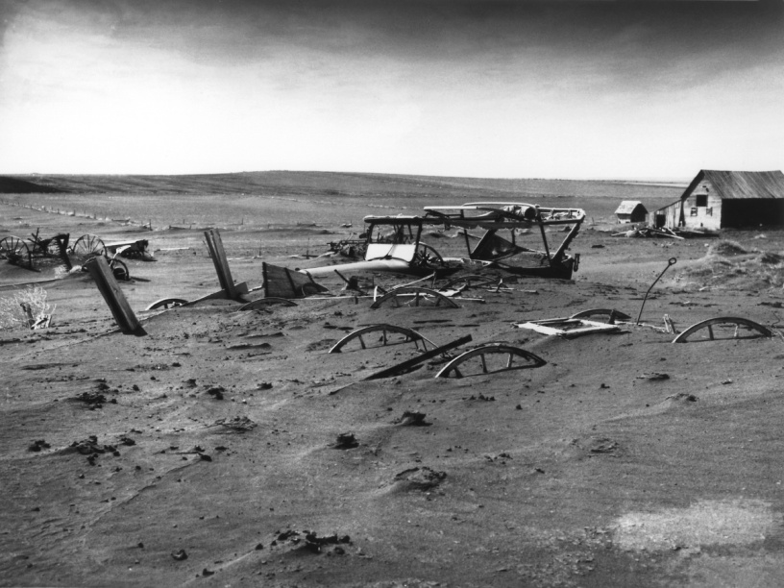
2. Agriculture
The demand for crops after WWI fell.
Farmers began to go into debt and the banks seized their farms.
Congress Proposed the McNary-Haugen bill which called for govt. price supports.
Calvin Coolidge vetoed this twice.
“Farmers have never made money. I don’t believe we can do much about it”
Calvin Coolidge

Slide 5
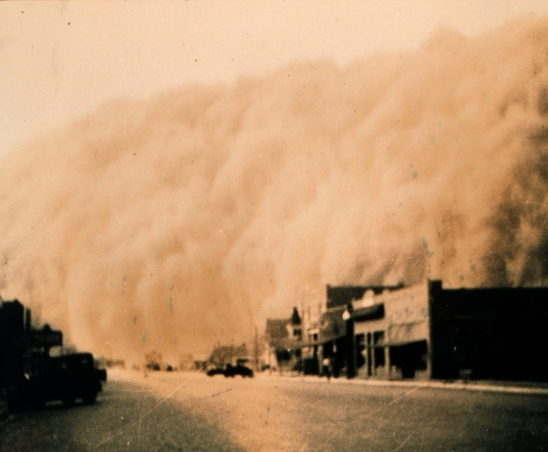
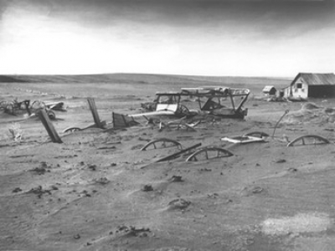
Effects on Farming
Dropping Prices
  forced many farmers to lose their farms
  Dust Bowl
    Farmland was exhausted from overproduction
    Also hit with drought and wind.
Many farmers packed up and went west to become tenant farmers
  Known as “Okies”

Slide 6
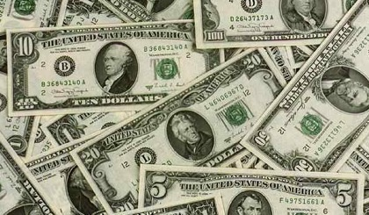
3. Consumer Spending
Americans were buying less by the late 1920s due to rising prices, stagnant wages and overbuying on credit.
70% of families made under $2,500 a year.
The unequal distribution of income meant most Americans could not participate in the economic advances of the 1920s.
Richest 1%:
Income grew 75 percent
Everyone else:
grew 9 percent

Slide 7

4. The Stock Market
The Dow Jones Industrial Average
  30 large firms being traded.
  Reached 381 points at peak
Many people engaged in Speculation- buying stocks on chance of fast profit, ignoring risks
and
Margin- Buying stock on credit

Slide 8
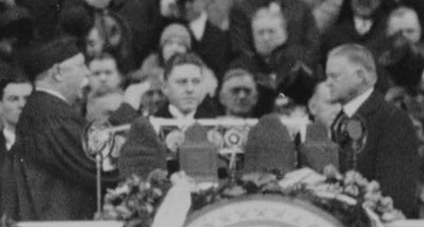
Meanwhile…
Election of Herbert Hoover
Under Harding and Coolidge, Hoover served as secretary of commerce
Hoover pointed to years of prosperity under the Republicans since 1920 and he overwhelmingly won the election.

Slide 9
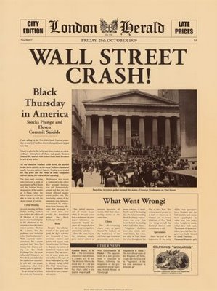
Black Tuesday:
Oct. 29, 1929
On October 24,
  the market took a plunge and many investors sold their shares.
Black Tuesday
  October 29 – shareholders dumped over 16.4million stocks with many not being able to sell

Slide 10
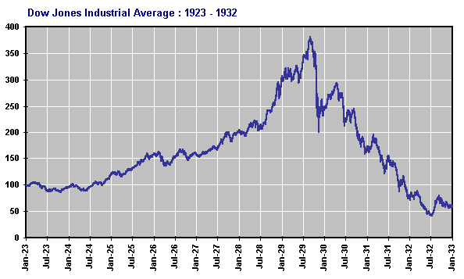

Slide 11
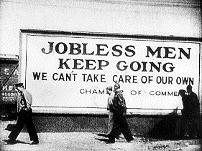
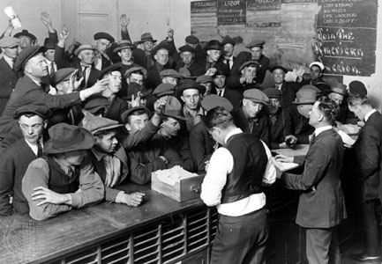
5 . Bank and Business Failures
Run on Banks
  Many rushed to the banks to get their money but did not have enough because the invested in the stock market.
Thousands of industries went bankrupt such as automobile and railroads.
Rising Unemployment
  1933 unemployment = %25

Slide 12
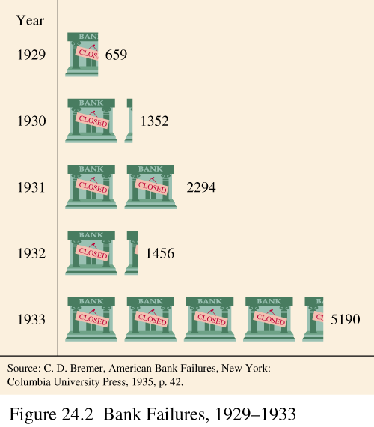

Slide 13
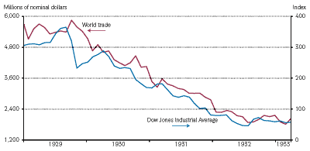
6. Worldwide Depression
European countries still rebuilding from WWI
1930: Hawley-Smoot Tariff
  Highest in history (up to 63%)
  Meant to protect against competition.
  Actually has opposite effect
Congress did not understand that we had become a world economy.

Slide 14
Hoover And the Depression
Was it really his fault?

Slide 15
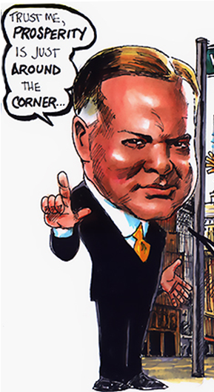
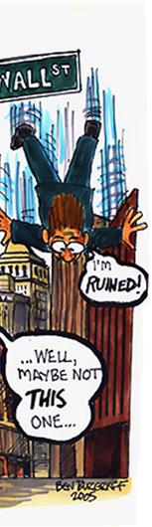
Hoover’s Reassurance
“Any lack of confidence in the economic future… is foolish” -Herbert Hoover 1929’
Believed that Americans should carry on as usual.
Rapid growth and slumps just a part of American economic trend

Slide 16
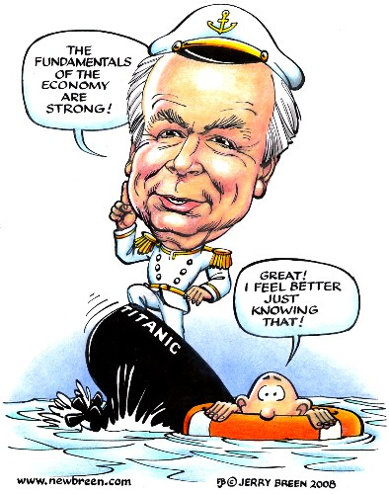

Slide 17
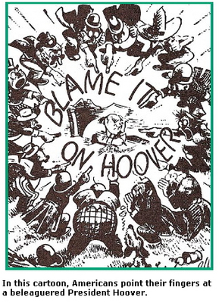
Hoover's Philosophy
Rugged Individualism- people should succeed through their own efforts.
Felt that handouts would weaken “moral fiber”
Hoover believed that Americans should have…
  savings protected
  steady job
  insurance
However, believed this was not governments job.

Slide 18
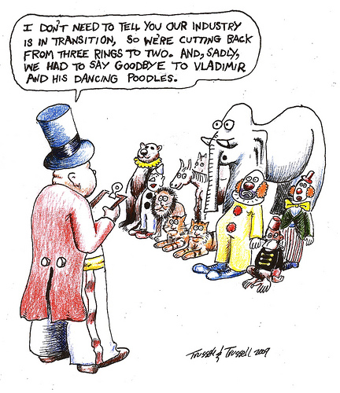
Hoover’s Requests
Asks….
  …employers not to cut wages or lay off workers.
  …labor leaders not to demand higher wages or go on strike.
Provides no incentive

Slide 19
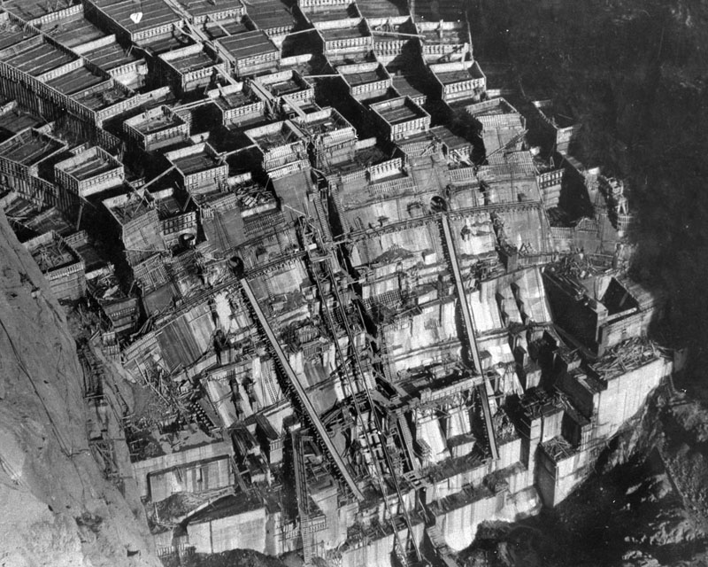
Hoover’s Actions
$423 Million for public works programs
  Boulder Dam Project
  Mount Rushmore
Reconstruction Finance Corporation (RFC)
  $2 billion to finance failing banks and businesses.
Attempts to Aid Farmers
  Agricultural Marketing Act
    Maintain prices
  Farm Board
    Handle surplus goods

Slide 20
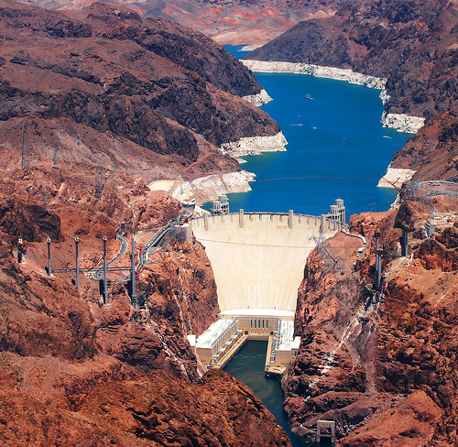
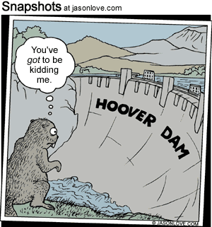
Boulder Dam

Slide 21
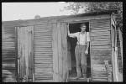
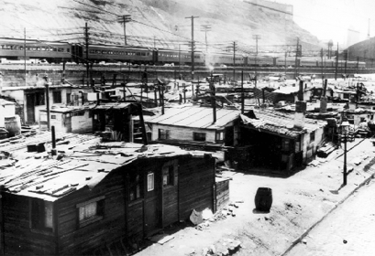
Hoover Gets the Blame
Hoover gets the blame
People living in shantytowns began calling them Hoovervilles
Called newspapers they wrapped themselves in Hoover blankets
In 1930, the Democrats win control of the House of Representatives

Slide 22
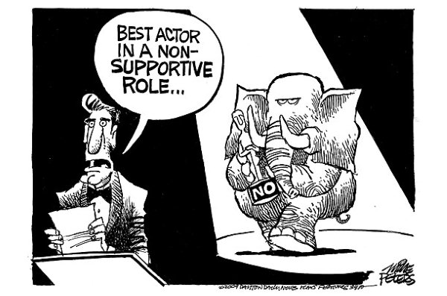
Despite Criticism, Hoover struggles to maintain his principles.
Angry Americans blame him for Depression

Slide 23
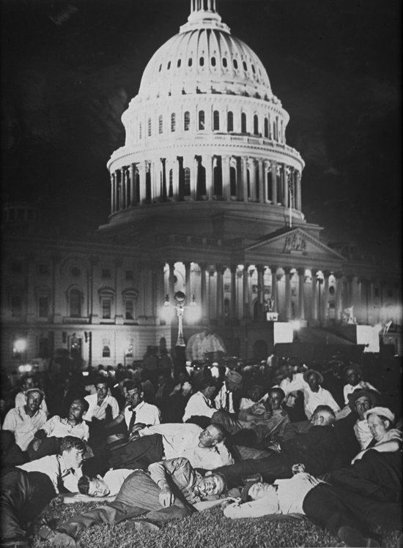
Bonus Army
In 1932 10,000-20,000 WWI veterans march on Washington D.C.
Demanded that a bonus promised for 1945 be paid immediately
Hoover said no but acknowledged their right to assemble peacefully

Slide 24
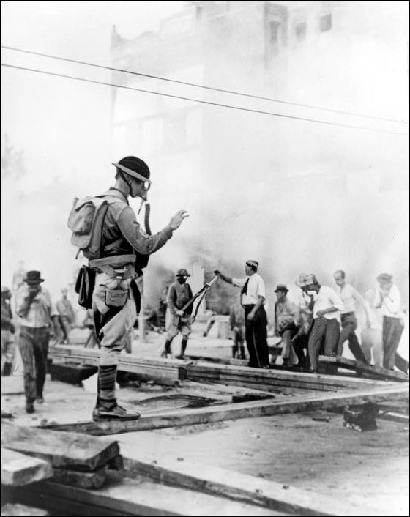
Bonus Army Cont.
The proposal went to the Senate who voted it down.
Hoover asks army to leave
  Most did but 2000 refuse
Hoover calls on a group of 1000 soldiers to remove the veterans
  Led by Douglas Macarthur and Dwight D. Eisenhower
  100 Injured
Seen as a symbol for Hoovers Legagy

