Slide 1
Multiplying a Decimal by a Whole Number

Slide 2
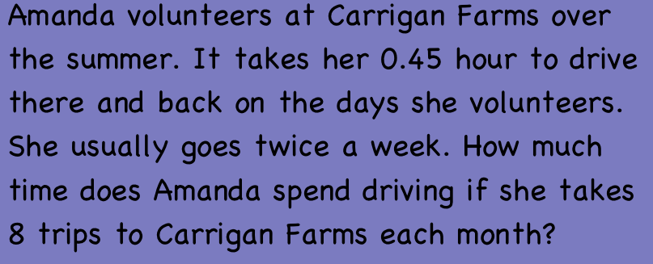
1

Slide 3
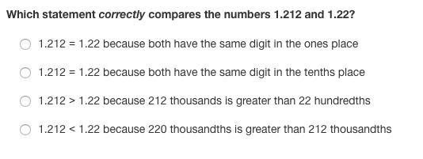
2

Slide 4

3

Slide 5
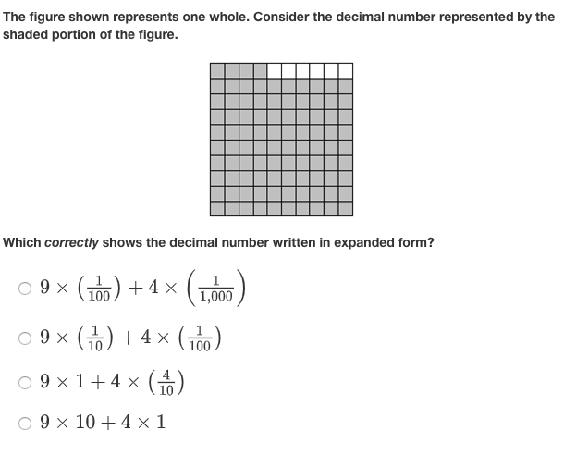
4

Slide 6

5

Slide 7
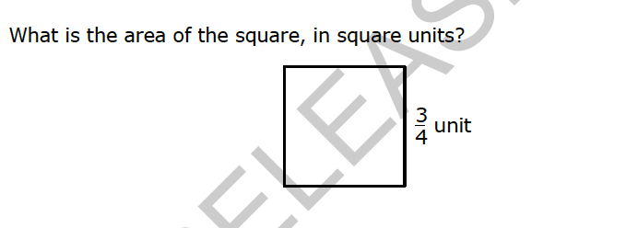
6

Slide 8

7

