Slide 1
The Roaring Life of the 1920s
Chapter 21
Notes:
1920: 51.2% lived in communities of 2,500-1million
22-29 2 million left farms and towns a year for cities

Slide 2
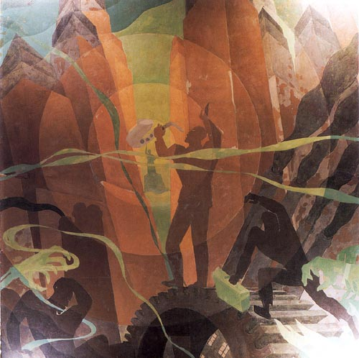
New Urban Scene
65 cities with over 100K people
People judged each other by their accomplishments
Drank, gambled, casually dated, danced
City life was fast-paced & impersonal
Notes:
NYC: 5.6 mill, Chicago: 3mill, Philly: 2 mill
Daytime- filled with workers, nighttime- crowded movie houses and vaudeville houses
Debated about scientific and social issues

Slide 3
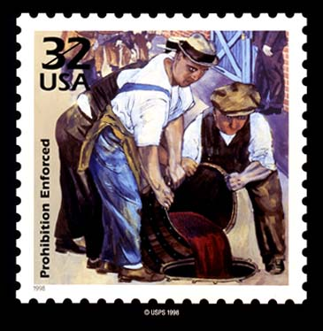
Prohibition Experiment
Liquor led to crime, family abuse and accidents on the job
18th Amendment passed making it illegal to manufacture, sale and transport alcohol
Volstead Act established the Prohibition Bureau, but it was underfunded and undermanned
Notes:
Manufacture, sale and transport of alcoholic beverages prohibited
Saloons closed but post WWI people fed up with idea
Prohibition Bureau at Treasury est. in 1919
1,500 agents and local cops to patrol all USA

Slide 4
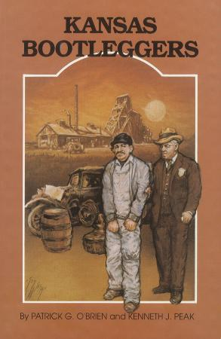
Prohibition Experiment
Speakeasies were places where people could illegally buy liquor
  They were in cellars and hardware stores
Bootleggers were individuals who smuggled alcohol into the U.S
Notes:
Cellars, office buildings, tenements, hardware stores, penthouses
Mix of upper-middle to middle class
Built own stills
Medicinal and religious alcohol sales increased

Slide 5
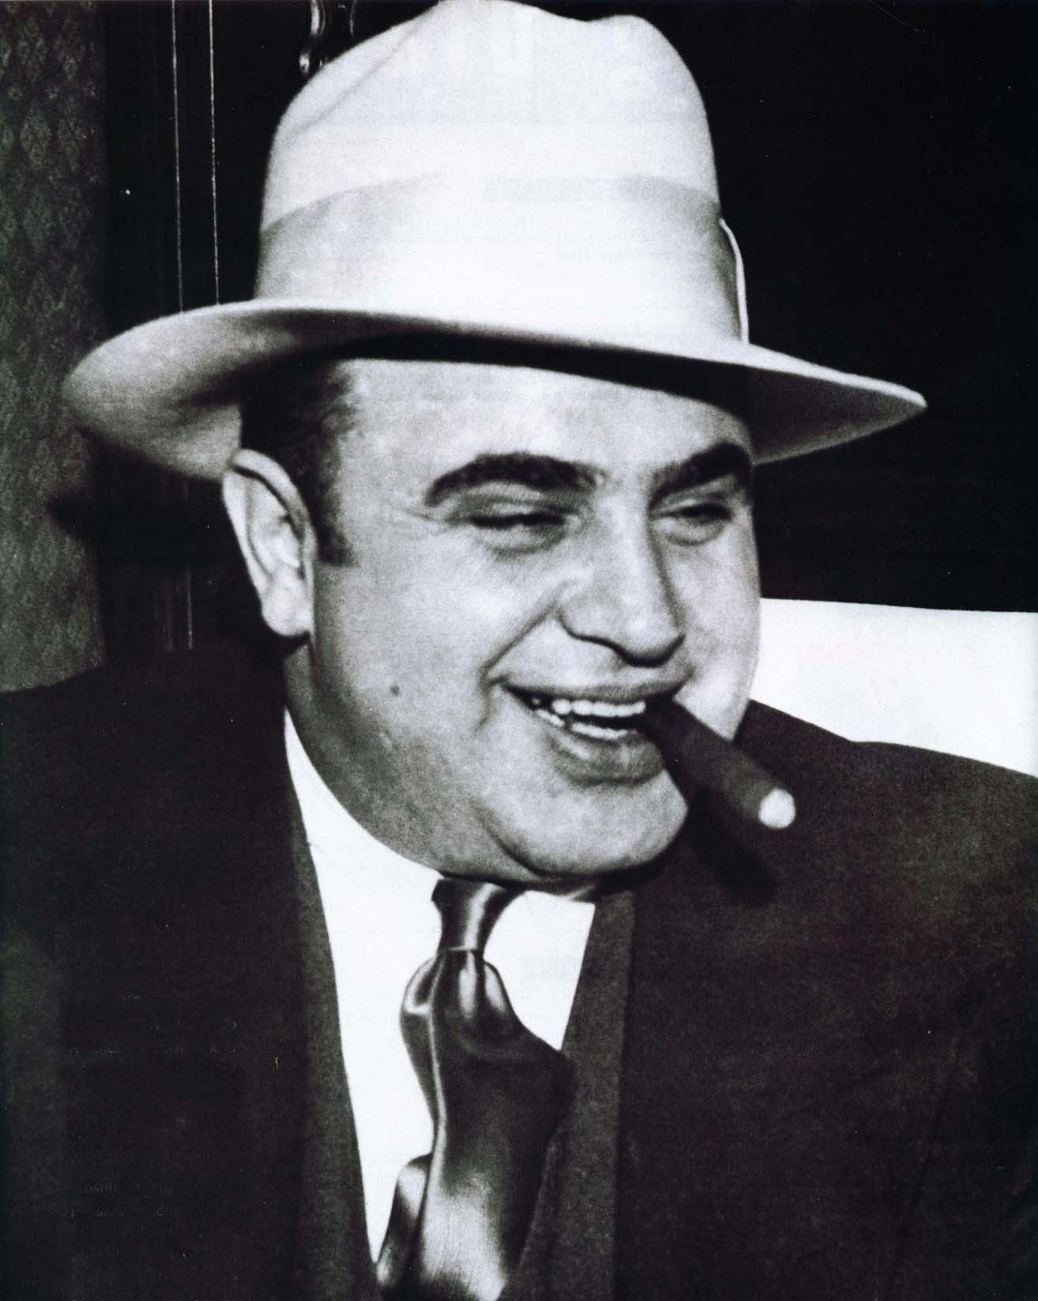
Prohibition Experiment
Al Capone was the most famous organized crime boss in Chicago
Killed off most of his competition
By Mid 20s only 19% support Prohibition
1933: 21st Amendment repealed Prohibition
Notes:
Prohibition led to a rise in every major city
Reportedly linked to 522 murders
Convicted of tax evasion

Slide 6
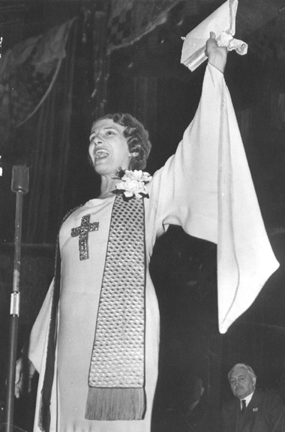
American Fundamentalism
Fundamentalism believed in the literal interpretation of the bible.
They were skeptical of science and rejected theory of evolution
Use religious revivals or radio to spread word of God
Notes:
All important knowledge found in the Bible
Could not believe that evolved from Apes

Slide 7
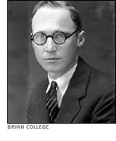
The Scopes Trial
1925: TN made it a crime to teach evolution
John Scopes defied the law and the ACLU hired Clarence Darrow to defend him
Prosecutor: William Jennings Bryan
Notes:
ACLU promised to defend teacher who defied it
Darrow was the most famous trial lawyer at the time

Slide 8
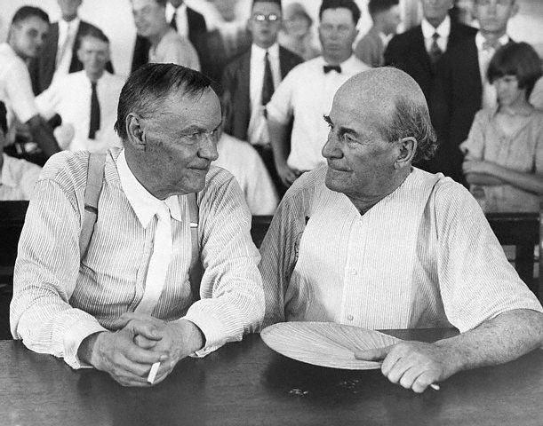
The Scopes Trial (July 10, 1925)
Called Bryan to the stand
Bryan: “Not 6 days of 24 hours”
Scopes found Guilty
TN Supreme Court overturned ruling
Darrow and Bryan
Notes:
Judge moved the trial outside to accommodate all the people
Darrow asked: Do you think Earth made in 6 days? PEOPLE WERE SHOCKED
Bible left to interpretation
Overturned on a technicality: Law remained in place

Slide 9
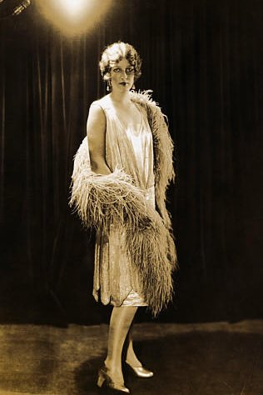
Women
Emancipated women who embraced new fashions and attitudes were called FLAPPERS
Smoked, drank, talked about sex
Marriage an equal partnership

Slide 10
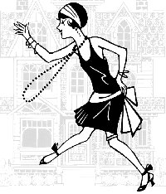
Women
Not all subscribed to Flapper
Casual Dating rose
Men could have greater sexual freedom, while women had to observe stricter standards. This is known as the double standard

Slide 11
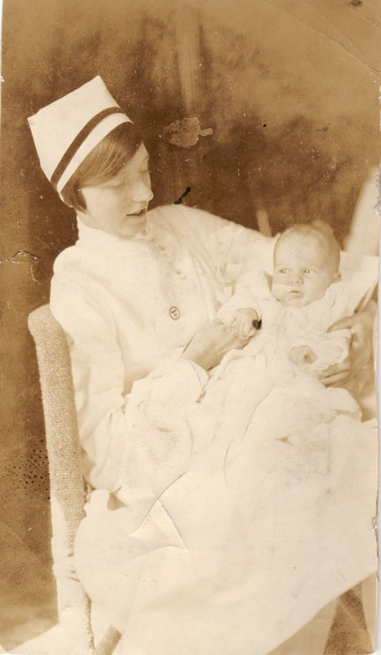
New Work Opportunities
Teaching, nursing, libraries, clerks, secretaries
1930: 10 million employed

Slide 12
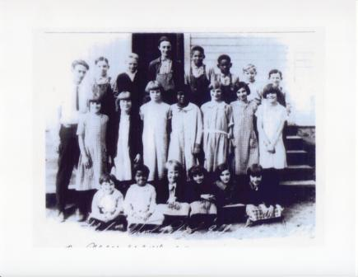
Changing Family
Births decreased
  Margaret Sanger
    Advocated use of Contraceptives
Free time for women
More children in schools

Slide 13
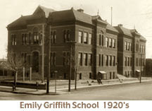
Education and News
School enrollment rose dramatically
Offered a broad range of vocational courses.
Teachers had to now teach students who did not speak English
Notes:
1914: only 1million 1926: 4million enrolled
Determined teachers met challenge of teaching illiterate immigrants
School costs double through the 20s to 2.7billion

Slide 14
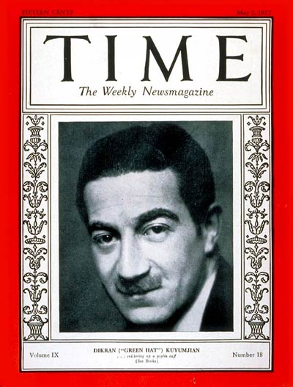
Education and News
Newspaper circulation rose
Mass circulation magazines summarized the weeks news
Americans tuned into radio which became the most powerful means of mass communication
Notes:
Mastered sensationalized journalism to hook readers
600 local papers shut down and 230 taken over by national chains
Time, Reader’s Digest
Heard News as it happened; could hear President and World Series
29: Spent 4.5billion on entertainment
Had money and time to enjoy leisure activities

Slide 15
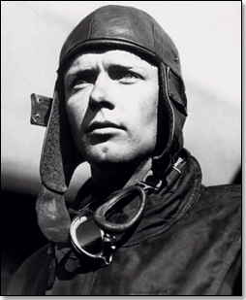
American Heroes in the 1920s
Charles Lindberg made the first non stop solo flight across the Atlantic
Flew in his plane the Spirit of St. Louis.
Became a national hero
Notes:
Prize of $25,000 offered
Left near NYC on May 20, 1927
Took 33hrs and 29 minutes
Stood for bravery and honor in a time that lost it

Slide 16
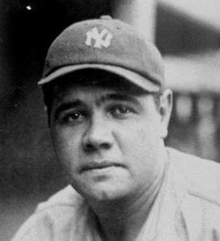
Babe Ruth: Hit 60 Home Runs

Slide 17
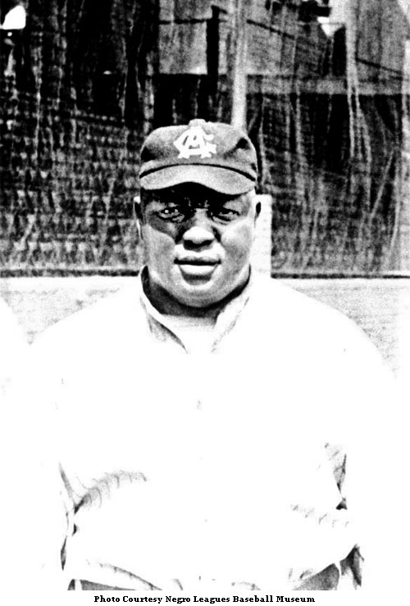
Andrew “Rube” Foster: Founded Negro National Baseball League

Slide 18
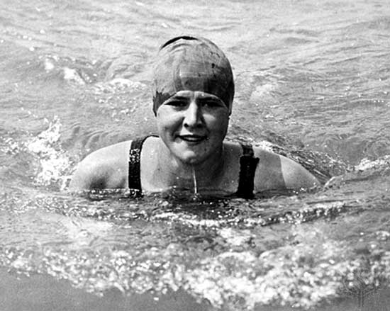
Gertrude Ederle: First Woman to Swim the English Channel

Slide 19
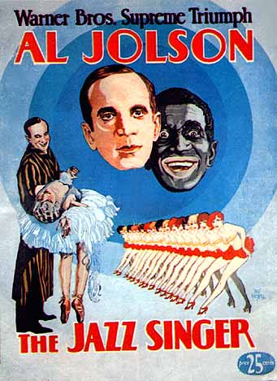
Movies, Writers, and Artists
A national pastime
In 1927 The Jazz Singer was the first “Talkie”
Steamboat Willie was the first talking animated movie
Talkies doubled attendance
Notes:
Steamboat Willie (’28): First animated movie with Sound

Slide 20
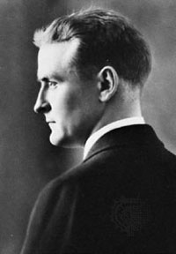
F. Scott Fitzgerald and Sinclair Lewis
Fitzgerald coined the term “Jazz Age”
The Great Gatsby showed negative side of the period
Sinclair Lewis: first American to win the Nobel Prize in Literature
Notes:
Writers of the 1920s:
Sinclair Lewis- first American to win Noble prize in literature
Criticized Americans for conforming and materialism
This Side of Paradise and Gatsby
Age of Innocence (Edith Wharton): tackled clash of moral and traditional value

Slide 21
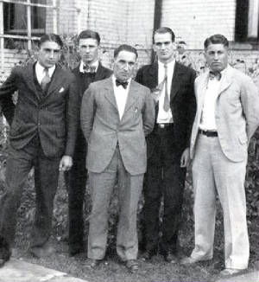
The Lost Generation
The “Lost Generation” was a term used to describe people in post WWI America
This term also characterizes a specific group of writers during this era.
Fitzgerald, Gertrude Stein and Ernest Hemingway were some of this “club’s” members
Most of these authors focused on the negative aspects of the era
Notes:
Mainly in Paris
Joined by Gertrude Stein, T.S. Eliot, and Ezra Pound
Socialized in Paris Cafés
Hemingway introduced tough, simplified style of writing; A Farewell to Arms and The Sun Also Rises

Slide 22
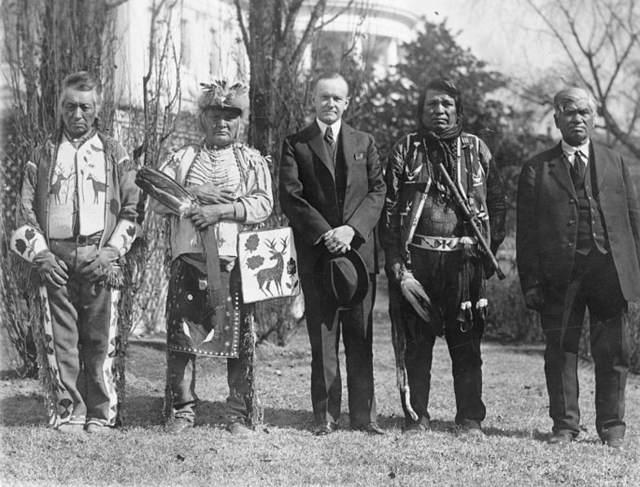
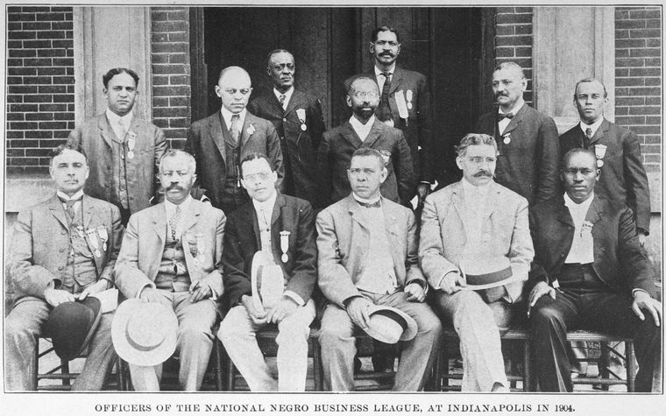
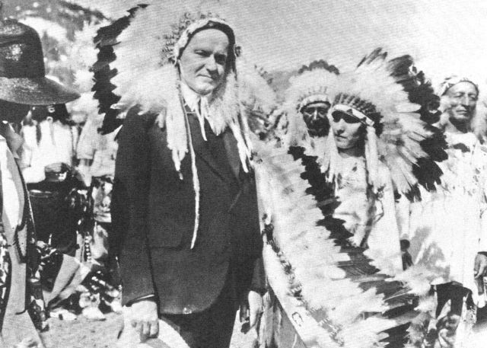
Civil Rights in the 1920’s
African Americans
  Harding
    Supported Anti Lynching Laws
    First Prez to openly do so
  Coolidge
    Spoke in favor of Af Am Rights
    Applauded role in WWI
  Southern Democrats filibustered most proposed laws
Native Americans
  Indian Citizenship Act 1924
    Signed by Coolidge
    Granted citizenship to all Native Americans

Slide 23

The Harlem Renaissance
A period of African-American artistic activity
Expressing previous struggles of African Americans (under slavery)
Pride in African American heritage and folklore
Speaking out against discrimination and prejudice

Slide 24
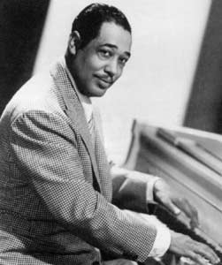
Duke Ellington
Jazz pianist
Self-taught musician
“Soda Fountain Rag” at the age of 15

Slide 25
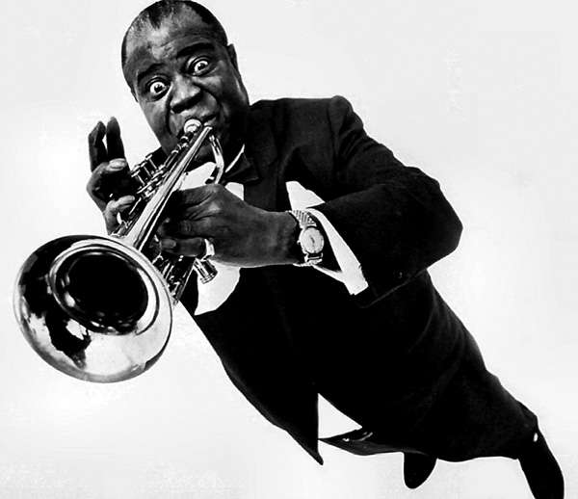
Louis Armstrong
One of the most influential musicians in the history of Jazz

Slide 26
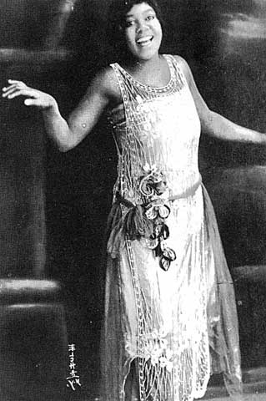
Bessie Smith
Female blues singer
1927, highest paid black artist in the world.

Slide 27
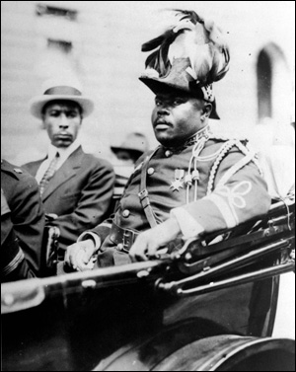
Marcus Garvey
Immigrant from Jamaica
Founded the UNIA
(Universal Negro Improvement Association)
Advocated for blacks to start a colony in Africa

Slide 28
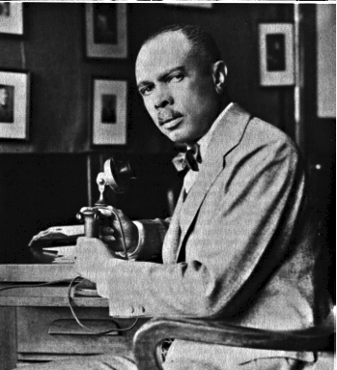
James Weldon Johnson
Poet
Lawyer
Executive Secretary of the NAACP

Slide 29
Lift Every Voice and Sing ---James Weldon Johnson
Lift every voice and sing, till earth and Heaven ring,
Ring with the harmonies of liberty;
Let our rejoicing rise, high as the listening skies,
Let it resound loud as the rolling sea.
Sing a song full of the faith that the dark past has taught us,
Sing a song full of the hope that the present has brought us;
Facing the rising sun of our new day begun,
Let us march on till victory is won.

Slide 30
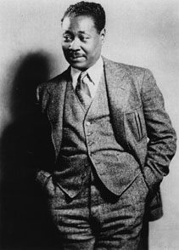
Claude McKay
Jamaican immigrant
Poems – militant versus encouraged blacks to resist prejudice

Slide 31
If We Must Die --Claude McKay
If we must die—let it not be like hogs
Hunted and penned in an inglorious spot,
While round us bark the mad and hungry dogs,
Making their mock at our accursed lot.
If we must die—oh, let us nobly die,
So that our precious blood may not be shed
In vain; then even the monsters we defy
Shall be constrained to honor us though dead!
Oh, Kinsmen! We must meet the common foe;
Though far outnumbered, let us show us brave,
And for their thousand blows deal one death blow!
What though before us lies the open grave?
Like men we’ll face the murderous, cowardly pack,
Pressed to the wall, dying, but fighting back.

Slide 32
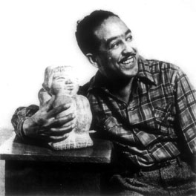
Langston Hughes
Poet
Describes the difficult lives of working-class African Americans

Slide 33
I, too, sing America ---Langston Hughes
I am the darker brother.
They send me to eat in the kitchen
When company comes,
But I laugh,
And eat well,
And grow strong.
Tomorrow,
I'll be at the table
When company comes.
Nobody'll dare
Say to me,
"Eat in the kitchen,"
Then.
Besides,
They'll see how beautiful I am
And be ashamed -
I, too, am America.

