Slide 1
Day 11

Slide 2
1) Anthony Fremont has a can of lemonade that cost $2.56. it will make 64 cups of lemonade, what is the cost per cup?
Show your work
Use models if needed

Slide 3
2) A package of 25 clean and pure water bottles cost $20.00 Fred buys some of the water. What is the cost per water bottle?
Show your work
Use models if needed

Slide 4
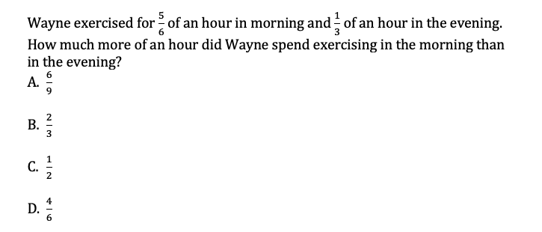
3

Slide 5
4. Mark made $60 after working 7.5 hours. How much money did he make per hour?
Show your work
Use models if needed

Slide 6
5. At a candy store, you can purchase a candy bar for $0.79 each. How many candy bars can you purchase with $3?
Show your work
Use models if needed

Slide 7
6
Th 5th grade team is hosting a dinner party. The 5 teachers will split the cost of the meal. If the entire meal costs $67.80, how much does each teacher spend?

Slide 8
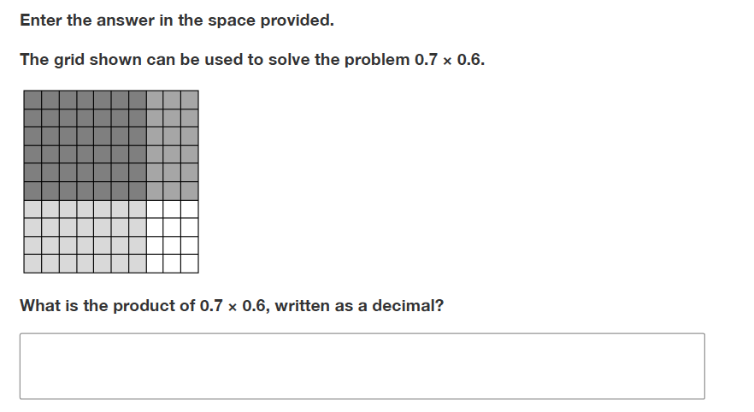
7.

