Slide 1
1990s-Today
Focus Questions: How have terrorist attacks changed American life and foreign policy? How has American society changed at the beginning of the 21st century?

Slide 2
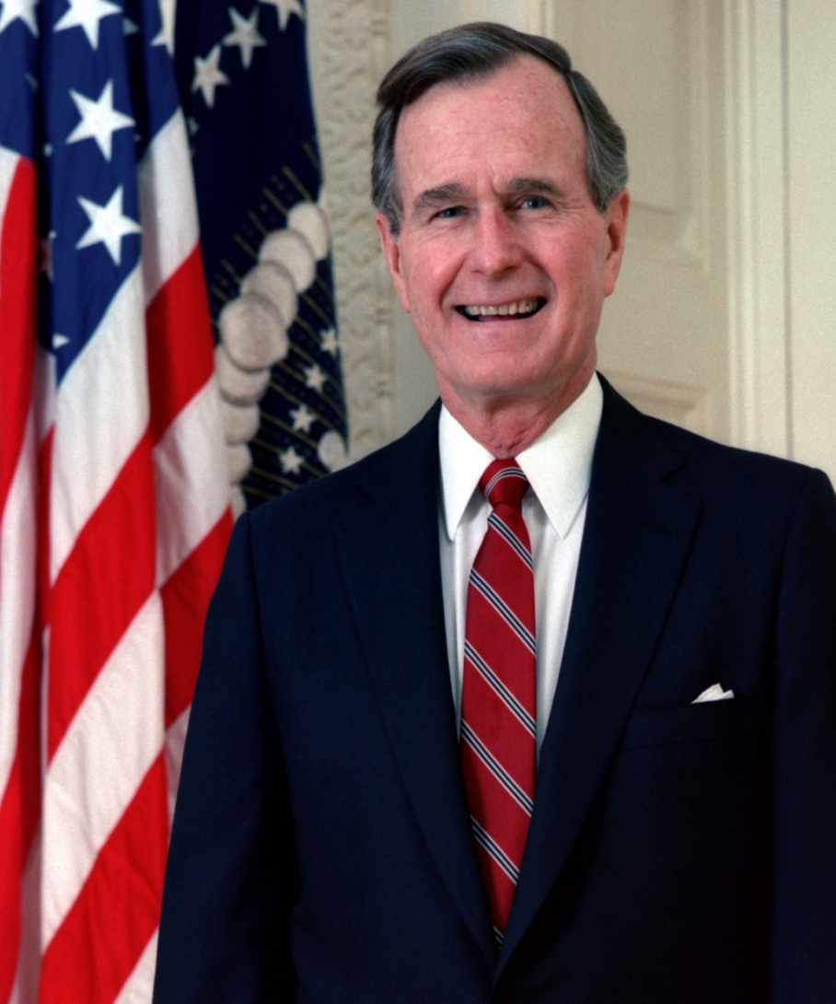
Conservatism continues with Bush
1988 George Bush wins--most voters see no reason for change from Reagan
“Read my lips: no new taxes.”
http://www.livingroomcandidate.org/commercials/1988

Slide 3
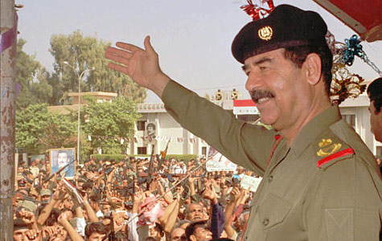
Persian Gulf War
Saddam Hussein, dictator of Iraq, invades oil-rich Kuwait
Threatened U.S. oil supplies

Slide 4

Persian Gulf War Continued..
U.S. begins Operation Desert Storm led by General Norman Schwarzkopf/ Colin Powell
Outcome: Iraqis were pushed out of Kuwait but Hussein remains in power in Iraq (sanctions are placed on Iraq)

Slide 5
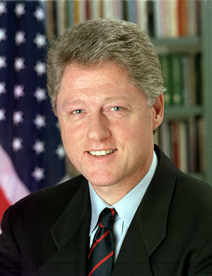
12 Years of Republican Rule Ends
Bill Clinton elected to the presidency
A “new,” more moderate Democrat
Former governor of Arkansas
http://www.livingroomcandidate.org/commercials/1992
1993-2001

Slide 6
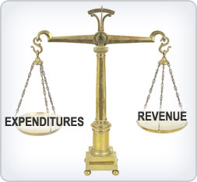
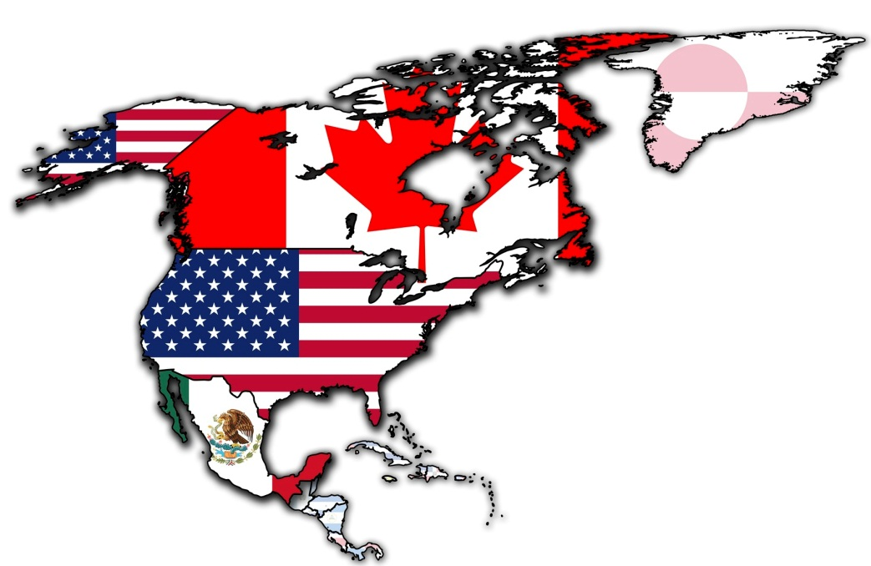

The 1st Clinton Term – The Good
Balanced Budget - 1993
  Tax increase on wealthy
  Reduction in Govt Spending
  Tax credits to low income families
NAFTA -1993
  North American Free Trade Agreement
Bosnian Civil War Ended – 1995

Slide 7
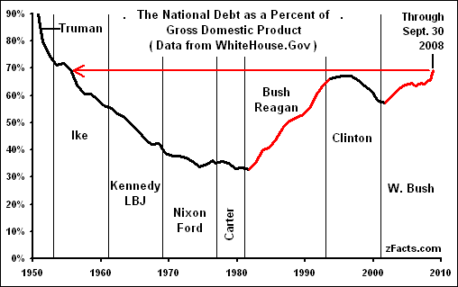

Slide 8

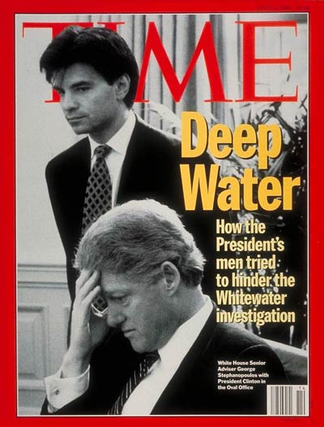
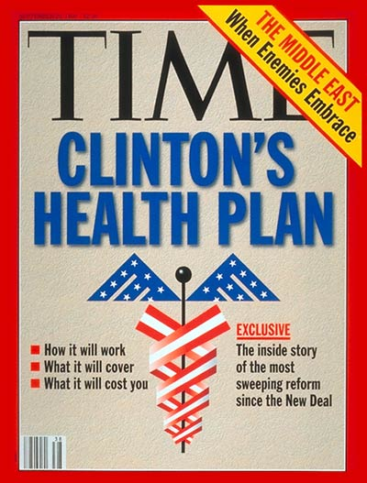
The 1st Clinton Term - The Bad
“Don’t ask don’t tell” -1993
  Homosexuals in Military
Whitewater Scandal - 1993
  Real Estate investments investigated by SEC
Healthcare Bill fails to pass - 1994

Slide 9
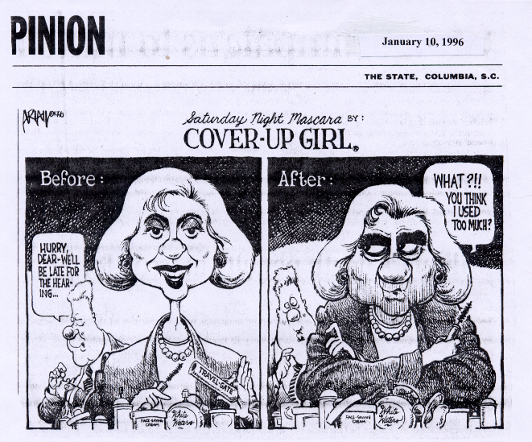

Slide 10
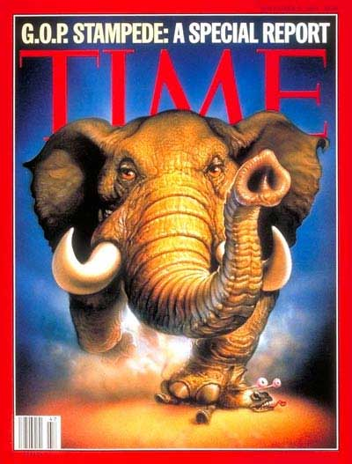
Midterm Election -1994
Republicans win control in both houses
Forces Clinton to shift his agenda toward the “Center”
  Cut Taxes, Balance Budget

Slide 11
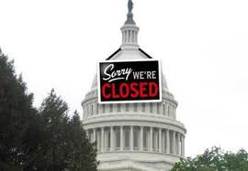
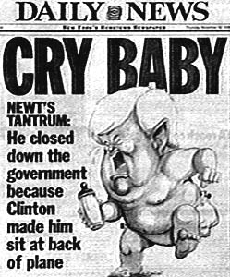
Government Shutdown
Clinton’s proposed budget “compromise” fails to be approved in time by Rep. congress
Result:
  Congress approval rating ▼
  Clinton’s approval rating ▲

Slide 12
The 1nd Clinton Term
Welfare Reform -1996
  Personal Responsibility and Work Opportunity Act
  “Deserving poor” vs. “Undeserving poor”
    Ending welfare as an entitlement program
    Must begin working after two years of receiving benefits
    Limit of five years on benefits paid by federal funds
    Encourage two-parent families
    Enhancing enforcement of child support
    Requires state professional and occupational licenses be withheld from illegal immigrants.

Slide 13
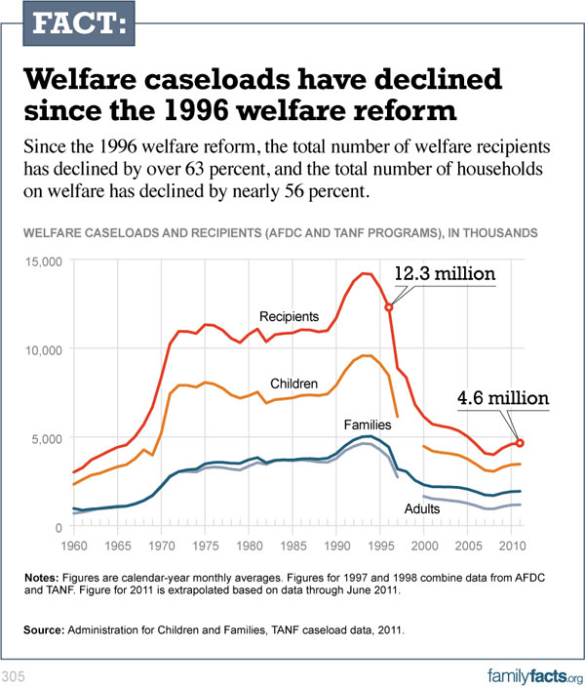

Slide 14
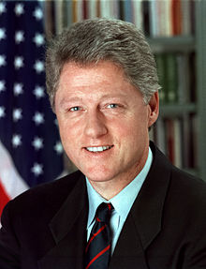
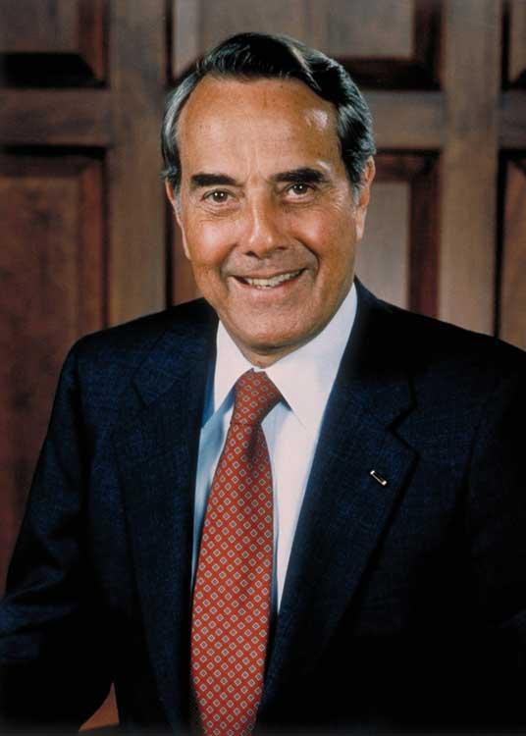
Election of 1996
Clinton vs. Bob Dole
Clinton wins by pointing at economic prosperity during first term

Slide 15
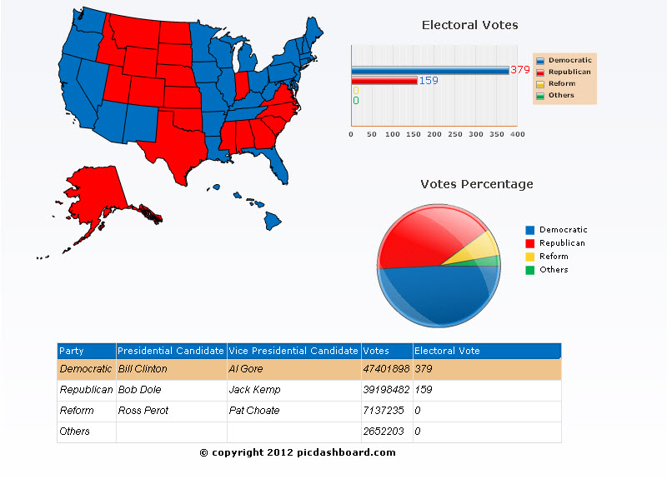

Slide 16
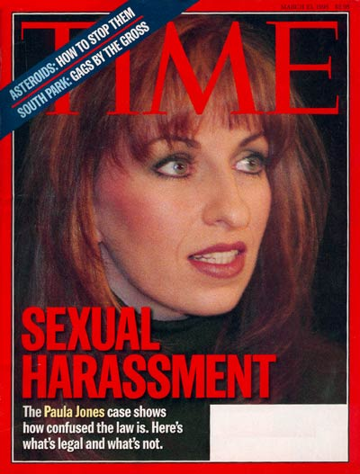
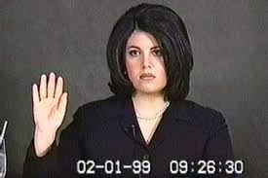
The Lewinski Scandal
Sexual Harassment Suit by Paula Jones
Leads to additional accusations of “improper relationship” with intern Monica Lewinski
Clinton initially denies allegations
Lewinski testifies against President leads to confession.

Slide 17
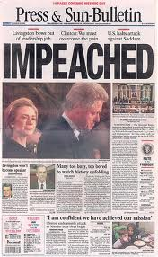
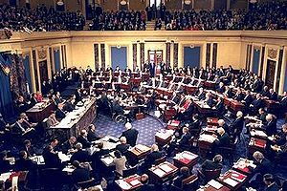
Clinton Impeachment
House approves two counts of impeachment
  Lying to Grand Jury
  Obstruction of Justice
Senate acquittal receives less than 50%
  Needed 2/3rds to remove President

Slide 18

90s Culture – Technology
High-tech industries lead to economic boom
Emergence of Microsoft and Apple
Expansion of the Internet
NASDAQ
  a stock index tracking “Technology Industries”

Slide 19
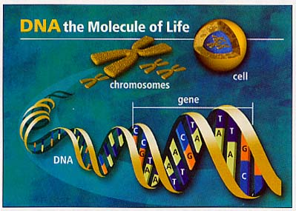
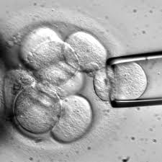
90s Culture – Medicine
Human Genome Project
  Govt Supported program to map /identify human genes
  Over 100,000 identified
  Completed in 2003
Ethnics Controversy
  Conservative disapproval of genetic predictions and possibilities of alteration
  Stem Cell Research

Slide 20
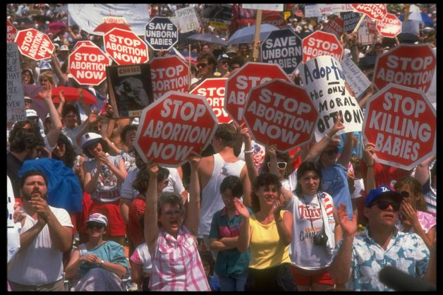
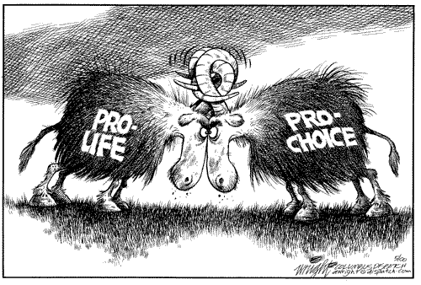
90s Culture – Feminism
Right to Life Movement
  Anti Roe v. Wade
  Seen primarily during the Reagan years
Emergence of Pro Choice
  Clinton elected despite being an openly pro choice supporter.
  Shows ideological shift

Slide 21
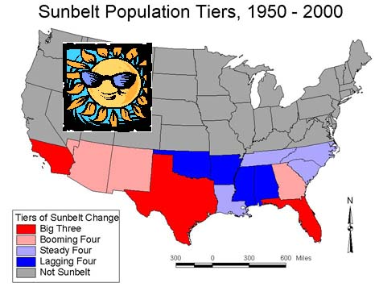
90s Culture - Population Changes
People are moving to the Sunbelt
The average age of Americans is getting older--graying of America
Why do you think they call it the Sunbelt?

Slide 22
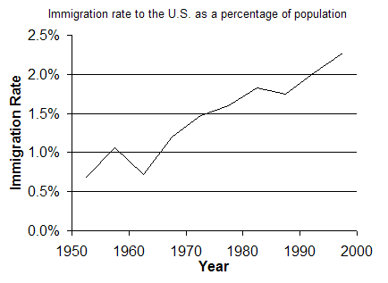
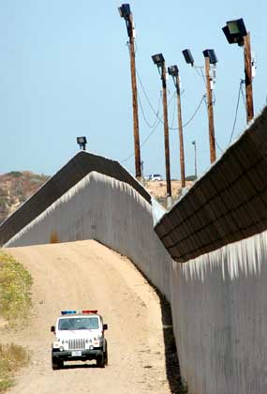
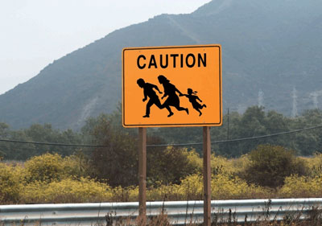
Immigration
U.S. immigration policy since 1986- reduce the number of people entering the country illegally.

Slide 23
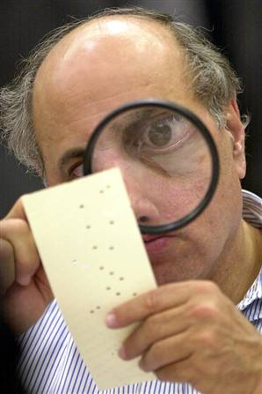
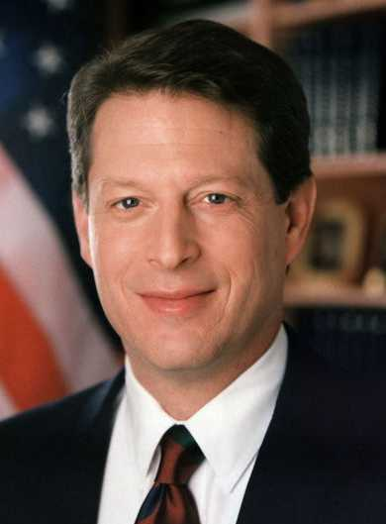
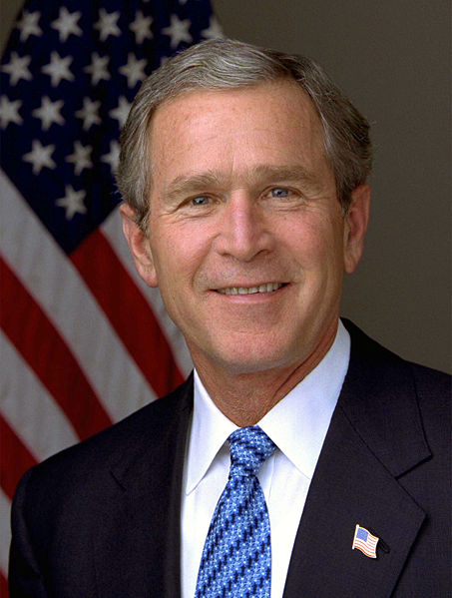
2000 Election--Confusion
A close call in Florida--votes must be recounted
Issue goes to the Supreme Court for them to decide-recounts and victory goes to Bush
VS
http://www.livingroomcandidate.org/commercials/2000

Slide 24
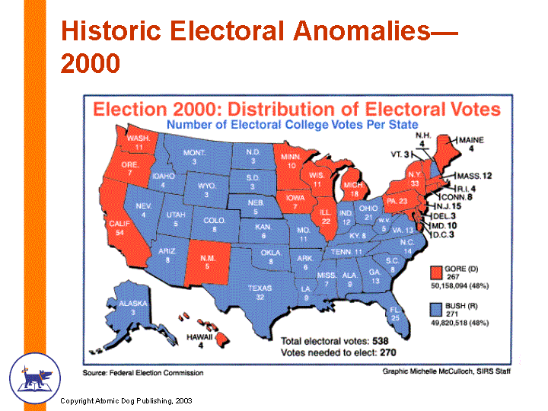

Slide 25
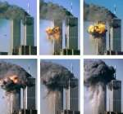
Attack on America
September 11, 2001, the World Trade Center and Pentagon are hit by planes hijacked by terrorists
What has been the impact on American life?

Slide 26
Effects of Terrorism
Department of Homeland Security Created (Cabinet Post)
Patriot Act
Operation Iraqi Freedom
Changes American Foreign Policy: Focus on “War on Terrorism”

