Slide 1
Day 10 Independent Work

Slide 2
1
Heather used 3 pounds of roast beef. She used it all in sandwiches. She used 0.5 a pound in each sandwich. How many sandwiches did she make?

Slide 3
2
At the grocery store, a pound of apples costs $6.98 each. If you purchase 2.5 pounds of apples, how much money did you spend?

Slide 4
3
Keisha buys 24 kilograms of rice. She separates the rice into packages that contain 0.4 kilogram of rice each. How many packages of rice can Keisha make?

Slide 5
4
Peter had 2 pounds of fruit. He ate 0.08 pounds a day. How many days did it take him to eat the fruit?

Slide 6
5
Wolfgang has 12 million dollars. He deposits 0.6 of the money at the bank each time he goes. How many visits to the bank will it take Wolfgang to deposit his money?

Slide 7
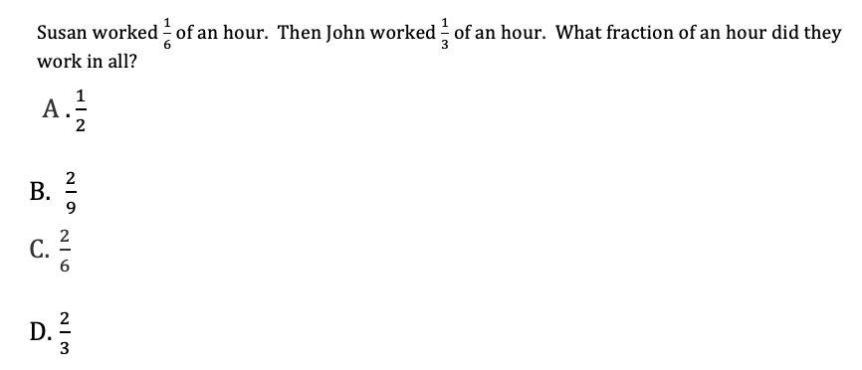
6

Slide 8
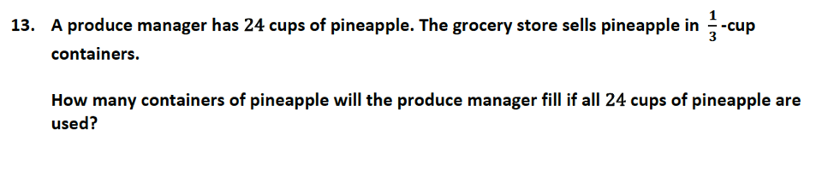
7

Slide 9
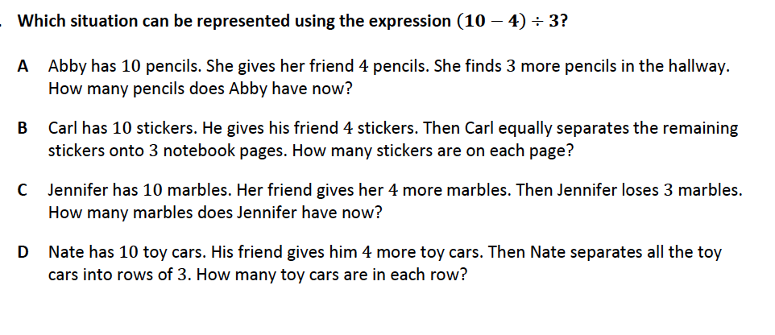
8

