Slide 1
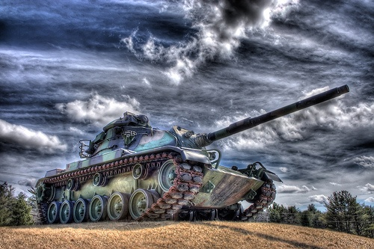
Chapter 24-1
Dictators Threaten
World Peace

Slide 2
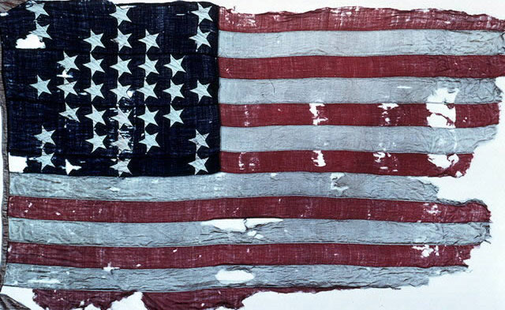
Long Term Causes
of World War II
1. World War I
2. Economic instability in Europe
3. Rise of totalitarianism
4. Failure of appeasement

Slide 3
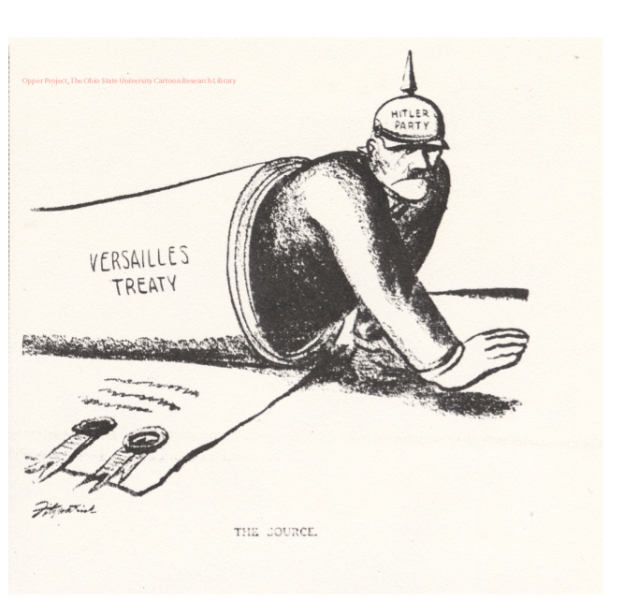
World War I
Treaty of Versailles
Germany loses surrounding lands
Germany forced to pay $33 billion in reparations
Forced to sign War Guilt Clause
Germans are Angry and Embarrassed

Slide 4
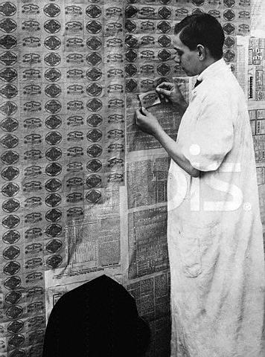
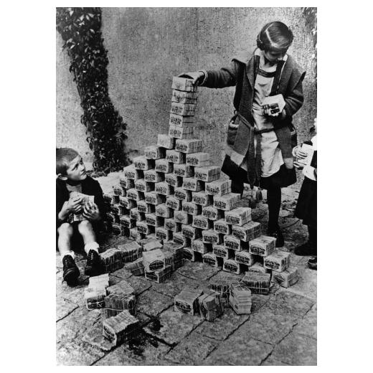
Economic Instability in Europe
World Wide Depression
Depression extends outside of the U.S… Especially in Germany
European Desperation leads allows outspoken dictators to rise to power
  Germany
  Russia
  Spain
  Italy
These leaders find a scapegoat to blame for their struggles.

Slide 5

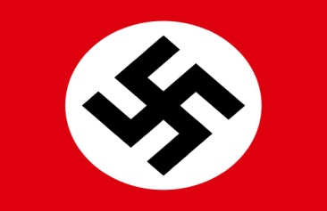
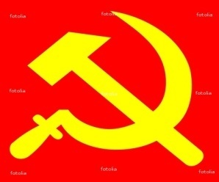


Rise of Totalitarianism
In a Totalitarian country, individual rights are not viewed as important as the needs of the nation
Mussolini
Hitler
Stalin
Communist (USSR)
Fascism
(Germany, Italy, Spain)
Totalitarianism
Franco
Military Rule (Japan)
Tojo

Slide 6
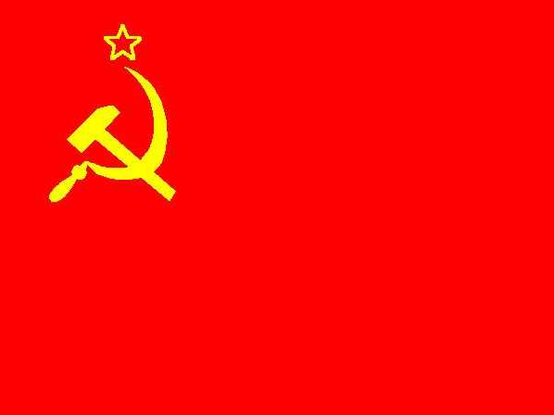
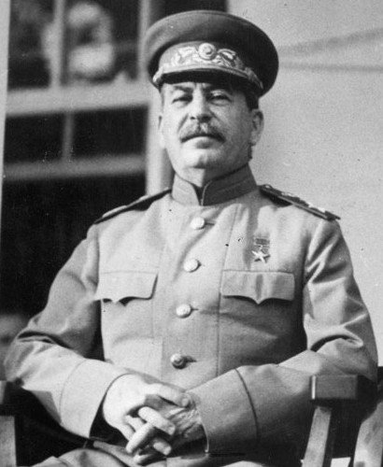
Soviet Union – Joseph Stalin
Death of V.I. Lenin (1924)
Communist
  Against all private enterprise – state owns everything
Leads U.S.S.R. to become Industrial Power (2nd only to the U.S.)
  Kills anyone who stands in the way
  (13-20 million)
Stalin’s last name means “Man of Steel”

Slide 7
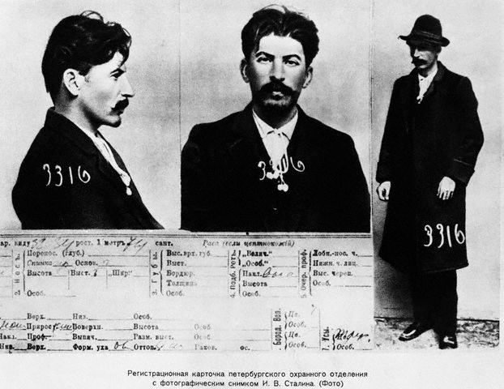
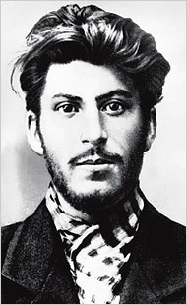

Slide 8
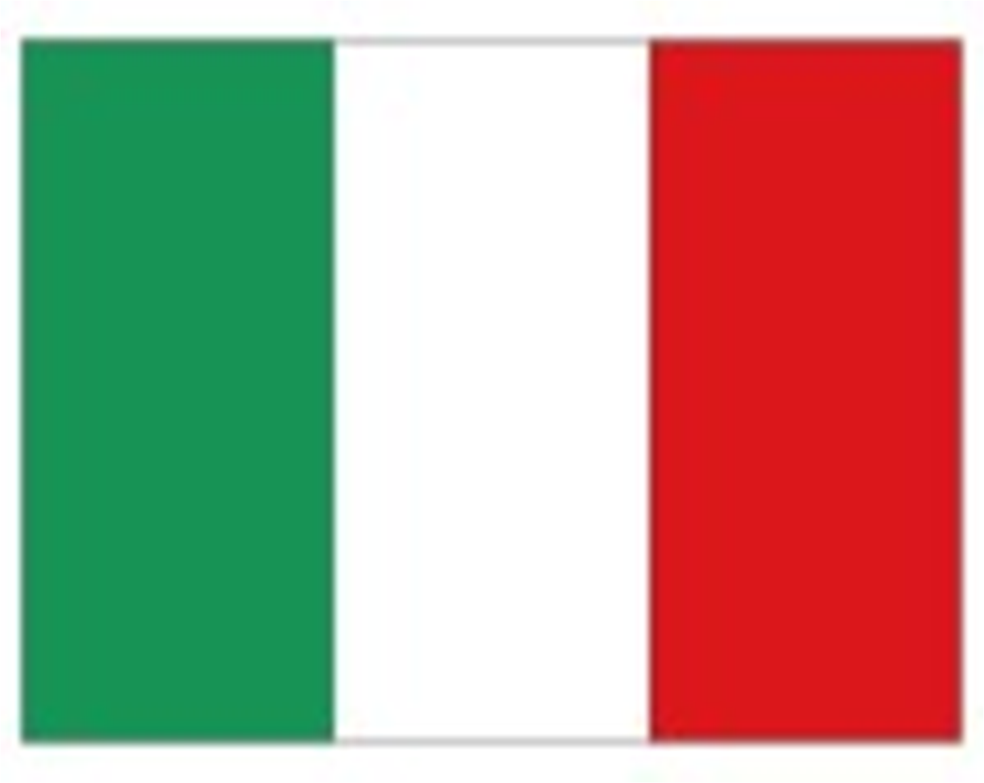
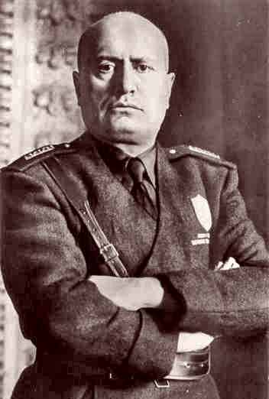
Italy – Benito Mussolini
1921 – forms the Fascist Party
Played on fears of economic collapse and communism
With thousands of his followers, marches on Rome where the king appoints him as head of the government.
Known as Il Duce – “the leader”

Slide 9

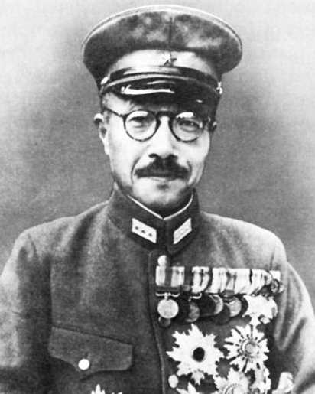
Japan- Hideki Tojo
Japanese military leaders wish to expand empire
Military Leader Hideki Tojo rises to power
Emperor Hirohito left virtually powerless.

Slide 10

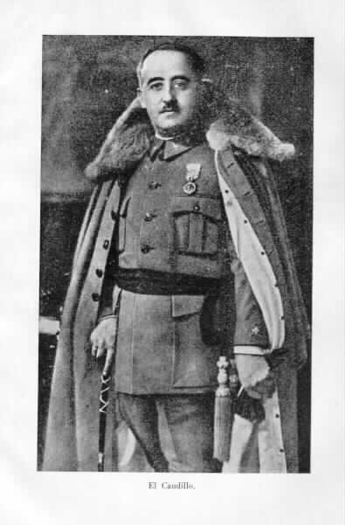
Spain- Francisco Franco
General Francisco Franco leads rebels into civil war
Backed by Mussolini
500,000 dead
Franco declared victory in 1939 → established another totalitarian government

Slide 11
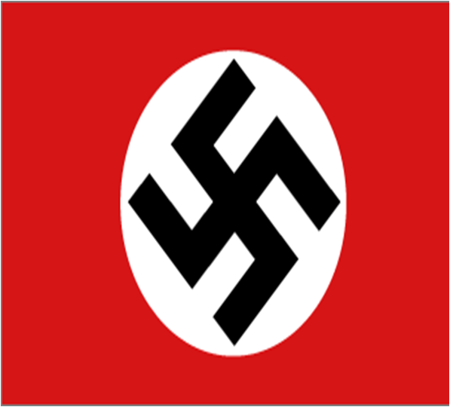
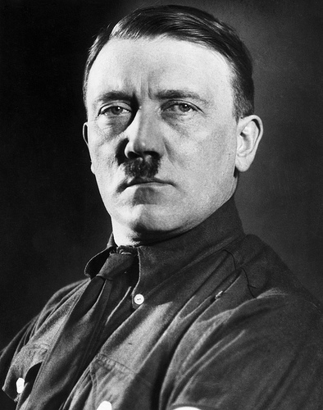
Germany – Adolf Hitler
Unemployed drifter after WWI
Joined National Socialist German Worker’s Party (NAZI)
Known as powerful speaker and
became Der Fuher – “the Leader” of Party
Nazism: extreme nationalism – based on racial purification
Hitler’s goal was to re unite all German Speaking People
1933: Millions unemployed – elected Hitler chancellor of Germany. Replaces democracy with the Third Reich

Slide 12
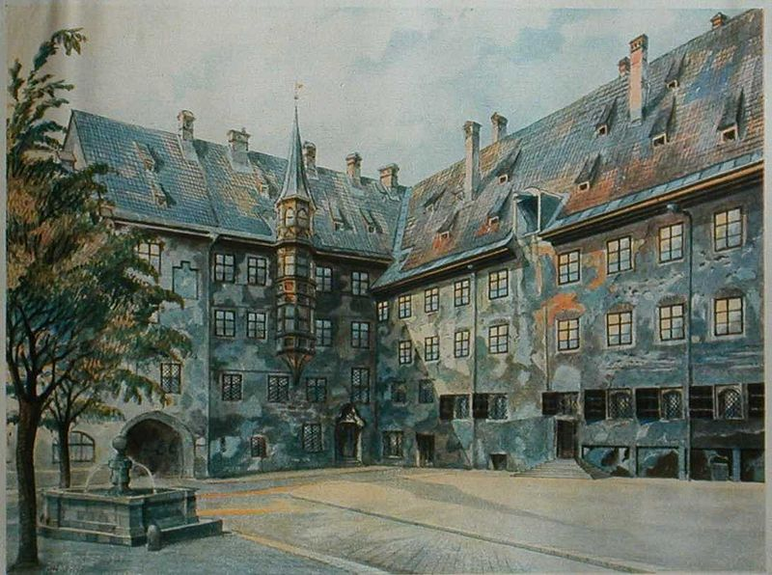
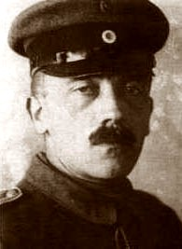

Slide 13
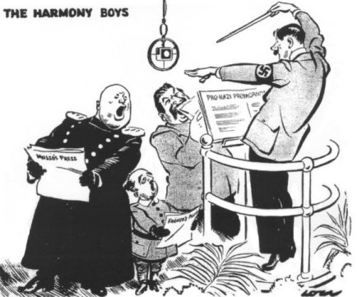

Slide 14
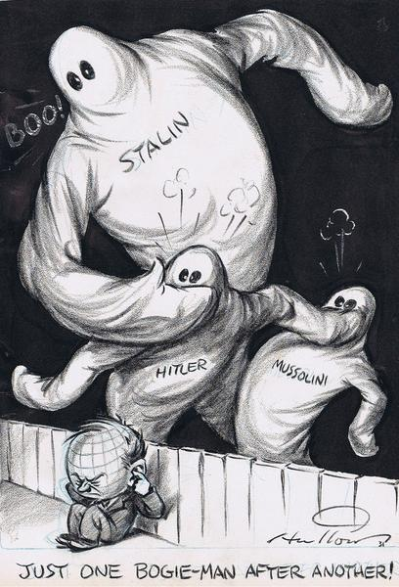

Slide 15
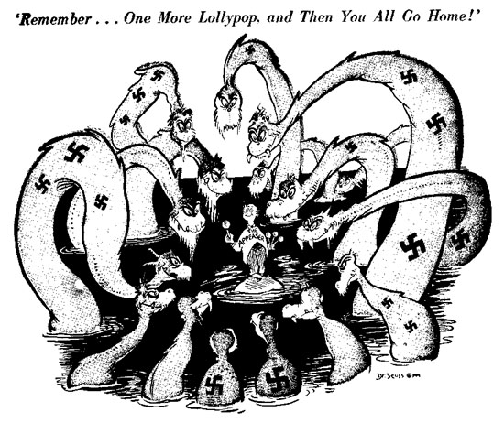
Failure of Appeasement
Appeasement: giving dictators what they want and hope that they won’t want anything else
“giving a bully what he wants”

Slide 17

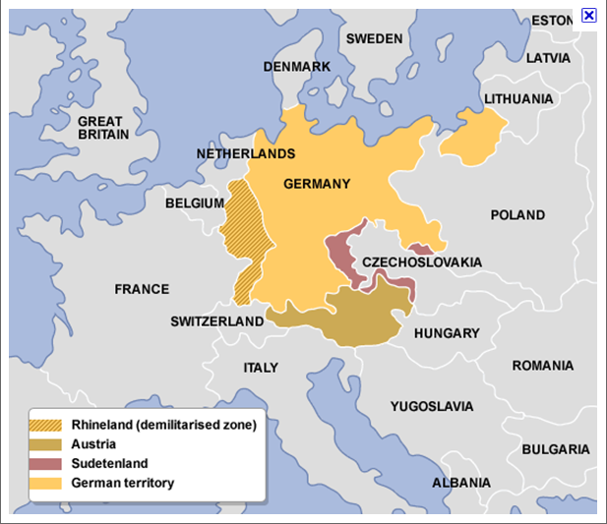
Germany
Hitler violates Treaty of Versailles
  Send Military into Rhineland
  Takes Sudetenland from Czechoslovakia
  Annexes Austria
  L.O.N. Nations does nothing
    Britain actually sign agreement allowing Germany to rebuilt a portion of their navy

Slide 18
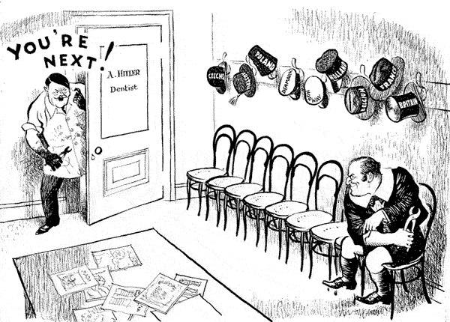

Slide 19
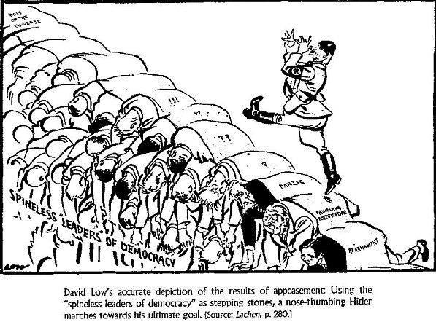

Slide 20
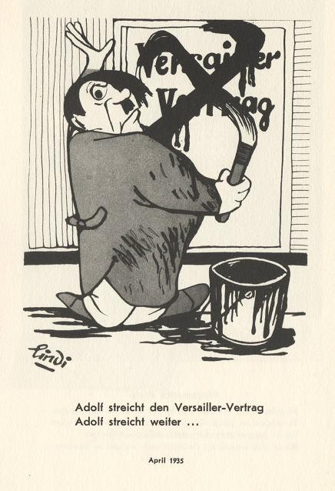
Hitler cancelling the Treaty of
Versailles

Slide 21
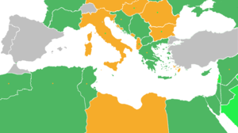
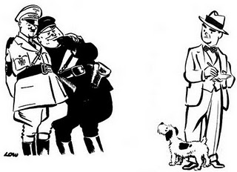
Italy
Invades Northern Africa
  First takes Ethiopia (1835)
    Wants access to Mediterranean
    Wished to expand Empire
  Rome-Berlin Axis Pact
    Peace agreement between Hitler and Mussolini
  Despite plea from Ethiopia, L.O.N. does nothing
“It is us today, it will be you tomorrow” –
Haile Selassie (ousted emperor of Ethiopia)

Slide 22
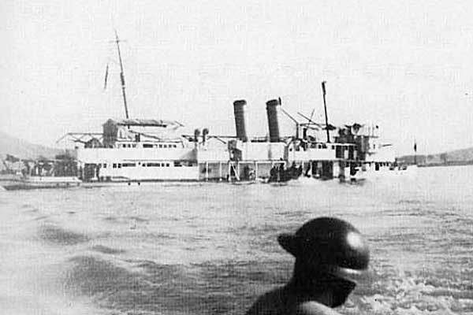
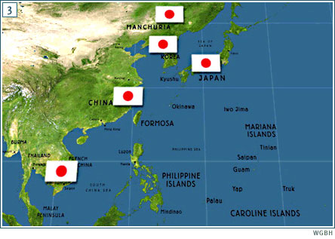
Japan
Moves into SE Asia and China
  First move into Manchuria
  Expands into modern day
  Vietnam, Korea, and China
  - Sino Japanese War
  - Approx 25 Million killed
  - Most were not soldiers
  Sinks U.S. Ship in international waterway in China
    Panay Incident (1937)
  U.S. does virtually nothing

Slide 23
Japan invades Manchuria

Slide 24
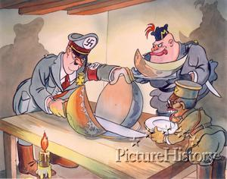

Slide 25
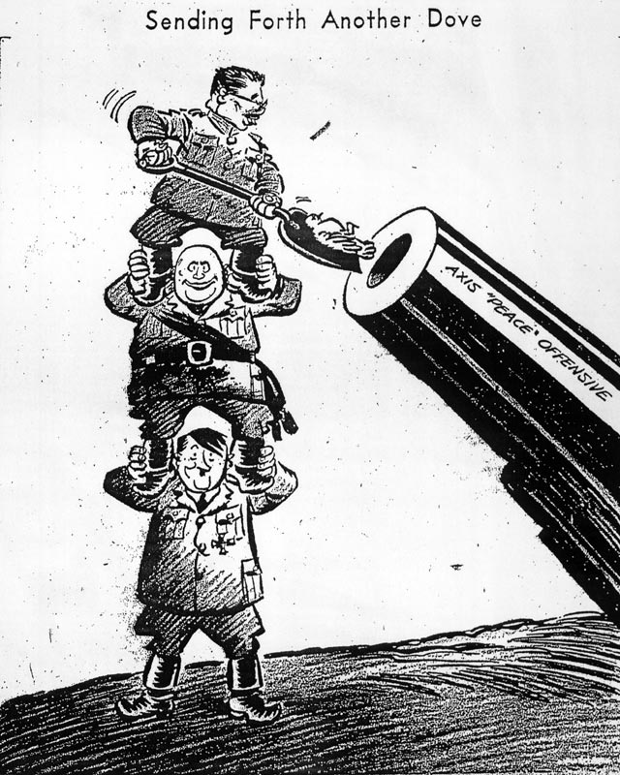

Slide 26
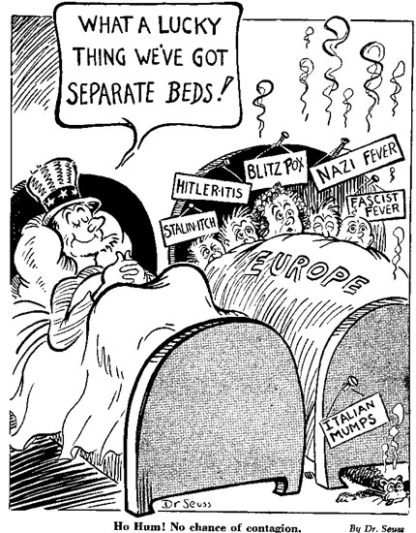
The U.S. Responds Cautiously
Neutrality Acts of 1935
  Passed to please Isolationists
  Embargo on any country involved in conflict
  Warned US citizens against travel in these areas
Neutrality Acts of 1937
  Allows for “Cash and Carry” of Non Military Goods

Slide 27

American Isolationism
America First Committee
  800,000 Members
  Non-Interventionists
  Beliefs
  The United States must build an impregnable defense for America.
  No foreign power, nor group of powers, can successfully attack a prepared America.
  American democracy can be preserved only by keeping out of the European war.
  "Aid short of war" weakens national defense at home and threatens to involve America in war abroad.

Slide 28
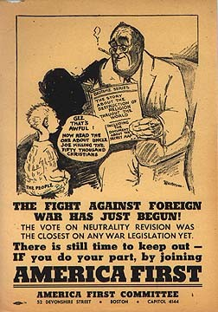
America First Committee
“It is not difficult to understand why Jewish people desire the overthrow of Nazi Germany. The persecution they suffered in Germany would be sufficient to make bitter enemies of any race. No person with a sense of the dignity of mankind can condone the persecution the Jewish race suffered in Germany. But no person of honesty and vision can look on their pro-war policy here today without seeing the dangers involved in such a policy, both for us and for them.”

Slide 29
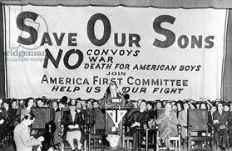
America First Committee
  Members/Contributors/Supporters
  JFK
  Gerald Ford
  Charles Lindbergh
  Sinclair Lewis
  Walt Disney
  Frank Lloyd Wright

Slide 30
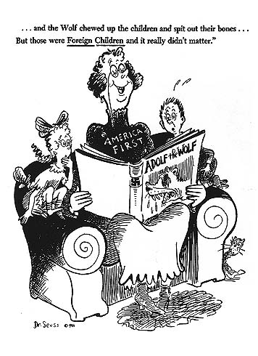

Slide 31
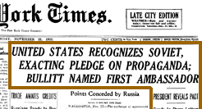
FDR Pushes for Intervention
FDR Recognizes the Soviet Union (1933)
FDR felt that recognizing Moscow might bolster the US against Japan.
Maybe trade with the USSR would help the US economy during the Depression.
  Shift from Isolationism to Neutrality
- Is there a difference?

Slide 32
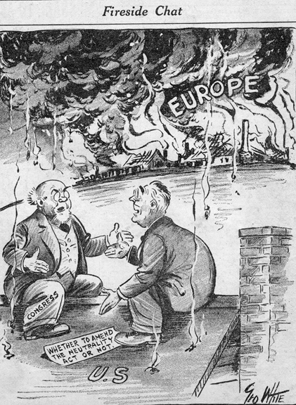

Slide 33
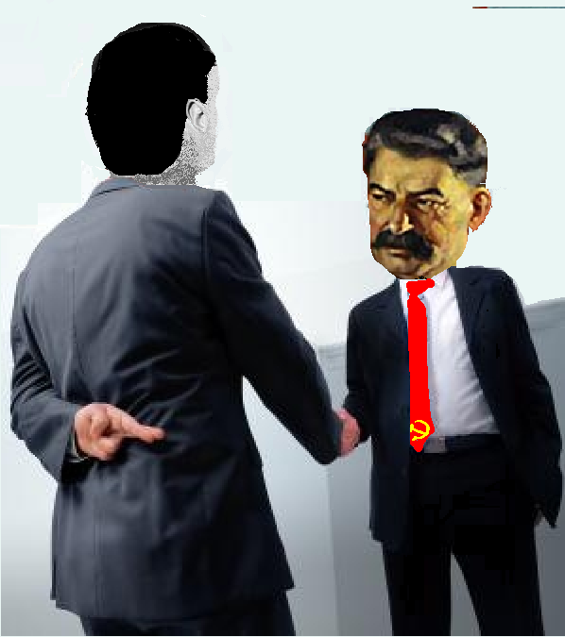
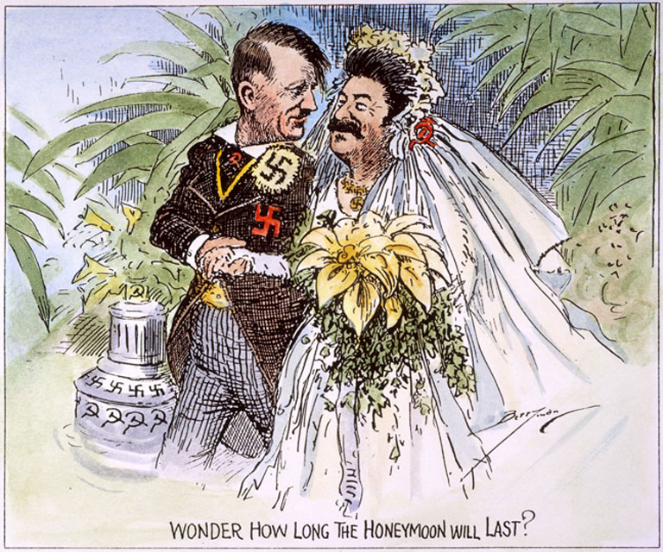
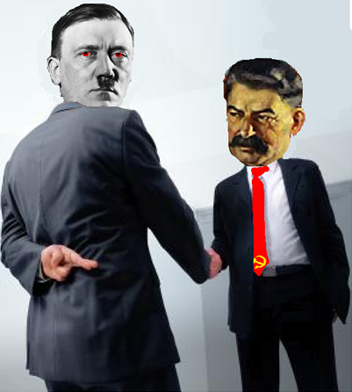
German invasion of Poland 1939
Return of German Speaking Lands
Nonaggression Pact
Russia stays out of the war in return for 1/2 of Poland
Prevents a war on two fronts
Great Britain & France declare war on Germany
League of Nations fails to prevent another world war.
Lil Hitler Video

Slide 34
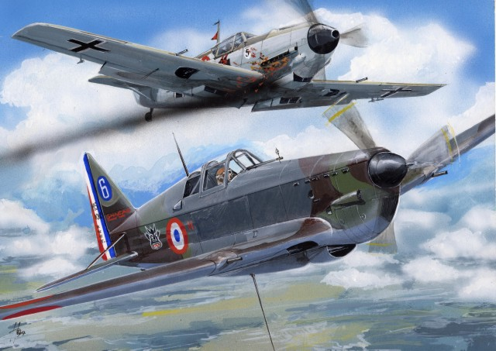
France and Great Britain go to war against Germany

Slide 35

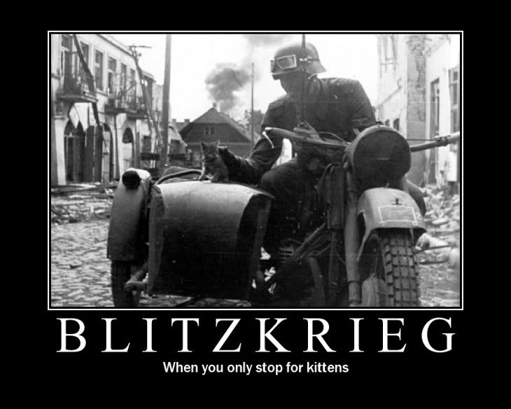
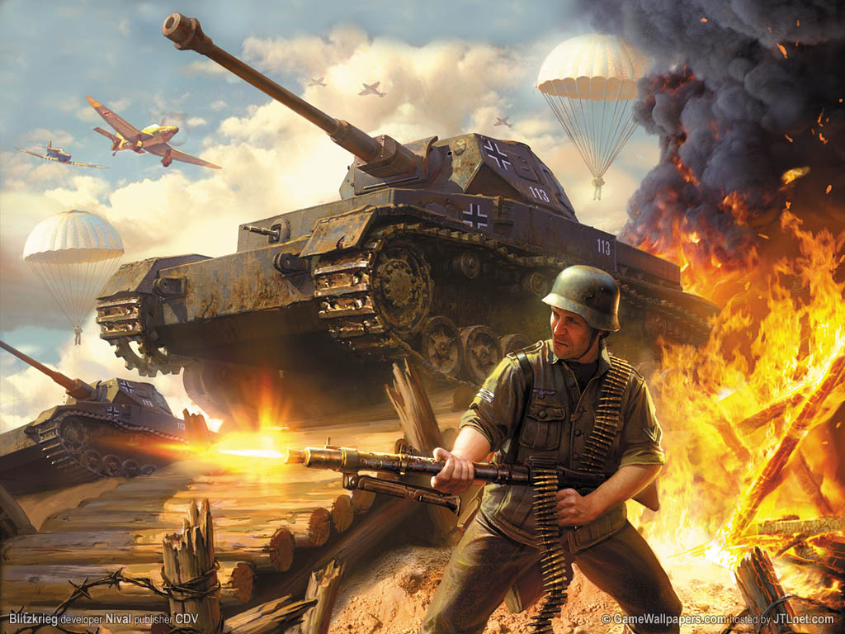

Slide 36
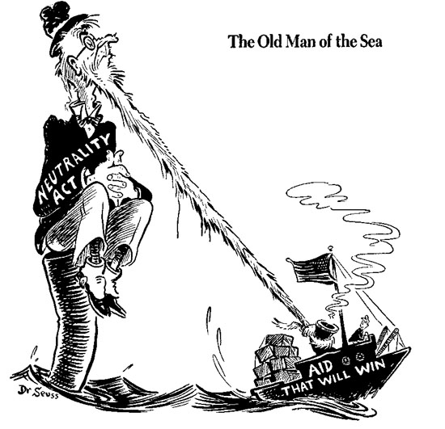
Neutrality Breaks Down
Neutrality Act of 1939
  FDR’s Idea pushes through congress
  Amends Neutral. Act of 37
  Maintains “Cash and Carry”
  Now allows for Military supplies to be sold

Slide 37
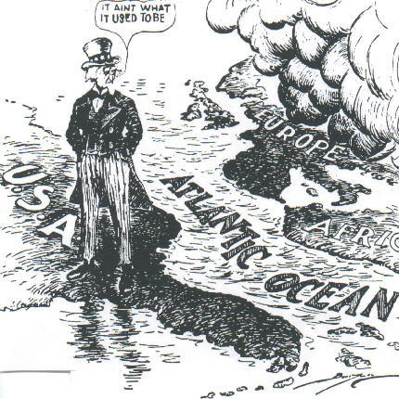
US Neutrality

Slide 38
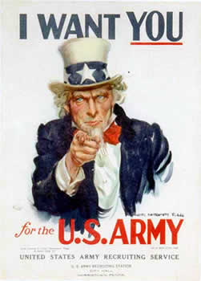
Neutrality Breaks Down
Selective Service Act 1940
  A.k.a. Burke Wadsworth Act
  First ever “Peacetime” Draft
Initially
  All men 21 to 35 must register
After Declaration of War
  18 to 45 Eligible for combat
  18 to 65 must register

Slide 39
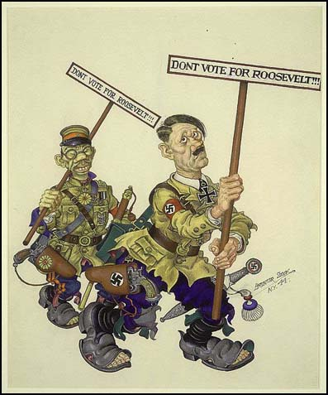
FDR breaks two term tradition
→elected 3rd & 4th terms

Slide 40
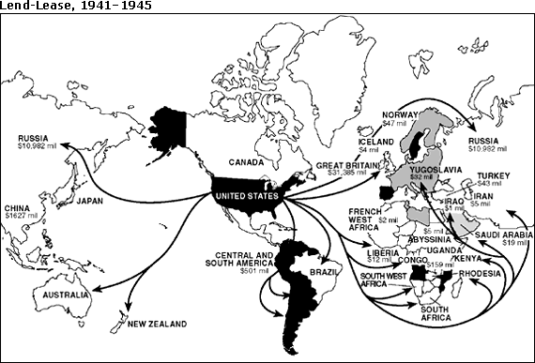
Lend-Lease Act (1941)
→U.S. would lend or lease arms and supplies to countries vital to the U.S.
→U.S. spent $50 billion under the act

Slide 41
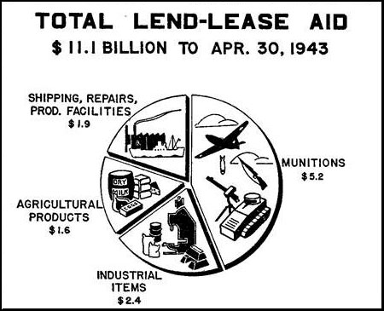

“Lend-Lease” Act (1941)
Great Britain.........................$31 billion
Soviet Union...........................$11 billion
France......................................$ 3 billion
China.......................................$1.5 billion
Other European.................$500 million
South America...................$400 million
The amount totaled: $48,601,365,000

Slide 42


Slide 43


German Wolf Packs
- Hitler deploys German U-boats to the North Atlantic
- U-boats sink hundreds of British ships and some American ships
- June 1941, FDR orders U.S. Navy to protect U.S. shipments

Slide 44

Breaking Down of Isolation
Atlantic Charter
  FDR and Churchill
  Both Agree that “the final destruction of the Nazi Tyranny” would be the only way to “Better the future of the world

Slide 45

Road to Pearl Harbor
Japanese aggression
  Move into Indo China
  Seize Vietnam (French colony)
  Plan on seizing Dutch East Indies
American Response
  FDR froze all Japanese assets in the US
  Japan forced to respond

Slide 46

The United States is Attacked
→December 7th, 1941: Japanese attack U.S. naval base at Pearl Harbor, Hawaii
→ The attack cripples U.S. Pacific Fleet:
1. 21 ships sunk/badly damaged
2. 350 planes destroyed
3. 2,403 people dead
4. 1,178 people wounded
→ FDR calls this day “a date which will in infamy”

Slide 47

Pearl Harbor from the Cockpit of a Japanese Plane

Slide 48


Slide 49


Slide 50

Pearl Harbor – Dec. 7, 1941
A date which will live in infamy!

Slide 51


Slide 52


Slide 53


Slide 54

December 8th, 1941 - The U.S. Congress declares war on
Japan
- December 11th, 1941:
Germany and Italy declare war on the
United States

Slide 55

December 8th, 1941
FDR addresses U.S. Congress

