Slide 1



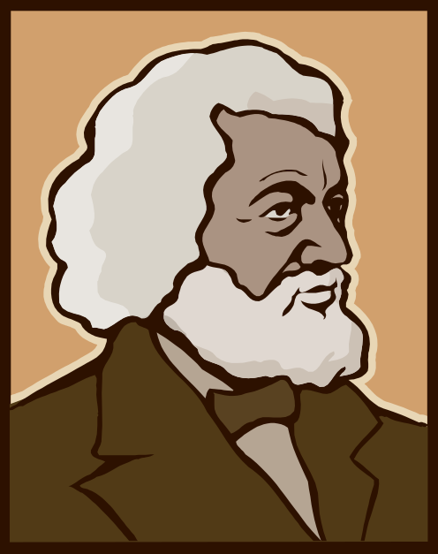
Antebellum Culture and Reform

Slide 2
Changing
Culture

Slide 3
Art and Literature

Slide 4
Search for Perfection
Transcend-entalism
Utopian
Societies
2nd Great
Awakening
Social Reforms
Abolitionism
Education
Asylum &
Prison Reform
Women’s Rights
Temperance

Slide 5

Romanticism
Literary and artistic movement
Anti Enlightenment ideas
Anti Scientific Rationalization
Anti Organized Religion
INDIVIDUALISM
LIBERALISM
RADICALISM
NATIONALISM
Nature = Inherently Good
Humans = Inherently Evil

Slide 6
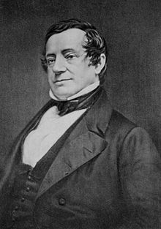
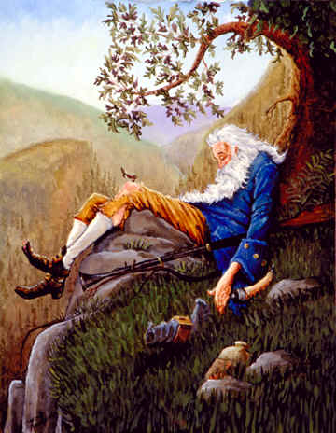
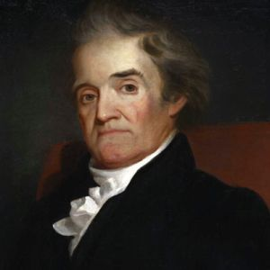

American Literature
Washington Irving
    “American” Folk Tales
  Rip Van Winkle (1819)
  The Legend of Sleepy Hollow (1820)
Noah Webster
  American Dictionary (1828)
    Promotes “American” literacy

Slide 7
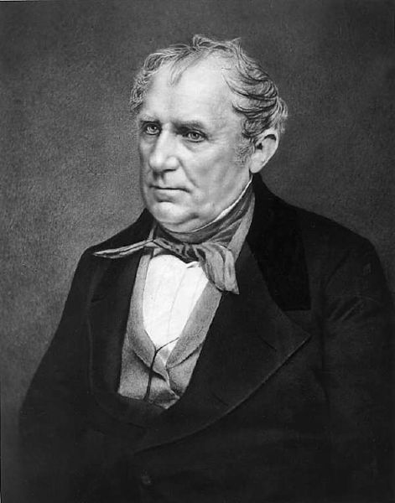
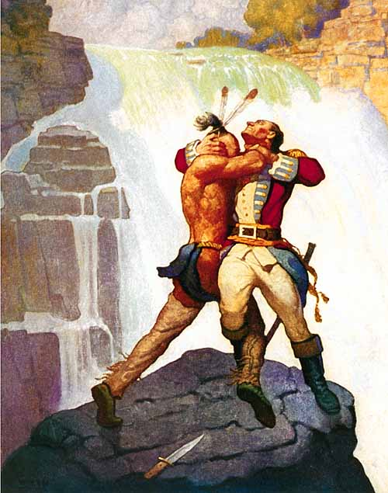
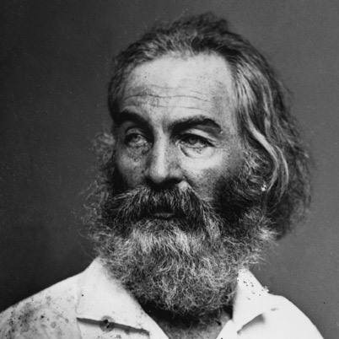

American Literature
James Fennimore Cooper
  Last of the Mohicans (1826)
    French and Indian War
  Deerslayer (1841)
    Life on the Frontier/Native Conflicts
Walt Whitman
  Leaves of Grass (1855)
    Group of Poems
    Often discussed “sensuality” and therefore seen as obscene
      “Resist much, obey little.”
      “Do anything, but let it produce joy.”

Slide 8
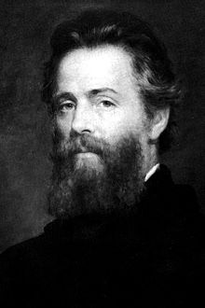

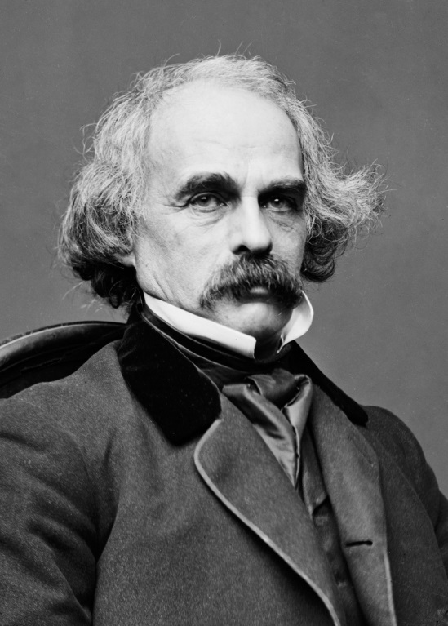
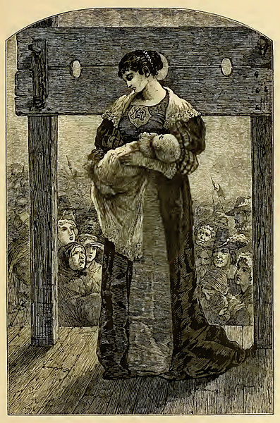
American Literature
Herman Melville
  Moby Dick (1851)
    Whale v. Sailor
    Human v. Nature
    Good v. Evil
    “Call me Ishmael”
Nathaniel Hawthorne
  Scarlett Letter (1850)
    Woman has child out of wedlock and becomes outcast
    Sin of Humanity
    Attempts at redemption
    Pro Individualism

Slide 9
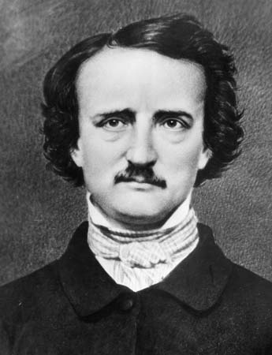

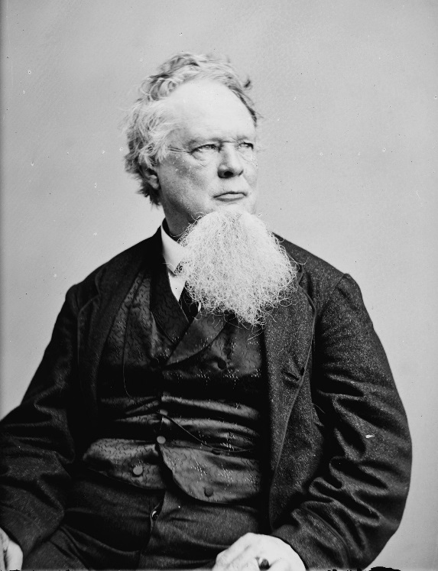
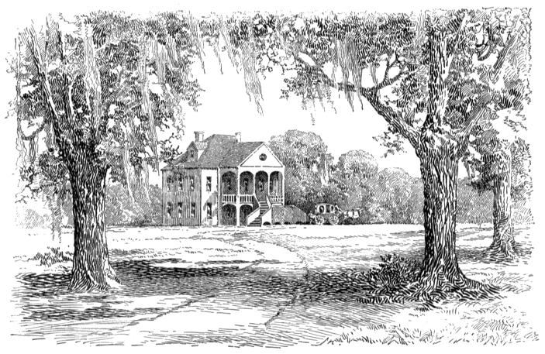
Southern Romanticism
Edgar Allan Poe
  Known as American father of mystery and science fiction literature
  Raven (1845)
    “Once upon a midnight dreary”
    “Nevermore”
William Gilmore Simms
  Romantic view of plantation life
  Pro Slavery
  Celebrated Southern heroes

Slide 10
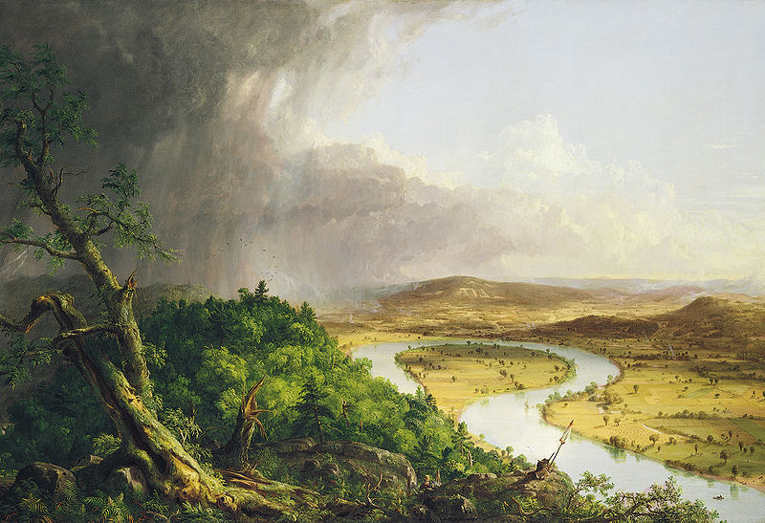
Painting
  Hudson River School
  Group of artists who focused on American landscapes

Slide 11
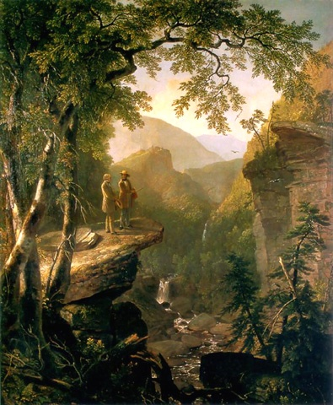
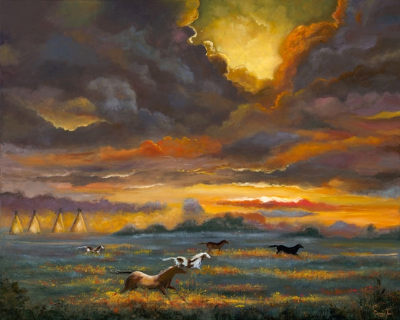

Slide 12
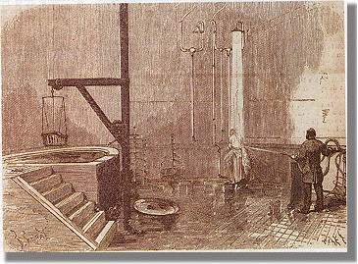
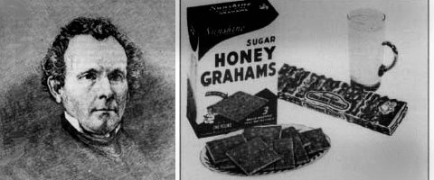
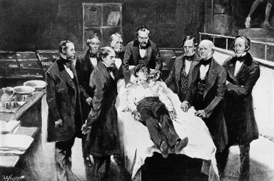
Health Reform
Hydrotherapy
  Use of “Spas” and water to prevent/heal diseases
Dietary Reform
  Encourages fruits/vegetables and other substitutes for meats/breads
  Sylvester Graham
New Practices
  Anesthetics
  Understanding of Contagions

Slide 13
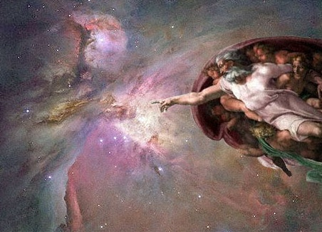

1800 America - Religion
Deism
  Mixture of science and religion
  Franklin and Jefferson
  God as “Watchmaker”
  Many see this as “skepticism”

Slide 14
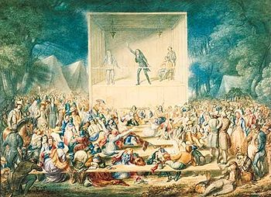
1800 America - Religion
Second Great Awakening - 1820
  Rejection of Predestination
  Focus on Good Works
  Revivals/Evangelism
  Reject Skepticism
    Presbyterian – West
    Methodist – Nationwide
    Baptist – South
Effects
  Sparks Reform movement of mid1800s
  Women - More involved
  African Americans - Beginnings of abolition movement
  Natives - Some turn away from customs
“Camp Meeting”

Slide 15
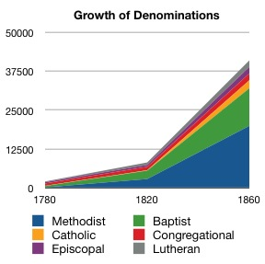

Slide 16
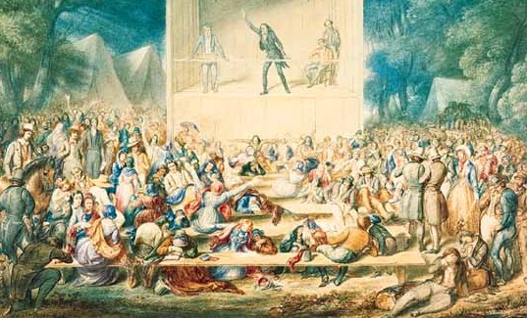
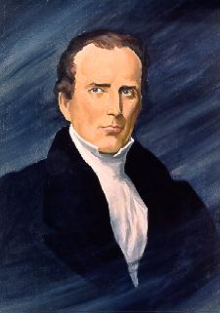
Religious Reform
Carry over from Second Great Awakening
  Focus on the individual's responsibility to improve relationship with God.
Charles Finney
  Evangelist working in New York State

Slide 17
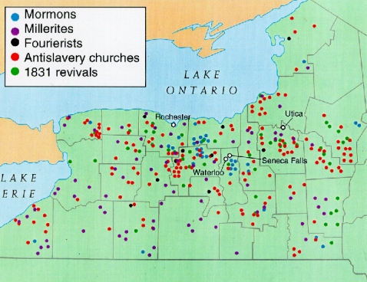
The “Burned-Over” District
in Upstate New York

Slide 18
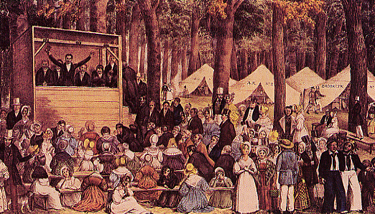
Second Great Awakening
Revival Meeting

Slide 19
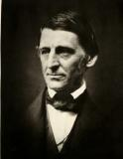
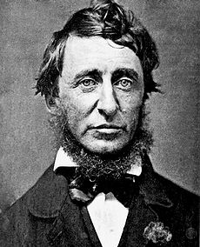
Transcendentalism
Philosophical, Religious, and Literary movement
Simple life centered around nature and self reliance.
Henry David Thoreau
  Poet, Abolitionist,
  Walden (1854)
  Moral Opposition, Civil Disobedience, Simple living
    "I ask for, not at once no government, but at once a better government"
Ralph Waldo Emerson
  “Leader “of movement
  Essays, poems, lectures
  Nature (1836)
  Focus on individual

Slide 20
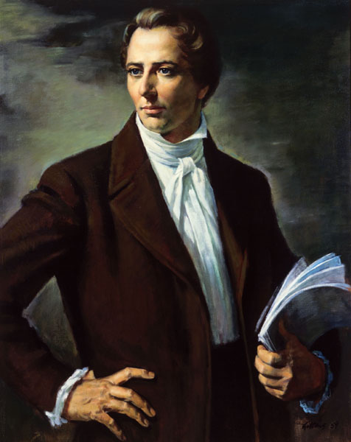
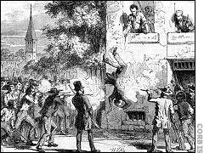
The Mormons
(The Church of Jesus Christ of Latter-Day Saints)
1823 → Golden
Tablets
1830 → Book of
Mormon
1844 → Murdered in
Carthage, IL
Joseph Smith
(1805-1844)

Slide 21
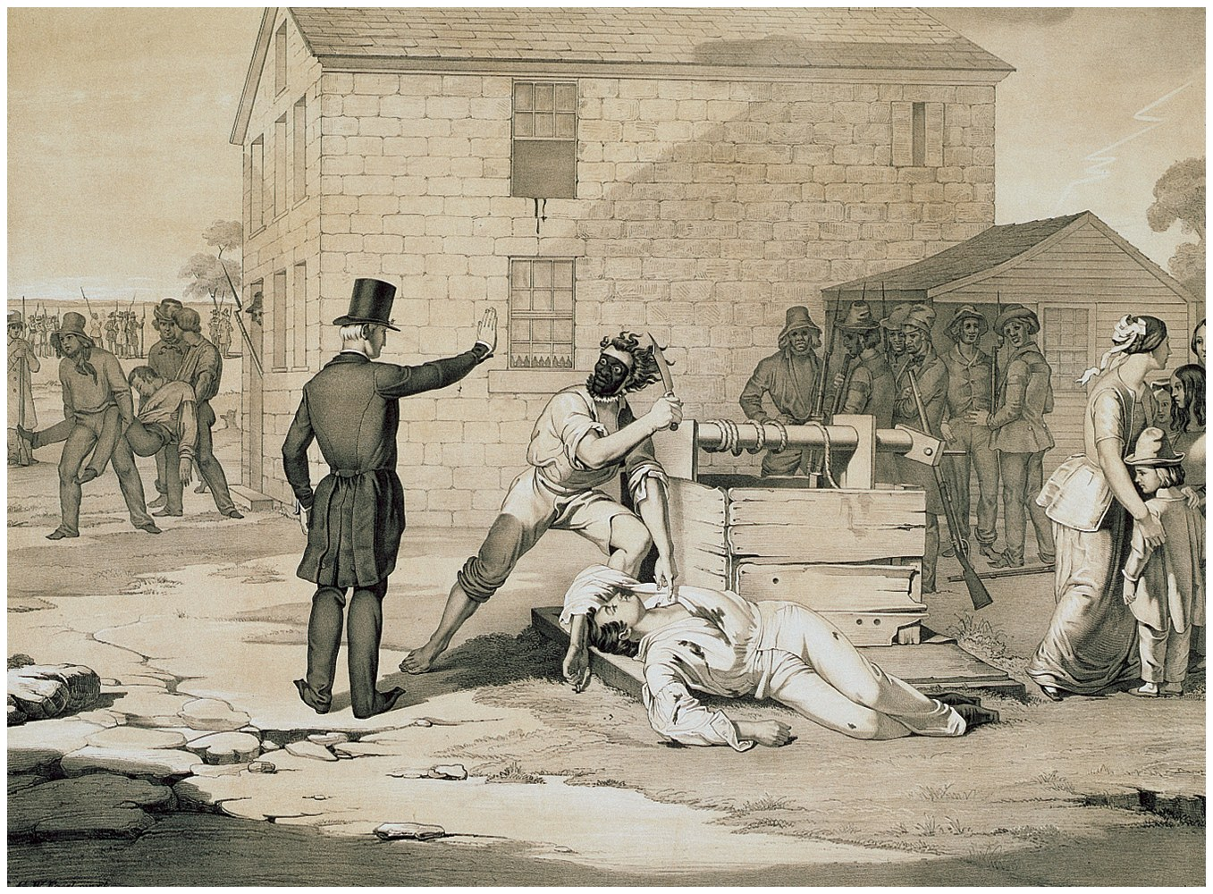
Violence Against Mormons

Slide 22
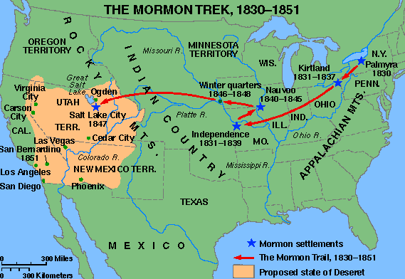
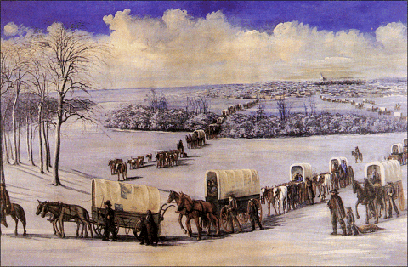
The Mormon “Trek”

Slide 23
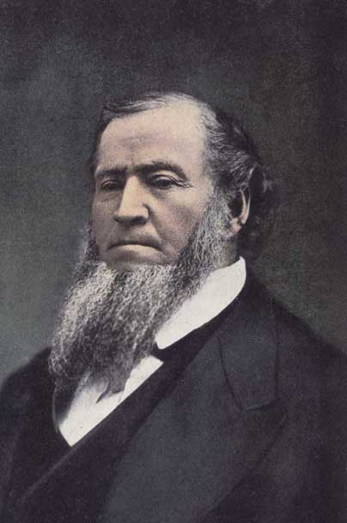
The Mormons
(The Church of Jesus Christ of Latter-Day Saints)
Deseret community.
Salt Lake City, Utah
Brigham Young
(1801-1877)

Slide 24

Utopian Societies
Philosophical movements lead to changing thoughts on society
Several groups attempt to create “Perfect Societies”

Slide 25
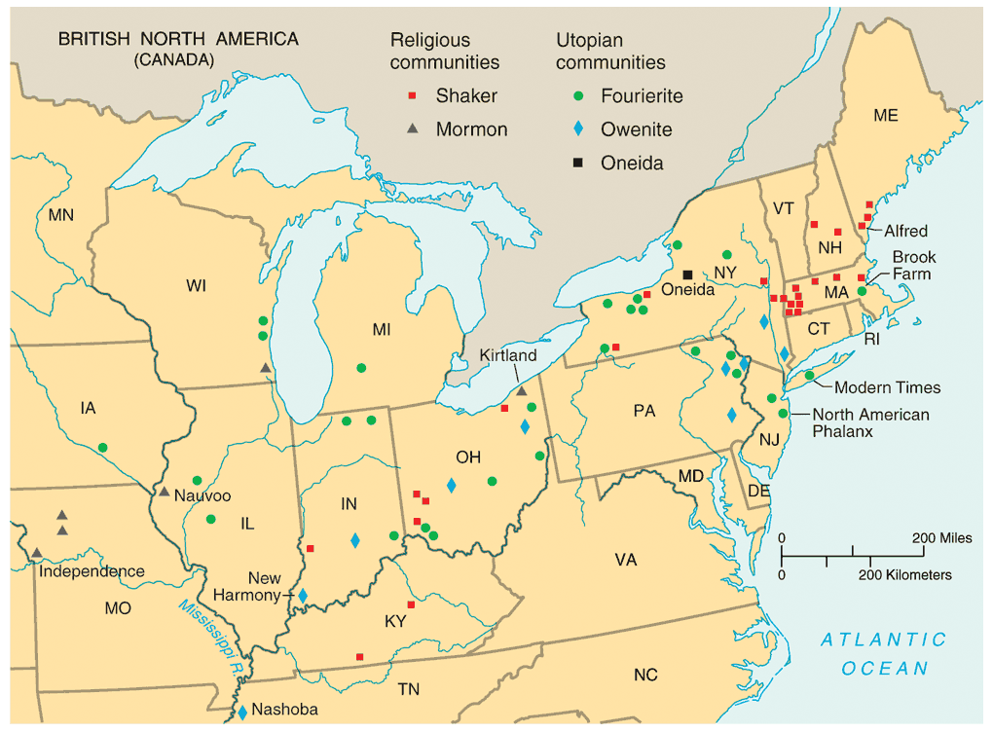
3. Utopian Communities

Slide 26
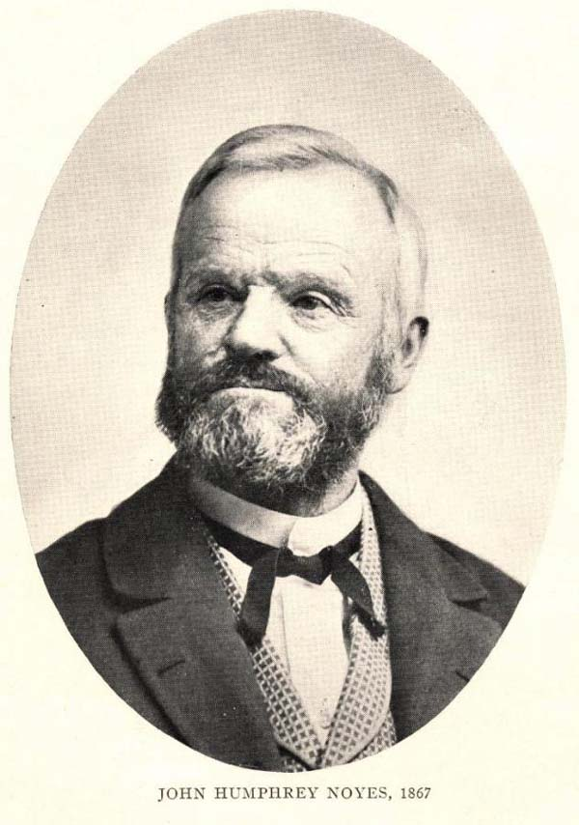
The Oneida Community
New York, 1848v
Believed that the 2nd coming of Christ had already occurred.
Humans were no longer obliged to follow the moral rules of the past.
all residents married
to each other.
John Humphrey Noyes
(1811-1886)
carefully regulated
“free love.”

Slide 27
The Oneida Community
…The Oneida community believed strongly in a form of free love, where any member was free to have sex with any other who consented.
Possessiveness and exclusive relationships were frowned upon.
Postmenopausal women were encouraged to introduce teenage males to intercourse, providing both with legitimate partners that rarely resulted in pregnancies.
Furthermore, these women became religious role models for the young men.
Likewise, older men often introduced young women to sex.

Slide 28
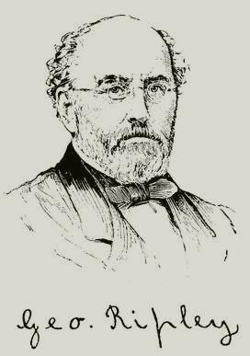
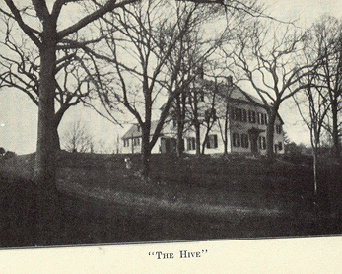
George Ripley (1802-1880)
Brook Farm – 1841
  Communal Living
  Shared Workload
  Made $ through private school and farming
  Nathaniel Hawthorne (Scarlet Letter Author)
  Ended in failure after central building destroyed in fire
“Brook Farmers believed that by sharing the workload, ample time would be available for leisure activities and intellectual pursuits.”
Brook Farm
West Roxbury, MA

Slide 29
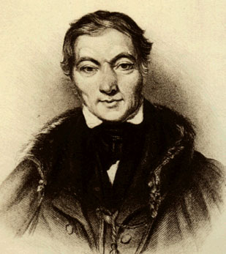
Robert Owen (1771-1858)
Utopian Socialist
“Village of Cooperation”

Slide 30
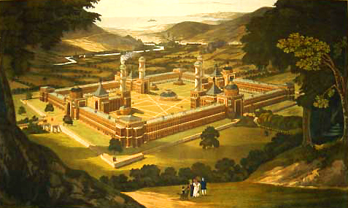
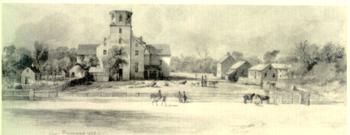
Original Plans for New Harmony, IN
New Harmony in 1832

Slide 31
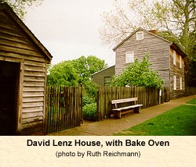
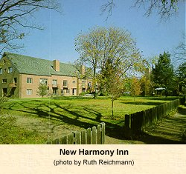

New Harmony, IN

Slide 32
Reform

Slide 33
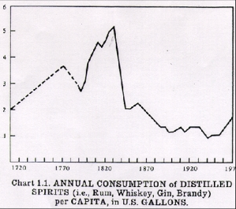
Temperance Movement
Led by Women
Claimed alcohol to be the cause of Crime, Disorder, Poverty and Abuse

Slide 34
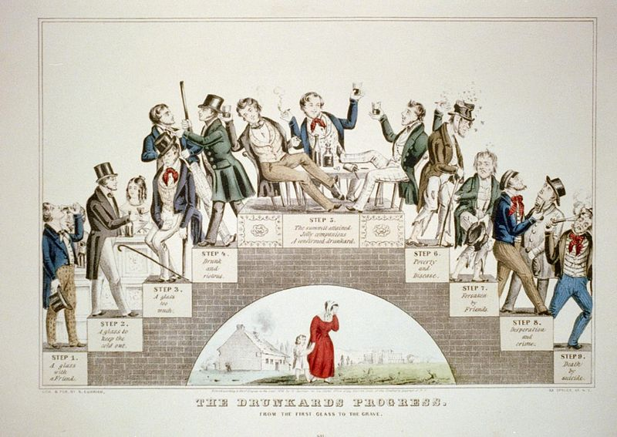

Slide 35

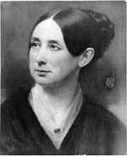
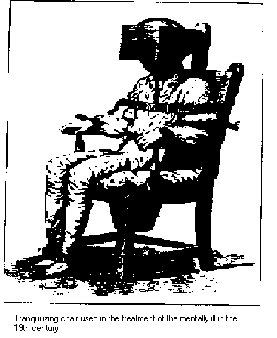
Prison/Asylum Reform
In the first half of the 19th century, prisoners lived in horrible conditions and received horrible treatment.
Dorothea Dix
  Wrote about treatment of prisoners
  Findings led to the creation of the first asylums.

Slide 36
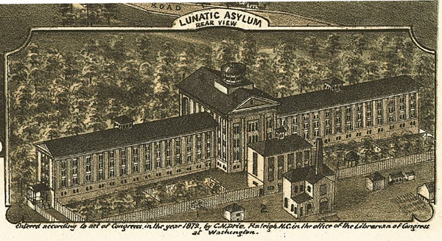
Dorothea Dix Asylum - 1849
"confined in this Commonwealth in cages, closets, cellars, stalls, pens! Chained, beaten with rods, lashed into obedience."

Slide 37
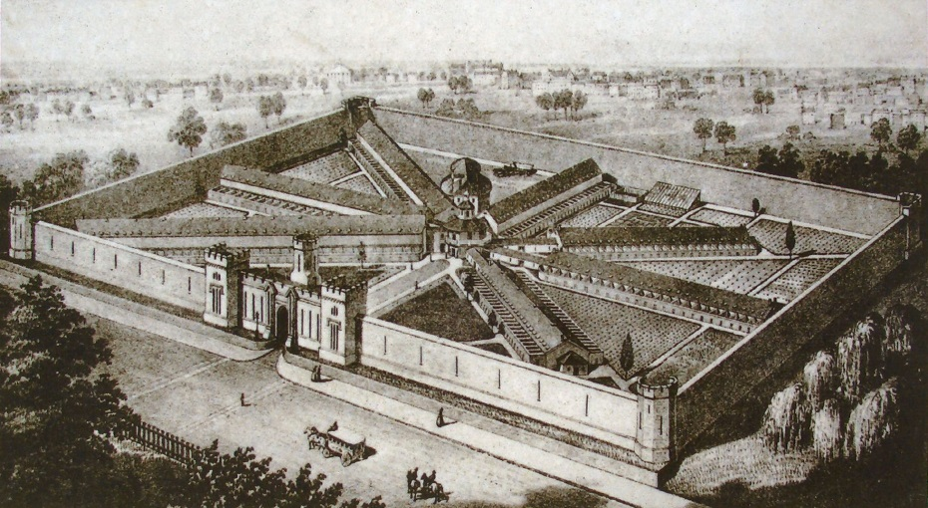
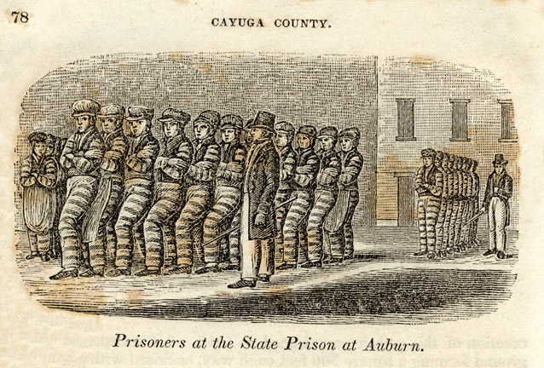
Prison/Asylum Reform
Pennsylvania System – Early 1800s
  Penitentiary System
    or
  Separate System
  Solitary Confinement
Juvenile Detention – 1810s
Auburn System – 1820s
  Manual Labor during the Day
  Solitary at night

Slide 38


Slide 39


Education Reform
Horace Mann
  Leader in the public school reform
  Secretary of Massachusetts Board of Education.
  Beliefs
    Publicly funded schools
    All children should have access
    Education should be non religious
    Teachers should be well trained
  Known as the “Father of American Public Education”

Slide 40


Slavery and Abolition
Abolitionists- people who called for the outlaw of slavery
William Lloyd Garrison
    Radical white abolitionist
    Wrote the Liberator- paper calling for the immediate emancipation of slaves
Frederick Douglass
    Born into slavery and taught to read by slave owners wife
    Escaped and began a public speaking career along side Garrison

Slide 41


Abolition
American Colonization Society (1819)
  Advocated relocation to Africa
  Slave owners paid to release slaves
  Creation of Liberia
    Monrovia
  Overall, unsuccessful

Slide 42


Proslavery Defenses
Bible
    Many people claimed that the Bible has several references to slavery.
Happy Slave Myth
    Slave owners often argued that slaves in the South had better living conditions than those working in Northern Factories
Necessary Evil
    Southerners who knew were not supporters of these beliefs stated that while they knew slavery was not right, Southern states could not survive without it.

Slide 43

“Separate Spheres”
Or
“Cult of Domesticity”
Women should be…
More religious than men
Pure in heart, mind, and body
Submissive to their husbands
Staying at home

Slide 44
Early 19c Women
Unable to vote.
Legal status of a minor.
Single → could own her own property.
Married → no control over her property or her children.
Could not initiate divorce.
Couldn’t make wills, sign a contract, or bring suit in court without her husband’s permission.

Slide 45

What It Would Be Like If Ladies Had Their Own Way!
R2-8

Slide 46

Cult of Domesticity = Slavery
Angelina Grimké
Sarah Grimké
Women’s Rights activists and Abolitionists
R2-9

Slide 47


R2-6/7
Women’s Rights
Lucretia Mott
Elizabeth Cady Stanton
Women’s Rights activists and Abolitionists

Slide 48

Women’s Rights
Seneca Falls Convention
  First women’s right’s convention
Declaration of Sentiments
  Signed by 68 women, 32 men
  Stated that “all men and women are created equal”
Notable attendees
  Elizabeth Cady Stanton
  Lucretia Mott
  Frederick Douglass
Susan B Anthony met Stanton in 1851

