Slide 1

Chapter 18-1
Imperialism
and
America

Slide 2
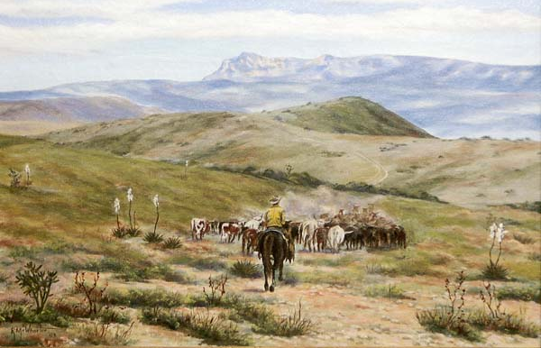
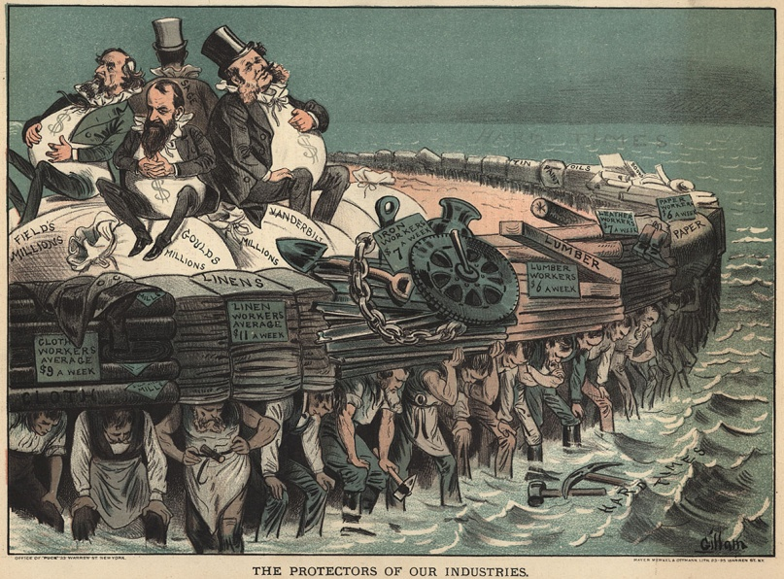
Background
Why did the U.S. wait so long to get involved in Imperialist movement?

Slide 3
Change of Course
What Changes in the late 1800’s that will change our outlook?
Imperialism: Where a stronger
country forces their way of life
on a weaker country

Slide 4
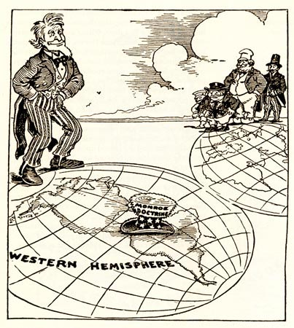
Has the US done this already?
Monroe Doctrine
Manifest Destiny
Frederick Jackson Turner’s “Frontier Thesis”

Slide 5
Why did America
join the imperialist
club in the early 1900s?
(3 Reasons)

Slide 6
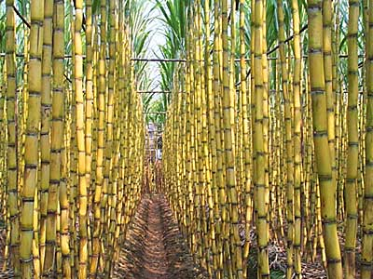
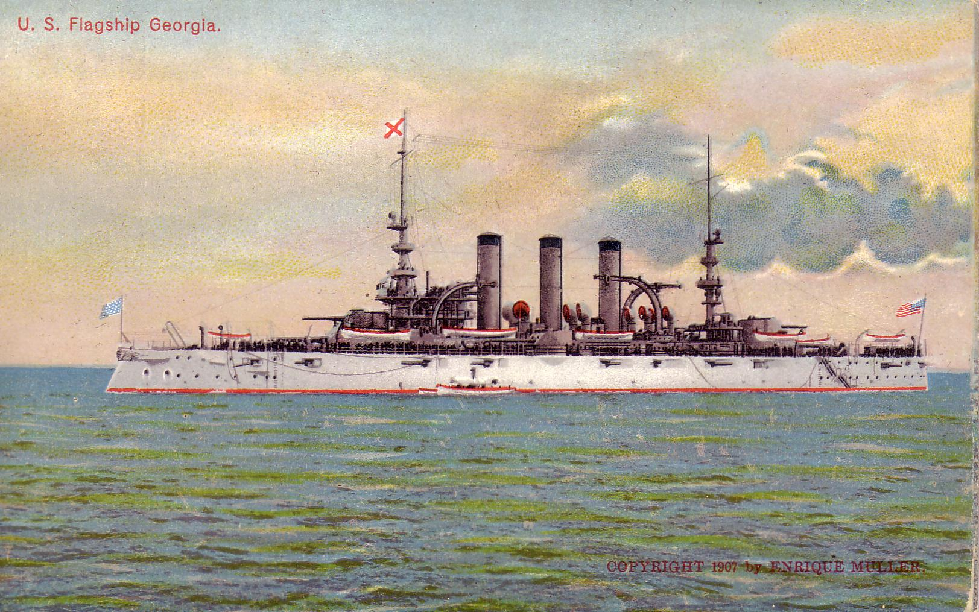
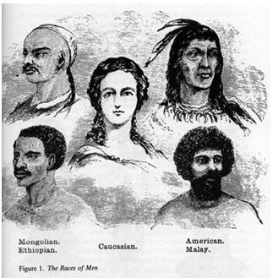
Motives for Imperialism
Money
  Need new markets and new raw materials
  Sugar
Military
  Desire for bases
  Alfred T. Mahan
Cultural Superiority
  Social Darwinism
  Racism
  “ White Man’s Burden”

Slide 7
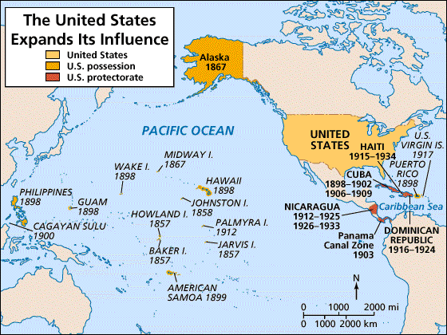
Military
Alfred T. Mahan → The Influence of Sea Power on History: 1660-1783

Slide 8
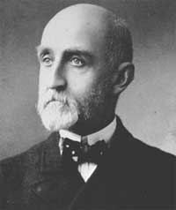
Military
Admiral Alfred T. Mahan
  1890 - Wrote “The Influence of Sea Power on the World”
  Argued that control of the sea was key to world dominance
US builds 5th largest navy by 1898
3rd largest by 1900
Notes:
Other nations were increasing their global military strength and the U.S. needed to catch up
Read by the major world powers and helped stimulate the naval race
US built 9 steel-hulled cruisers between 1883-1890

Slide 9
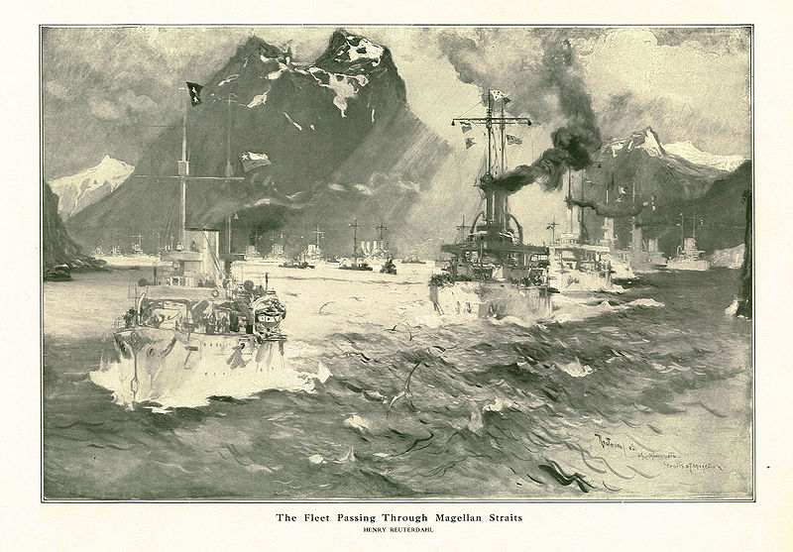
The Great White Fleet
US fleet (16 ships) sent out to show the US naval strength around the world (T. Roose.)
  Circumnavigated the world
  Enforced treaties and protected overseas holdings
America became the 3rd largest navy by 1890
  1. Britain
  2. Germany
  3. U.S.
  4. Japan

Slide 10
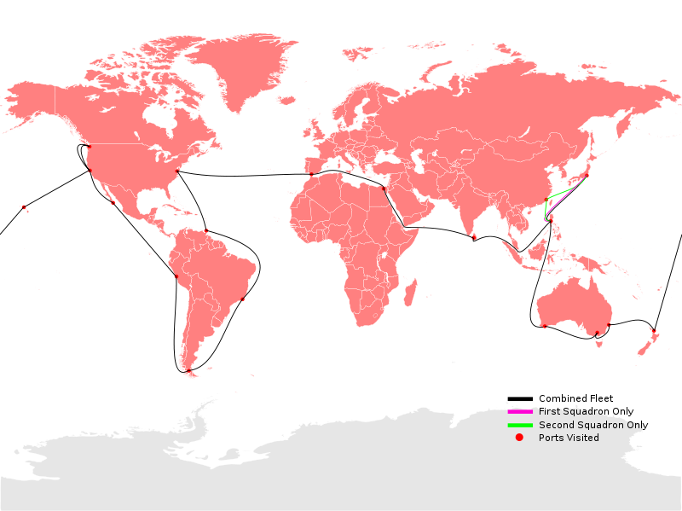

Slide 11
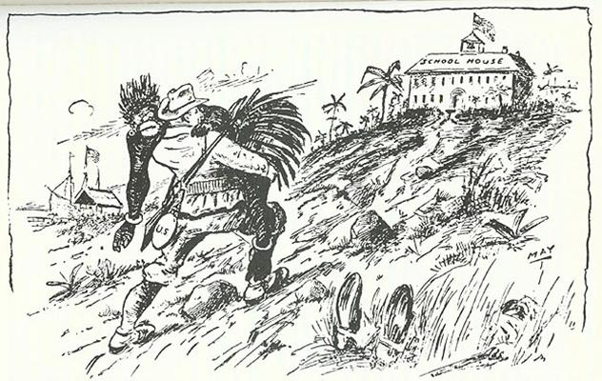
Cultural Superiority
The White Man’s
Burden
(Responsibility)
-Rudyard Kipling
The Hierarchy
of Race

Slide 12
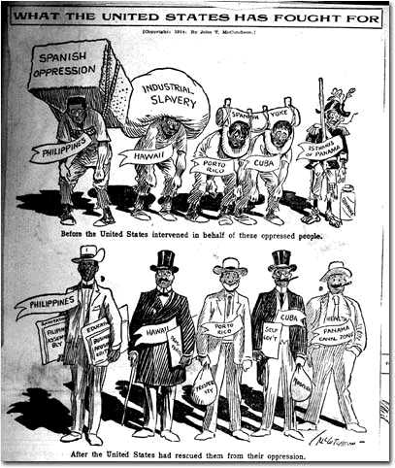
Take up the White Man’s burden—
Send forth the best ye breed—
Go send your sons to exile
To serve your captives' need
To wait in heavy harness
On fluttered folk and wild—
Your new-caught, sullen peoples,
Half devil and half child

Slide 13
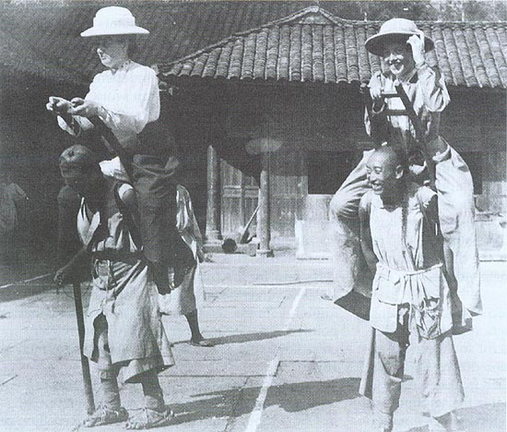
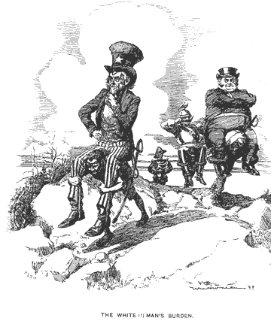
Religious/Missionary Interests
American Missionaries
in China, 1905

Slide 14
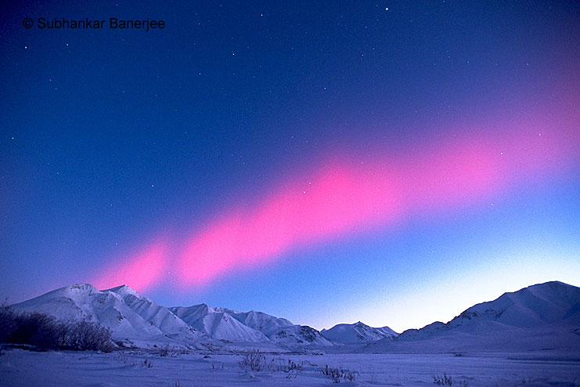
Alaska

Slide 15

Acquiring “Seward’s Icebox”
1867: Secretary of State William Seward bought Alaska from Russia for $7.2 million (.02/acre)
- People thought this was a bad deal and called it “Seward’s Folly”
Notes:
William Seward arranged for U.S. to buy
House of Representatives gave him a hard time to approve funds for the purchase
Great deal: 2 cents an acre got a land rich in timber, minerals and OIL

Slide 16
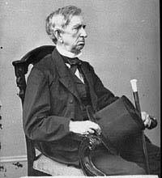
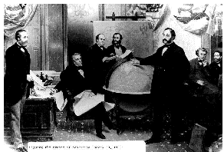
“Seward’s Folly”: 1867
$7.2 million

Slide 17
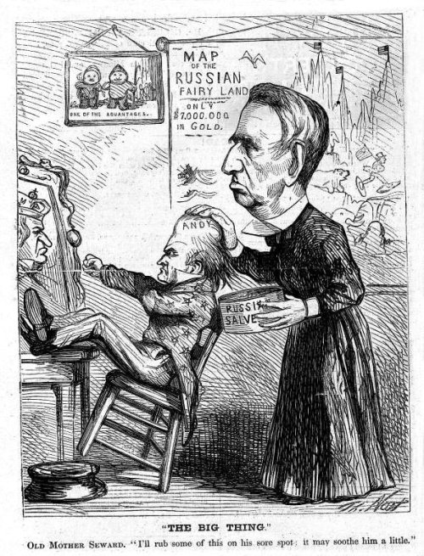
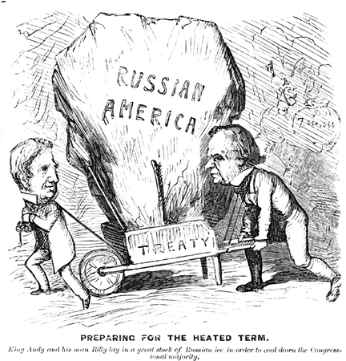
“Seward’s Icebox”: 1867

Slide 18
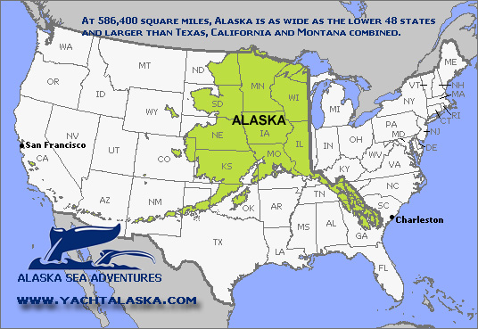

Slide 19
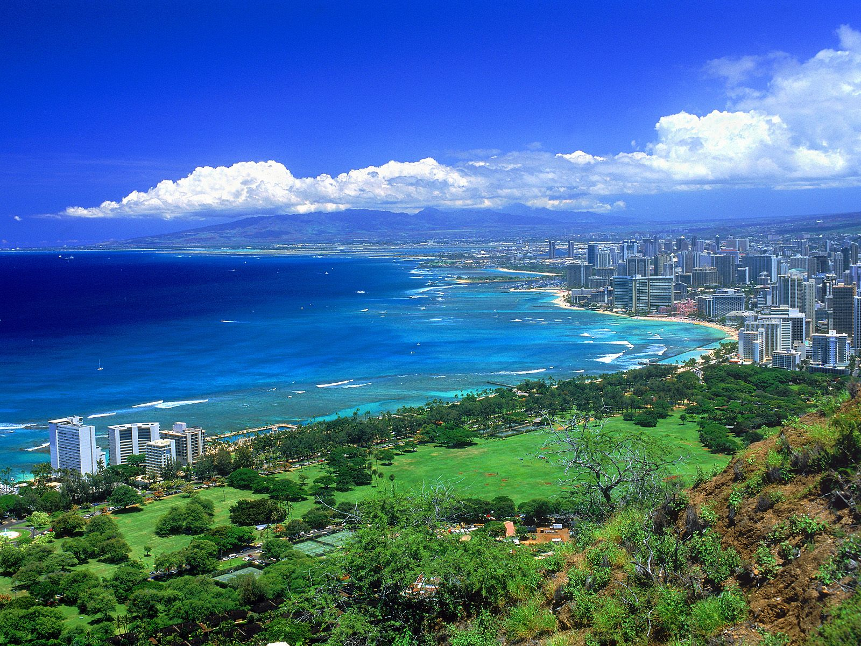
Hawaii:
"Crossroads
of the
Pacific"

Slide 20
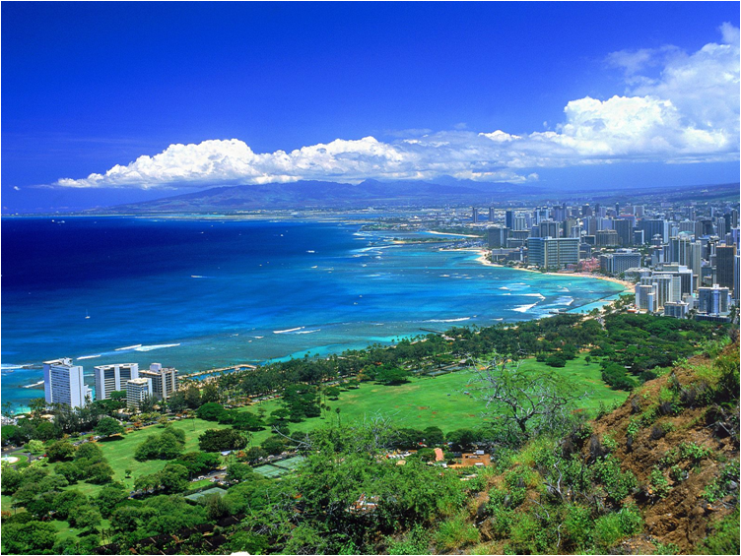

U. S. Missionaries in Hawaii
-Settled in 1500’s by Polynesians
-Discovered by the British in 1778 by James Cook
- First American Missionaries arrive in 1830s

Slide 21
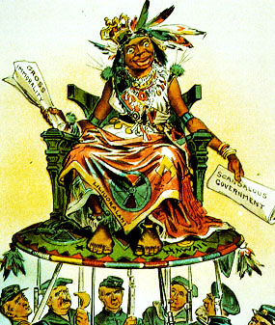
American Impact
Diseases
  50% of Hawaiis killed
Arrival of Christianity
Introduction of alcohol, guns, and trade
Becomes a Constitutional Monarch in 1840s
  Governed by an American

Slide 22
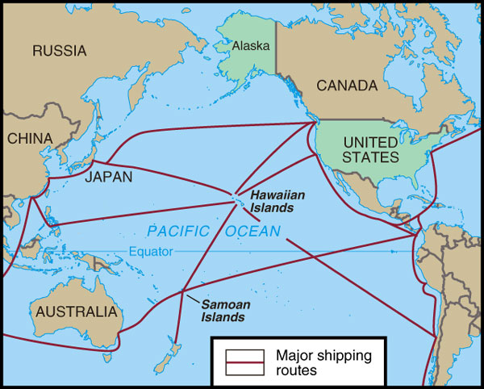
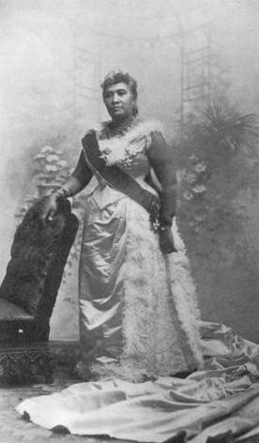
Hawaiian Queen Liliuokalani
- Hawaii for the Hawaiians!

Slide 23
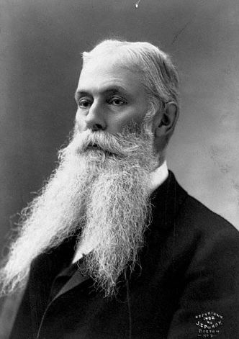
U. S. Business Interests In Hawaii
1887- Hawaiians forced to sign a constitution which gave whites most of the power
1893 – American
businessmen backed an
uprising against Queen
Liliuokalani.
Sanford Ballard Dole
proclaims the Republic
of Hawaii in 1894, against the orders of Grover Cleveland

Slide 24
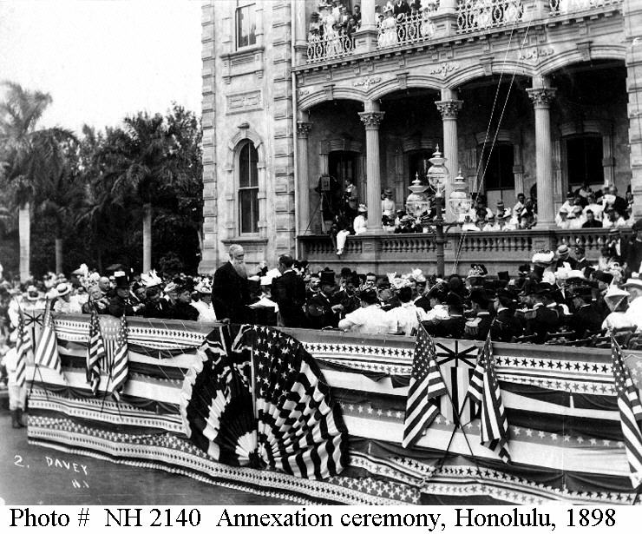
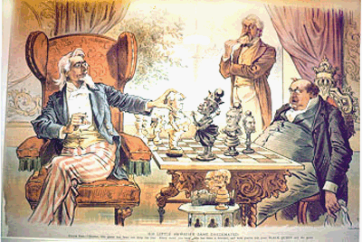
To The Victor Belongs the Spoils
- Hawaii officially annexed in 1898, after Cleveland leaves office.

Slide 25
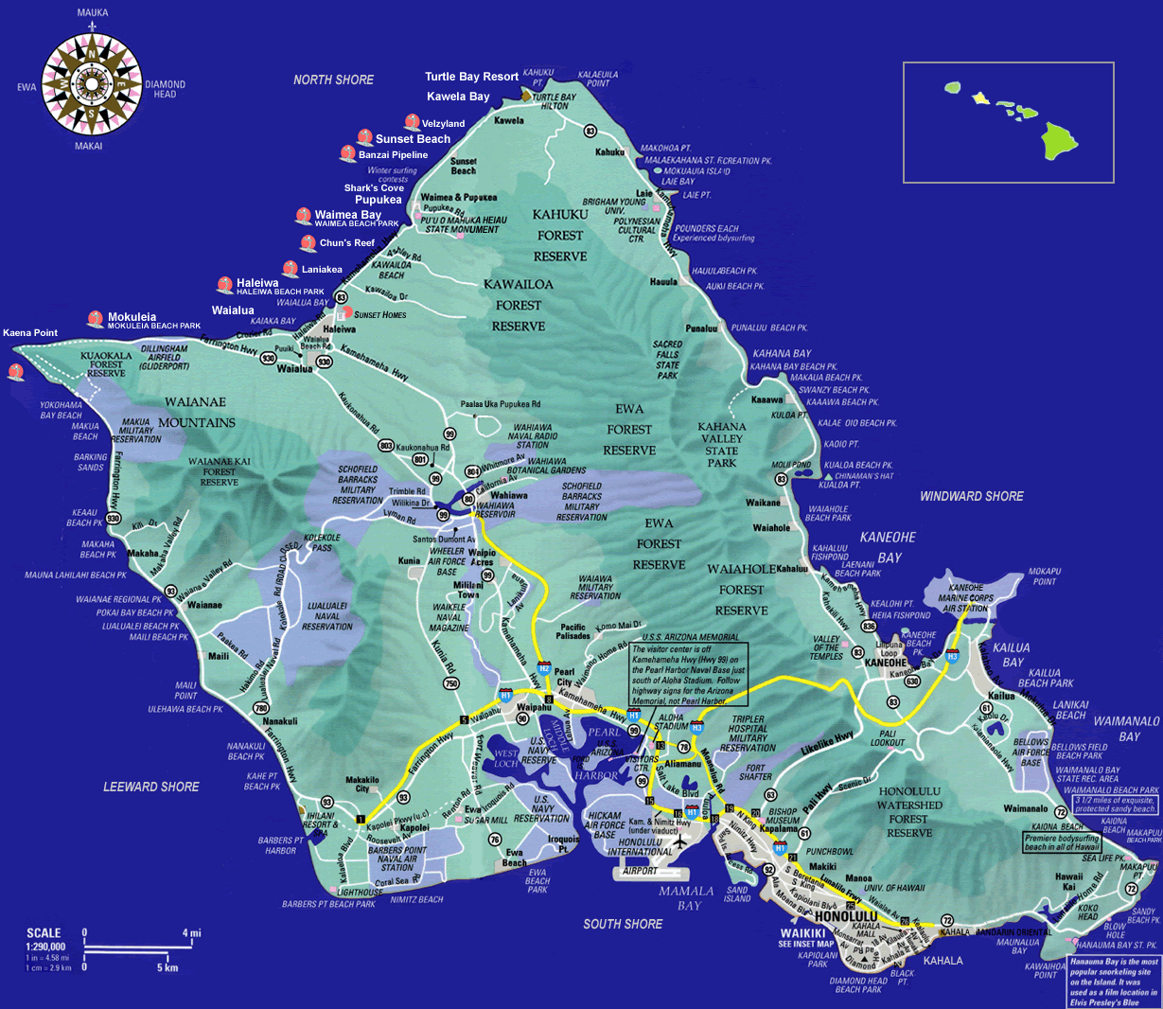
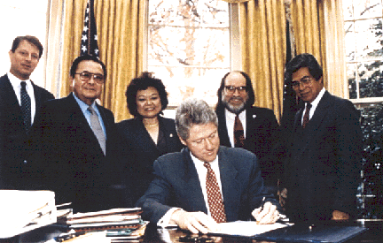
1887: U.S. builds naval base at
Pearl Harbor
1959: Becomes 50th U.S. State
1993: President Clinton Signs Apology Resolution
  Apologized for the overthrow of Queen Liliuokalani

Slide 26
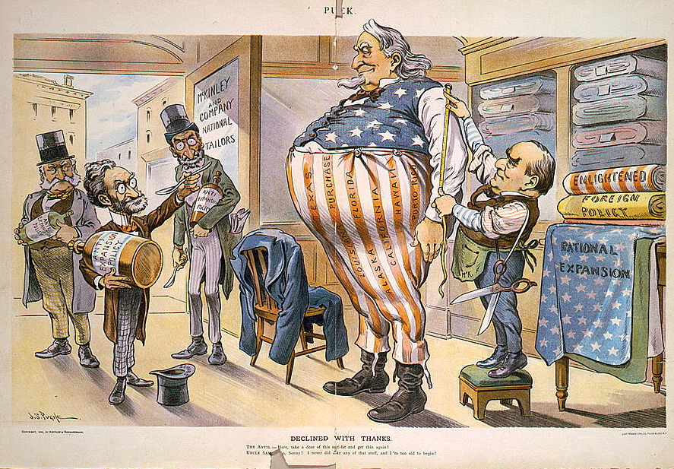

Slide 27
Resources
Chris Balga – Hickory Ridge HS, NC
Susan M. Pojer – Horace Greeley HS, NY
Lewis Hoban – JM Robinson HS, NC

