Slide 1


Slide 2
Registration Information
Please have your $35 fee for membership ready today.
We have 15 students registered currently.
There are a couple who have paid and have not registered.
I can extend payment until November 10th, but after that date
you will be withdrawn for DECA.
Bring your $35 to Mr. Busshart and he will receipt you and get you registered in DECA International

Slide 3



PRESIDENTS
Austin O’Day | Andy Lara Martinez
VICE PRESIDENTS
Vice-President of Leadership | Randy Walker | Nathan Martinez
Vice-President of Career Development | Noah Sutt | Jenna Guilmette
Vice-President of Marketing | Ayeshah Bhatti | Bradley Ortolano
Vice-President of Finance | Gaby Duarte Orellana | Bailey Land
Vice-President of Hospitality | Rebecca Joyner | Benedicte Tshikaya | Olivia Powell
Vice-President of Philanthropy | Owen Corley

Slide 4
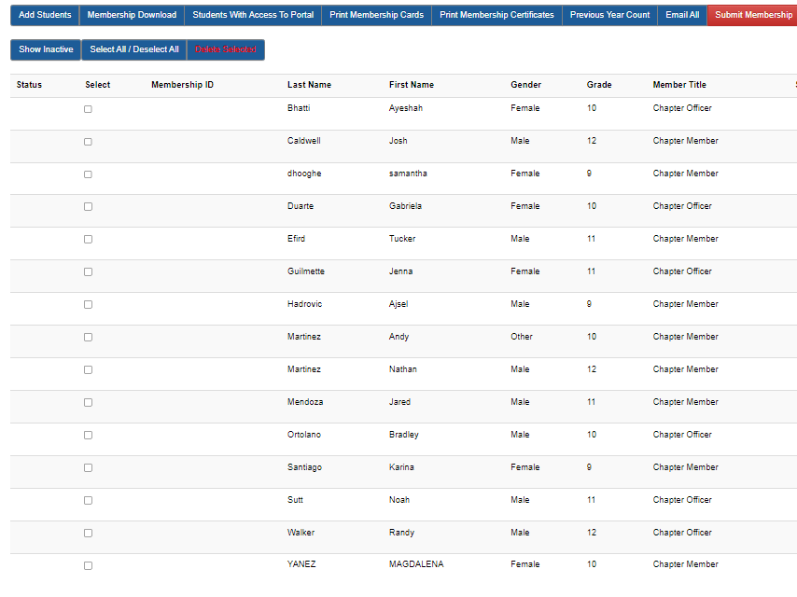



Slide 5
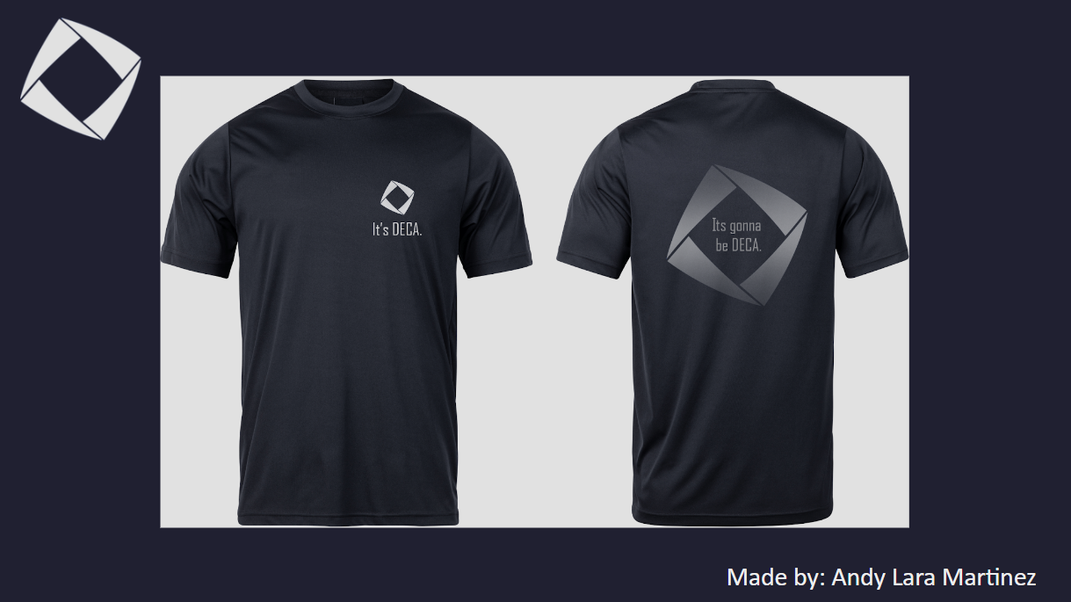
Vote on your Shirt and Size Today Near Sign-In Form
A

Slide 6
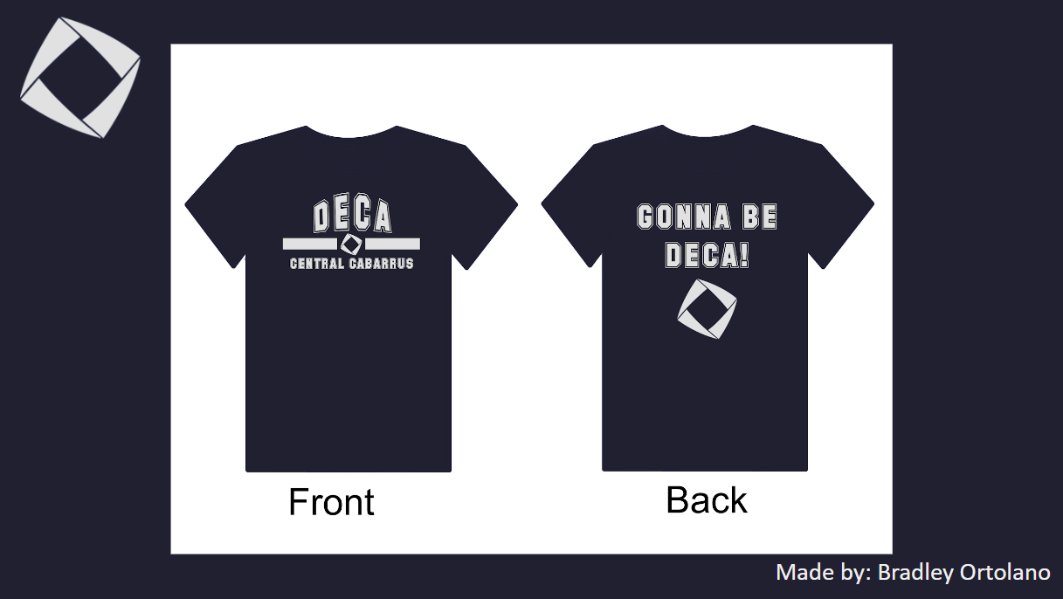
B

Slide 7

Competitive Events | HS – DECA Inc

Slide 8



ROLEPLAY
Andy & Austin

Slide 9
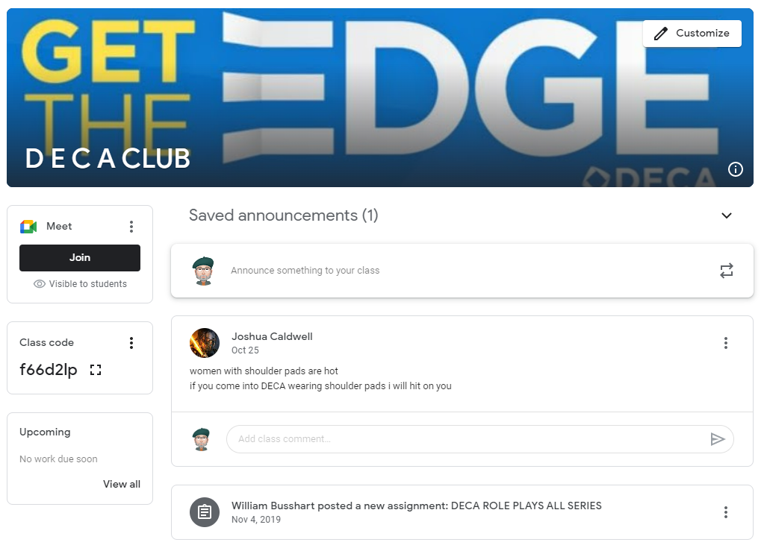
https://classroom.google.com
Join:
Class Code:
f66d2lp

Slide 10



Mark your calendars for November 18th
Check our front page on the school website
We will have information about
Greensboro State Competition
February 2023
Shop DECA | Shop DECA

