Slide 1
Read to Achieve
North Carolina: Excellent Public Schools Act
Notes:
Welcome and Introduction

Slide 2
Read to Achieve Legislation
Part VII-A
Excellent Public Schools Act
“The goal of the State is to ensure that every student read at or above grade level by the end of third grade and continue to progress in reading proficiency so that he or she can read, comprehend, integrate, and apply complex texts needed for secondary education and career success.”
House Bill 950
Goals of Legislation
All students will be proficient readers by the end of third grade
Students have multiple opportunities to show proficiency
Extra support is provided to third and fourth grade students
Notes:
The goals of the legislation are: for every child to read at or above grade level by the end of third grade, for students to have multiple opportunities to show proficiency, and to provide extra support to third and fourth grade students.

Slide 3
Read to Achieve Legislation
7 Components
Comprehensive Plan for Reading Achievement
Developmental Screening and Kindergarten Entry Assessment (2014-2015)
Facilitating Early Grade Reading Proficiency
Elimination of Social Promotion
Successful Reading Development for Retained Students
Notification Requirements to Parents and Guardians
Accountability Measures
Notes:
There are seven components to the Read to Achieve legislation, two of which we are going to focus on today. These two components directly impact your child during their third grade year through assessments and their class assignments for the next school year based on demonstrated proficiency levels.

Slide 4
Major Components
K-3 Diagnostic Reading Assessment
Mandatory retention (label) of third graders not performing on grade level
Optional Summer Reading Camp
Fourth Grade classes with interventions and monitoring
Notes:
The major components of Facilitating Early Grade Reading Proficiency and the Elimination of Social Promotion include the K-3 diagnostic reading assessment, mandatory retention (label) of third graders not performing on grade level, optional summer reading camp, and once in fourth grade, they will continue to be provided with interventions and their progress will be closely monitored.

Slide 5
Early Grade Reading Proficiency
K-3 Reading
Foundational reading skills build deeper comprehension skills and success in other content areas
Students are assessed three times per year – August/September, January/February, and May
mClass Reading 3D assessments
Assessments measure: phonics, phonemic awareness, fluency, vocabulary, and comprehension
Provide information to teachers for instructional decisions
Monitor student progress more frequently as needed
Home Connect letter
Notes:
The major component of Early Grade Reading proficiency is ensuring that students have the foundational reading skills that they need to build deeper comprehension skills and success in other content areas. In order to provide information on where each child is performing in reading as well as their strengths and areas of growth, students are assessed three times per year – at the beginning of the year, middle of the year, and end of the year. The assessments measure the five areas of reading supported by the National Reading Panel:
phonics: An understanding of and connecting letters of written language with sounds of oral language.
phonemic awareness: A child’s understanding that every spoken word is made up of a sequence of phonemes. The phonemes that make up a word can be heard when the word is said slowly. Phonemic awareness is key to understanding the logic behind the alphabetic nature of our language and thus the ability to learn to spell, use phonics and learn to read.
fluency: A reader’s expression, phrasing, and speed as s/he reads a text. The term fluent describes a level of automatic, accurate word recognition and reading that is correlated with increased comprehension.
vocabulary: The oral or reading language needed for effective communication.
comprehension: The use of purposeful and active strategies for understanding written language. The act of constructing meaning from text. Includes strategies such as activating existing knowledge, making connections, questions, visualizing, inferring, summarizing and synthesizing.
These assessments provide information to teachers for instructional decisions and if needed, teachers monitor student progress more frequently – up to once per week.

Slide 6
Early Grade Reading Proficiency
Diagnostic Assessments
DIBELS | TRC
1 minute probes to assess early literacy skills and fluency | Assess text reading comprehension
Teacher get immediate feedback about the
instructional needs of students
Parent reports are generated to provide notification
of assessment results and information regarding
reading proficiency
Notes:
The assessments that are given three times per year measure early literacy skills such as letter naming, letter sounds, and students ability to blend and segment sounds as well as skills such as fluency and comprehension. The assessments provide teachers with immediate feedback and parent reports are sent home after each testing window.

Slide 7
Early Grade Reading Proficiency
Additional Support
If students need additional support:
Interventions are implemented at school
Intervention plan is shared with parents
Teachers frequently monitor student progress
Instructional changes are made as needed
Notes:
If students need additional support, there are several things that are put in place to support them. We have a variety of interventions that may be implemented at school, including…If interventions are implemented, then we share the place with you so that you are also able to support your child at home. In addition, teachers frequently monitor student progress in order to ensure that the interventions that have been put into place are working and changes are made as needed.

Slide 8
Early Grade Reading Proficiency
At or Above Grade Level
If students are reading at or above grade level:
Continue to progress in reading proficiency
Read, comprehend, integrate, and apply complex texts
Become an independent reader
Notes:
If students are reading at or above grade level, we continue to support their progress. Reading is taught during a 90 minute block each day and students receive whole group, small group, and individual instruction in order to tailor learning experiences to each student’s needs.

Slide 9
State Level Assessments
Beginning of Grade (BOG) and End of Grade (EOG)
Measures student progress toward standards
BOG is for reading only and provides an indication as to whether a student is on track
EOG is for reading and math
Scores range from Level 1 (the lowest) to Level 5 (the highest)
Multiple choice tests
Student reads selections and answer questions
Notes:
Students will take two state level assessments in third grade – the BOG and EOG. If students are proficient on the BOG, they meet the requirements of Read to Achieve, but still take the EOG.

Slide 10
Elimination of Social Promotion
What to Expect
Third Grade students take End of Grade assessment
If proficient, move to 4th grade
If not proficient, take second test
Third Grade students take second assessment
If proficient, move to 4th grade
If not proficient, option to attend summer camp
Third Grade students attend summer camp and/or multiple data sources are reviewed
If proficient, move to 4th grade
If not proficient, move to 4th grade with 3rd grade retention label or physically retained in 3rd grade
Notes:
The next component of Read to Achieve that directly impacts third grade students is the elimination of social promotion. At the end of third grade, students will take the end of the grade assessment. If they are proficient, then they move on to fourth grade as they have in years past. If they are not proficient, then they will take a second test (the Read to Achieve test). If they are proficient on the second assessment, then they move on to fourth grade. If they are not proficient, then they will be given the option to attend summer camp. If a parent decides not to have their child attend summer camp then multiple measures of student progress will be taken into account to determine whether or not the student will physically move on to fourth grade. If the student does not demonstrate proficiency on the BOG, EOG, local assessments, or qualify for a good cause exemption, then he or she may be physically retained in third grade or move on to fourth grade with a “retention label”. Students will take the Read to Achieve test again at the end of summer camp. This will provide students with another opportunity to demonstrate proficiency.

Slide 11
Good Cause Exemptions
Limited English Proficient students with less than two school years of instruction in an English as a Second Language program.
Students with disabilities, as defined in G.S. 115C-106.3(1), and whose individualized education program indicates (i) the use of the NCEXTEND1 alternate assessment, (ii) at least a two school year delay in educational performance, or (iii) receipt of intensive reading interventions for at least two school years.
Students who demonstrate reading proficiency appropriate for third grade students on an alternative assessment approved by the State Board of Education (Discovery Education, Reading 3D, Read to Achieve alternative assessment)
Students who demonstrate, through a student reading portfolio, reading proficiency appropriate for third grade students.
Students who have received reading intervention and previously been retained more than once in kindergarten, first, second, or third grades.
Notes:
In addition to the EOG and Read to Achieve test, there are good cause exemptions that are also in place for students. If students meet one of these criteria, then they will not be requested to attend summer camp nor move on to fourth grade with the retention label.

Slide 12
Summer Reading Camp
Provided by Cabarrus County Schools
No cost to parents
At least 72 hours of instruction over the course of four weeks
Students are engaged in:
  Small group, intensive reading instruction
  Blended learning opportunities
  Science-based inquiry lessons on a topic of their choice
Breakfast and lunch are provided
Transportation is provided
Low student-teacher ratios with highly-qualified teachers
Notes:
If students are not proficient on any of the measures provided or do not meet the requirements for a good cause exemption, then they are encouraged to attend summer reading camp. Summer camp will include all of the components listed above

Slide 13
What if my child has a retention label in fourth grade?
Students move on to 4th grade with retention label
Taught 4th grade standards
Provided with interventions and monitoring to continue to support student in reading
Monthly written reports on your child’s reading progress
Reading contract between parent and school
90 minutes of uninterrupted reading instruction
Notes:
This is the experience students will have if they move on to fourth grade with a retention label.

Slide 14
What if my child has a retention label in fourth grade?
Opportunity for mid-year promotion: Read to Achieve test, local alternative assessment approved by the State Board of Education, or completed portfolio by November 1
Retention label is removed if child is proficient
All students remain in same classes for entire year
Take 4th grade EOG
Promotion to 5th grade is principal decision
Notes:
This is the experience students will have if they move on to fourth grade with a retention label.

Slide 15
What can I do to help my child?
Read with your child for 15-20 minutes each day.
Let your child see you reading for fun and for practical purposes.
Choose and read books that your child enjoys.
Talk with your child and ask questions about what he or she is
reading.
Visit the local public library, check out books, and participate in library events.
Notes:
As we continue to support interventions during the school day, there are several things that you can do to support your child at home.

Slide 16
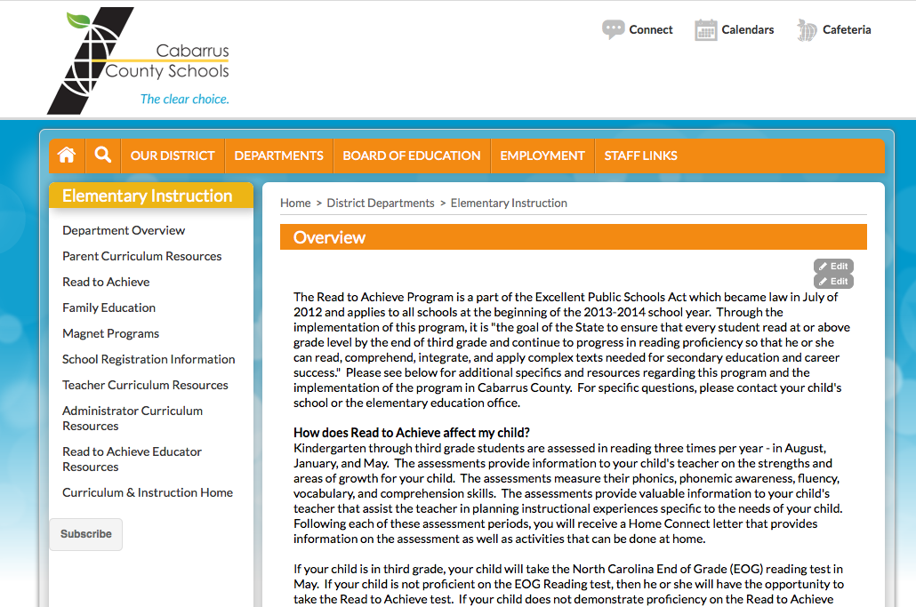
Additional Resources
Notes:
Additional information is available on the website.

