Slide 1

Ms. Hunter’s Class Info
Kindergarten 2019-2020
https://www.cabarrus.k12.nc.us/odell

Slide 2
Master Schedule
7:55-8:15 – Attendance/Morning Work
8:15-8:45 Morning Meeting
8:45-9:50 –Math
9:55-10:40- Encore
10:45-11:00 – Restroom / Snack
11:00-12:25 – Literacy
12:30-1:00 – Lunch
1:05-1:45 - Writing
1:50-2:20 – Recess
2:25-2:50 Social Studies / Science
2:55- Dismissal

Slide 3
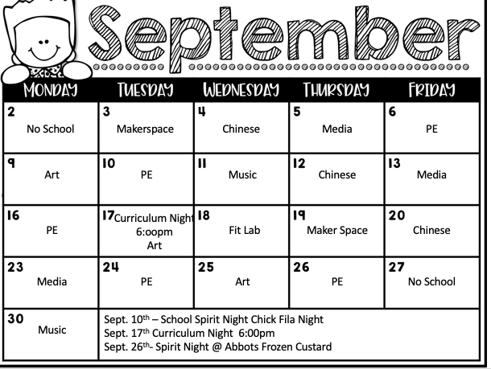
Encore Schedule

Slide 4
School Hours / Attendance
8:15 – 3:00
Students may arrive starting at 7:50
Half day is 11:40 am for students.
In order to be considered in attendance, a student must be present in school for at least one half of the school day or at a place other than the school with the approval of the appropriate school officials for the purpose of attending an authorized school activity.
At the elementary school level, more than ten (10) absences a year are considered excessive. At the middle school level, more than ten (10) absences in a course per semester or twenty (20) absences a year are considered excessive. At the elementary and middle school level, a student will be given one (1) unexcused absence when the student has accumulated a combined total of five unexcused tardies of (15) minutes or more (example: 3 late check-ins + 2 early check outs will count as one unexcused absence).
Students who have excessive unexcused tardies/early check outs may be assigned ‘make-up time’ at the discretion of the principal.

Slide 5
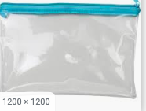
Money
Send all money to school in your child’s money envelope. This should stay at home unless your sending in money.
Be sure to designate what the money is for.
Paying on-line is the best way to pay for field trips and other fees.
https://www.cabarrus.k12.nc.us/odell

Slide 6
Snack
Individually Wrapped
Healthy
Should not need a spoon or fork
Put in front pocket or side pocket of bookbag
Only water in water bottles

Slide 7

Class Newsletter / Volunteers
A newsletter will be sent on Class Dojo every week.
https://www.smore.com/hdnj8
Volunteers are welcome and appreciated. Please be sure to fill out the volunteer form in order to be released to work in the classroom. - https://www.cabarrus.k12.nc.us/Page/3767
I need volunteers for parties and field trips.

Slide 8
Class Dojo
We will be using Class Dojo for monitoring behavior this year. It is a program that works great for fast and effective communication. Each student has his or her own avatar. Each student will accumulate points over each nine-week period. Points can be given at any time including class, hall, bathroom, lunch, recess, encore, etc. Every student that has received 100 or more points at the end of each nine-weeks will go to a celebration. The computer keeps track of each point earned. You can log into Class Dojo to check your child’s behavior at any time by using your child’s specific code that you will receive in their folder. How often you choose to check your child’s progress is up to you. Be sure to login to Class Dojo and sign-up using your child’s code. Feel free to call or e-mail me anytime you have a question or concern about a behavior issue. The good behavior award celebration dates are listed below.
First Quarter Celebration – October 25
Second Quarter Celebration – January 24
Third Quarter Celebration – March 26
Fourth Quarter Celebration – June 8
https://www.classdojo.com/

Slide 9
Assessments
Math – IREADY
Reading- IREADY, Istation, Mclass, & Sight Words

