Slide 1
Welcome to Second Grade!
Mrs. Smereka’s Class

Slide 2
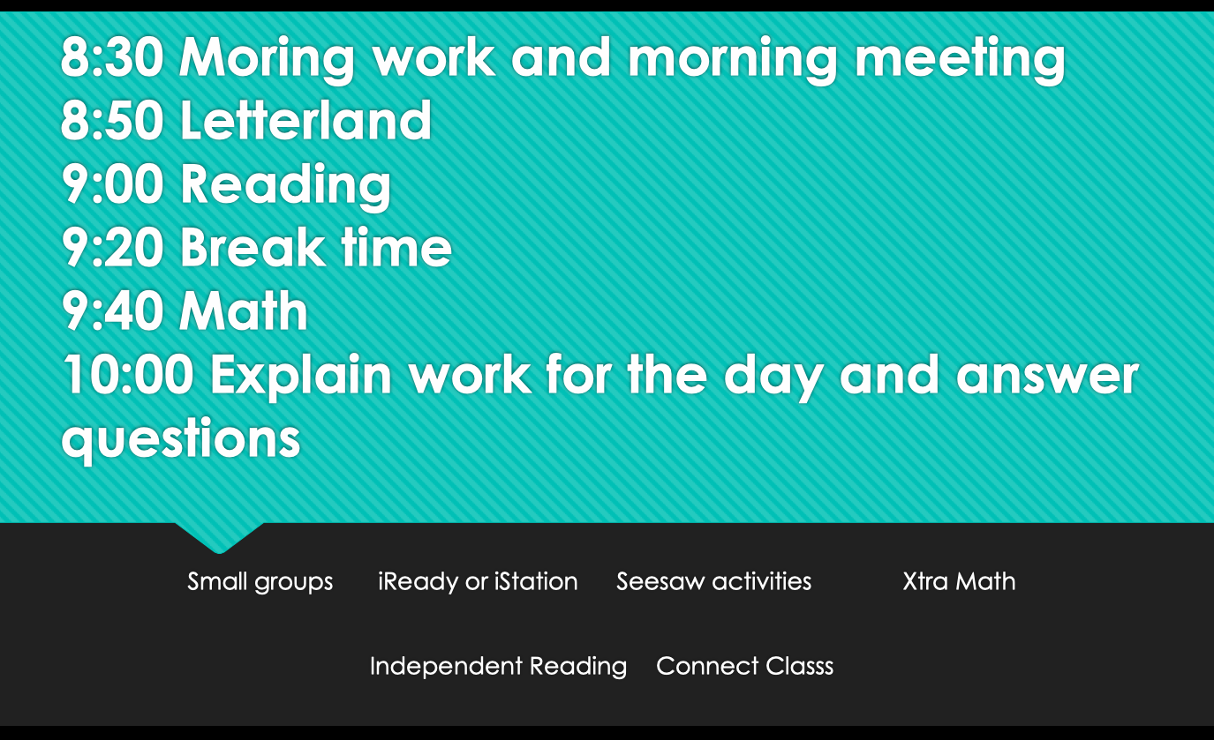
Virtual Schedule
This is what a typical day in our classroom looks like.

Slide 3
READING
Our reading curriculum includes:
Phonics instruction and mini-lessons - shared literature or read-aloud by the teacher that focuses on units of study
Guided Reading - small group reading lessons based on your child’s instructional reading level
Independent Reading - Each child chooses a book and reads silently to him/herself. We will strive for fluency and stamina.
Focus on comprehension of text. This will be done through questions, discussions, written responses, and peer conversations.
iStation – a research-based program which adapts to the student's needs (lessons will change based on how the student is doing at each monthly progress check). We will use iStation twice a week.

Slide 4
READING
Reading Workshop includes the following elements:
Phonemic Awareness - ability to hear and manipulate sounds in words
Phonics - understanding the relationship between letters and sounds
Fluency - ability to read text accurately and quickly
Vocabulary - knowledge of the words within a text
Comprehension - ability to understand and gain meaning from what you read

Slide 5
READING
Students will be formally assessed at the beginning of each month in IStation.
The reading level goals for 2nd Grade are:
Beginning of Year (September) Reading Level: I WPM: 62
Middle of Year (January) Reading Level: J or K WPM: 88
End of Year (May) Reading Level: L or M WPM: 106
Students who need more intensive practice will work in small groups with a teacher. Their progress will be checked more often.

Slide 6

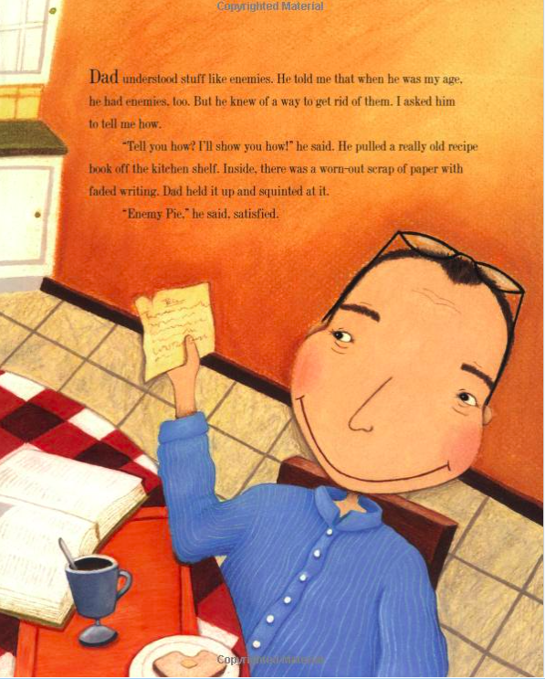
READING
By the end of second grade, the goal is for your child to fluently read and understand texts at a level L or higher. Please remember that this is a goal. It is most important that we help your child make progress and increase their confidence and love of reading throughout the year.

Slide 7
WORD STUDY
Letterland
This is a phonics and spelling program that covers all 44 sounds in the English language and their major recurring spelling patterns. The tricks and strategies the children learn will help them read, write, and spell with confidence.
Students will have a Letterland lesson each day with their teacher.
Each week, students will be given a list of words. Individual teachers will decide the lists that their classes or small groups need.

Slide 8
WRITING
Lucy Calkins Writing Workshop is student-centered with teacher conferencing. Units include: narrative writing (small moments stories), persuasive writing, authors as mentors, non-fiction (how-to and all about), and realistic fiction.
Shared/interactive writing consists of class discussions, brainstorming ideas, using graphic organizers (thinking maps), keeping journals in science, or writing facts in social studies.

Slide 9
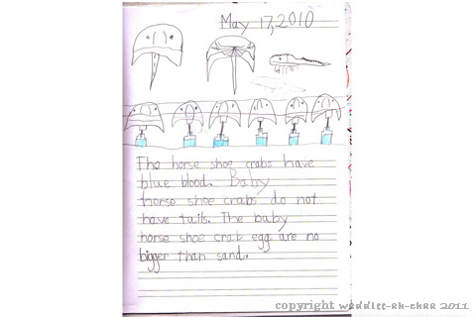
WRITING

Slide 10

READING AND WRITING SUPPORT AT HOME
The Parent Guide for English Language Arts is an excellent resource for you to support your child with reading and writing strategies.
https://simplebooklet.com/publish.php?wpKey=9BEvIytrdC928Cwu9VXkym - page=0

Slide 11
MATH
Math instruction is developed using the Units by Design and the resources provided by Cabarrus County Schools.
Teachers use a Launch/Explore/Discuss model for whole-class instruction.
Math Workshop is a hands-on program in which your child uses manipulatives, games, and workbooks to develop math skills. After whole-group instruction, the children will work in small groups with the teacher and independently practice skills. The concepts will become more challenging as we progress.
Math Journal - a composition notebook of various math skills completed at school
i-Ready is an adaptive math program that CCS students are expected to complete 2-3 times a week for 20 minutes.
Online programs we use to supplement math instruction: XtraMath (helps with addition and subtraction fluency), BrainPOP Jr., and LearnZillion.

Slide 12
SCIENCE
Our science curriculum includes hands-on activities that allow your child to explore and investigate. This year we will study:
Evolution and Genetics
Animal Life Cycles
Weather
Changing States
Sound

Slide 13
SOCIAL STUDIES
In social studies, second graders will learn about themselves and how they are alike and different than other children around the world. The curriculum includes:
Civics and Government in our Community
Geography
Understanding the Past
Environmental Impact
Economics
Cultural Expression

Slide 14
How do we know what they know?
Pre-tests and post tests are given to determine mastery in math and reading skills. Writing samples are reviewed to assess mastery of writing skills. Rubrics, conference notes, and student work are also used to determine mastery of reading skills as well as iStation and running records.
This information is reported on report cards which will be sent home each quarter (four times during the year).
Benchmark assessments also occur throughout the year. IStation reading assessments are given at the first of every month. This is an adaptive program that will determine their lessons for the month. This data drives our small group instruction. Math standards are assessed at the end of each unit.
All assignments are submitted and checked in Seesaw. Some assignments will include feedback from the teacher. Please be sure you are connected to the Parent Portal in Seesaw to view your child’s progress.

Slide 15
REPORT CARDS
STANDARDS BASED GRADING
Our report cards are standards based. This means:
Students' most recent work is used to determine their level on the report card.
The level reflects what they know or are able to do currently rather than an average of their performance throughout the quarter.
Students' performance can be measured in many ways such as, tests, journal entries, and teacher observations.
Student work that is sent home may comprise only a portion of the evidence that teachers use to determine students' performance levels.

Slide 16
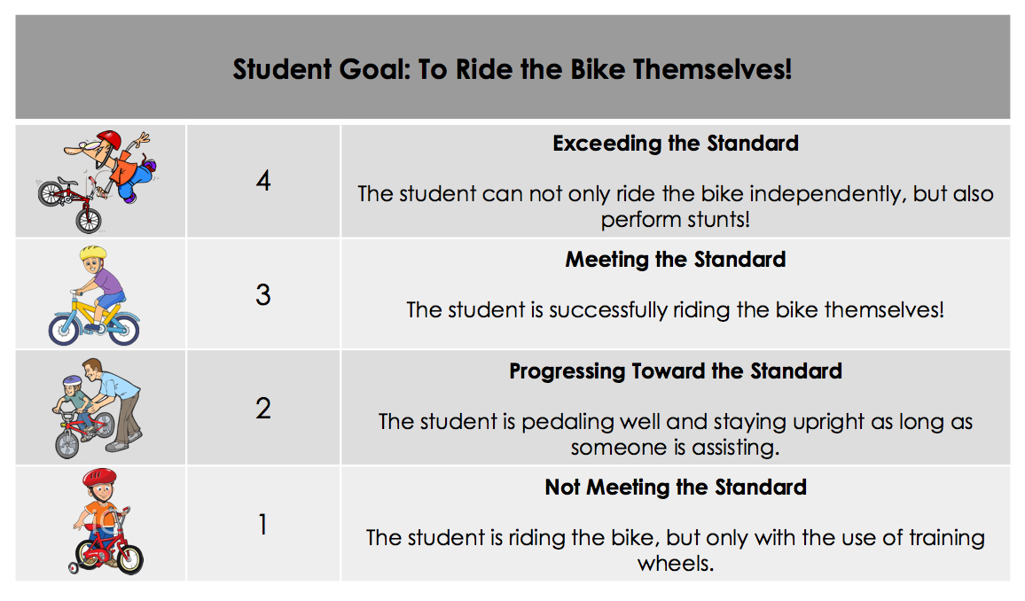
STANDARDS BASED GRADING
It is important to remember students learn at different rates and in different ways. Imagine a child learning how to ride a bike and the natural development of these skills. It may look something like this...

Slide 17
BEHAVIOR
At HES we use PBIS (Positive Behavior Incentive System) to encourage our students to behave appropriately. They will be rewarded with points for demonstrating positive behavior.
We remind our 2nd graders that each day is a new beginning, with opportunities to make choices about his or her behavior.
Key Concepts to Reinforce at Home
Respect
Responsibility
Readiness
These concepts are also the focus of the HES Positive Behavior Matrix.

Slide 18
PBIS Matrix
 | Classroom / Specials | Hallways / Walkways | Cafeteria | Bathrooms | Playground | Bus
I am.. READY I will… | * Be in my seat * Have materials ready * Eyes and ears on the speaker | * Pay attention | * Have my name tag, money, and/or lunch box ready | * Use bathroom at appropriate times * Return to class promptly | * Line up when the whistle blows/first signal * Enter the building at Level 0 | * Sit with bottom on seat, back on back of seat, and feet on floor * Stay seated * Listen carefully
I am… RESPECTFUL I will… | * Raise my hand to talk or ask questions. *Keep hands, feet, and other objects to myself *Listen to adults and follow directions *Use inside voice and kind words | * Silent/Level 0 * Walking feet * Keep hands and feet to myself *Follow traffic patterns | * Silent/Level 0 in serving line and first 10 minutes of eating *Indoor voices after the first 10 minutes * Walk and follow traffic patterns *Keep hands and feet to myself | * Respect privacy of others * Keep hands and feet to myself | * Keep hands, feet, and other object to myself * Play fair and share * Include others | * Listen to bus driver * Keep hands, feet, and other objects to myself * Use a quiet voice and kind words
I am… RESPONSIBLE I will… | * Use time appropriately/wisely * Do my best job/be proud of what I’ve done * Take care of the school and materials | * Stay with my class * Go only where I need to go *Walk safely | * Clean up after myself * Place trash, plates, bowls, and /or utensils in the proper place | * Use bathroom manners: flush, wash hands, clean up paper towels * Notify an adult about messes or broken items | * Use playground equipment properly * Play safely * Keep up with belongings | * Follow the bus rules * Keep my belongings in my backpack

Slide 19
ATTENDANCE / TARDY POLICY
Cabarrus County Schools stresses the importance of attendance, tardiness and early dismissals.
6 unexcused absences - Parent/guardian will be contacted by administration.
When a student must miss school, a written excuse from a parent or guardian must be presented to the teacher within two school days of the student’s return after an absence. Written excuses submitted beyond two school days will be subject to principal approval.
Attendance is taken the first 45 minutes of the virtual day. The children will have until the end of the day to complete assignments if they arrive after attendance has been taken. Attendance will then be updated for that day.

Slide 20
IMPORTANT INFORMATION AND REMINDERS
If your child is absent, please complete the Absence Form on the HES website under Parents. You may also send a written note or email with the excuse. https://www.cabarrus.k12.nc.us/domain/1561
Please be sure you have completed all Back to School forms online in Scribbles.

Slide 21
Questions?

Slide 22
Let’s Have a
Great Year!

