Slide 1

Health
The Subject That Saves Kids Lives

Slide 2
Health Risks for Adolescents
Centers for Disease Control
The following have been identified as the six serious health risks for adolescents by the CDC. These risks result in mortality, morbidity, and social problems and are all preventable.
1. Intentional and Unintentional Injuries
--suicide or attempts
--violence
--”accidents”
2. Lack of physical activity
3. Use of Tobacco
4. Sexual risk taking
5. Use of alcohol and other drugs
6. Poor dietary behaviors

Slide 3

Mental Health
6th:
Apply the decision making
process to real life situations
The three areas of health, how they are
related, and how to improve each area
Goal Setting
Coping with failure
Differentiate between positive and negative stress management strategies

Slide 4

Mental Health
7th:
Infer outcomes of impulsive behaviors
Interpret adolescent emotions in flux
Stress management strategies
Resources for treating common mental disorders
Seeking help for self destructive behaviors

Slide 5

Mental Health
8th:
Stress management strategies
Ways to deal with anxiety
Evaluating use defense mechanisms
Signs/symptoms of depression, suicide and self harming behaviors and ways to seek help

Slide 6
Personal & Consumer Health
6th:
Differentiate between communicable and chronic diseases
Incidence of disease and mortality over the decades
Protecting eyes and vision
Protecting ears and hearing
Asthma triggers/symptoms/control
Evaluate validity of health claims for products and services
Environmental health: reduce, reuse, recycle

Slide 7
Personal & Consumer Health
7th:
Importance of adequate sleep
Protecting your skin from sun exposure
Immune system parts and functions
Recognize quackery and evaluate health claims for services/products
Fire related injury prevention
Water related injury prevention

Slide 8
Personal & Consumer Health
8th:
Classifying risk factors for leading causes of death
Factors for chronic disease: asthma, epilepsy, allergies, and diabetes
Interpret health appraisal data to assess personal risk for preventable disease
Judge effects of body art: tattooing/piercing
Impact of behavior on environmental health
Hands only CPR (required for graduation) and the Heimlich maneuver

Slide 9
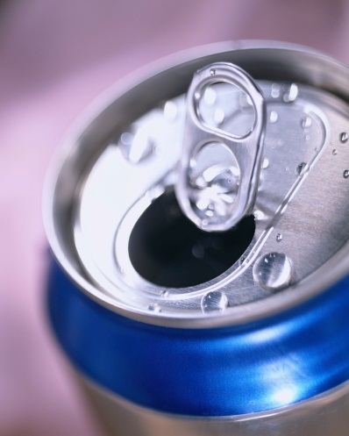
Nutrition
6th:
Preventing disease with healthy food choices
Implement a plan to consume more fiber
Developing a personal meal plan (height, weight, age, gender) using My Plate including proper portion sizes and nutrient group
Healthy beverage choices and how they can affect my health
Evaluate food facts label
Apply My Plate to ethnic and vegan choices

Slide 10
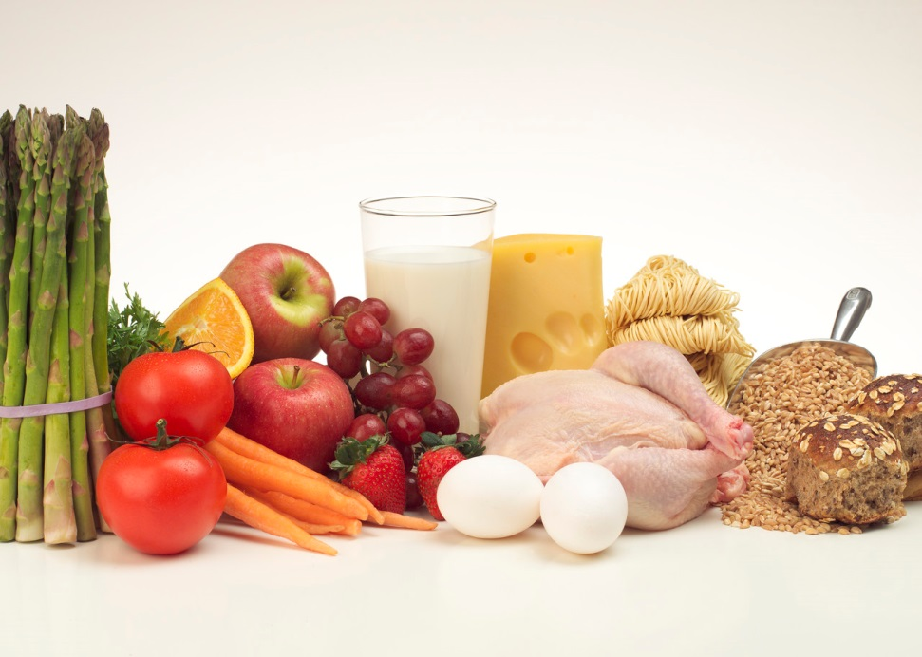
Nutrition
7th:
Dietary Guidelines/nutrient density
Analyze food facts labels
Benefits of consuming more water
Maintaining a positive body image to prevent risky eating behaviors

Slide 11

Nutrition
8th:
Planning healthy meals outside the home
Making diet choices according to caloric intake/expenditure
Calculate/interpret BMI
Causes, signs, and treatment of common eating disorders
Identify media and peer pressures that result in unhealthy weight control

Slide 12
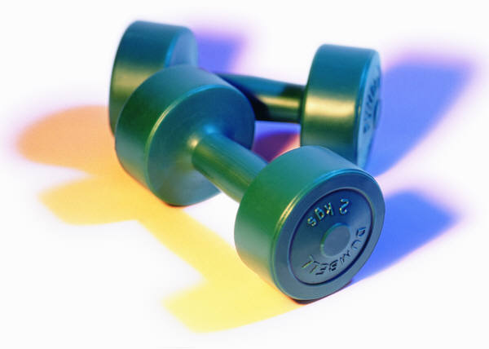
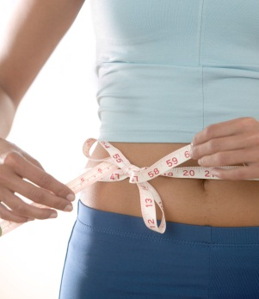
Fitness
6th: Create a personal fitness plan that addresses weight management and activity levels to enhance quality of life
7th: Design a personal goal for increasing activity levels and develop strategies for achieving those goals
8th:Summarize benefits of physical activity and create a personal fitness plan

Slide 13
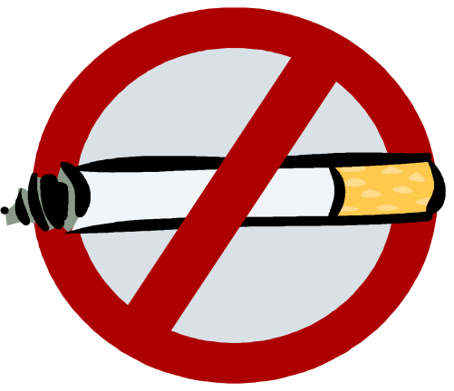
Substance Abuse
6th:
What are the dangers of tobacco products? How can I refuse tobacco products? What are the new tobacco products and what are their dangers? How does the media affect tobacco use? How does second hand smoke affect me?
Tobacco and alcohol in the media
The effects of drug use on relationships and long term goals
Refusal skills

Slide 14

Substance Abuse
7th:
Refusal Skills
Common sequence of substance abuse
Injection drug use
Abuse of OTC drugs
Explain how drug use is a barrier to personal goals
Ways to seek help for drug abuse

Slide 15
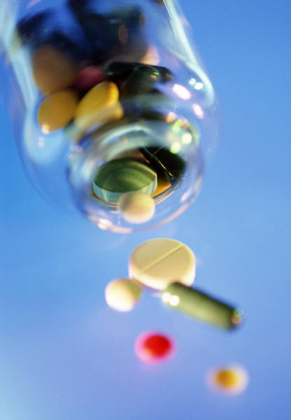
Substance Abuse
8th:
Categories of illegal drugs
How drug use affects the individual, families, communities, society
Review alcohol and tobacco
Identify positive alternatives to drug and alcohol use

Slide 16
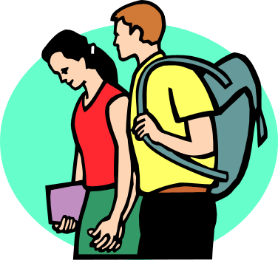
Reproductive Health & Safety
6th:
the parts and functions of the reproductive system
practicing good hygiene during puberty
explain impact of early sexual activity on all areas of health
refusal skills for sexual activity
conception and the menstrual cycle
social and emotional changes at puberty
**Girls and boys are separate

Slide 17
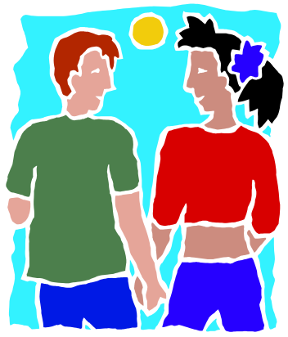
Reproductive Health & Safety
7th:
the functions of the reproductive system?
How can I spot, prevent, and report sexual harassment?
What are ways that HIV is transmitted and how can I prevent it? How does AIDS affect our society and others worldwide?
FDA approved methods of disease prevention
Contrast healthy and unhealthy relationships
Review benefits of abstinence
Explain effects of culture, media, family values on decisions about abstinence

Slide 18

Reproductive Health & Safety
8th:
the financial/legal/social/physical consequences of teen pregnancy?
the most and least effective methods of contraception for disease and pregnancy prevention
the nine months of pregnancy and the three stages of labor and delivery
Healthy vs. unhealthy friendships and dating relationships: communication for healthy relationships and how to get help for unhealthy ones
Ways to avoid being a victim of sexual abuse via digital media
Recall skills/strategies to abstain from sexual activity
Identify reasons for violent behaviors and resources for seeking help

Slide 19
The Healthy Youth Act- 2009
What does this mean for the curriculum?
Abstinence is still taught as a positive choice for young people and the best and most certain means of preventing sexually transmitted diseases and unintended pregnancy.
The law now includes FDA approved methods of preventing pregnancy and STDs. It also includes the prevention and reporting of sexual harassment and assault.

