Slide 1
Journal
Is there any sort of event is your life that has forced you to make personal changes? Describe this event and the changes you made.

Slide 2
Protestant Reformer Comparison
In your groups, review your notes on the Protestant Reformation.
Complete the chart on the back of yesterday’s notes as you discuss, being careful to identify where the church was founded, who established the church, and key basic beliefs of the church.
You may use the books on your table for additional assistance.

Slide 3
Reformation Map
Page 497
Where was the center of the Calvinist Movement?
What countries are the main centers of Calvinism?
What countries are the main centers of Lutheranism?
What countries are the main centers of Catholicism?
Where is Protestantism stronger, Southern or Northern Europe?

Slide 4
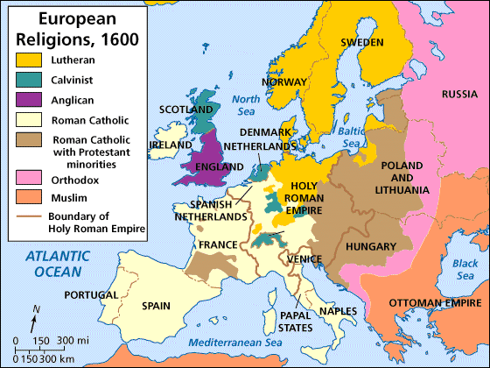

Slide 5
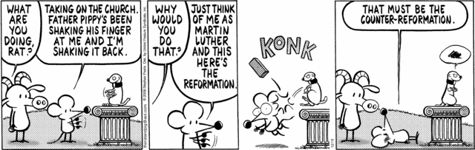
Counter Reformation
Based on the cartoon, in your own words, tell me what the Counter Reformation is.

Slide 6
Counter Reformation
(Catholic Reformation)
Definition: a movement to reform the Catholic Church and reduce the spread of Protestantism.

Slide 7
2 Phases
1. Jesuits – new monastic order started by Ignatius of Loyola that emphasized discipline and obedience
GOALS:
Found superb schools for priests (better training)
Convert non-Christians to the Catholic faith (Asia, Africa, Americas)
Prevent further spread of Protestantism

Slide 8
2. Council of Trent – meeting of all Catholic Church leaders to establish new reforms:
A. Pope’s interpretation of Bible was FINAL.
B. Christians were saved by faith AND good works
C. The Bible and Church tradition shared equal authority for guiding Christian life
D. Reaffirmed the use of indulgences but placed a ban of the selling of indulgences without express permission of the Church in Rome

Slide 9
Change leads to conflict!
The Inquisition tries Protestants for heresy.
France falls into civil war between Protestants and Catholics for the crown.
The Holy Roman Empire suffers the 30 Years’ War. Protestantism is firmly established.

Slide 10
Effects of the Protestant Reformation
Each Group Needs:
  A pair of scissors -
  A piece of paper – folded accordingly
Analyze and organize each document into a category: religious, political, social, valid, not valid.
Answer the following questions:
  What do the documents tell us about the validity of the statement? Does it support or dispute the statement? Why?

Slide 11
Creative Ranking
With a partner, rank the events provided in order of importance: 1 – most important, 6 – least important.
Cut out and paste your events on the provided paper.
Below the event, justify why each event belongs where it is placed.
Turn in to Mrs. Pleasants!

Slide 12
Facebook Invite
Final section!
  On your final template, create an invite to one of the following:
    Council of Trent
    Peace of Augsburg
  Include a picture, even name, date, time, location, and who you would be invited by.
Make 3 wall posts: one for each of your profile figures.

