Slide 1
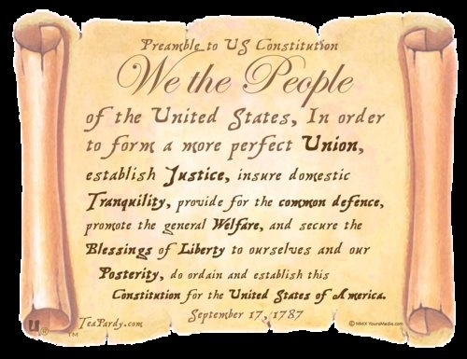

Slide 2
“If men were angels, no government would be necessary.”
-James Madison

Slide 3
Welcome to Unit 3!
Here are the essential questions for this unit:
  Are political parties good for a nation?
  Should national interests be put above regional and individual wants and needs? (National problems over state problems)
  Should the majority always rule?

Slide 4
The Constitutional Convention

Slide 5
THEMES OF THE DAY
The Founding Fathers call for a change to the Articles
Americans disagree on how to go about creating a new stronger federal government
Compromise helps bring the different ideas together
Our Constitution is created, but is the hard part over?

Slide 6
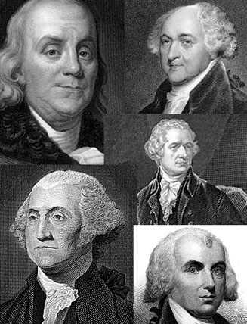
The Nationalists
Nationalists were those Americans who supported the idea of strengthening the central government
They included George Washington, John Adams, James Madison, Alexander Hamilton, Benjamin Franklin, & Robert Morris

Slide 7
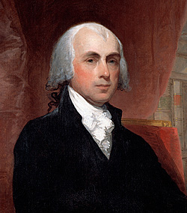
A Call for Change
In 1786, James Madison convinced the Virginia legislature to organize a convention of the states to discuss economic issues such as trade, tariffs, & taxation

Slide 8
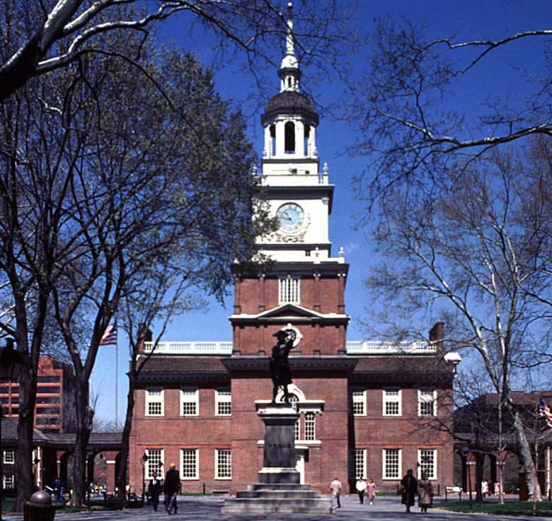
A Call to Convention
Congress agreed to call a convention, primarily because of the threat posed by Shays’ Rebellion and other episodes of civil unrest
Every state except Rhode Island met in Philadelphia in May of 1787 “for the sole purpose of revising the Articles of Confederation”

Slide 9
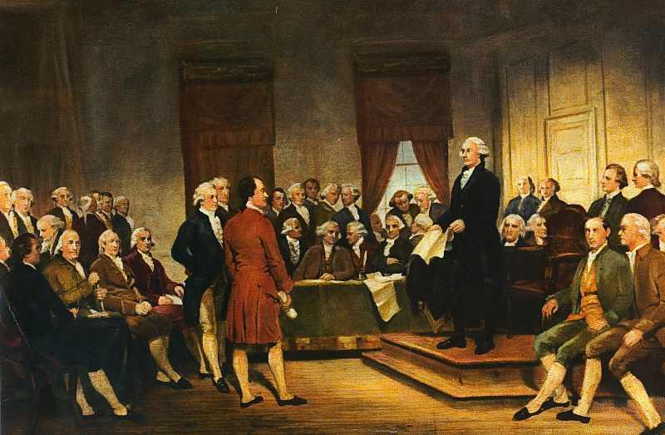
The Constitutional Convention
The 55 delegates at the Convention included 7 former governors, 39 members of Congress, and 8 who had signed the Declaration of Independence
They chose George Washington to serve as presiding officer of the Convention

Slide 10
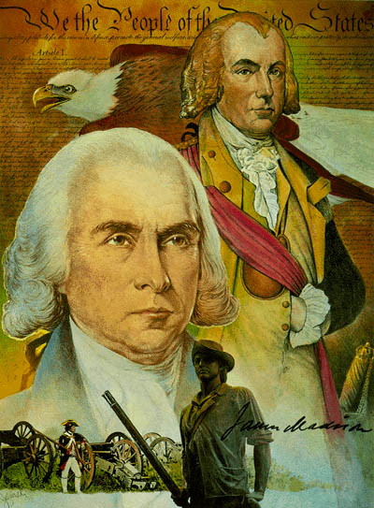
Behind Closed Doors
It was decided to keep the Convention closed to the public, to ensure no political factors could corrupt the debate
James Madison tasked himself with keeping a record of the debates between the delegates

Slide 11
Two plans emerge from the convention

Slide 12

The Virginia Plan
The Virginia delegates proposed a complete overhaul of the national government
Their plan, designed by James Madison, called for scrapping the Articles of Confederation and starting over completely with a new guiding document which would grant the central government much greater powers

Slide 13
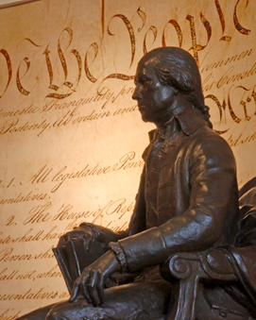
The Virginia Plan
The Virginia Plan would give the new federal government the power to raise money through levying taxes and the power to create laws which all states would be legally bound to follow

Slide 14
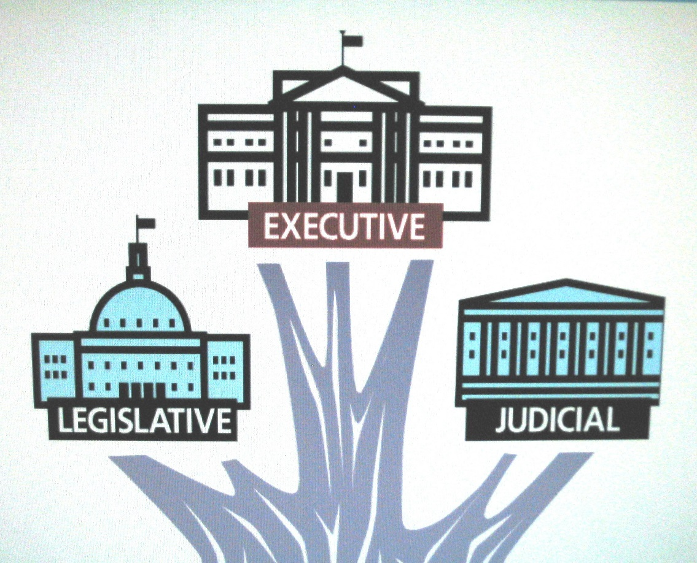
The Virginia Plan
The Virginia Plan also called for dividing the government across three branches: executive, legislative, and judicial
The legislative branch would then be divided into two houses, an “upper” and “lower”

Slide 15
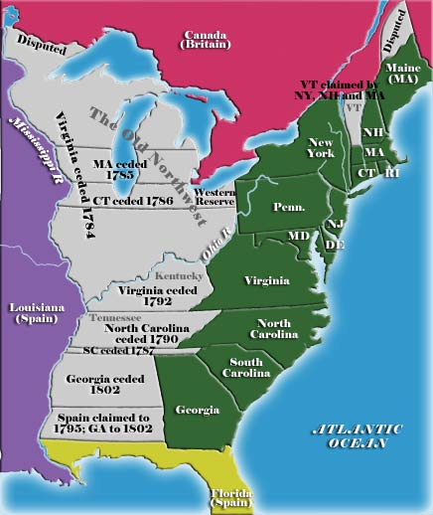
The Virginia Plan
The number of representatives in each house would be determined by each state’s population, thereby giving the more populous states more influence in the making of laws and levying of taxes

Slide 16
What type of states will object to the Virginia Plan?

Slide 17
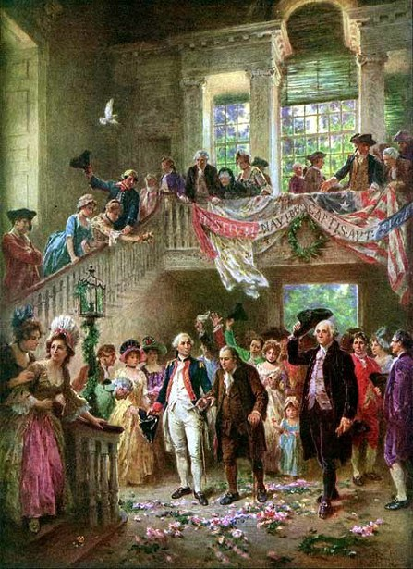
The “Small” States Object
While most delegates accepted the structure of the Virginia Plan, the smaller states objected to a legislature in which they would get less representation
As a result, they refused to support the Virginia Plan

Slide 18

The New Jersey Plan
New Jersey’s William Paterson responded with a plan which kept the Articles of Confederation in place, but with modifications which would give the central government more powers, such as taxation and the ability to regulate trade

Slide 19
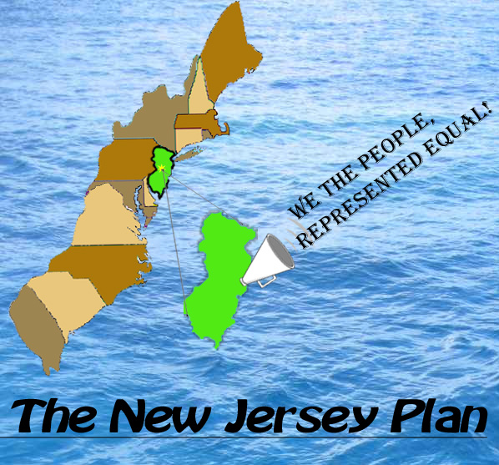
The New Jersey Plan
The New Jersey Plan accepted the idea of a three-branch government, however, it kept Congress as a single house where each state had equal representation
The executive branch would be elected by Congress and the judiciary would be appointed by the executive

Slide 20
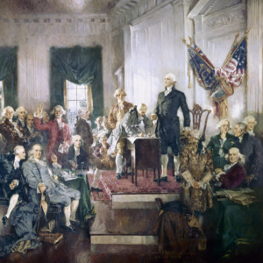
Virginia Plan Wins
After much debate, the Convention voted to pursue the Virginia Plan, abandoning the Articles of Confederation
This vote meant that they would have to write an entirely new constitution for the United States

Slide 21
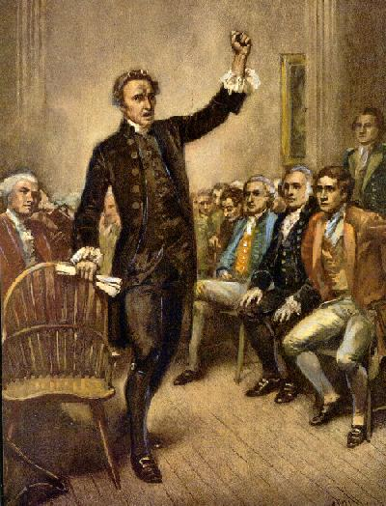
“Small” States Object
After the vote, small states continued to push for equal representation in Congress, prompting the larger states to threaten a walk out.
Eventually, it was decided to create a special committee of moderates, led by Benjamin Franklin, to work out some sort of compromise

Slide 22
How will they resolve this problem?

Slide 23
com·pro·mise
ˈkämprəˌmīz/ noun
1. an agreement or a settlement of a dispute that is reached by each side making concessions

Slide 24
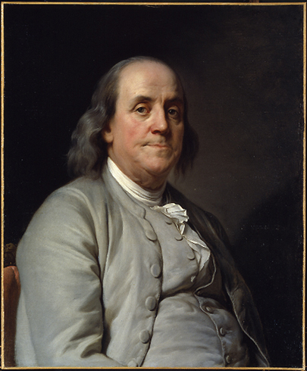
The Great Compromise
The resulting recommendation by Franklin’s committee became known as the “Great Compromise” or the Connecticut Compromise (since it was based on an idea by Roger Sherman of Connecticut)

Slide 25
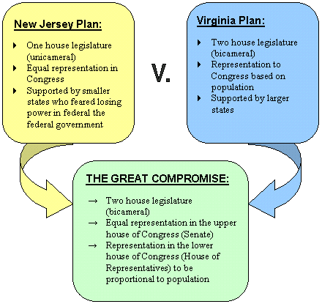
The Great Compromise
The Compromise proposed basing representation in one house of Congress (the House of Representatives) on population, and allowing the voters in each state to elect their representatives
The other house (the Senate) would have equal representation for all states, and senators would be appointed by the state legislatures

Slide 26
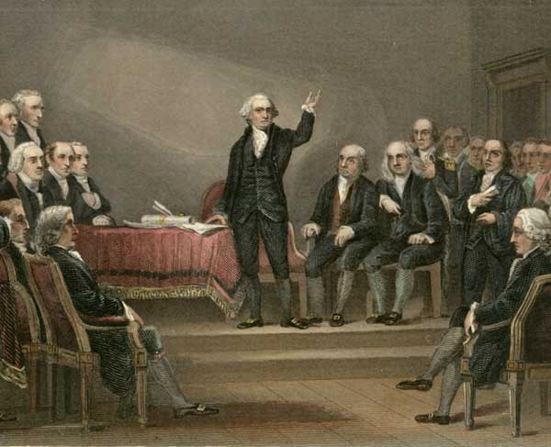
The Great Compromise
In the House of Representatives, each state would get 1 representative for every 40,000 people in the state
This caused another argument to erupt – should slaves count towards population?

Slide 27
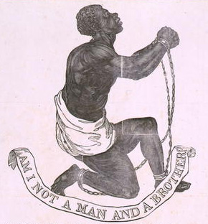
3/5ths Compromise
Southern states wanted slaves counted because slaves accounted for a sizeable percentage of their population
Northern states did not believe slaves should be counted because they were not citizens and could not vote

Slide 28
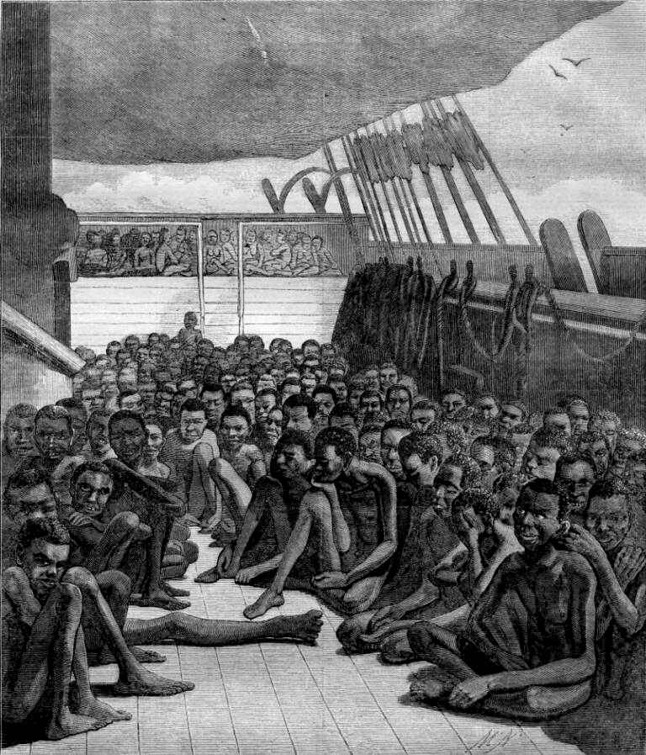
Slaves & Taxation
Northern states also argued that if slaves were going to be counted for purposes of representation, then they should also be counted for purposes of taxation

Slide 29
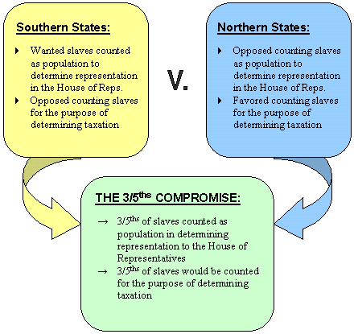
The 3/5ths Compromise
In the end, an agreement was reached to count 3/5ths of slaves for purposes of both representation and taxation
Once this issue was resolved, northern and southern states were able to settle several other disagreements as well

Slide 30
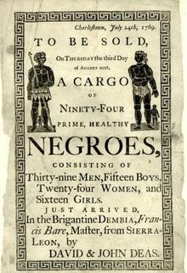
Final Compromises
It was agreed that the new national government would not be empowered to tax exports (southerners worried about exported farm goods such as tobacco and cotton being taxed) or be allowed to ban the slave trade prior to 1808

Slide 31
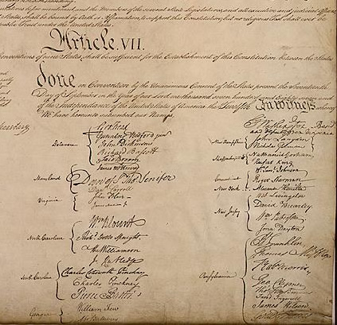
The Convention Closes
By mid-September, all of the compromises had been completed and the Constitution of the United States had been completed
It was signed by 39 delegates and sent to the Confederation Congress for approval

Slide 32
Is the hard part over?

Slide 33
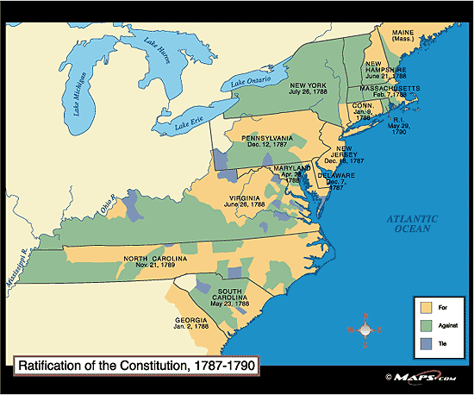
Ratification?
Once Congress signed off, it was then submitted to the states for ratification – and a whole new round of debate would begin in the sphere of public opinion

Slide 34
The Constitution
&
LEJSASR mnemonic device

Slide 35
Short Response
What does it mean to "compromise"?
In detail, describe a time when you had to reach a compromise with someone else.
Essay Format: No Numbering, minimum half page in length.

