Slide 1
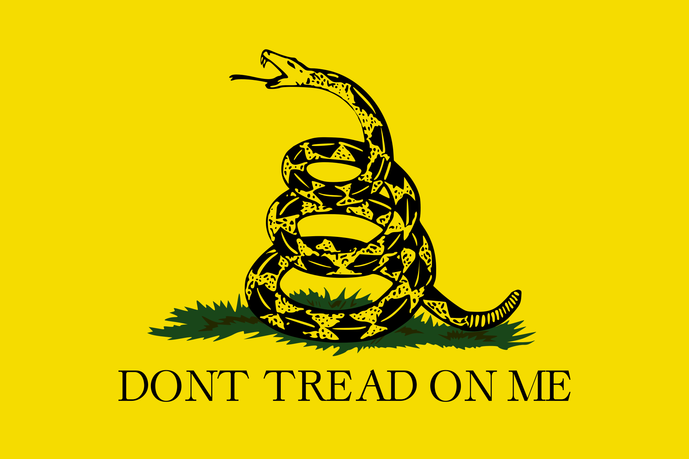

Slide 2
Quote of the Day
“Old minds are like old horses; you must exercise them if you wish to keep them in working order.”
-John Adams

Slide 3
UNIT 2: TYRANNY, OPPRESSION AND REVOLUTION

Slide 4
Tyranny: the unrestrained, unjust use of power

Slide 5
Oppression: prolonged cruel or unjust treatment

Slide 6
Revolution: forcible overthrow of a government or social order

Slide 7
The Colonists Become Defiant

Slide 8
The French and Indian War is over. Does this mean no more violent conflict?

Slide 9
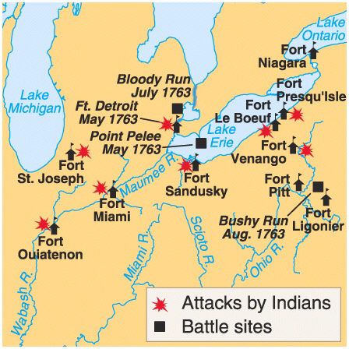
Pontiac’s Rebellion
Just as the French & Indian War was ending, the Ottawa chief Pontiac led an uprising of the Ottawa, Delaware, Shawnee, and Seneca tribes against the British, burning several towns and settlements along the frontier
Eventually treaties between the Indians and British were made and the fighting ended

Slide 10
England has to do something about violent conflict with Native Americans! What options do they have?

Slide 11
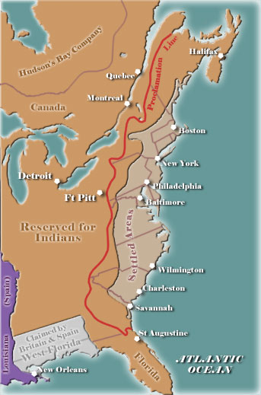
Proclamation Act of 1763
Not wanting to fight future wars with the Indians (and also not wanting to disrupt the lucrative fur trade in the Great Lakes region), King George issued the Royal Proclamation of 1763, declaring colonists could not settle west of the Appalachians
This angered many colonists along the frontier who believed that the French & Indian War had been fought to make those very lands available to settlers
Will this anger people?
Will people obey this law?

Slide 12
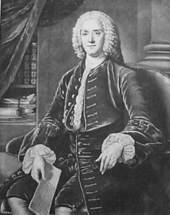
British War Debt
Britain needed to find a way to pay off the debt from fighting the Seven Years’ War and to cover the cost of keeping 10,000 soldiers stationed in North America
New Prime Minister George Grenville looked to the Colonies to help generate revenues to lessen the economic strain on England

Slide 13
Prior to The French & Indian War, what was the relationship between Britain and the colonies?

Slide 14
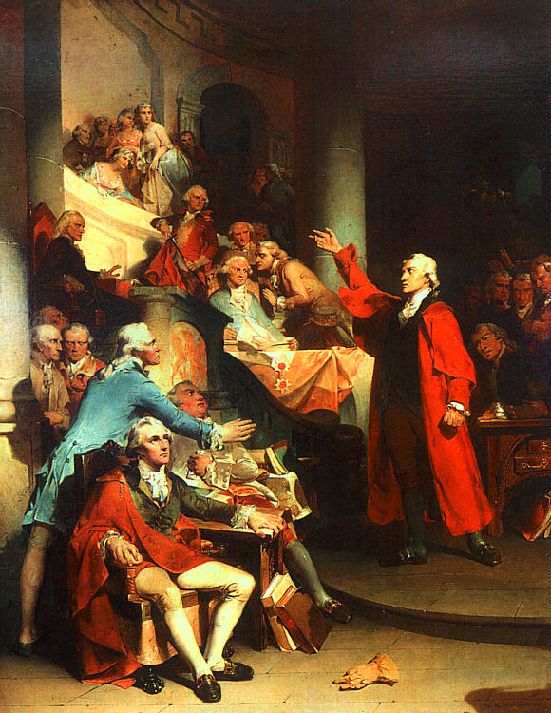
Salutary Neglect
Britain had long practiced a policy towards the Colonies of “salutary neglect,” or leaving them to go their own way and allowing them to mostly govern themselves
Even such rules as were put in place by Parliament had been rarely enforced

Slide 15
No more Salutary Neglect! The British need revenue!

Slide 16
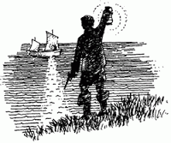
Customs Reforms
One major source of revenue was customs duties on goods imported to the Colonies, but smuggling was cutting into customs revenues
To cut down on smuggling, Grenville passed a law requiring smugglers to be tried by military, rather than civilian courts

Slide 17
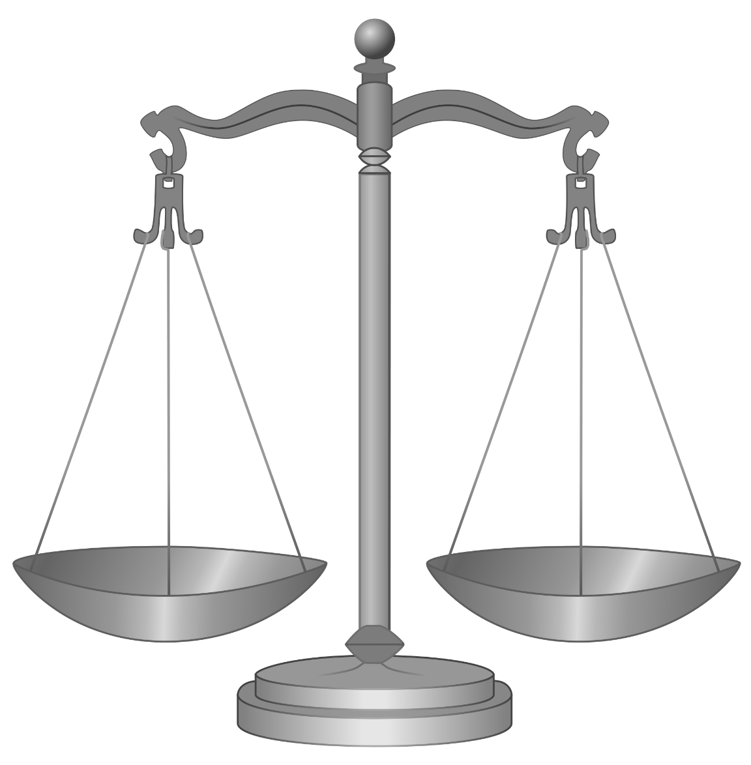
Unfair Trials?
Colonists argued that the smuggling trials were unfair because they did not follow English common law, allowed no trial by jury, and were too distant (being in Canada) to allow for a speedy trial
Enlightenment, English B.O.R.

Slide 18
Even Founding Fathers were not safe…

Slide 19
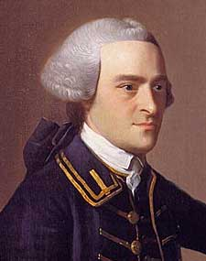
John Hancock
One of the more famous colonists tried in the new court was businessman John Hancock, who had become wealthy smuggling sugar and molasses into New England
Through the help of his lawyer, John Adams, Hancock was never convicted, although one of his ships was confiscated

Slide 20
Prior Knowledge!!
Identify all of the TAXES imposed by the British that you remember from past history classes?

Slide 21
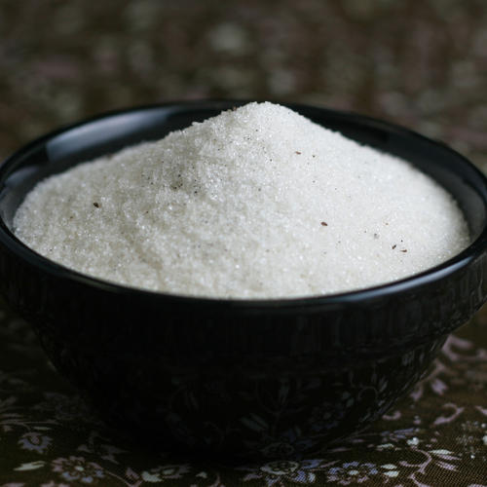
The Sugar Act of 1764
Grenville also approved the American Revenue Act of 1764 (commonly called The Sugar Act) which raised the tax rate on sugar, as well as numerous other goods imported to the Colonies

Slide 22
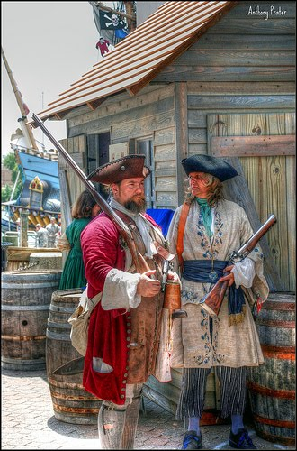
The Sugar Act
The Act also declared those accused of smuggling to be guilty until proven innocent, allowed for the seizure of goods without due process, and banned merchants from suing for the return of their goods if confiscated
Enlightenment, English B.O.R.

Slide 23
Colonists will protest, “No Taxation Without ___________?”

Slide 24
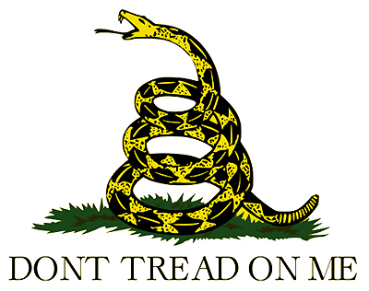
“No Taxation Without Representation”
American merchants were livid at these violations of their rights as English citizens
They also began to challenge Parliament’s right to levy taxes against colonists on the basis that the Colonies had no representation in Parliament – hence the motto, “no taxation without representation”

Slide 25
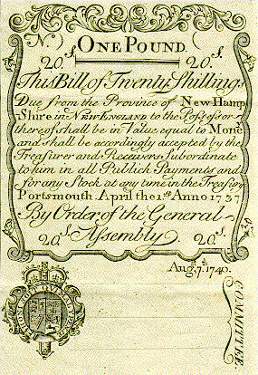
The Currency Act of 1764
Grenville also approved the Currency Act of 1764
This act banned the use of paper money in the Colonies in an effort to control inflation, but angered colonists because it restricted the money supply and made it much harder for them to both borrow money and to pay off debts

Slide 26
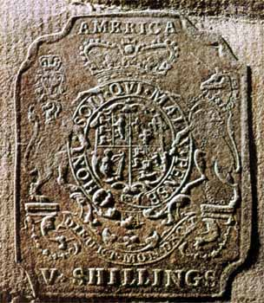
The Stamp Act of 1765
First direct tax on colonists (previous taxes had been on trade)
Required that a “stamp” be placed on all printed goods, such as newspapers, posters, wills, deeds, licenses, diplomas, and playing cards
The “stamp” was just a mark showing that a tax had been paid

Slide 27
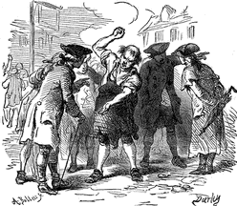
The Quartering Act of 1765
Required the Colonies to provide barracks for the housing of British soldiers
If the barracks were not provided, then soldiers would be housed in taverns, inns, and other personal properties, at the Colonies expense

Slide 28
Colonial Resolutions
The Stamp and Quartering Acts led numerous colonial assemblies, including Virginia’s House of Burgesses, to issue resolutions declaring Parliament’s actions to be a violation of the colonists’ rights as English citizens

Slide 29
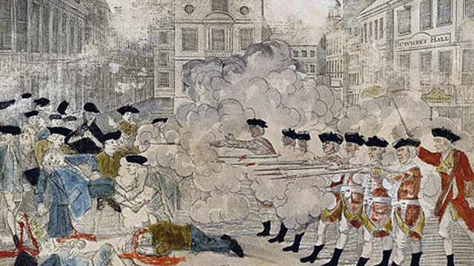
End Part 1

Slide 30
Grab a Chrome Book!

Slide 31
Quote of the Day
“Government, even in its best state, is but a necessary evil; in its worst state, an intolerable one.”
-Thomas Paine

Slide 32
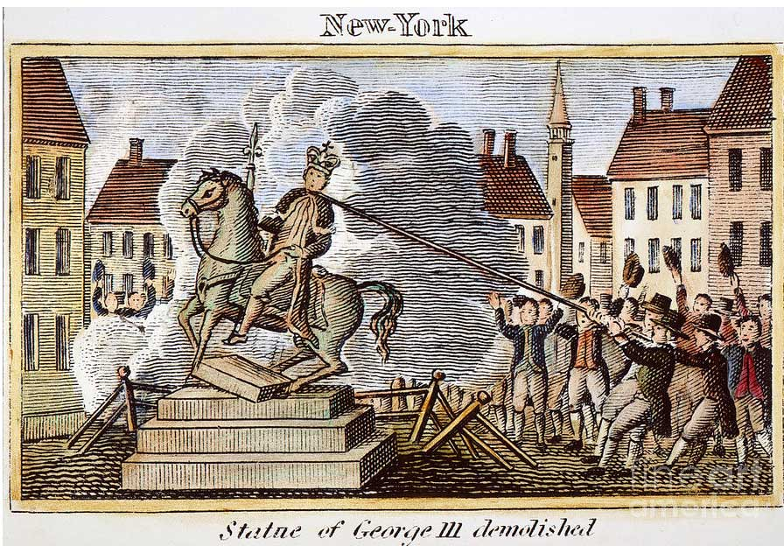

Slide 33
Themes of Todays PPT
More Taxes
Protest grows
More taxes
Groups being to organize in Protest
Intro to some founding fathers
Tension grows
Violence breaks out

Slide 34
Let the Protests Begin!

Slide 35
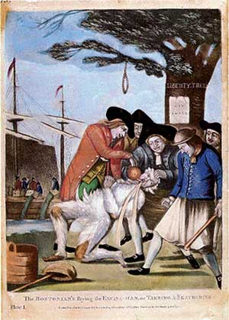
The Sons of Liberty
Protest group created in Connecticut in 1765 by a merchant named Isaac Sears
Organized meetings and protests against the Stamp Act
Used terror tactics to intimidate English tax collectors – threatened them with violence, burned their homes
Group quickly had branches throughout the Colonies

Slide 36
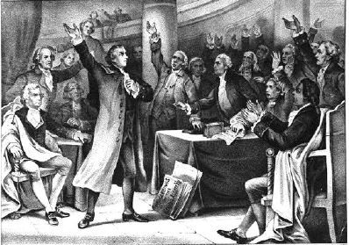
The Stamp Act Congress
Representatives from throughout the Colonies met in October 1765 and issued the Declaration of Rights and Grievances
Petitioned King George and Parliament to repeal the taxes on the grounds that Parliament had no right to tax the Colonies without allowing them representation

Slide 37
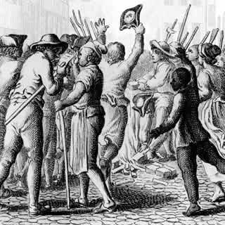
Boycotts
To avoid the Stamp Act and other taxes, colonists enacted a boycott against any goods the British had tried to tax
Particularly damaging, was their refusal to buy imported tea or British cloth, both of which damaged the English economy

Slide 38
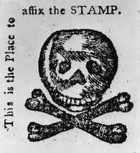
Boycotts Lead to Repeal
The boycott led to high unemployment rates in England and badly hurt English merchants’ profits, leading the English themselves to pressure Parliament to repeal the Stamp Act
Parliament finally did so in 1766

Slide 39
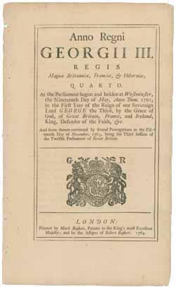
Declaratory Act of 1766
After being forced to repeal the Stamp Act, however, Parliament retaliated with the Declaratory Act
This act stated that Parliament had the power to make laws for and impose taxes upon the Colonies

Slide 40
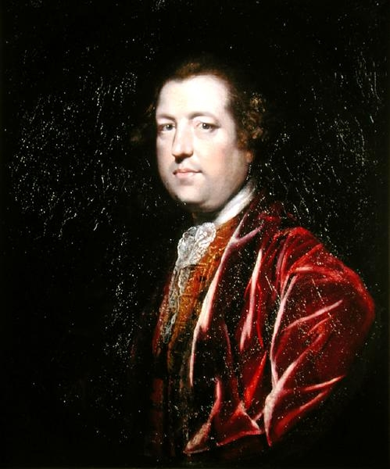
The Townshend Acts
The economic crisis in England had led to a drop in tax revenues there, prompting Parliament to seek even more revenues from the Colonies
Charles Townshend, Chancellor of the Exchequer, introduced a series of new laws aimed at the Colonies, starting in 1767

Slide 41
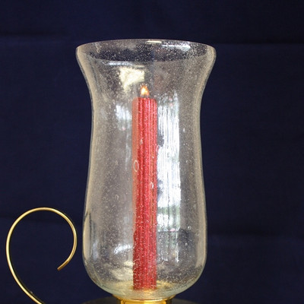
The Townshend Acts
Levied new taxes on glass, lead, paper, paint, and tea imported into the Colonies
Violators were treated as smugglers and tried in the military courts
Customs officials were allowed to enter any property via “writs of assistance” to search for evidence of smuggling without a warrant

Slide 42
How many Founding Fathers have we discussed in this class so far?
(3)

Slide 43
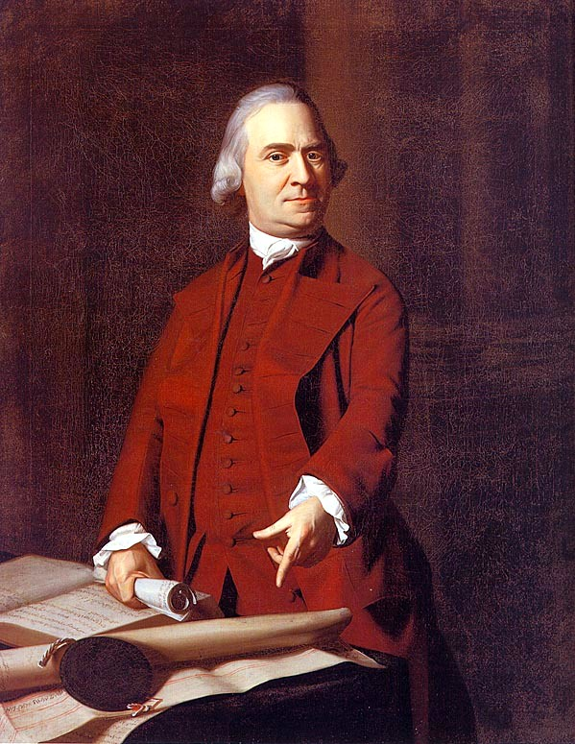
Sam Adams
Businessman Sam Adams drafted a “circular letter” of protest against the Townshend Acts which was signed by the members of the Massachusetts Assembly
The letter once again argued that Parliament had no right to tax the Colonies

Slide 44
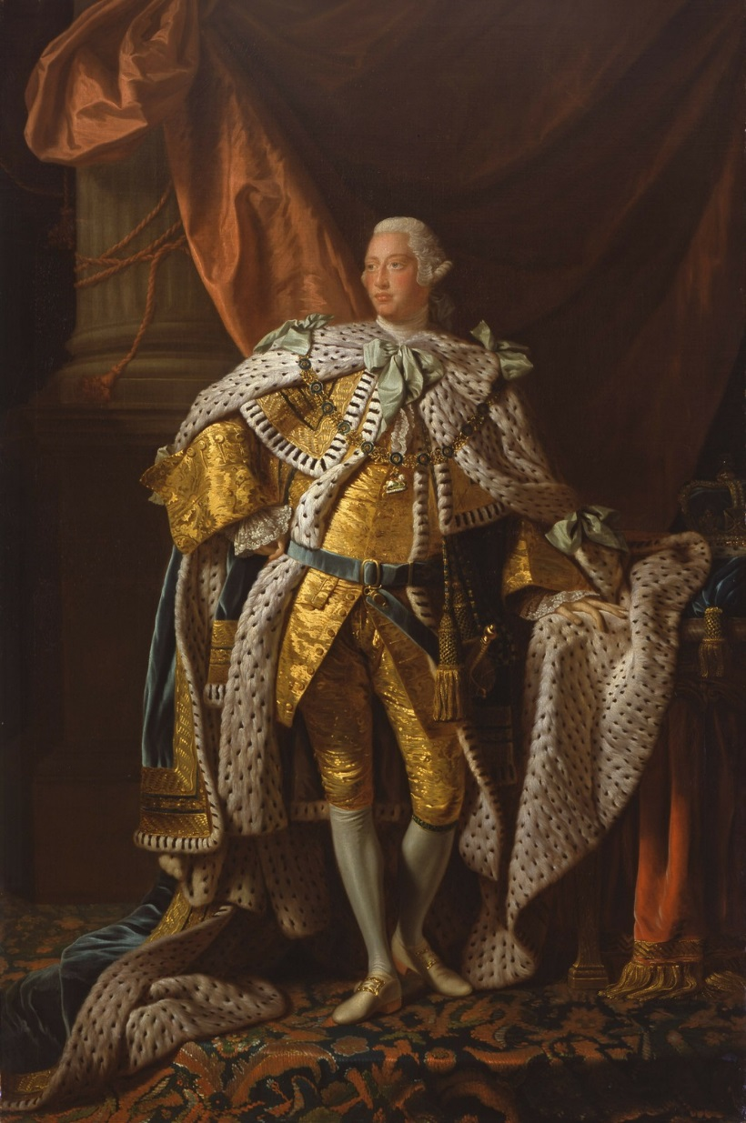
British Response
British officials demanded that the Massachusetts assembly withdraw their letter of complaint, but the assembly refused
In response, the British government ordered the assembly dissolved

Slide 45

More Boycotts
Merchants in Boston, New York, and Philadelphia then banded together and signed non-importation agreements, further strengthening the boycott against British goods and worsening the economic crisis

Slide 46
The Virginia Resolves
In May 1769, the Virginia House of Burgesses declared that only they had the right to tax Virginians
The Royal Governor dissolved the House in response, but, under the leadership of George Washington, Patrick Henry, and Thomas Jefferson, they refused to disband and instead passed a law blocking the sale of British-made goods in Virginia

Slide 47
What role did Women play in the protests?

Slide 48
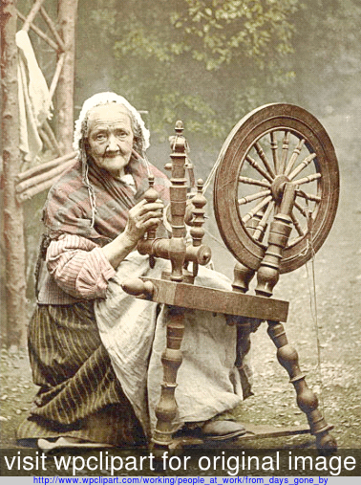
The Daughters of Liberty
Women also supported the boycott by refusing to drink tea and by spinning their own “homespun” cloth to avoid buying British cloth
Suddenly, wearing rough “homespun” became a public display of defiance

Slide 49
The first example of violence in the struggle between the colonists and the British….

Slide 50
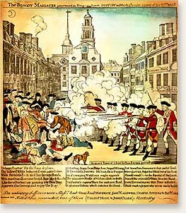

Slide 51
The Boston Massacre
March 5, 1770: Angry colonists in Boston confronted British soldiers guarding a customs house, they began to taunt the “Red Coats” and throw snowballs resulting the soldiers opening fire on the crowd
6 colonists were killed and 6 were wounded in what came to be known as the Boston Massacre

Slide 52
To make matters worse…

Slide 53
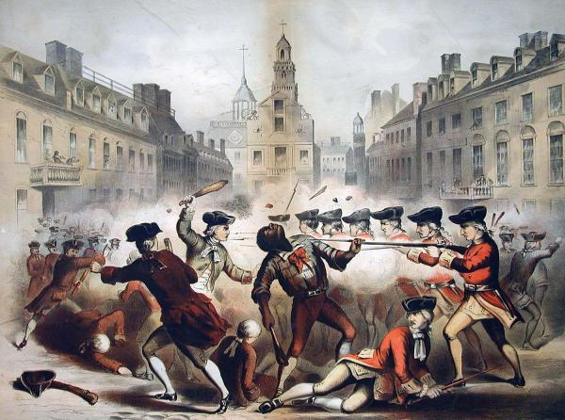
The Boston Massacre
The soldiers involved were charged with murder and put on trial
Colonists were further enraged when the soldiers were all either acquitted or convicted of the much lesser charge of manslaughter thanks to the work of their American lawyer, John Adams

Slide 54
How will the British deal with this crisis?

Slide 55
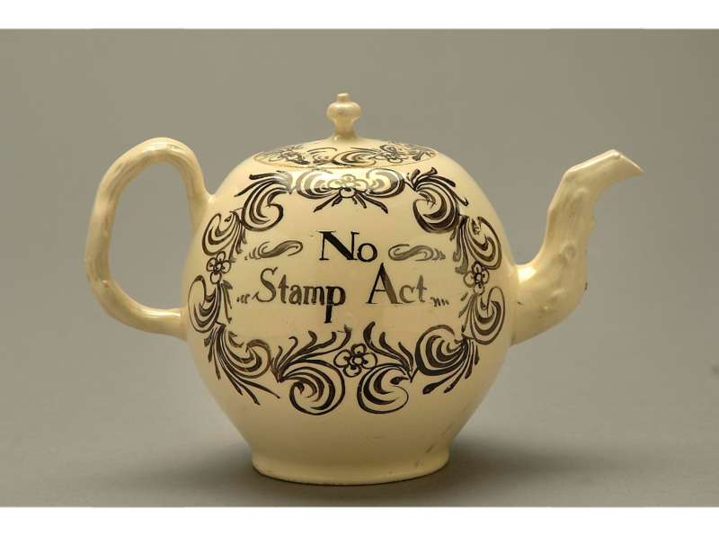
Repeal of Townshend Acts
Tensions were temporarily eased when Parliament announced the repeal of nearly all of its taxes aimed at the Colonies
Parliament left only the tax on tea in place, as a symbol of its right to levy taxes in America

Slide 56
How will colonists protest this tax on tea?

Slide 57
Taxation: Short Response
  1. Define “Taxes”
  2. Who should pay taxes in America today? Why them and not others? Be specific!
  3. What products should be taxed? Why those and not others? Be specific!
  4. What percentage of one’s income should be taxed? Explain, Be specific.
  4. Is it important to tax the wealthy at a higher rate than others? Why or Why not?
  150 Words

