Slide 1
climate change

Slide 2
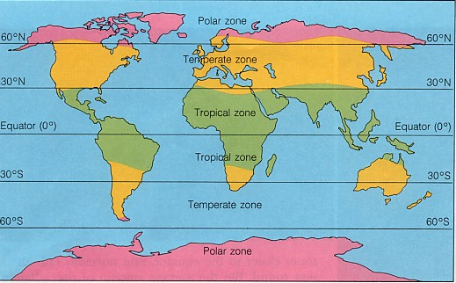
Climate Zones by Latitude

Slide 3
What is Climate Change?
Throughout its history, Earth has experienced climate change. Ice ages have come and gone. (so have organisms)
If the climate doesn’t remain constant, we call it climate change. But we generally refer to it as a rise in average surface temperatures on Earth.

Slide 4
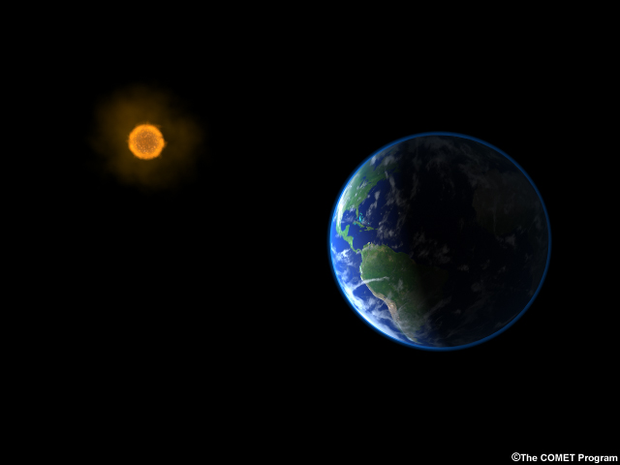

What PROCESSES/FACTORS CAUSE CLIMATE CHANGE?
Changes in:
  (1) The sun’s output and (2) changes in Earth’s orbit have already been mentioned as factors that affect climate and climate change.
  As (3) continents have drifted through different climate zones throughout Earth’s history, climates have changed. This may explain why some plants and animals went extinct.
Notes:
Scientists have a good understanding of what has changed earth’s climate in the past:
Incoming solar radiation is the main climate driver. Its energy output increased about 0.1% from 1750 to 1950, increasing temperatures by 0.2°F (0.1°C) in the first part of the 20th century. But since 1979, when we began taking measurements from space, the data show no long-term change in total solar energy, even though Earth has been warming.
Repetitive cycles in Earth’s orbit that occur over tens of thousands of years can influence the angle and timing of sunlight.
In the distant past, drifting continents make a big difference in climate over millions of years by changing ice caps at the poles and by altering ocean currents, which transport heat and cold throughout the ocean depths.
Huge volcanic eruptions can cool Earth by injecting ash and tiny particles into the stratosphere.
Changes in the concentration of greenhouse gases, which occur both naturally and as a result of human activities, also influence Earth’s climate.

Slide 5
What changes climate?
(4)Volcanic eruptions emit some gases and particles that can cause sunlight to be reflected away from the Earth, resulting in global cooling.
Other gases emitted, like CO2, may cause warming by contributing to the Greenhouse Effect.
Notes:
Scientists have a good understanding of what has changed earth’s climate in the past:
Incoming solar radiation is the main climate driver. Its energy output increased about 0.1% from 1750 to 1950, increasing temperatures by 0.2°F (0.1°C) in the first part of the 20th century. But since 1979, when we began taking measurements from space, the data show no long-term change in total solar energy, even though Earth has been warming.
Repetitive cycles in Earth’s orbit that occur over tens of thousands of years can influence the angle and timing of sunlight.
In the distant past, drifting continents make a big difference in climate over millions of years by changing ice caps at the poles and by altering ocean currents, which transport heat and cold throughout the ocean depths.
Huge volcanic eruptions can cool Earth by injecting ash and tiny particles into the stratosphere.
Changes in the concentration of greenhouse gases, which occur both naturally and as a result of human activities, also influence Earth’s climate.

Slide 6
What changes climate?
(5) Greenhouse Effect
(6) Heat Islands
(7) Carbon Sources
(8) Carbon Sinks
These will be explained in upcoming slides.
Notes:
Scientists have a good understanding of what has changed earth’s climate in the past:
Incoming solar radiation is the main climate driver. Its energy output increased about 0.1% from 1750 to 1950, increasing temperatures by 0.2°F (0.1°C) in the first part of the 20th century. But since 1979, when we began taking measurements from space, the data show no long-term change in total solar energy, even though Earth has been warming.
Repetitive cycles in Earth’s orbit that occur over tens of thousands of years can influence the angle and timing of sunlight.
In the distant past, drifting continents make a big difference in climate over millions of years by changing ice caps at the poles and by altering ocean currents, which transport heat and cold throughout the ocean depths.
Huge volcanic eruptions can cool Earth by injecting ash and tiny particles into the stratosphere.
Changes in the concentration of greenhouse gases, which occur both naturally and as a result of human activities, also influence Earth’s climate.

Slide 7
5. The greenhouse effect

Slide 8
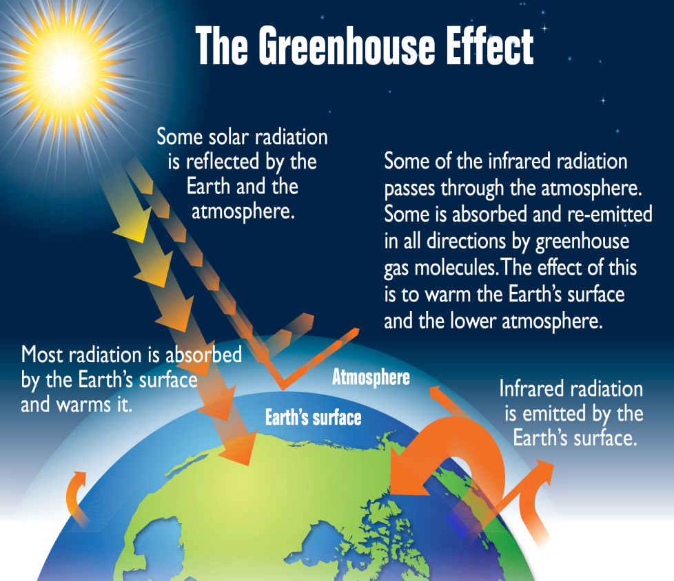
The Greenhouse Effect
When sunlight reaches the surface of the Earth, some of it is absorbed, which warms the ground, and some bounces back to space as heat.
The greenhouse effect increases the temperature of the Earth by trapping heat in our atmosphere. Greenhouse gases that are in the atmosphere absorb, and then redirect some of this heat back towards the Earth. The more greenhouse gases you have in the atmosphere, the more heat stays on Earth.
This keeps the temperature of the Earth higher than it would be if direct heating by the Sun was the only source of warming. Watch the NASA video and answer the questions.
NASA Video
Greenhouse gases:
Water Vapor – H₂O_{(v}
CO₂
Methane – CH₄
_{Nitrous Oxides}
_{CFC’s}
_{Fluorinated gases}

Slide 9
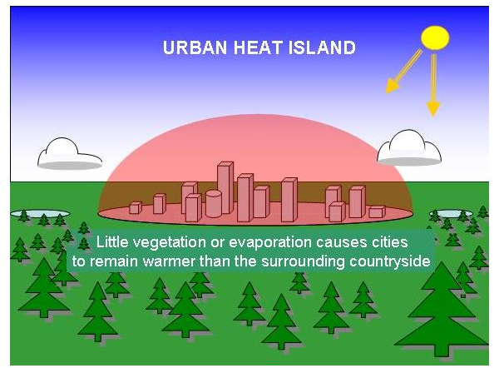
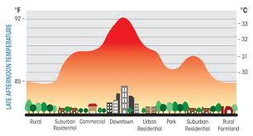
6. Urban Heat Islands
An urban heat island, or UHI, is a metropolitan area that's a lot warmer than the rural areas surrounding it. Heat is created by energy from human activities: cars, buses, trains, lots of pavement (asphalt) and buildings, lack of trees and large vegetative areas. Urban heat islands occur in areas that have lots of activity and lots of people.

Slide 10

Carbon Sources and Sinks
SOURCES
SINKS
A carbon source is anything that releases more carbon than it absorbs.
A carbon sink is anything that absorbs more carbon than it releases.
The Carbon Budget
carbon sources- carbon sinks= ???

Slide 11
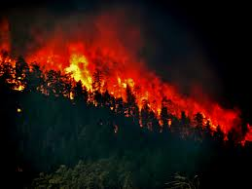
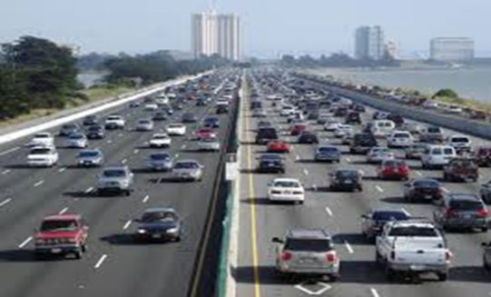
7. Carbon Sources
Natural
Human Induced
Volcanic eruptions
Wildfires
Organic combustion/ decomposition (decay of plant and animal matter)
Burning of fossil fuels
Deforestation
Reduction in wetlands

Slide 12
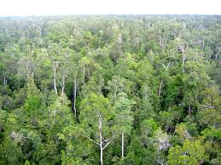
8. Carbon Sinks
Natural Carbon Sinks
What are humans doing to each of these sinks to change their ability to absorb carbon? Why?
Plants/ Forests
Oceans
Wetlands
Notes:
Teacher notes:
Forests- Destruction of wood for fuel, grazing cattle
Oceans- Increase in temperature causes them to lose their ability to absorb carbon. Ie. A cold ocean absorbs more than a warm one.
Wetlands- Being dubbed as “swamps”, often this land is paved over and utilized for urban activities.

Slide 13
deforestation
Natural Carbon Sinks – Forests and Plants
What are humans doing to each of these sinks to change their ability to absorb carbon? Why?
Vegetation helps to cool the atmosphere through the absorption of carbon dioxide and the process of transpiration. Removing trees and vegetation eliminates these processes, not to mention that deforestation and lack of vegetative buffers around bodies of water increases soil erosion.
Notes:
Teacher notes:
Forests- Destruction of wood for fuel, grazing cattle
Oceans- Increase in temperature causes them to lose their ability to absorb carbon. Ie. A cold ocean absorbs more than a warm one.
Wetlands- Being dubbed as “swamps”, often this land is paved over and utilized for urban activities.

Slide 14
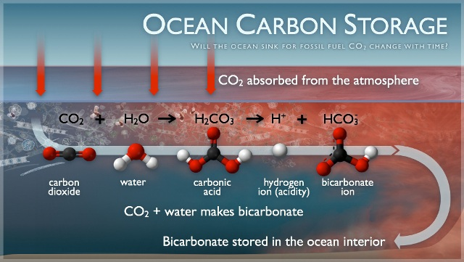
What are humans doing to each of these sinks to change their ability to absorb carbon? Why?
Natural Carbon Sinks - Oceans
Oceans absorb huge amounts of carbon dioxide from the atmosphere, as algae use it to undergo photosynthesis – ocean algae produce most of our atmospheric oxygen. When CO2 is dissolved into ocean water, it is converted into carbonic acid. Some of it is used in biological processes of ocean animals. But excessive amounts of CO2 (from the burning of fossil fuels) may cause our oceans to become too acidic over time. This will negatively affect marine organisms and ecosystems.
Notes:
Teacher notes:
Forests- Destruction of wood for fuel, grazing cattle
Oceans- Increase in temperature causes them to lose their ability to absorb carbon. Ie. A cold ocean absorbs more than a warm one.
Wetlands- Being dubbed as “swamps”, often this land is paved over and utilized for urban activities.

Slide 15
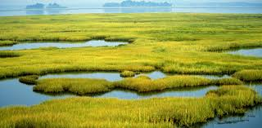
Natural Carbon Sinks - Wetlands
What are humans doing to each of these sinks to change their ability to absorb carbon? Why?
Plants in wetlands have a high growth rate, so they capture large amounts of carbon dioxide. Human actions such as agriculture, mining, dumping, residential development (building condos and beach houses), and global warming due to burning of fossil fuels can negatively affect our wetlands, possibly raising atmospheric CO2 levels.
http://www.iitk.ac.in/nerd/web/articles/wetlands-sources-or-sinks-of-greenhouse-gases/#.WtPg8C7wbZ4
Notes:
Teacher notes:
Forests- Destruction of wood for fuel, grazing cattle
Oceans- Increase in temperature causes them to lose their ability to absorb carbon. Ie. A cold ocean absorbs more than a warm one.
Wetlands- Being dubbed as “swamps”, often this land is paved over and utilized for urban activities.

Slide 16
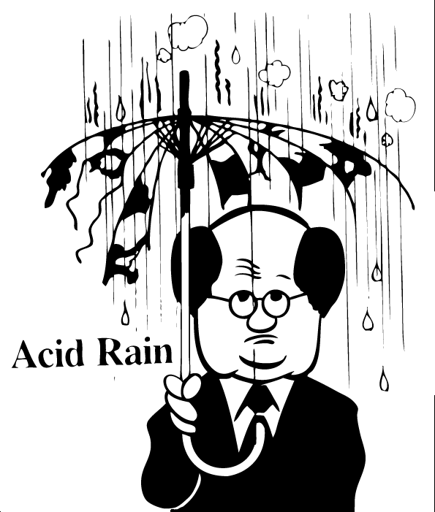
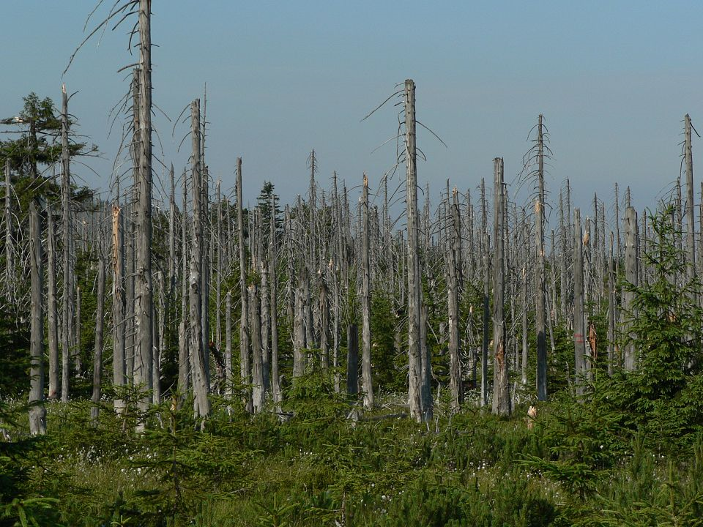
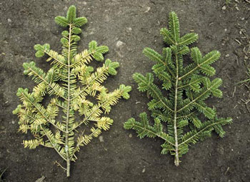
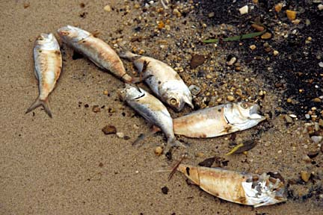
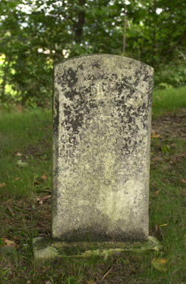
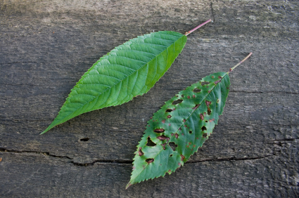
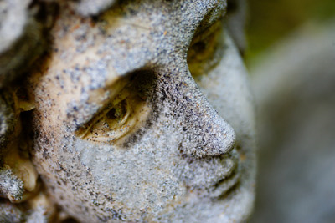

Acid Rain!!

Slide 17
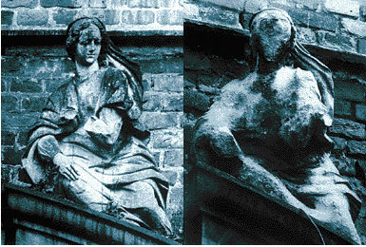
How does acid rain affect stonework?
The picture on the left was taken in 1908…
The picture on the right was taken in 1968!
Click here to watch video! Move ahead to 1:41 and keep watching. Complete the notes.

Slide 18
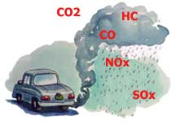
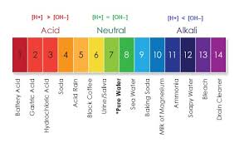
Acid rain forms through a complex process of chemical reactions involving air pollution.
The two most important pollutants that contribute to acid rain are sulfur dioxide and nitrogen oxides released through the burning of fossil fuels..
They are converted into acids in the atmosphere. These acids return to the Earth with rainfall.
This acidic rainfall can lower the pH of soil and bodies of water to levels that are so acidic that plants and animals are harmed.

