Slide 1

INTODUCTION TO Middle School Counseling
September 2016

Slide 2
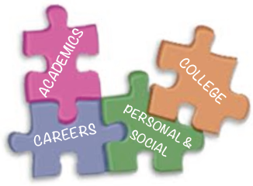
What do middle School Counselors Do?
Middle School Counselors help students solve problems that they are unable to solve themselves. School Counselors also share information with students and families to help them make important decisions.

Slide 3

How to Middle school counselors do their job?
Talking to student individually or in small groups
Teaching classroom guidance lessons each year.
Talking with teachers, parents and other adults that support students
Helping students transition to new grade levels

Slide 4

When do School counselors call parents?
Counselors also may call parents to help students solve problems that continue to happen. I always try to let students know that I am calling parents.

Slide 5





Mrs. Egbert

Slide 6

Words Of Encouragement

