Slide 1
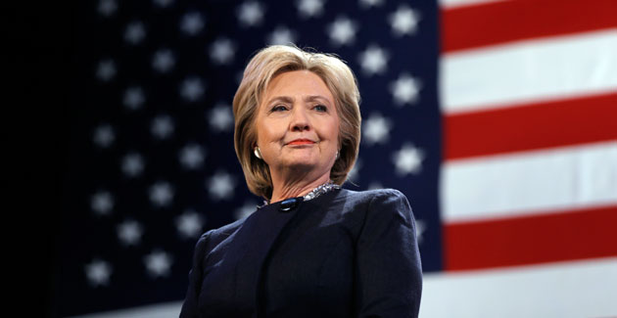
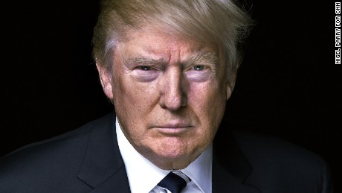
Warm Up
What is necessary to create law and order in society? Generate a list. Be prepared to share!

Slide 2

Classical China

Slide 3
The Zhou (Chou Dynasty)
Zhou dynasty
  1050 B.C.
Replaced one ruling class with another
  “meet the new boss...same as the old boss.”
  longest ruling dynasty (900 yrs)

Slide 4
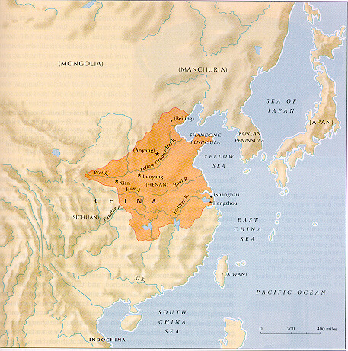
Zhou dynasty 1100-256 B.C.

Slide 5
Zhou (Chou) Dynasty
Expanded Bureaucracy
  Civil Service: People who run the government
Mandate of Heaven
  Idea that Gods Favored a certain group to rule and that group is only overthrown when they have lost the favor the Gods
Constant Conflict – “The Warring States Period”
  Set up Dynastic Cycles
  Northern invaders weaken Zhou Dynasty

Slide 6
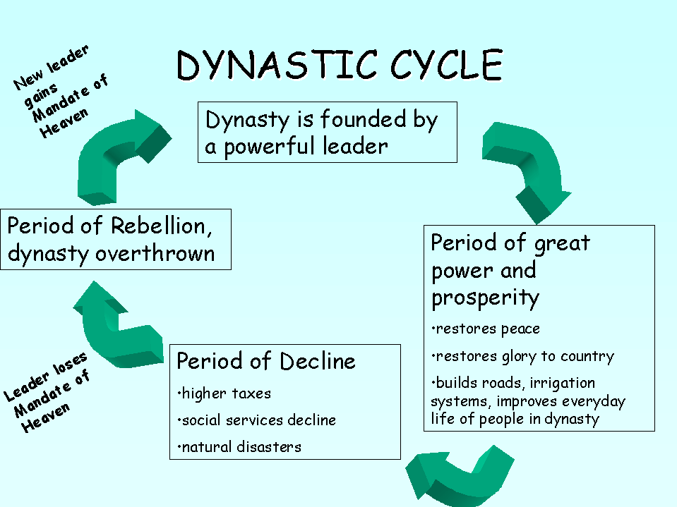

Slide 7
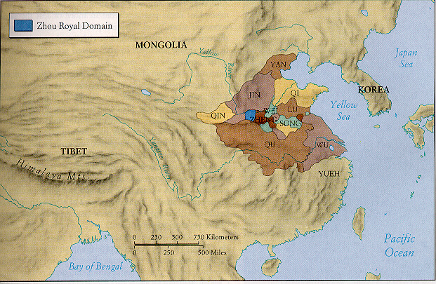

Slide 8
Zhou Dynasty
China moves away from ancient values
  Social order, harmony, respect for authority
No law codes: rule by decree
- Mandate of Heaven
Feudal Society
- Emperor gave out fiefs
Development of cheap iron weaponry

Slide 9
The Period of Warring States
771 B.C.
dozen-plus states
balance of power until 500’s
period of consolidation by warfare
  warfare chronic

Slide 10
The Period of the Warring States, ca. 500 B.C.

Slide 11
The Period of Warring States
Constant conflict set the stage for the revival of traditional Chinese values as well as the creation of new ethical system that would be utilized by later dynasties.
Confucianism
Legalism
Daoism

Slide 12
Confucianism
Read the document provided using the Close Reading strategies we learned at the beginning of the year.
Highlight and annotate as you read.
Answer the questions that follow.

Slide 13
Confucianism
With a neighbor, compare responses and be prepared to discuss.

Slide 14
Qin (Ch’in) Dynasty 221-206 B.C.
dominated by “The First Emperor”
Qin Shi Huangdi (Chin Shi Huang Ti)
ambitious= understatement
centralized the government- rid of feudal lords
constructed roads and canals
The Great Wall- many people died
An amazing tomb found in 20th Century

Slide 15
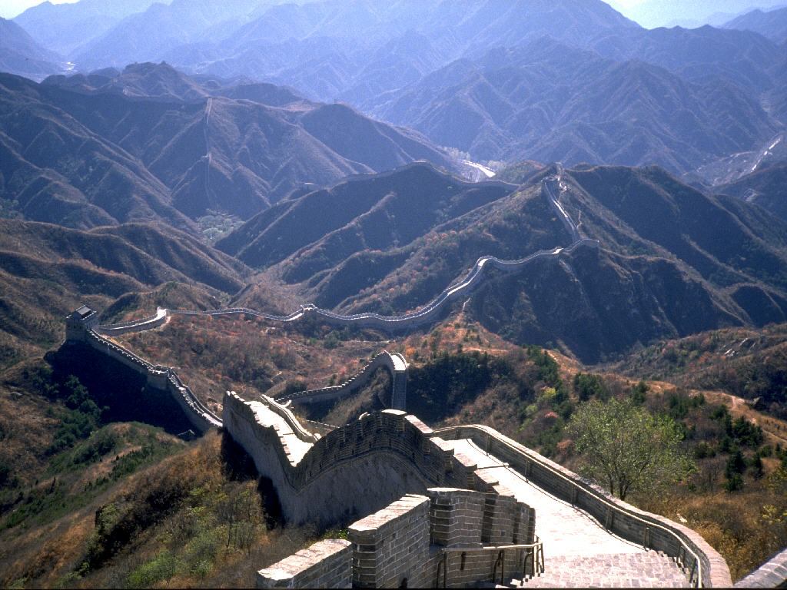

Slide 16
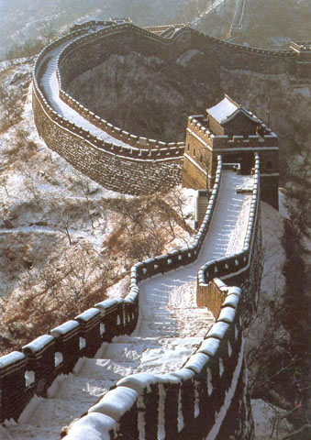

Slide 17
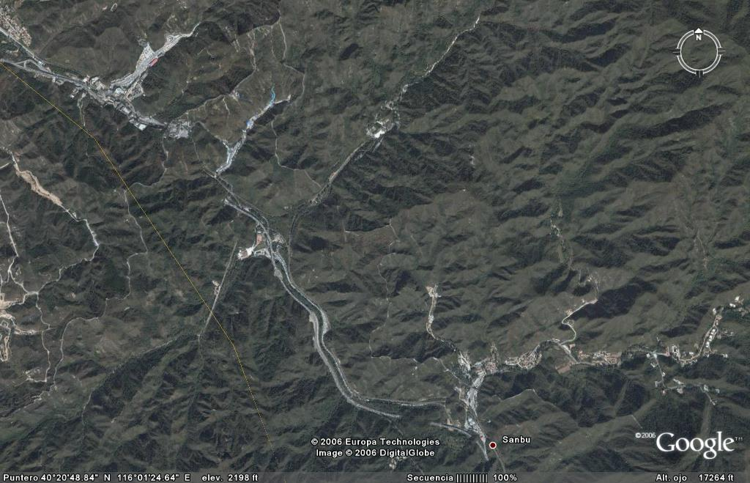

Slide 18
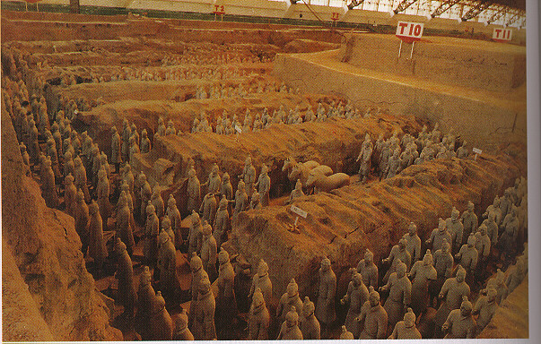
Tomb of Shi Huangdi

Slide 19
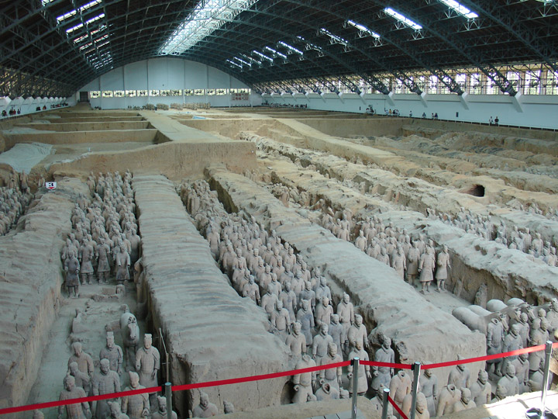
Terra Cotta Warriors

Slide 20
The Qin and the Legalist Tradition
Ideology of rule
- absolute power of the ruler
- people existed to serve the state
- destroy Confucian philosophy?

Slide 21
The Qin and the Legalist Tradition
Read the provided passage on Legalism.
Highlight and annotate the passage using our Close Reading strategies.
Answer the questions following the passage.

Slide 22
The Qin and the Legalist Tradition
With a neighbor, discuss and verify your answers. Be prepared to discuss.

Slide 23
Resistance to Qin Policies
Emperor orders execution of all critics
Orders burning of all Confucian books
Some 460 scholars buried alive
Others exiled
Massive cultural losses

Slide 24
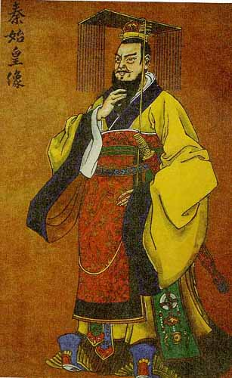
Fall of the Qin Dynasty
Shi Huangdi unified China
1. established strong government
Died in 210 B.C.
Son was ineffective leader
China’s government collapses

Slide 25
Warm Up
Over the weekend, you had to considered two different philosophies of how to create a successful society: Confucianism and Legalism. Based on your homework, which philosophy would you prefer? Explain your answer.
Place your homework on your desk, for me to check.

Slide 26
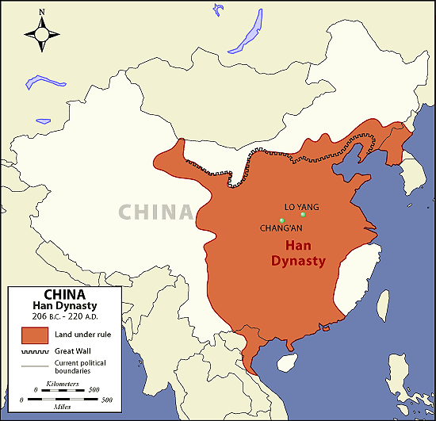
Han Dynasty
202 BC
Many of the Chinese people consider themselves “The people of Han”
Confucianism: began in Zhou Dynasty but become the major Chinese Philosophy during this time

Slide 27
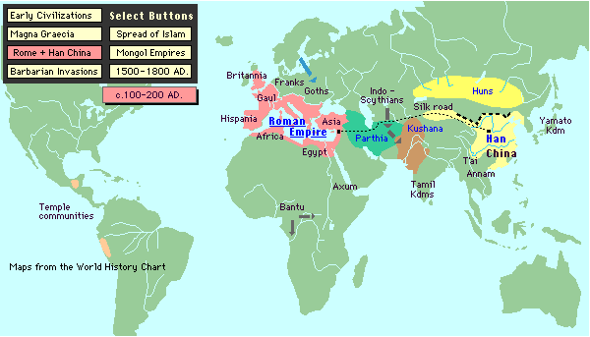
Han – Roman Empire Connection

Slide 28
Han Dynasty
Civil War follows Qin Dynasty
1. Two leaders emerge
Xiang Yu (Shee-ANG-yoo)
1. willing to allow warlords to keep land
2. had to acknowledge him as feudal lord
Liu Bang (LEE-oo-bahng)
1. one of Xiang Yu’s generals
2. turned against him and won
3. declared himself first emperor

Slide 29
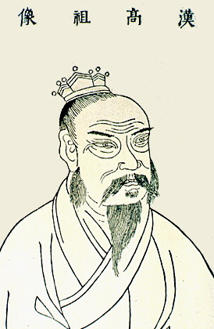
Han Dynasty
Dynasty ruled China for 400 years
Liu Bang’s goal
1. centralized government
2. local provinces called commanderies
3. lowered taxes
4. softened harsh punishments
5. brought peace and stability

Slide 30
Han Dynasty
Liu Bang died in 195 B.C.
Empress Lu takes power
1. not Liu’s only wife
2. son became emperor in name only
3. her friends in court helped her seize power
4. devoted to her husband and safety of empire
5. had reputation of being ruthless
6. died in 180 B.C.

Slide 31
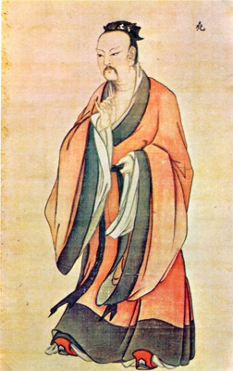
Han Dynasty
Emperor Wudi (woo-dee) takes the throne
1. Great grandson of Liu Bang
2. ruled from 141 to 87 B.C.
3. continued centralized policies
4. known as the “Martial Emperor”
> he expanded empire through war

Slide 32
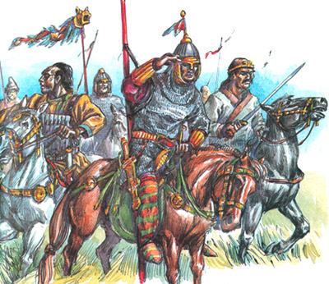
Han Dynasty
Xiongnu (shee-ung-noo)
1. E. Wudi’s enemies
2. fierce nomads north &
west of China
3. excellent archers
4. raided China’s farmlands
5. Wudi’s army forced them
to retreat to Central Asia
Emperor Wudi colonized
Manchuria & Korea

Slide 33
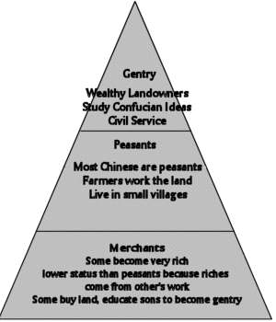
Han Dynasty
Han Society
1. Emperor – divine authority
- link be/ heaven & earth
2. Kings & Governors
- appointed by Emperor
3. State Officials, Nobles,
Scholars
4. Peasants
- produced food: important
5. Artisans & Merchants
6. Soldiers
7. Slaves

Slide 34
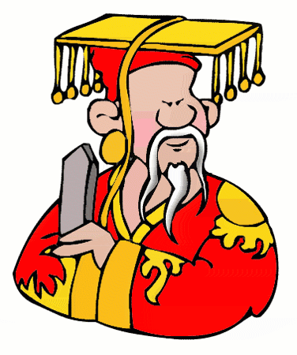
Han Dynasty
Civil Service & Confucianism
1. Govt. employed 130,000
2. Jobs required examination
3. Testing knowledge of
Confucianism
4. Wudi set up schools for
people seeking jobs to study
5. Exams included:
- history
- law
- literature
- Confucianism
6. Only wealthy sons could
afford to go to school

Slide 35

Han Dynasty
Han Technology
1. Paper invented in A.D. 105
- used silk before paper
- government documents
written on wood
2. Collar harness
- allowed horses to pull heavier
loads
3. Two blade plow
4. Wheelbarrow
5. Mill grains

Slide 36
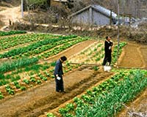
Han Dynasty
Agriculture most important occupation
1. 60,000,000 million people to feed
Government established monopolies
1. Mining of salt
2. Forging of iron
3. Minting of coins
4. Brewing of alcohol
5. Making of silk

Slide 37
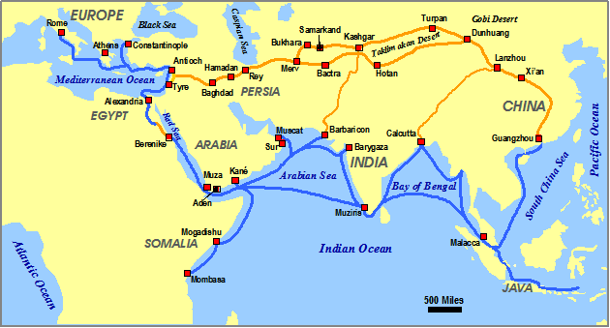
The Silk Road

Slide 38
Han Dynasty
The Han Unifies Chinese Culture
1. Government encourages assimilation
- conquered people adapting
to Chinese culture
2. Government set up schools
- to train people in Confucian
philosophy

Slide 39
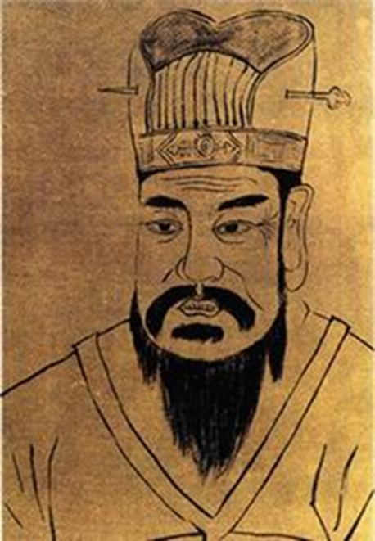
Han Dynasty
Fall of the Han
1. Wealth Gap -Rich take advantage of poor
2. Political instability grows
3. Wang Mang overthrows Han Dynasty in A.D. 9
- tries to restore economy (more money – disrupts: raises prices)
- attempts to redistribute land to poor (angers wealthy)
4. Great flood kills thousands and left millions homeless
- Yellow River changes course: famine, disease, migration
- Peasants revolt
- Wang Mang assassinated in A.D. 23
5. Old Imperial Family takes throne
- Begins second period of Han rule (the Later Han)
Wang Mang

Slide 40
The Later Han Years
First decades very prosperous
Government sent agents to regain control
of Silk Road
China suffers from social, political, and economic weakness
By A.D. 220, dynasty broke up into 3 kingdoms

Slide 41
But wait there’s more!
Watch Eastern Philosophy-Lao Tzu. Complete the Daoism portion of your chart as indicated. Be prepared to discuss!

Slide 42
Resources
Mr. Wells
Hickory Ridge HS
Sue Pojer
Chappaqua, NY
World History: Patterns of Interaction
McDougal Littell

