Slide 1
Claiming IAM Accounts
SchoolNet Training
Presenter: Jennifer Yandle

Slide 2
Overview
Schoolnet is a program within the Rapid Identity system that we will use for testing.
Before students can log into school net, students must claim their IAM account.
  Students only need to claim IAM account once during educational career.
All middle school CTE courses will be tested using Schoolnet for the 2016-2017 school year.
  Semester courses test in January (must test within last 3 days of semester).
  Yearlong courses test in June (must test within last 5 days of school).

Slide 3
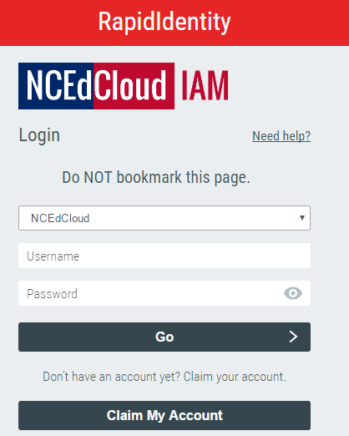
Claiming IAM account
my.ncedcloud.org

Slide 4
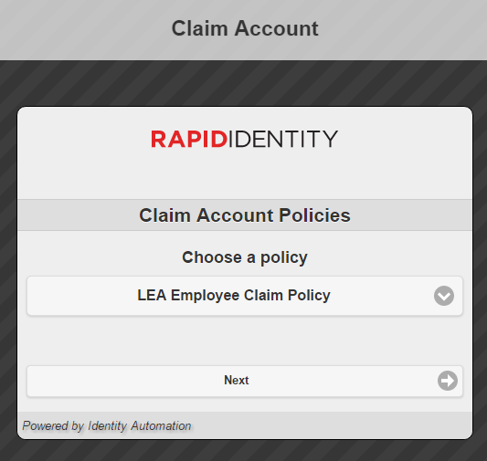
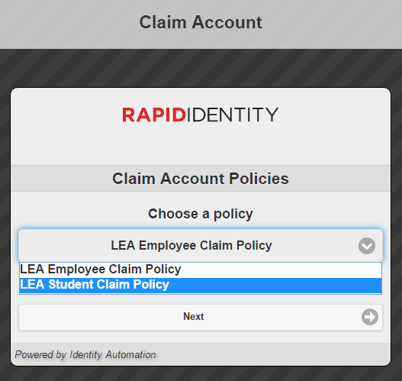
Claiming IAM account
Select dropdown arrow to change to
“LEA Student Claim Policy”
2
1

Slide 5
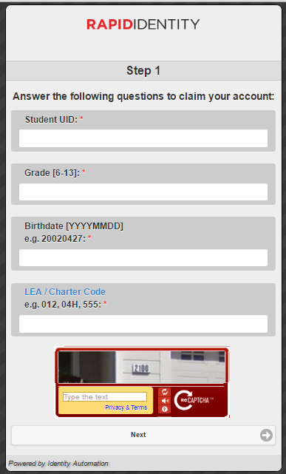
10012345
Student ID Number/”Lunch Number”
6
Numeric Grade
19850517
Birthday: Be sure to follow the correct format
130
Cabarrus County LEA: 130

Slide 6
Step 1 issues
Birthday: the #1 issue of this step is incorrect birthdays
  incorrect format
    Have students look at neighbor’s computer before hitting “next”
  incorrect date
    Double check birthday against PowerSchool

Slide 7
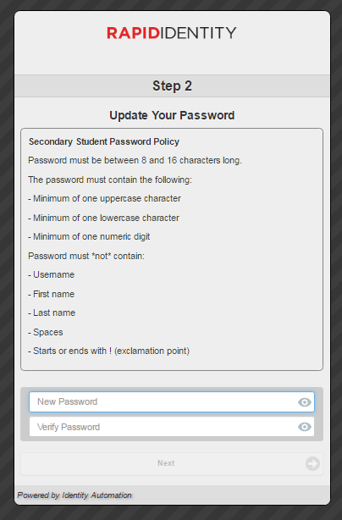
Update Password
Options:
  Whole school password (not suggested)
  Student generated password
MPtigers1

Slide 8
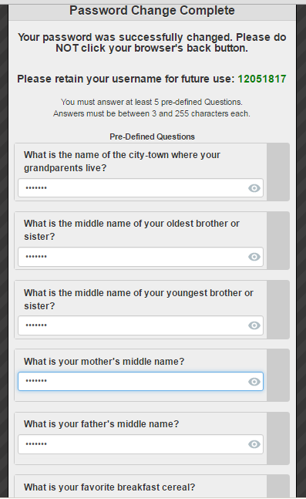
Security Questions
Recommended students type school mascot for all
Answer ALL questions, not just 5
tigers
tigers
tigers
tigers
tigers

Slide 9
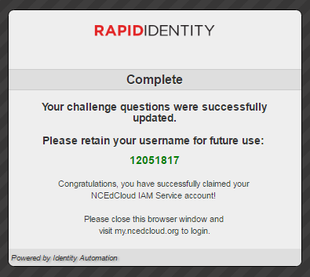
Complete
Once complete:
  Close out browser
  Return to website
  Log in

Slide 10
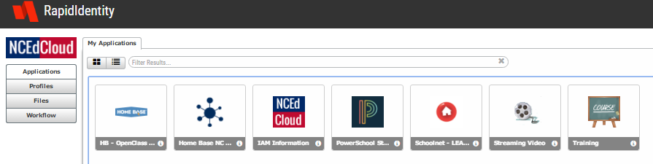
Student view
Schoolnet

Slide 11
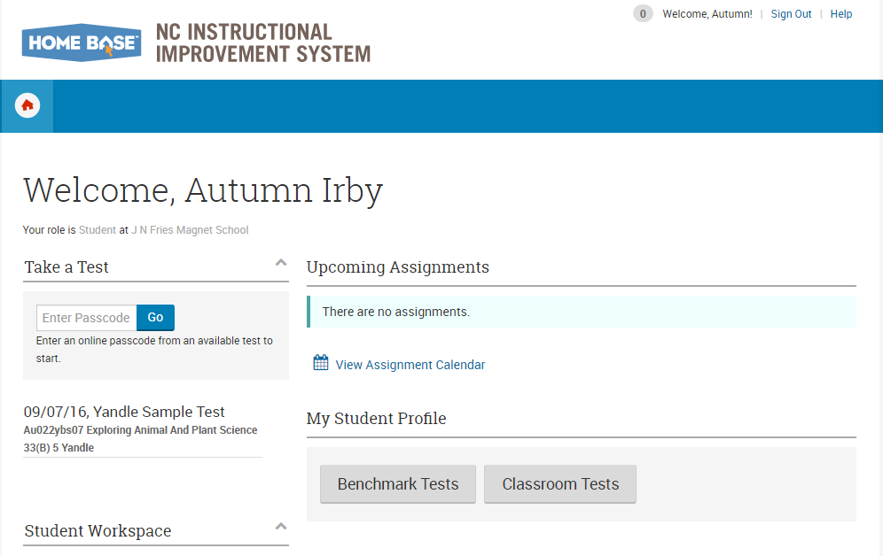
Schoolnet

Slide 12
SchoolNet
Where students will take state created & mandated test
Can load bank questions to create quick tests
Can create your own test questions and save to bank
Can collaborate with other teachers to create/share tests

Slide 13
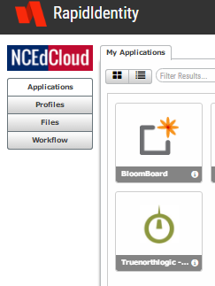
Changing Student passwords
Login to Teacher IAM account.
Select Profiles to the left of screen

Slide 14
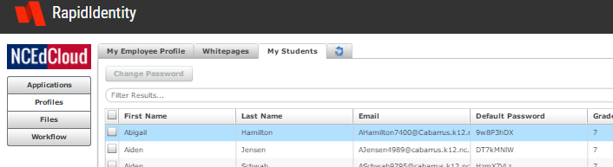
Changing student passwords
Select the “My students” tab
Check student
Select “Change password”

Slide 15
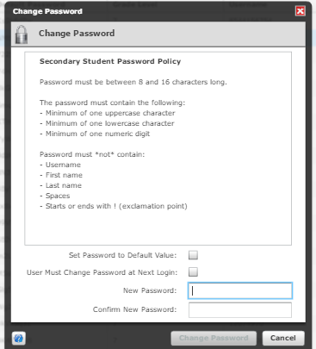
Changing student password

Slide 16
Claiming Accounts Recap
Double Check Birthday
Reset Password
Contact Wendy Byrd
  Best to put in a work order
    Specify it is for IAM accounts to expedite order

